Slide 1
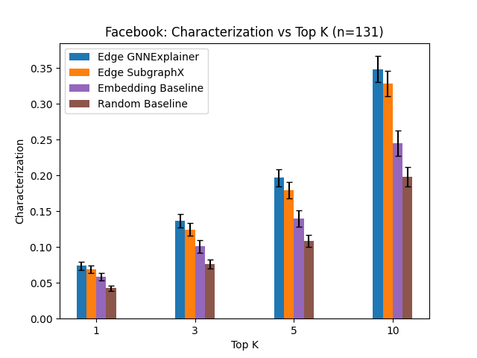
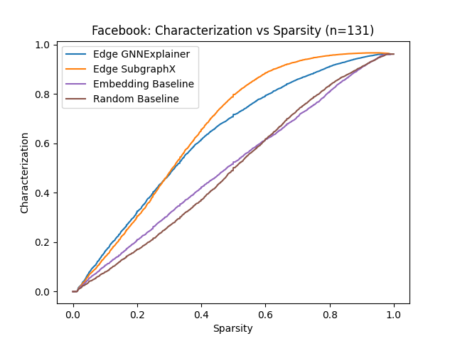
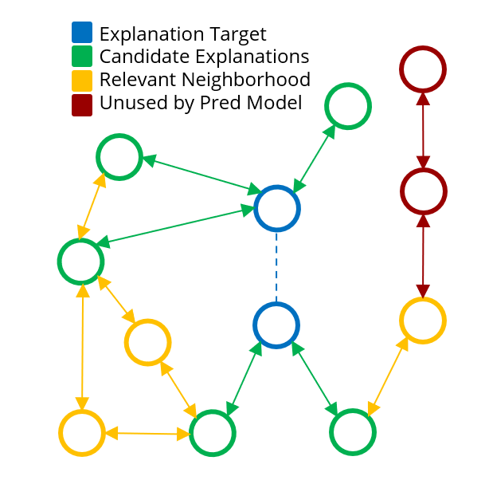
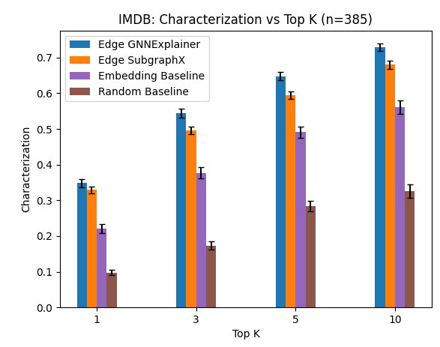
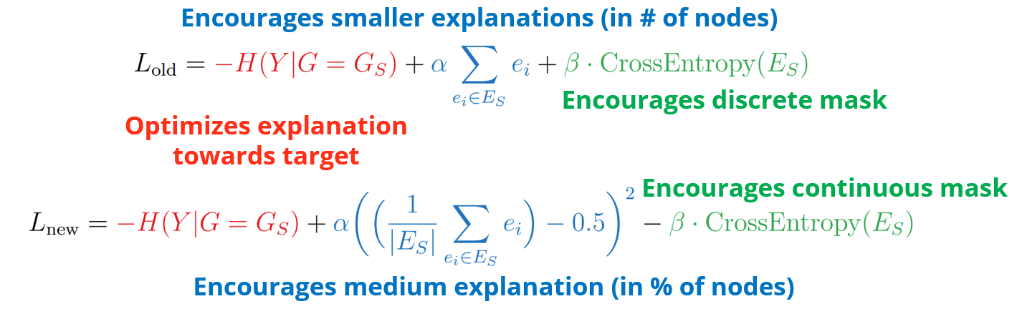
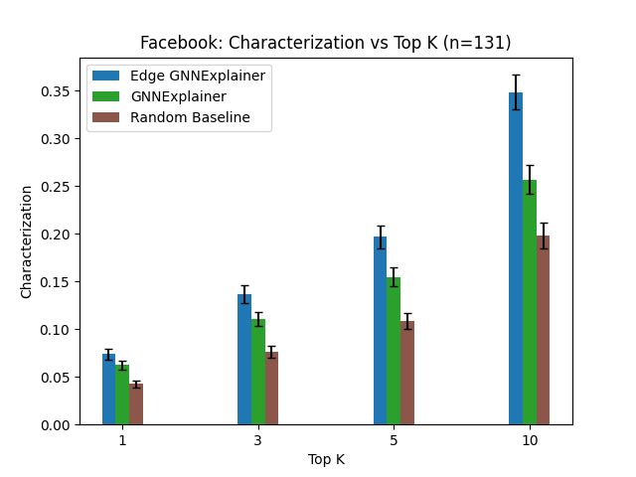
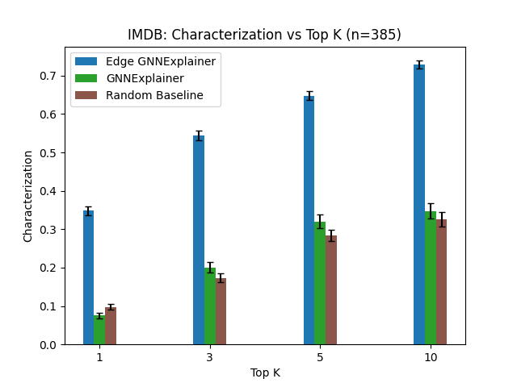
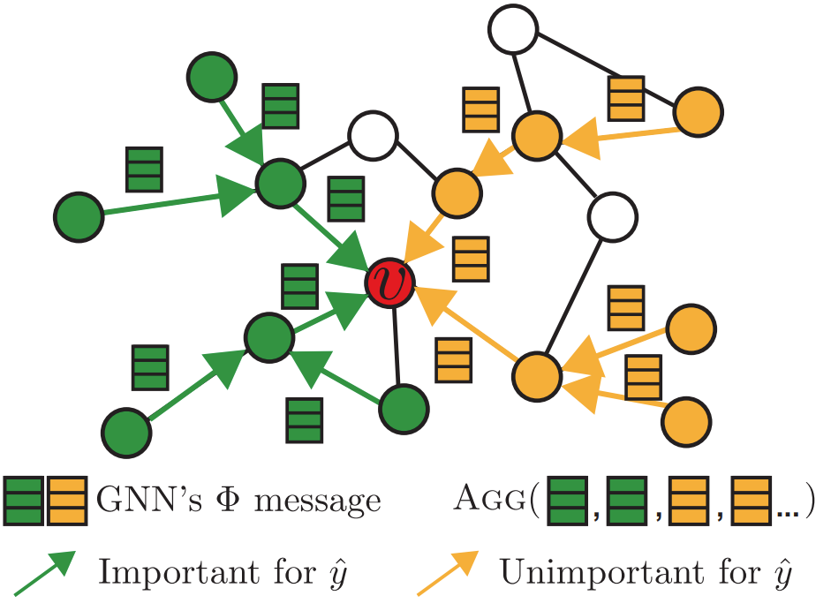
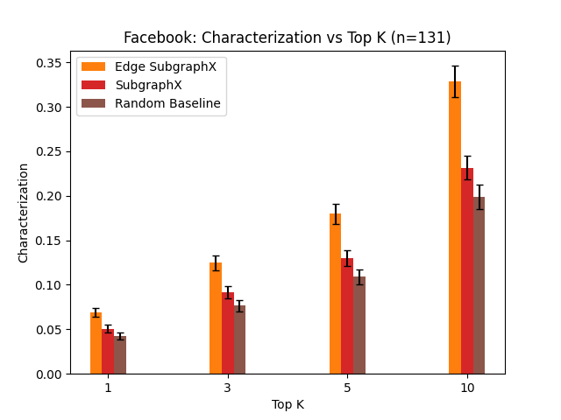
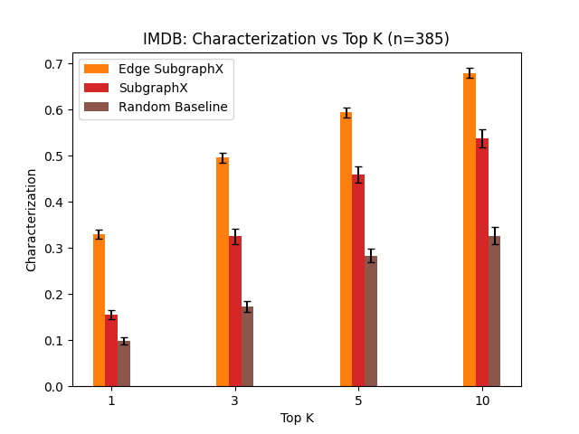
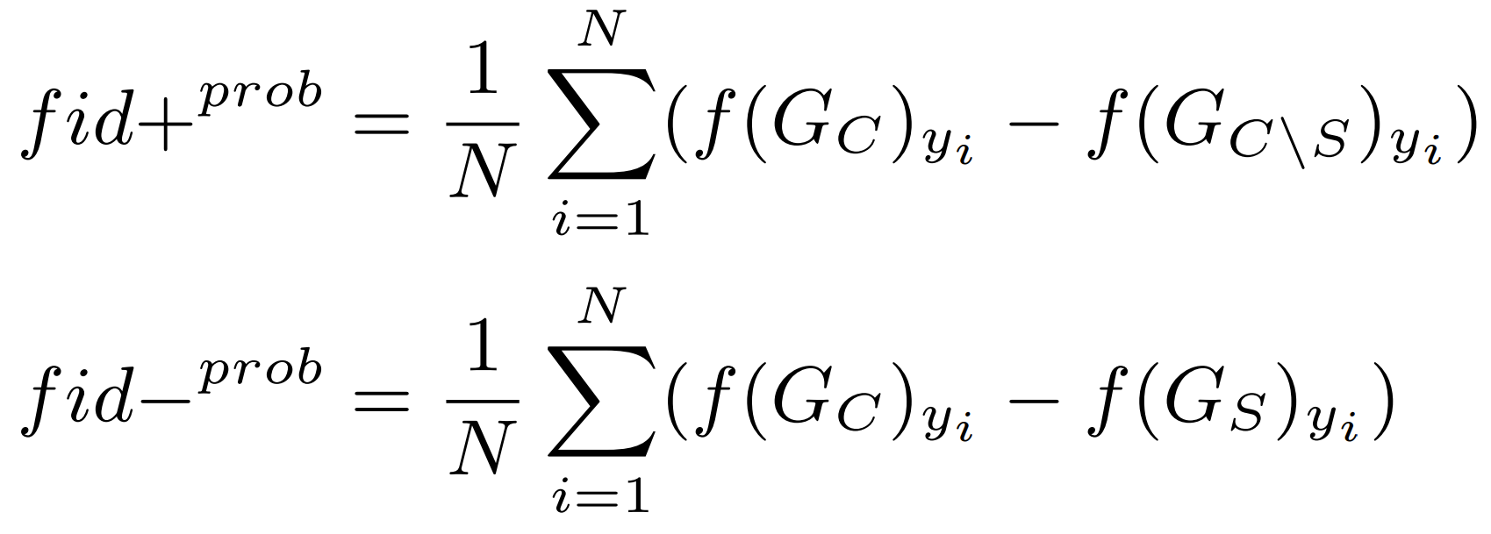
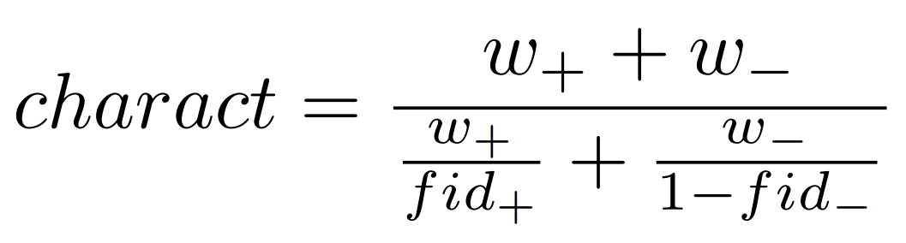
Link Explanation for Heterogeneous Graphs
Yale
Abhijit Gupta, Department of Computer Science, Rex Ying, Department of Computer Science
MOTIVATION
EXPERIMENTS
RESULTS
Graph data emerges in many contexts (social networks, molecules, knowledge graphs) but creates unique challenges for traditional machine learning (ML) methods.
Graph Neural Networks (GNNs) are a type of neural network that operates directly on the graph structure to perform tasks.
Explainability builds trust, promotes fairness, and can improve human-in-the-loop performance.
Just as graph structured data poses challenges to traditional ML methods, new explainability methods are required to reason about graph structured data.
GNNs have been applied in many settings, but explanation methods have lagged behind. For example, link explanation and heterogeneous graph explanation are underexplored.
We selected the Facebook (homogeneous) and IMDB (heterogeneous; movie-actor, movie-director edges) datasets.
Figure 2: Explanations are restricted to
immediate neighbors for increased
interpretability and real-world use cases.
When explaining the dotted blue edge,
we only allow subsets of the green nodes
as possible explanations.
We measured continuous characterization score (with emphasis on necessary explanations) as a function of sparsity.
Modified GNNExplainer: New loss encourages ordering of candidate nodes, handles varying neighborhood sizes better.
Figure 3: Modified GNNExplainer outperforms GNNExplainer on both datasets, across all explanation sizes.
Modified SubgraphX: Instead of masking removed nodes to 0, mask removed edges by deleting edge from subgraph.
Figure 4: Modified SubgraphX outperforms SubgraphX as well.
Figure 5: Facebook dataset characterization scores for four explanation methods. Left: Continuous plot with sparsity percentage. Right: Discrete plot with fixed explanation size. Modified GNNExplainer and SubgraphX outperform baselines.
Figure 6: IMDB dataset characterization scores for four explanation methods. Modified GNNExplainer and SubgraphX outperform Embedding and Random baseline.
BACKGROUND
GNNs are composed of multiple message passing layers. GCN, GraphSAGE, GAT, and GIN are common building blocks.
Explanations can be made during initial prediction or post hoc. We focus on post hoc model-agnostic perturbation methods.
GNNExplainer optimizes soft masks to maximize mutual information with the GNN prediction.
SubgraphX applies Monte Carlo Tree Search and Shapley values to measure subgraph importance.
Figure 1: A computation graph
for predicting the class of node
v with useful and unimportant
neighbors. The goal is to
identify a small set of
important pathways crucial to
the prediction.
Explanations are evaluated by multiple metrics including sparsity (size of explanation), fidelity (necessary/sufficient), stability, accuracy, and inference time.
CONCLUSIONS
> First application of GNN explanation methods to heterogeneous graphs, link prediction task.
> Modified GNNExplainer and SubgraphX algorithms outperform the Embedding baseline.
> Modified GNNExplainer has the best combination of inference time and fidelity among methods tested.
NEXT STEPS
Improve scalability to enable additional results on the Facebook dataset, LastFM dataset. Develop new explanation methods leveraging heterogeneous graph meta-paths.
Contribute heterogenous graph explanation and link explanation to the open-source PyTorch Geometric project.

