Slide 1

Indian Institute of Information Technology, Nagpur
Object Oriented Programming Lab-Project Submission
Project Presentation (06 November 2023)
On
“FOOD STALL MANAGEMENT SYSTEM”
by
MR. AVIRAL GUPTA(BT22CSD049)
Department of CSE, IIITN

Slide 2
Index
Problem statement Details
Literature Survey
Datasets & Preprocessing
Flowchart
Output
Future Work
References

Slide 3
Problem statement Details
The Food Stall Management System is a comprehensive software solution implemented using OOPs C++ designed to streamline and enhance the operations of food stalls, allowing administrators to manage their stalls efficiently, and customers to easily discover and order from various food stalls.
This system provides a platform for administrators to create and manage their food stall profiles, menus, and customer orders. Customers can access the system to explore the menu of their preferred food stalls.
The Food Stall Management System aims to simplify the management of food stalls and improve the experience for customers looking to explore and order from different stalls. It streamlines operations for administrators and provides a user-friendly interface for customers, making it a valuable tool for food stall businesses in the modern age.

Slide 4
Literature Survey
Structure and Modularity : The provided code implements a Food Court Management System, and it demonstrates a structured and modular approach to software development. It defines classes for Admin, Main Menu, and handles various operations like adding, viewing, modifying, and deleting food stalls and their menus. The code effectively separates concerns by encapsulating functionalities within their respective classes, promoting code reusability and maintainability.
User Authentication and Data Management : The code showcases user authentication mechanisms for admin and food stall portal users, emphasizing security. It leverages file I/O for storing and retrieving food stall information, including stall profiles and menus. Password recovery and data retrieval mechanisms enhance user experience and data integrity.
User Interfaces and Portals : The code offers different user interfaces for administrators, food stall operators, and customers, each with their own set of operations. It employs simple text-based user interfaces with menu-driven options, providing a clear and interactive way for users to interact with the system. The code emphasizes user-friendliness and access control, making it suitable for managing a food court or similar establishments.

Slide 5
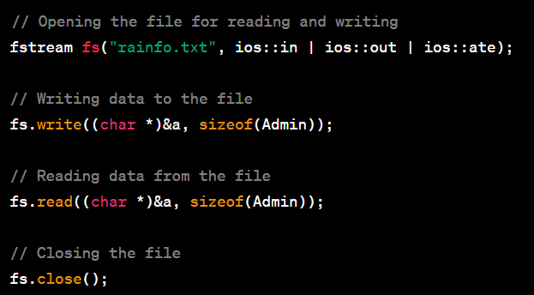
Datasets & Preprocessing
The primary file handling operations are related to data storage and retrieval. The project seems to use a file as a data storage mechanism to store information about food stalls and their details. The file name is rainfo.txt. This is our main file in which our whole data of food stalls is being stored.

Slide 6
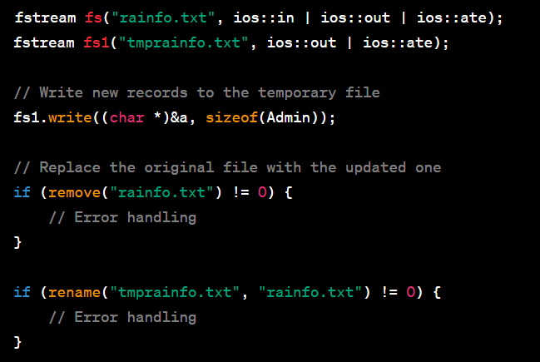
Datasets & Preprocessing
Adding New Food Stalls: When adding new food stalls with their records, a temporary file named “tmprainfo.txt" is created. The code writes the new data to this temporary file first. After all the new records are added, the temporary file is renamed to the original data file, effectively replacing it with the updated data.

Slide 7
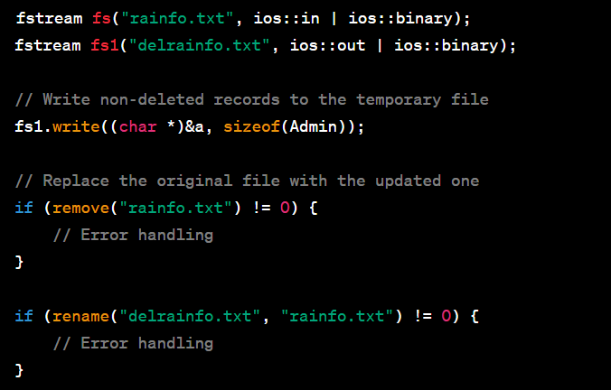
Datasets & Preprocessing
Deleting Food Stall Records: When deleting food stall records, a similar process is followed. The code creates a temporary file ("delrainfo.txt") to store records without the deleted item. After copying the non-deleted records to the temporary file, it replaces the original data file with the temporary file.

Slide 8
Flowchart
Start
Enter Your Choice
(Admin, Stall, Customer)
Admin Portal
Food Stall Portal
Customer Portal
Add Food Stall
View Menu
View Food Stall
Display Food Stall
View Profile
Search Food Stall
Delete Food Stall
Add Food Item
Modify Profile
End

Slide 9
Flowchart
Start
|
|---> Display Welcome Message
| |
| |---> Display Options:
| | - 1: Admin Portal
| | - 2: Food Stall Portal
| | - 3: Customer Portal
|
|---> If Option is 1 (Admin Portal):
| |
| |---> Enter Admin Portal
| | |
| | |---> Display Admin Options:
| | | - 1: Add Food Stall Record
| | | - 2: View All Food Stalls
| | | - 3: Delete a Food Stall
| |
| | |---Option 1: Add Food Stall Record---|
| | | |
| | | |---> Prompt for Food Stall Details
| | | |
| | | |---> Add Food Stall Record
| |
| | |---Option 2: View All Food Stalls---|
| | | |
| | | |---> Retrieve and Display Food Stall Records
| |
| | |---Option 3: Delete a Food Stall---|
| | | |
| | | |---> Prompt for Food Stall ID to Delete
| | | |
| | | |---> Delete the Selected Food Stall
| |
| | |
| |---(Exit Admin Portal)
|---(End)
Part 1: Admin Portal

Slide 10
Flowchart
Start
|
|---> If Option is 2 (Food Stall Portal):
| |
| |---> Enter Food Stall Portal
| | |
| | |---> Display Food Stall Options:
| | | - 1: View Your Profile
| | | - 2: Know Your Menu (with Price)
| | | - 3: Add a Food Item
| | | - 4: Delete a Food Item
| | | - 5: Modify Your Profile
| |
| | |
| | |---Option 1: View Your Profile---|
| | | |
| | | |---> Retrieve and Display Food Stall's Profile
| |
| | |---Option 2: Know Your Menu (with Price)---|
| | | |
| | | |---> Retrieve and Display Food Menu
| |
| | |---Option 3: Add a Food Item---|
| | | |
| | | |---> Prompt for Food Item Details
| | | |
| | | |---> Add the Food Item to the Menu
| |
| | |---Option 4: Delete a Food Item---|
| | | |
| | | |---> Prompt for Food Item ID to Delete
| | | |
| | | |---> Delete the Selected Food Item from the Menu
| |
| | |---Option 5: Modify Your Profile---|
| | | |
| | | |---> Modify the Food Stall's Profile
| |
| | |---> Display Option to Continue (Y/N)
| | |
| |
| |---(Exit Food Stall Portal)---|
|
|---(End)
Part 2: Food Stall Portal

Slide 11
Flowchart
Start
|
|---> If Option is 3 (Customer Portal):
| |
| |---> Enter Customer Portal
| | |
| | |---> Display Customer Options:
| | | - 1: View List of All Food Stalls
| | | - 2: Search a Stall by Stall Unique ID
| | | - 3: Search a Food Stall (Depending on Taste)
| | |
| | |---Option 1: View List of All Food Stalls---|
| | | |
| | | |---> Retrieve and Display List of Food Stalls
| | |
| | |---Option 2: Search a Stall by Stall Unique ID---|
| | | |
| | | |---> Prompt for Unique Stall ID
| | | |
| | | |---> Retrieve and Display Details of the Selected Stall
| |
| | |---Option 3: Search a Food Stall (Depending on Taste)---|
| | | |
| | | |---> Prompt for Taste Preferences
| | | |
| | | |---> Retrieve and Display Food Stalls Matching Preferences
| |
| | |---> Display Option to Continue (Y/N)
| |
| |---(Exit Customer Portal)---|
|
|---(End)
Part 3: Customer Portal

Slide 12
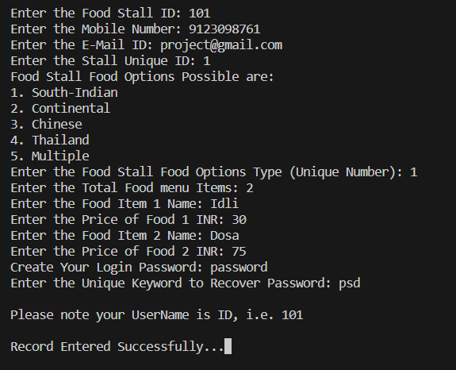
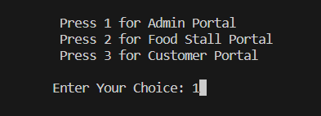
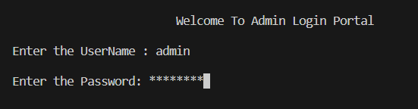
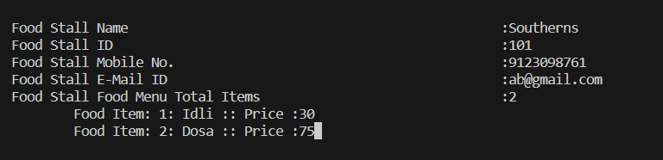
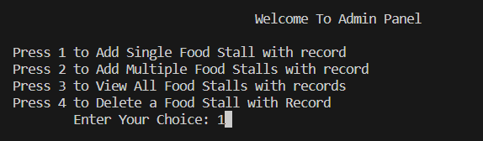
OUTPUT
(1) Admin Portal :-

Slide 13
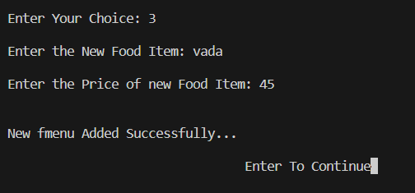
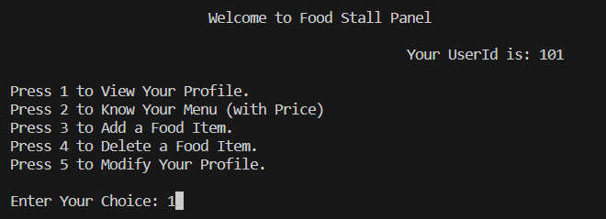
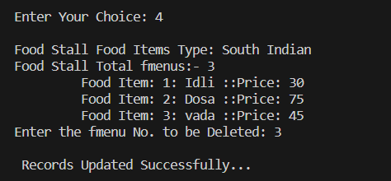
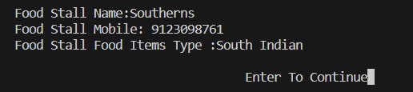
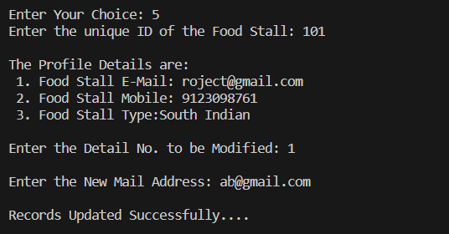
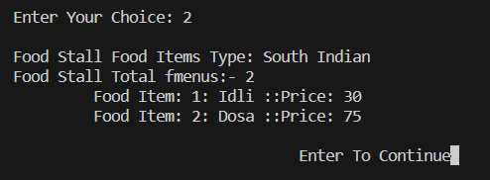
OUTPUT
(2) Food Stall Portal :-

Slide 14
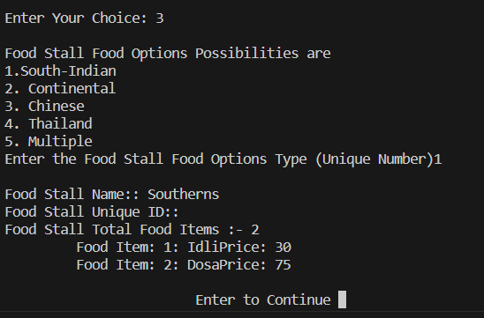
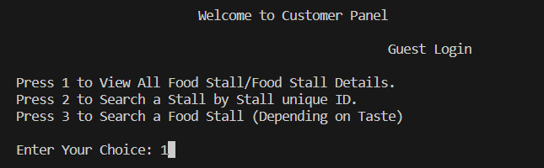
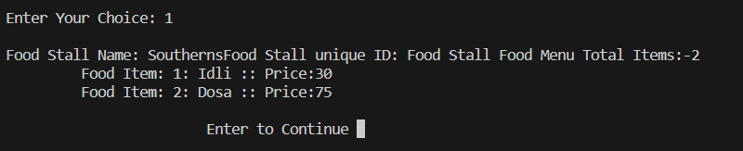
OUTPUT
(3) Customer Portal :-

Slide 15
Future Work
Online Ordering System: Implement a feature in the Customer Portal that allows customers to place orders directly from food stalls. This can include an online menu, order placement, and payment processing.
Integration with Mobile Apps: Develop mobile applications for both customers and food stall owners, allowing them to access the system on their smartphones. This can include features like order tracking and notifications.
User Ratings and Reviews: Add a feature for customers to rate and review food stalls and their items. This can help other customers make informed choices.
Inventory Management: Implement inventory management for food stall owners, helping them keep track of ingredients and restocking as necessary.
Payment Integration: Integrate with various payment gateways to offer multiple payment options for customers, such as credit cards, digital wallets, and UPI.

Slide 16
Reference
Teacher :- Mrs. Puja Gudadhe Mam
Books :- C++: The Complete Reference, 4th Edition by Herbert Schildt , McGraw-Hill
Websites and Online Resources:
www.google.com
https://www.geeksforgeeks.org/

Slide 17
Thank You

