Slide 1
CASE STUDY · ONLINE SHOP PERFORMANCE
How Is the Shop Performing?
Revenue, products, customers and payments, January 2024 – June 2026
Prepared for Mr R. Nemukula, Head of Operations
Compiled by Ndadza A.

Slide 2
The business question
1
2
3
Is revenue growing, shrinking or flat? Any seasonal peaks?
Which products and categories earn the most, and sell the most units?
Which customer segments are most valuable?
4
5
6
What share of payments fail or get refunded? Do some methods fail more?
Do bigger discounts lead to bigger orders, or just lower revenue?
What should we do next? Three recommendations follow.
2 / 8

Slide 3
Overall performance at a glance
50,000
93.1%
3.85%
3.01%
payment attempts
paid
failed (1,924)
refunded (1,507)
1 · Revenue has dropped
2 · Electronics drives revenue
3 · About 7% of payments are lost
Monthly revenue held near 110–132k until Jan 2026, then fell to roughly 75–87k.
Roughly half of all revenue, though Accessories sell slightly more units.
Failures and refunds add up to about 7%. Failure rates are similar across every payment method.
Gap: total revenue, order count and average order value are not shown in the screenshots. Add them from the working file.
3 / 8

Slide 4
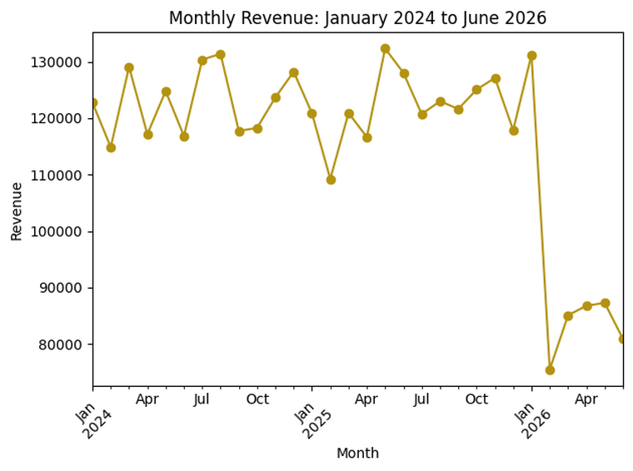
Revenue fell sharply in 2026
Finding
Revenue moved between about 110k and 132k a month through 2024 and 2025 with no clear seasonal peak. After a strong January 2026 (about 131k), it dropped to roughly 75–87k.
So what?
This is a step change, not normal fluctuation, and the most urgent issue: about 30–45k a month is at risk.
Values read from the chart; exact monthly figures should come from the working file.
4 / 8

Slide 5
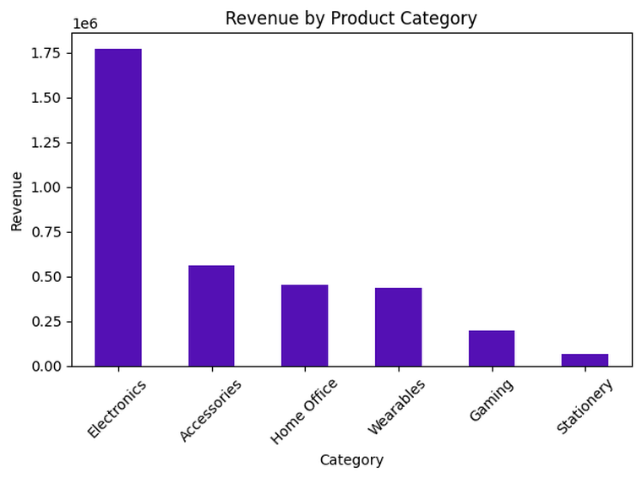
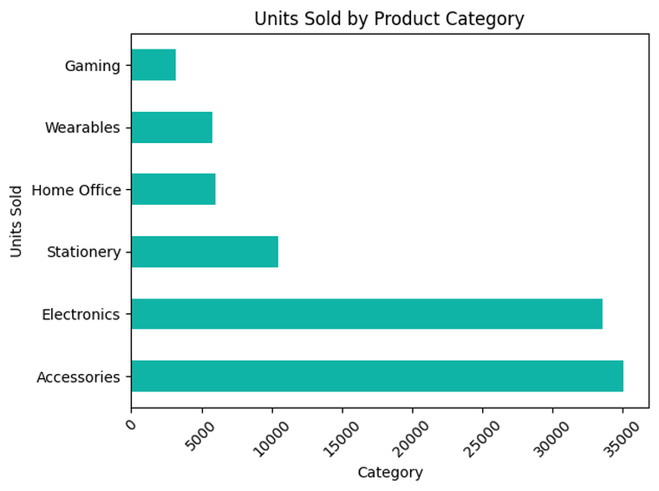
Electronics earns the most; Accessories sell the most
So what? Revenue and volume are not the same story. Electronics (about 1.77M) earns over three times Accessories (about 0.56M) on similar volumes (about 33–35k units each). Stationery sells about 10k units but earns very little.
Category values read from the charts (approximate).
5 / 8

Slide 6
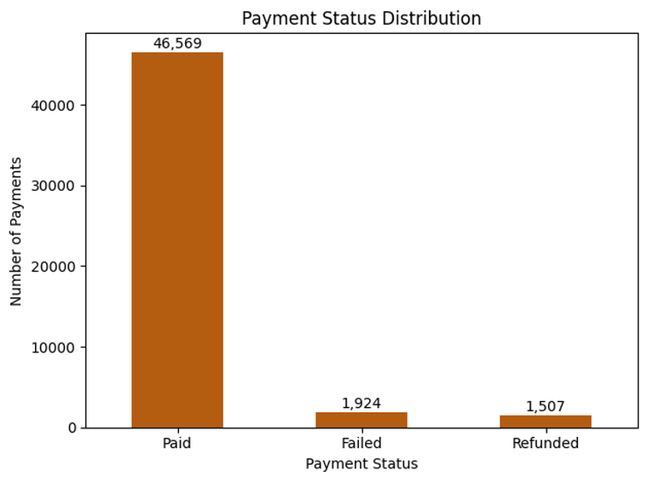
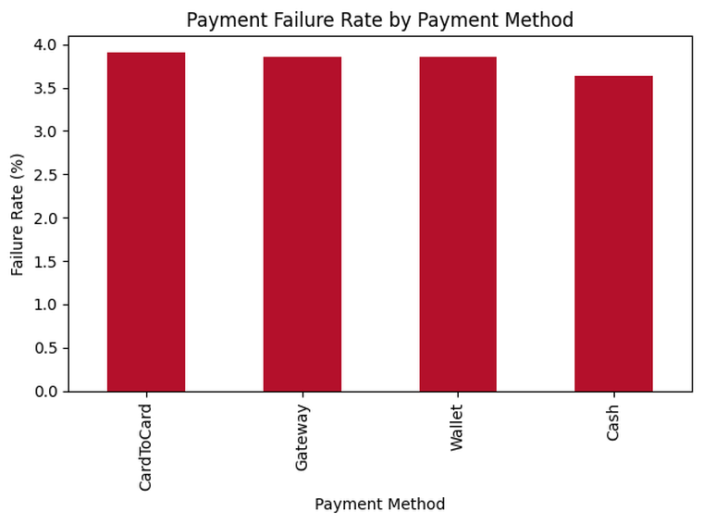
About 7% of payments do not complete
So what? 1,924 failed and 1,507 refunded payments out of 50,000. Failure rates sit at about 3.6–3.9% for every method (Card-to-Card highest, Cash lowest), so the problem is shared across checkout, not caused by one method.
6 / 8

Slide 7
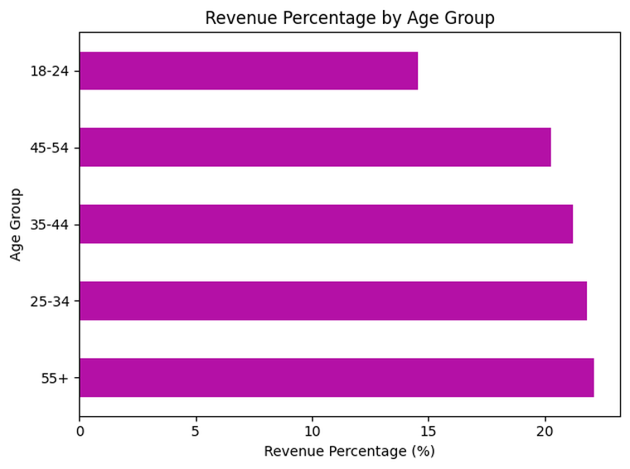
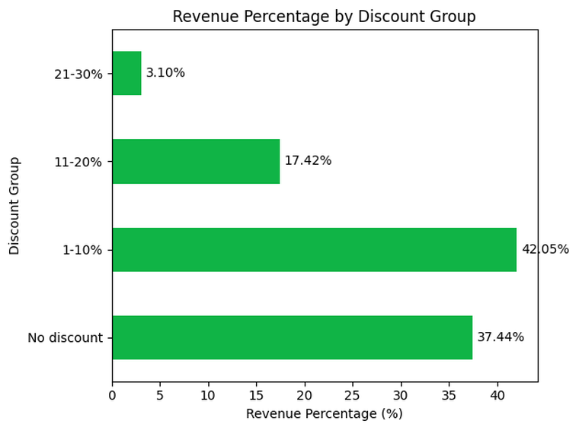
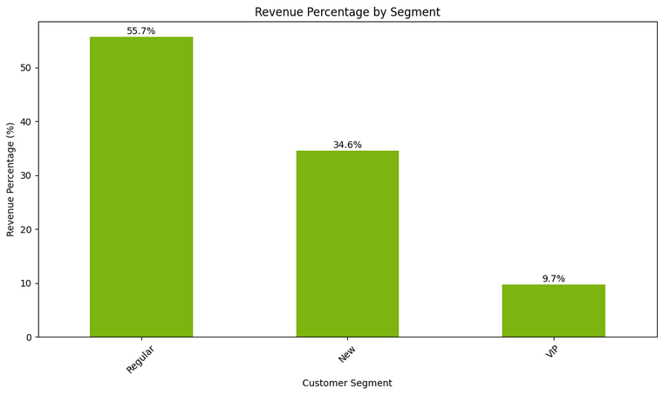
Customers and discounts
Segments: Regular customers bring 55.7% of revenue, New 34.6%, VIP only 9.7%.
Age: 25+ groups each give about 20–22%; 18–24 gives the least (about 14.5%).
Discounts: 62.6% of revenue comes from discounted orders, but only 3.1% from 21–30% discounts. The data shown does not prove discounts raise order size.
7 / 8

Slide 8
Three recommendations
1
Investigate the 2026 revenue drop
2
Protect and grow Electronics
3
Reduce payment failures
Evidence: Monthly revenue fell from about 120k to 75–87k after Jan 2026.
Benefit: Recover roughly 30–45k a month.
Next step: Compare Feb–Jun 2026 with 2025 by category, segment and payment status.
Evidence: Electronics is about half of revenue; Stationery earns the least.
Benefit: Safeguards the biggest revenue source.
Next step: Check Electronics stock, pricing and promotion; review whether Stationery earns its handling cost.
Evidence: 7% of payments fail or are refunded; all methods fail at 3.6–3.9%.
Benefit: More completed sales without needing new customers.
Next step: Review checkout and payment-provider errors, then set a failure-rate target.
Also worth testing: growing VIP customers (9.7% of revenue) and whether deep discounts are worth it.
8 / 8

