Slide 1
Responsible AI
Alexander Van Hecke
Assignment 2

Slide 2
Introduction
NLP analysis of topics discussed by experts (transcripts of Youtube videos)
Scientific and non-scientific communities
Before and after the introduction of ChatGPT
Are AGIs safe to use? (and is ChatGPT even an AGI?)
Do they act ethically and responsibly?
Do they comply with instructions?
Do they resist biases?
Is there a shift in views on safety of AGI before/after ChatGPT?
RQ 1 : Did the introduction of ChatGPT change the topics discussed in the scientific and non-scientific AGI community?
RQ 2: Did the introduction of ChatGPT change the general sentiment about AGI in the scientific and non-scientific AGI community?

Slide 3
RQ 1 : Did topics change?
Perform a number of analyses :
Wordclouds : very simple visualisation of “the most important words”
N-grams : bigrams and trigrams, these are often used expressions
Topic modeling using an LDA model : what kinds of topics are being discussed?
The results before and after ChatGPT were judged by a human => subjective analysis

Slide 4
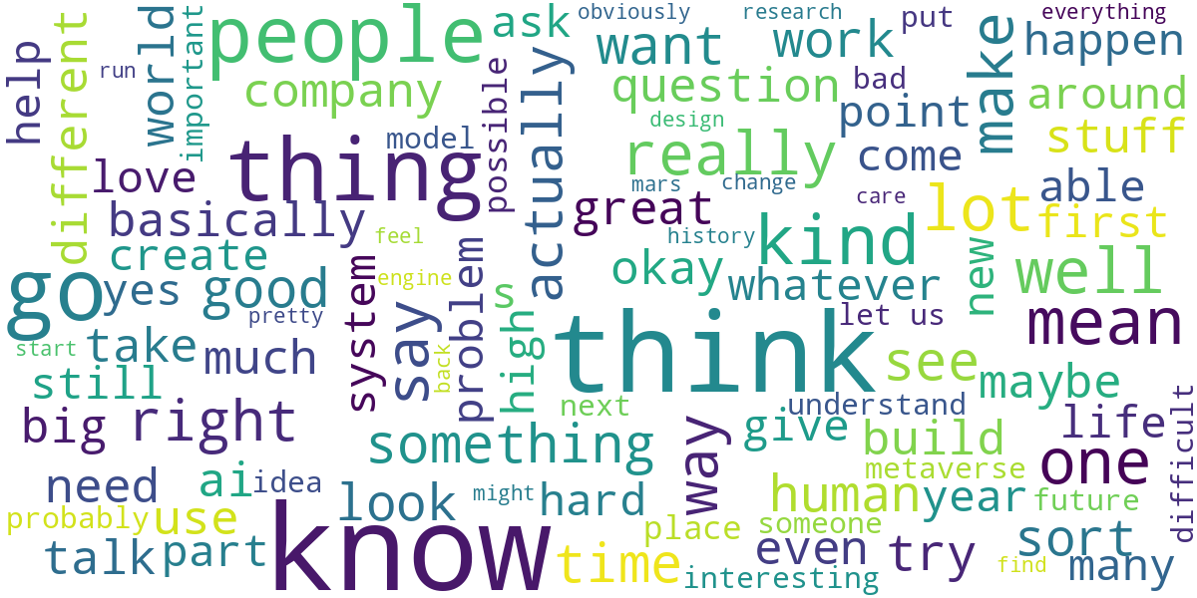
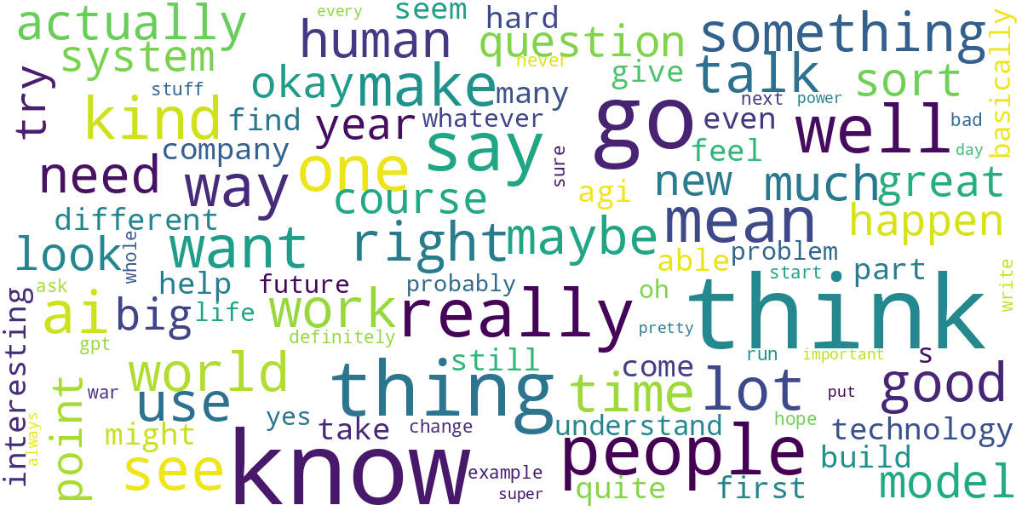
RQ 1 : Wordcloud
people
build
good
war
problem
hard

Slide 5
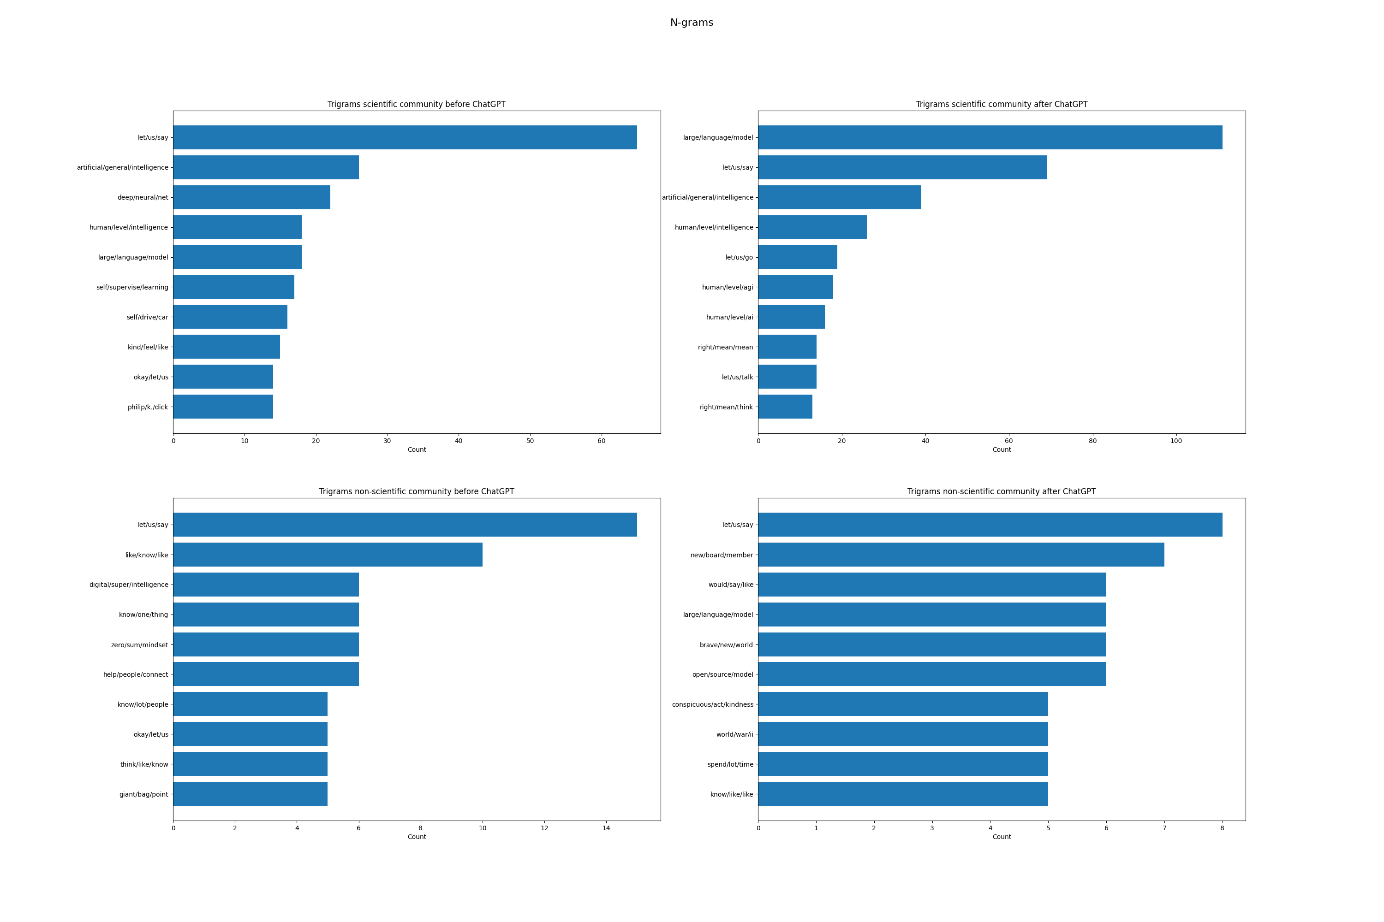
RQ 1 : N-grams

Slide 6
RQ 1 : Topic modeling
Poor results using an LDA model
Mostly nonsensical topics
Not enough data?
Some mentions of “super human level intelligence” and concerns about “replacement of workforce” were found

Slide 7
RQ 1 : Conclusion
This is a subjective interpretation :
There seems to be shift from more positive topics towards less positive topics

Slide 8
RQ 2 : Did sentiment change?
Try to perform a more objective analysis for RQ2
Use a sentiment classifier on all documents over time
Average the sentiments over all sentences of each document
Visualize this on a timeline and correlate with the introduction of ChatGPT
Generate a trendline (is sentiment going towards more positive or towards more negative?)

Slide 9
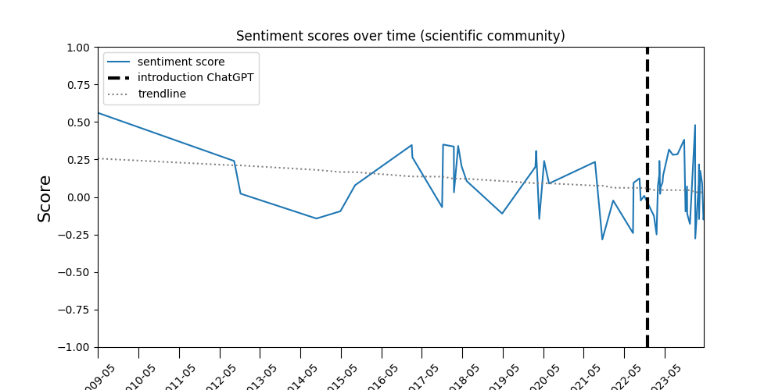
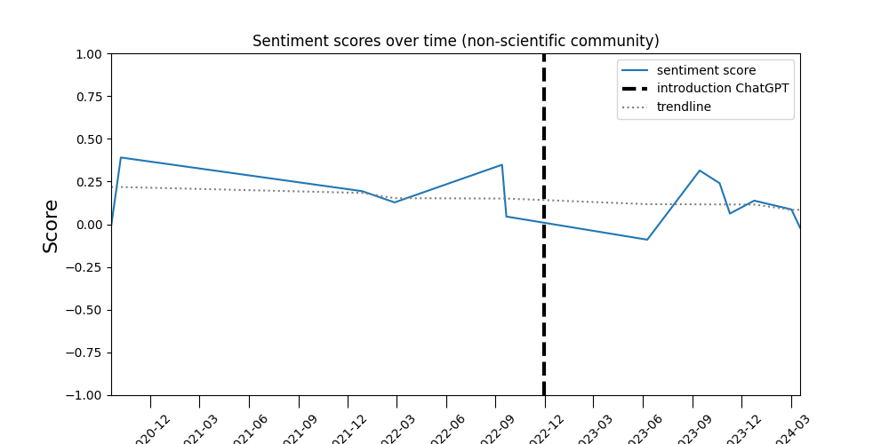
RQ 2 : Did sentiment change?

Slide 10
RQ 2 : Did sentiment change?
Trendline is going down (= more negative)
It was already going down before the introduction of ChatGPT
Slope increases (towards negative) after introduction of ChatGPT in both communities

Slide 11
Is ChatGPT safe to use?
Many ethical issues concerning safe use of ChatGPT :
Transparency: how are answers determined?
Accountability: who is liable when false information leads to injury or harm?
Data privacy: people may enter sensitive information
Trust : people may trust ChatGPT too much
Fairness : AGI should be available to all
(Input) bias : biased training sets
Environmental impact : use of compute resources
Societal impact : education, fake news, phishing by generating emails, …
…

Slide 12
Conclusion
These ethical issues are being discussed
We found some of these issues in the results
However the dataset was very limited and no clear conclusions can be drawn

