Slide 1


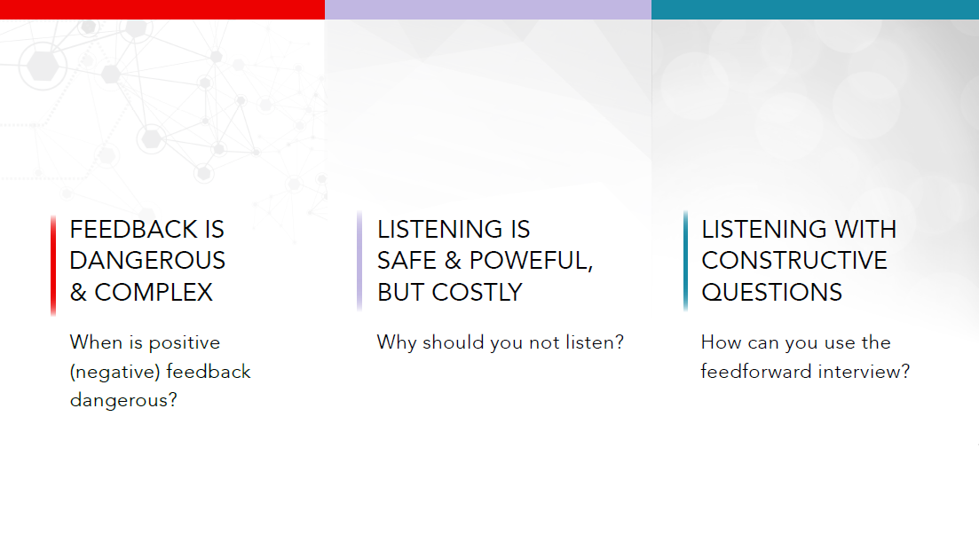
Three Research/Story Lines
By Avi Kluger

Slide 2


Slide 3
DEFINITION
Kluger & DeNisi (1996)
Feedback Interventions (FI)
Actions taken by (an) external agent (s)
to provide information
regarding some aspect (s) of one's task performance. (p. 255)

Slide 4
DEFINITION
Kluger & DeNisi (1996)
Types of Feedback
Outcome: mere knowledge of results
Process: information about policy rather than accuracy
Velocity: comparison to past performance
Normative: comparison to the performance of others

Slide 5
THE EVIDENCE
Kluger & DeNisi (1996, 1998)

Slide 6
THE EVIDENCE
Kluger & DeNisi (1996, 1998)
Mean = 0.40

Slide 7
THE EVIDENCE
Kluger & DeNisi (1996, 1998)
38% of the effects suggest damage to performance
Mean = 0.40

Slide 8
WHEN is feedback more/less effective?
Feedback sign does not, by itself, determine feedback effectiveness.
The more feedback threatens the self the more destructive it is.

Slide 9
SELF-REGULATION
Higgins (1997)
Prevention Focus
versus
Promotion Focus

Slide 10
THE EFFECTS of positive/negative feedback on motivation
Promotion focus / “want to”
Prevention focus / “have to”
+
+
-
-

Slide 11
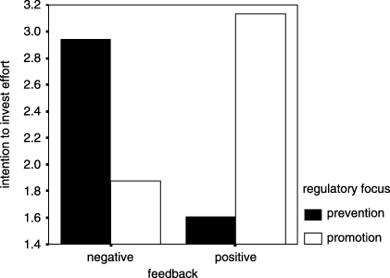
MOTIVATION feedback sign & type of work
Van-Dijk & Kluger (2004)

Slide 12
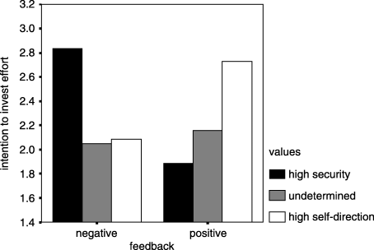
MOTIVATION feedback sign & values
Van-Dijk & Kluger (2004)

Slide 13
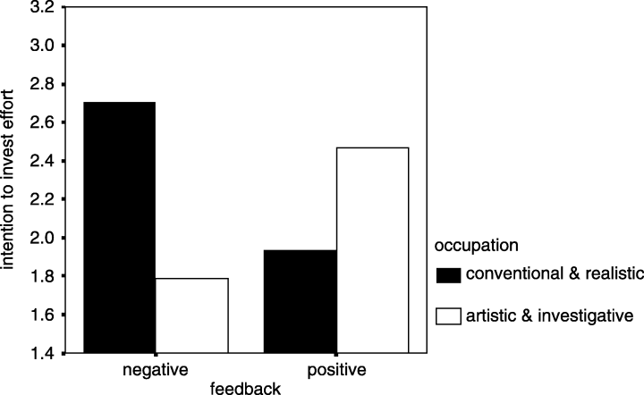
MOTIVATION by sign & occupation
Van-Dijk & Kluger (2004)

Slide 14
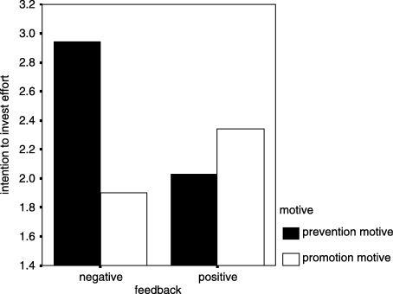
MOTIVATION by sign & reason
Van-Dijk & Kluger (2004)

Slide 15
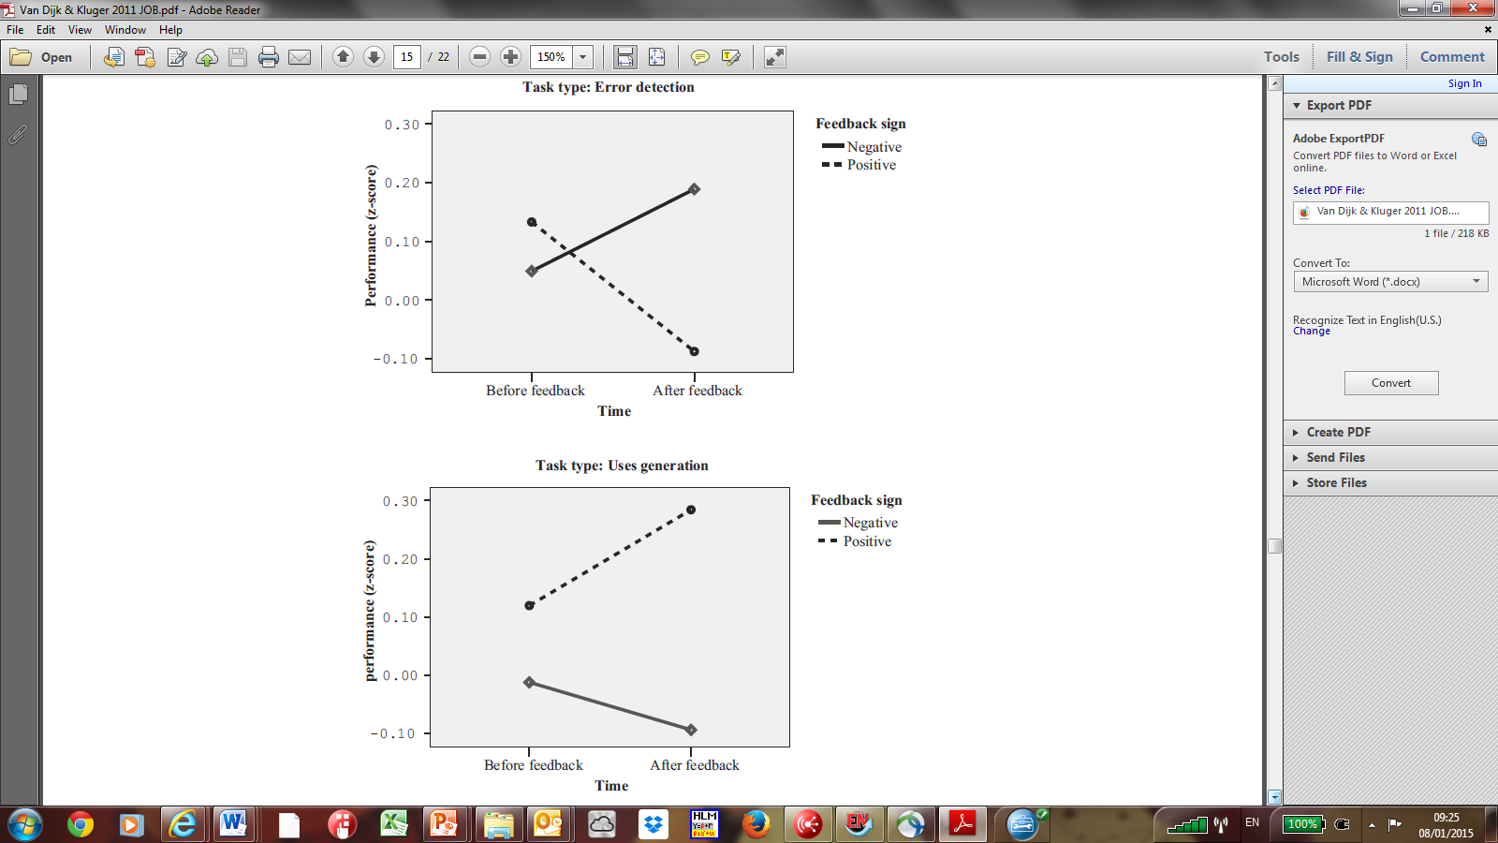
Prevention
PERFORMANCE
By feedback sign & task type
Van Dijk & Kluger (2011)
Promotion

Slide 16

COMPLICATIONS
Negative feedback impact under prevention focus
expectancy
value of
success

Slide 17
DISTURBING
Feedback in the field & performance appraisal
Rating improvement over time is practically useless (Smither, London, & Reilly, 2005).
Companies implementing 360-degree feedback had lower stock value! (Aguinis, 2009)
Experts suggest to drop performance appraisal altogether because it destroys relationships and stifles creativity (Coens & Jenkins, 2000).
Workers construe performance appraisal in different ways, leading to misunderstanding (Zambelli, 2013).

Slide 18
NO practical improvement in rating over time
Smither, London, & Reilly (2005)
 |  |  |  | 95% confidence interval
Feedback from: | k | N | d | Lower Limit | Upper limit
Direct reports | 21 | 7,705 | .12 | −.14 | .44
Peers | 7 | 5,331 | .04 | −.24 | .34
Supervisors | 10 | 5,358 | .10 | .01 | .29
Self | 11 | 3,684 | −.03 | −.10 | .02

Slide 19
RISK
Performance management, Aguinis (2009), Upper saddle river, NJ: pearson prentice hall.
“The risks associated with implementing a 360-degree system can be illustrated by Watson Wyatt’s 2001 Human Capital Index (HCI). This is an ongoing study of the effects of HR practices on the stock value of more than 700 publicly traded companies. One particular result was especially alarming. Of the companies surveyed, those that had implemented 360-degree feedback had lower stock value! Specifically, the companies that used peer reviews had 4.9% lower market value than did similar companies that did not implement peer reviews. Furthermore, companies that implemented upward feedback, where employees rated managers, had a 5.7% lower stock value than did similar companies that did not implement upward feedback. Does this necessarily mean that implementing 360-degree feedback systems causes the stock price to decrease? Based on the data collected, there is no definitive answer to this question. It could be that organizations that are not performing well financially decide to implement 360-degree feedback systems precisely to help improve their performance. Nevertheless, these results highlight the importance of following best practices in implementing 360-degree feedback systems in order to avoid any negative consequences of implementing such a system.” (p. 194 )

Slide 20
MISUNDERSTANDING
Zambelli (2013), dissertation
Learning (from negative)
Motivating (from positive)
Social obligation (mostly positive)

Slide 21
UNEASY
“An Uneasy look at Performance Appraisal” McGregor (1972), Harvard Business Review, (Sep-Oct), p.134.
“Conventional performance appraisal, unless handled with consummate skill and delicacy, constitutes something dangerously close to violation of the integrity of the personality.”

Slide 22
ABOLISHING
“Abolishing performance appraisals: Why they backfire and what to do instead”, Coens & Jenkins (2000), San Francisco: Berrett-Koehler Publishers.
Peter Scholtes: “We live our lives in webs of interdependence and yet we keep telling ourselves the story that we are independent” (p. 33).

Slide 23
