Slide 1

If You Listen to Me, I Will Change My Attitude Guy Itzchakov The Hebrew University of Jerusalem

Slide 2
While a speaker experiences listening for understanding…
“… The firm boundaries of self-organization relax. There is no longer the firm, tight gestalt which is characteristic of every organization under threat, but a looser, more uncertain configuration...
Notes:
In this atmosphere of safety, protection, and acceptance

Slide 3
…his self-structure is now sufficiently relaxed so that he can consider the complex and contradictory experiences upon which they are based. He discovers experiences of which he has never been aware, which are deeply, contradictory to the perception he has had of himself …“ (Rogers, 1951, p.193).

Slide 4
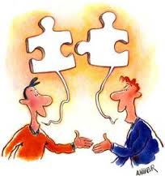
Good listening creates opportunity for an inner dialog within the self (Rogers, 1952/1991)
Inner dialog makes speakers aware of their own conflicting cognitions without canceling each other (Rogers, 1952/1991)

Slide 5
Hypotheses
The effects of listening for understanding on the speaker:
H1: Social anxiety
H2: Attitude ambivalence
H3: Attitude extremity

Slide 6
Attitude Measure (Kaplan,1972)
Positive items
Considering only your positive thoughts (feelings) about ______ and ignoring your negative thoughts (feelings), how positive is your attitude? (0 = not at all positive TO 10 = extremely positive)
Negative items
Considering only your negative thoughts (feelings) about ______ and ignoring your positive thoughts (feelings), how negative is your attitude? ( -10 = extremely negative TO 0 = not at all negative)
Attitude ambivalence = positive + |negative| - |Σ (positive + negative)|
Attitude extremity = |positive + negative|
Attitude valence = positive + negative

Slide 7

Scenario experiment (N=196)
“For the next 20 seconds think about a colleague towards whom you hold a negative attitude.”

Slide 8
Random assignment to a scenario
Good listener Regular listener Bad listener
Participants imagined expressing their attitude towards the colleague

Slide 9
Results
η_{p}² = .16
η_{p}² = .11
η_{p}² = .07

Slide 10
Manipulated Listening (bad = -1, regular = 0, good = 1)
Perceived listening
Social anxiety
Attitude ambivalence
Attitude extremity
.84
-.55
-.24
-.88
χ2 (5) = .07 CFI = .98
RMSEA = .07 SRMR = .08
Notes:
Indirect measures

Slide 11

Correlative study (N=162)
Goals: Replicate Study 1 using naturally varying levels of listening in a field study.
Procedure: Employees grouped in teams rated their managers listening behavior, feelings of social anxiety and attitudes towards their supervisor.

Slide 12
Unstandardized HLM Estimates of Listening Effects (Level 1)
DV | ICC | B | LL | UL
Social anxiety | .42 | -0.52 | -0.62 | -0.42
Attitude ambivalence | .38 | 1.55 | 0.35 | 2.75
Attitude extremity | .42 | -0.22 | -0.41 | -0.03
Attitude valence | .64 | 3.34 | 2.54 | 4.14

Slide 13



Quasi-experiment (N=31)
N=15
N=16

Slide 14
Measures
Post-seminar | Pre-seminar
“The other workshop members genuinely wanted to hear my point of view” | “My work colleagues genuinely want to hear my point of view” | Listening (manipulation check), Team listening environment scale
“I was worried about what the other workshop member thought of me” | “I am worried about what my colleagues think of me” | Social anxiety, state social anxiety inventory
As in Study 1 | As in Study 1 | Attitude ambivalence Attitude extremity

Slide 15
Listening-circle workshop
Benefits of attentive and empathic listening
Participants set in one circle
“Talking object”
Participants talked about experience with a colleague, they reported in the pre-workshop questionnaire, while the other group members listened

Slide 16
Self-enhancement workshop
Theoretical basis and practical tools for different thinking strategies
Learned self-control techniques
Learned and practiced making wise and rational decisions under time-pressure.
did not talk about the event they reported in the pre-seminar questionnaire.

Slide 17
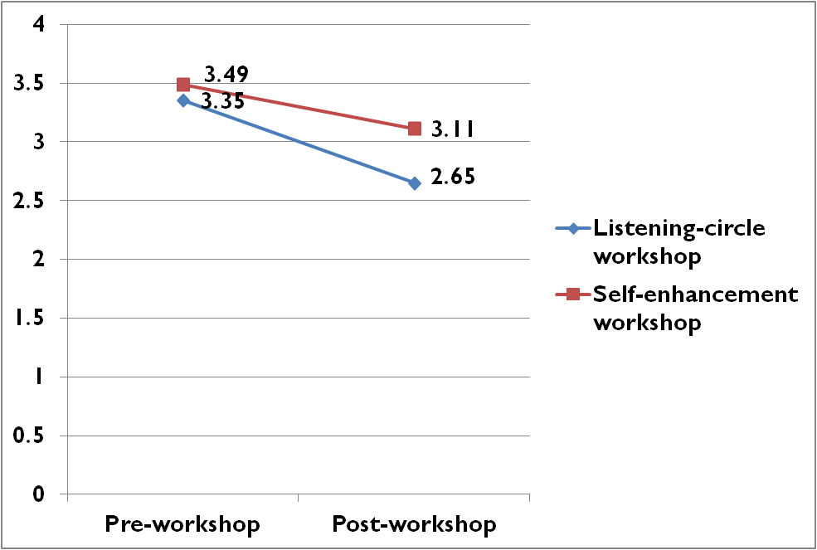
Social Anxiety
Cohen’s d = - 0.45

Slide 18
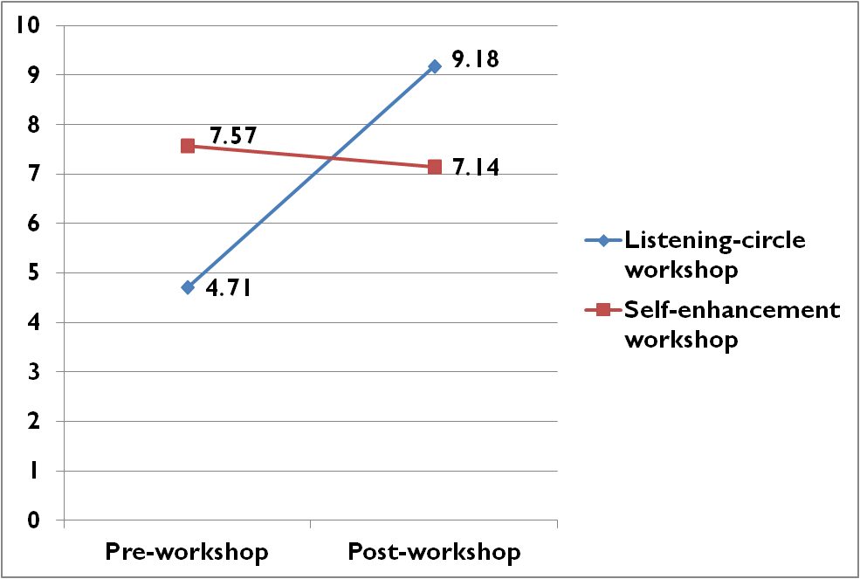
Attitude ambivalence
Cohen’s d = 0.86

Slide 19
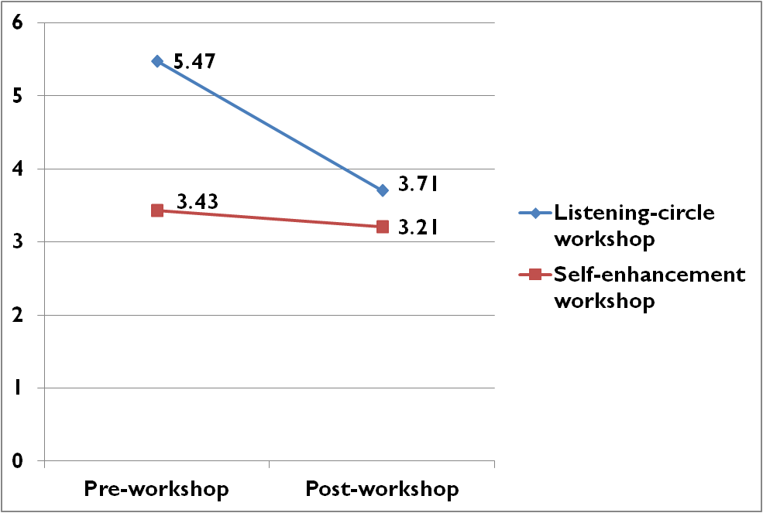
Attitude extremity
Cohen’s d = - 0.44

Slide 20

Laboratory experiment (N=114)
12 minutes
Compatibility for holding a managerial position in the future
Random assignment to three listening conditions:
Bad (actor confederates)
Regular, or
Good (certified coaches and a social worker)

Slide 21
η_{p}² = .26

Slide 22
Ambivalence : η_{p}² = .17
Extremity: η_{p}² = .08
Notes:
City-hall managers were allocated a budget to send their employees to one out of several training seminars. At the time we collected data, managers could allocate their subordinates to participate either in a listening-circle workshop (n = 16) or in a confidence-enhancement workshop (n = 15). Both workshops were six hour long. Upon arrival participants completed questionnaires about (a) the listening quality of their colleagues, (b) their feelings of social anxiety regarding their colleagues and, (c) attitude towards an either positive or negative event that occurred to them with a fellow colleague.

Slide 23
Meta Analyses: Good-Regular Listening (N = 260)
Q | τ | UL | LL | d
1.48 | .30 | 1.68 | 0.30 | 0.99 | Perceived listening
1.46 | .00 | -0.40 | -0.90 | -0.65 | Social anxiety
1.97 | .00 | 0.79 | 0.29 | 0.54 | Attitude ambivalence
0.50 | .00 | -0.02 | -0.51 | -0.26 | Attitude extremity
Note. None of the Q tests with 2 df is significant.

Slide 24
Implications (examples)
Listening can
Change attitudes.
Reduce stereotypes at the workplace.
Allow people to admit wrongdoing (as opposed to when receiving feedback).

Slide 25

Thank you for listening

