Slide 1

LISTENING: Why should you and why should you not?
Avraham N. Kluger, The Hebrew University of Jerusalem, Chair
Michael Frese, NUS Business School, Co-Chair
Angelo S. DeNisi, Tulane University, Co-Chair
Frederik Anseel, Ghent University, Co-Chair
Benjamin Schneider, CEB’s Talent Management Labs, Co-Chair
Gary P. Latham, University of Toronto, Co-Chair
Avraham N. Kluger, The Hebrew University of Jerusalem, Author
Guy Itzchakov, The Hebrew University of Jerusalem, Author
Anat Hurwitz, New York University, Author
Dotan R. Castro, The Hebrew University of Jerusalem, Author

Slide 2
SIGNS OF NO LISTENING
Nodding and saying “aha” when you play with your smartphone.
Talking on the phone, while checking emails on your computer, or cooking at the same time.
Saying “I know what you mean”.
Saying “I told you a thousand times”.
Giving advice, or feedback, when no one asked for it.
Waiting (impatiently) for your turn to talk.

Slide 3
DEFINTION
Listening in interpersonal context is multi-dimensional (Bodie, 2012):
Attention
Comprehension
Relation

Slide 4
DEFINTION
Listening in interpersonal context is multi-dimensional (Bodie, 2012):
Attention (pay attention, be present, responsiveness)
Comprehension (Understanding, curiosity)
Relation (Support, respect, empathy, caring, non-judgmental)

Slide 5
DEFINTION
Relational aspect (Rogers & Roethlisberger, 1991/1952):
Non-judgmental
Empathic
Authentic
Respectful

Slide 6
ALTERNATIVE SESSION TYPE
A typical symposium – 55 minutes
Small-group discussions led by the generous co-chairs – 15 minutes
Co-chairs summarize their findings to the plenary – 10 minutes (2 minutes each)

Slide 7
THE SYMPOSIUM
Listening: Why should you?
Avraham N. Kluger, The Hebrew University of Jerusalem
Guy Itzchakov, The Hebrew University of Jerusalem
Listening: Why should you not?
Dotan R. Castro, The Hebrew University of Jerusalem
Anat Hurwitz, New York University

Slide 8
YOUR ROLE
Think throughout the presentations
What is your strongest objection?
What is the greatest opportunity?
Share your thoughts with your group
Co-chairs will summarize findings to the plenary.

Slide 9
Two jokes that are already taken
The presenters will say nothing, they are only going to listen, right?
Listening ≠ not talking
Ames, D., Maissen, L. B., & Brockner, J. (2012). The role of listening in interpersonal influence. Journal of Research in Personality, 46(3), 345-349.
Feedback is bad, so the audience will say nothing, right?
Feedback intervention ≠ feedback seeking

Slide 10


The Hidden Power of Listening: Meta-Analyses
Avraham N. Kluger

Slide 11
THE STATE OF THE ART IN I/O
Journal of Applied Psychology (1965 – August 2014) → 4,279 articles
→ 8 pertained to listening.
→ mostly to listening to music, to lectures, or instructions, etc.
Listening to employees, customers, peers, and people in general is largely ignored by I/O psychology, and psychology in general (including clinical).
SOLUTION: A wide net – search listening in all relevant areas: Marketing, Law enforcement, Education, Nursing, etc.

Slide 12
THE SEARCH
(TS=(listen* NOT (computer energy or Schizophrenia or podcast* or audiotape* or wireless or autis* or linguistic* or Vocabulary Comprehension or eavesdrop* or auditory or hearing aid* or hearing impair* or online discussion* or hearing loss or accent or sound or music* or dichotic or radio or perceptual or acoust* or loud* or speech percept* or alarm call or language or spatial or multimedia)) NOT ((SU=(neuro* or acou* or linguistics)) OR (WC=(literature or mathematics)) OR SO=FORBES)) AND LANGUAGE: (English) AND DOCUMENT TYPES: (Article)
Indexes=SCI-EXPANDED, SSCI Timespan=All years ➔ Since 1965
Yield: 6,042 potential papers
So far scanned 2000-2015
+ google searches, back references, and personal knowledge

Slide 13
SELECTION CRITERIA
About interpersonal listening
Quantitative
Listening not confounded
Effect size reported, or computable, or obtainable

Slide 14
CODED
108 papers
145 studies
256 effect sizes
101 topics

Slide 15
ANALYSES
Random effect models
Designs:
Experiments – Cohen’s d
Correlations – r and ρ
Quasi-experiments – Cohen’s d for repeated measures
Report k > 1
Show selected forest plots

Slide 16
CODING
Effects involving
similar variables within the same study
same variable across several time periods
multiple-listening groups
→ Averaged
dissimilar variables within the same study
→ Coded in different meta analyses (e.g., people leadership vs. task leadership)

Slide 17
CODING RELIABILITY
An independent judge coded 11 experiments and used different software and obtained a similar effect size (.86 vs. 80).

Slide 18
EXISTING THEORIES
Being listened to:
Alters the quality of stories told and information shared – fluency (Bavelas, 2000; and others)
Shapes self knowledge, self definition, and memory (Pasupathi, 2001)
Changes personality (Rogers, 1952)

Slide 19
EXPERIMENTS fluency
DVs:
Story elaboration
Lack of speech dis-fluencies
Narration quality
Experiments:
Control group – listen as usual
Experimental group – distracted listener
d = control - experimental

Slide 20
EXPERIMENTS fluency
Forest plot

Slide 21
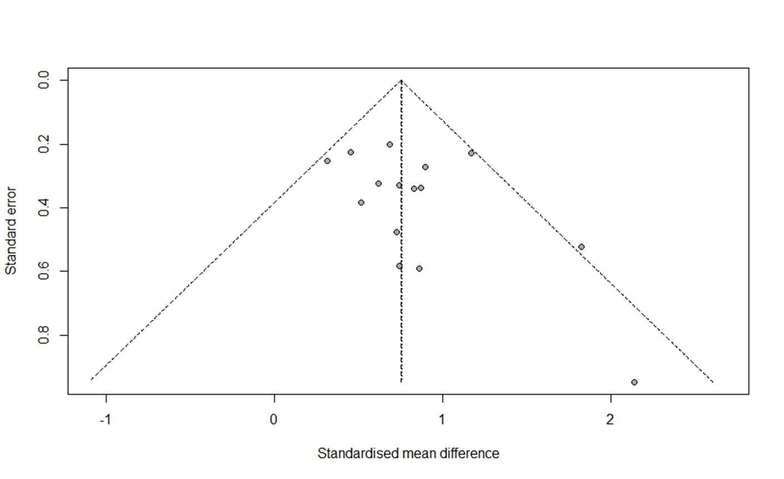
EXPERIMENTS
Topic | k | N | d | LL | UL | τ | I²
Fluency | 15 | 660 | 0.76 | 0.59 | 0.93 | 0.11 | 10%
Psychological safety | 9 | 1,060 | 0.78 | 0.15 | 1.41 | 0.94 | 96%
Training on listening | 5 | 438 | 0.72 | 0.22 | 1.23 | 0.51 | 83%
Depression | 3 | 708 | -0.07 | -0.22 | 0.08 | 0.00 | 0%
NA | 3 | 272 | -0.52 | -0.99 | -0.06 | 0.33 | 68%
PA | 3 | 233 | 0.33 | 0.03 | 0.63 | 0.12 | 21%
Self-change | 2 | 130 | 0.66 | 0.26 | 1.06 | 0.13 | 19%
Self-stability | 2 | 130 | 0.34 | -0.01 | 0.69 | 0.00 | 0%

Slide 22
CORRELATIONS performance
Salesperson to customers
Gross sales, unit sales, contribution to profit
Detective to suspects
Suspect provided information unknown to the police
Principal to teachers
Average of annual-school exam

Slide 23
CORRELATIONS
Topic | k | N | r | LL | UL | τ | I² | ρ
Performance | 10 | 1,613 | .29 | .18 | .39 | .16 | 79% | .32

Slide 24
CORRELATIONS
Topic | k | N | r | LL | UL | τ | I² | ρ
People leadership | 13 | 7,874 | .61 | .52 | .69 | .22 | 96% | .73
Job satisfaction | 11 | 7,601 | .48 | .37 | .57 | .21 | 96% | .55
Performance | 10 | 1,613 | .29 | .18 | .39 | .16 | 79% | .32
Trust | 9 | 29,571 | .52 | .25 | .71 | .49 | 99% | .60
Burnout | 8 | 3,652 | -.28 | -.33 | -.23 | .04 | 37% | -.34
Psychological safety | 7 | 1,149 | .61 | .53 | .68 | .12 | 64% | .68
Depression | 5 | 3,750 | -.16 | -.26 | -.05 | .11 | 87% | -.16
Task leadership | 5 | 1,893 | -.07 | -.23 | .09 | .18 | 91% | -.08
Commitment | 4 | 4,187 | .33 | .10 | .53 | .24 | 95% | .40
Patient satisfaction | 4 | 1,607 | .32 | .24 | .39 | .06 | 50% | .42

Slide 25
More CORRELATIONS
Topic | k | N | r | LL | UL | τ | I² | ρ
Voice | 4 | 1,170 | .18 | .09 | .26 | .07 | 50% | .21
Violence | 4 | 1,154 | -.29 | -.36 | -.23 | .04 | 30% | -.36
PA | 4 | 1,119 | .38 | -.02 | .68 | .42 | 97% | .45
Health | 3 | 733 | -.01 | -.08 | .06 | .00 | 0%
Nonverbal support | 3 | 309 | .48 | .28 | .63 | .17 | 75% | .58
Customer satisfaction | 2 | 58,673 | .54 | -.20 | .89 | .58 | 100% | .64
NA | 2 | 968 | -.45 | -.74 | -.01 | .34 | 98% | -.53
Knowledge | 2 | 492 | .13 | .05 | .22 | .00 | 0% | .15
Coded & Self-reported | 2 | 390 | .40 | .23 | .54 | .10 | 62% | .48
OCB | 2 | 366 | .31 | .22 | .40 | .00 | 0% | .36
Comforting | 2 | 224 | .48 | -.03 | .79 | .38 | 94% | .64

Slide 26
QUASI-EXPERIMENTS before-after designs
Topic | k | N | d | LL | UL | τ | I²
Training on listening | 16 | 991 | 0.89 | 0.59 | 1.18 | 0.44 | 71%
Depression intervention | 6 | 390 | -0.51 | -0.83 | -0.20 | 0.25 | 44%
Post-traumatic symptoms | 2 | 166 | -0.63 | -1.35 | 0.09 | 0.47 | 80%
Training on confidence | 2 | 70 | -0.55 | -1.06 | -0.04 | 0.12 | 10%

Slide 27
PUBLICATION BIASES
Trim & fill analyses suggest
Most meta analyses have no evidence of a publication bias.
Quasi-experiments of training effects on listening shows a publication bias, but it does not alter the conclusions that training is effective.

Slide 28
SUMMARY
Experiments:
Listening increases
fluency,
psychological safety,
self-change thoughts,
PA,
and reduces NA.

Slide 29
SUMMARY
Correlations:
Listening is highly correlated with many variables including
people leadership,
job-satisfaction,
trust,
commitment,
burnout (negatively),
violence (negatively),
objective-performance measures,
to name a few.

Slide 30
SUMMARY
Both experiments and quasi-experiments (before-and-after designs) suggest that
listening is trainable.

Slide 31
DISCUSSION 1
Listening is powerful: effects tend to be empirically large
based on Bosco et al., in press, JAP
r > .26 → top third
50% of the experimental outcomes;
71% of the correlation outcomes.

Slide 32
DISCUSSION 2
Investing in listening may have large benefits
Job-satisfaction with listening
(r = .55, explaining 30.5% of the variance)
Job-satisfaction with pay (meta-analysis by Judge et al., 2010)
(r = .15, explaining 2.25% of the variance)
A ratio of 13.5!

Slide 33
DISCUSSION 3
First, do no harm
Listening is relatively safe!
Very few (about 5%) undesirable listening effects, and even those with only minor effect sizes.
Feedback interventions caused performance decline in 38% of the experiments (Kluger & DeNisi, 1996), with occasionally very strong negative-effect sizes.
Feedback: listening -- Risk ratio of 7.6!

Slide 34
LIMITATIONS
Many judgment calls. Remedy: provide detailed account.
Low power for variance estimates. Remedy: expand search
Main effects only. Remedy: propose a theory + conduct primary research
Existing experiments manipulate distraction. Remedy, my colleagues also manipulate superior listening.

Slide 35
CONCLUSION
Listening is
Relatively safe
Powerful
A relatively unexplored research goldmine

