Slide 1



Leadership & Listening: A Meta-Analysis
Avraham N. Kluger

Slide 2
MY KEY MESSAGE
.73

Slide 3
THE PRESENT STUDY
A part of an ongoing meta analyses project of anything related to listening

Slide 4
THEORY
Listening is absent,
or not a central tenet,
in leading leadership theories
(see Avolio, Walumbwa, & Weber, 2009).

Slide 5
THEORY
Yet,
Listening is a key component in
Service leadership theory (Barbuto & Wheeler, 2006), and
Spiritual leadership theory (Reave, 2005).

Slide 6
THEORY
Moreover, scholars writing on developing leadership suggest that listening is a critical skill (Avolio, 2011; O’Toole & Bennis, 2009).
For example, “rare is the leader who regularly meets with—and listens to—employees, reporters, shareholders, regulators, and even annoying critics” – yet this is critical for creating a sustainable organization (O’Toole & Bennis, 2009).

Slide 7
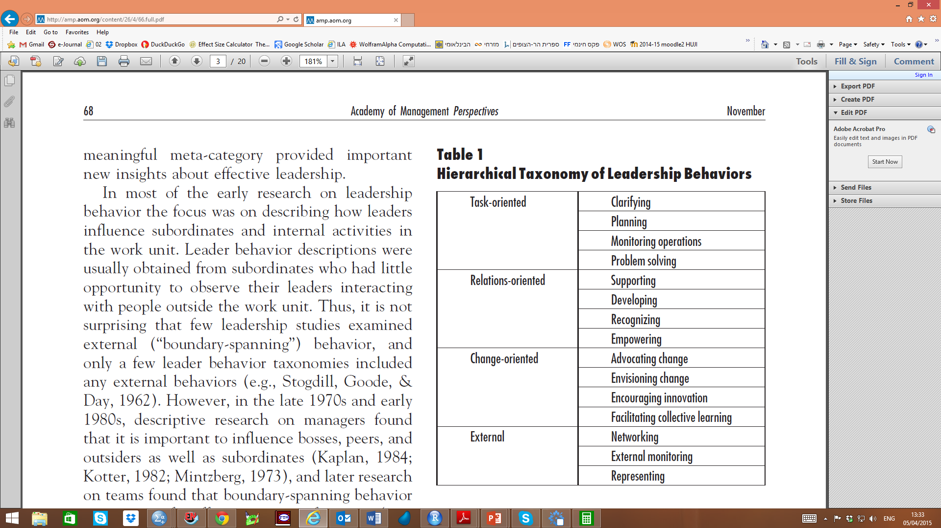
TAXONOMY
Yukl, G. (2012). Effective leadership behavior: What we know and what questions need more attention. Academy of Management Perspectives, 26(4), 66-85. doi: 10.5465/amp.2012.0088

Slide 8

PEOPLE (RELATIONAL) LEADERSHIP

Slide 9
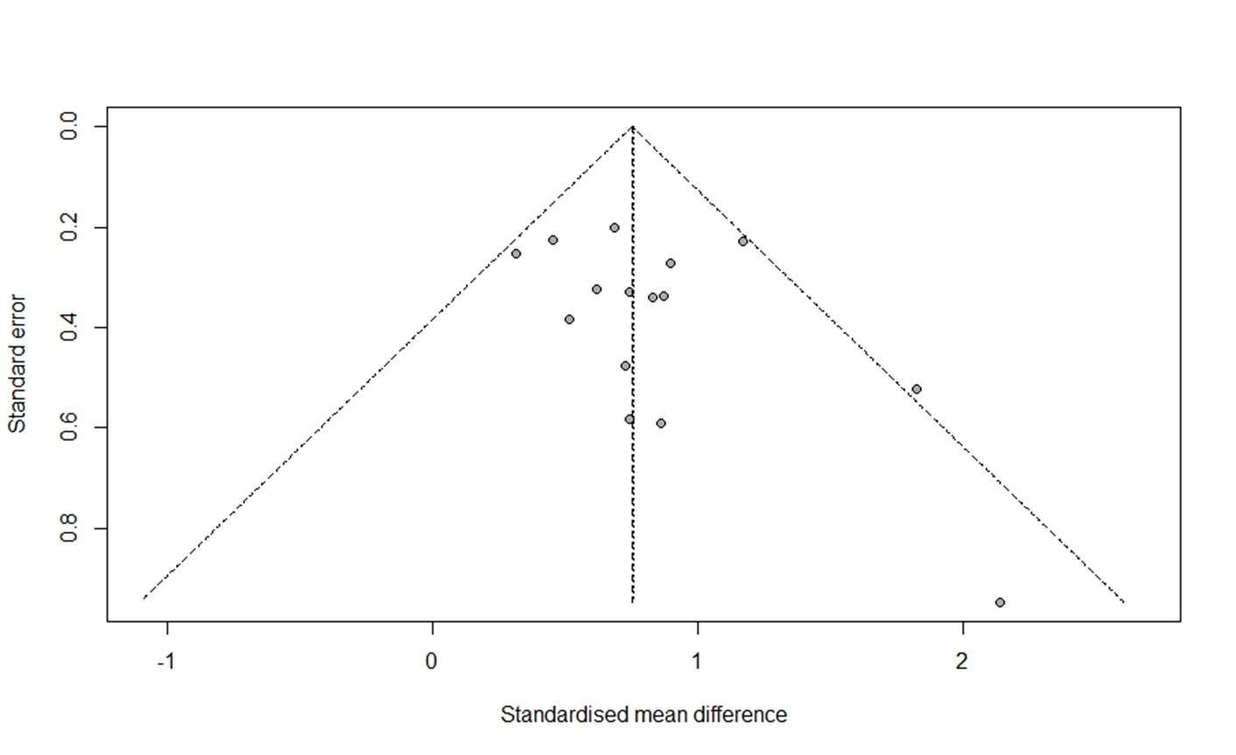
ADDITIONAL TESTS
Fill & Trim analysis suggests no publication bias.
Leadership measure did not moderate the results.

Slide 10
TASK (or non-relational) LEADERSHIP

Slide 11
SUMMARY
Topic | k | N | r | LL | UL | τ | I² | ρ
Relational leadership | 13 | 7,874 | .61 | .52 | .69 | .22 | 96% | .73
Non-relational leadership | 5 | 1,893 | -.07 | -.23 | .09 | .18 | 91% | -.08

Slide 12
DISCUSSION 1 Supervisor-listening & I/O outcomes: Meta-Analyses
Topic | k | N | r | LL | UL | τ | I² | ρ
Job satisfaction | 11 | 7,601 | .48 | .37 | .57 | .21 | 96% | .55
Trust | 9 | 29,571 | .52 | .25 | .71 | .49 | 99% | .60
Burnout | 8 | 3,652 | -.28 | -.33 | -.23 | .04 | 37% | -.34
Psychological safety | 7 | 1,149 | .61 | .53 | .68 | .12 | 64% | .68
Commitment | 4 | 4,187 | .33 | .10 | .53 | .24 | 95% | .40

Slide 13
DISCUSSION 2
Listening is strongly associated with
Perceptions of leadership in general, and with People (Relational) leadership.
Outcomes managers desire (cf. Schroeder SIOP 2015, this session).
But, listening may not be associated, or even negatively associated, with other specific aspects of leadership.

Slide 14
DISCUSSION 3
The extremely high listening-leadership correlation begs an explanation:
Is listening a key behavior through which people signal their relational leadership?
Or,
Is listening a key component of the leadership construct?

Slide 15
DISCUSSION 4
Listening measurement is a challenge.
Listening may have two dimensions (Kluger & Zaidel, 2013):
Constructive listening
Destructive Listening
Both should be correlated with all aspects of leadership

Slide 16
DISCUSSION 5
Leadership does not mean ONLY listening
Ames et al., (2012): “relationship between listening and influence was stronger among those more expressive” (p. 345)
Listening may be more effective when coupled with questioning (cf. Van Quaquebeke & Felps, SIOP 2015, this session).

Slide 17
IMPLICATIONS
Listening training could help develop leadership
Note that listening is trainable
The effect of training on listening | k | N | d | LL | UL | τ | I²
True experiments | 5 | 438 | 0.72 | 0.22 | 1.23 | 0.51 | 83%
Before-and-after designs | 16 | 991 | 0.89 | 0.59 | 1.18 | 0.44 | 71%

Slide 18
LIMITATIONS
One way to assert dominance is to demonstrate poor listening.
Listening → cost (Hurwitz, SIOP 2015).
The remedy is learning that social status can be gained by prestige. Listening increases prestige.

Slide 19
LIMITATIONS
Western samples (USA, Canada, Germany, Sweden, & Israel).
Findings may not generalize (cf. Es-Sabahi, SIOP 2015, this session).
Explore dominance and prestige across cultures.

Slide 20
LIMITATIONS
Correlational data.
Experiments manipulating listening and testing perceived leadership are needed.

Slide 21
CONCLUSION
The meta analyses indicate that perceptions of leadership, and relational leadership are very highly associated with listening.
This overview shows that listening is an important aspect of leadership, or leadership behavior, and suggest new research and practice avenues for I/O and OB.
New questions and opportunities for I/O:
Listening and other aspects of leadership (e.g., change)
Facets of listening
The role of culture
Effective-listening training

Slide 22
A FINAL NOTE
After this session, I will be “all ears”
Come tell me what is wrong with this presentation, and what are the opportunities you see.
I thank you for listening ☺

