Slide 1

Listener Effects on Psychological Safety – Attenuated by Avoidance-Attachment Style
Dotan R. Castro
SIOP, 2015

Slide 2
Does listening benefit all people?
Notes:
INDIVIDUALL DIFFERNECE

Slide 3
Theoretical Model
Avoidance Attachment
Style
H2
Listening
Psychological
Safety
H1

Slide 4
Psychological Safety Definition
Psychological safety
“Sense of being able to show and employ self without fear of negative consequences to self image, status or career” (Kahn, 1990, p. 705)

Slide 5
Listening creates an atmosphere of safety for the speaker (Rogers, 1951)
Listening
Psychological
Safety
H1
Notes:
CLINICAL SETTING

Slide 6
Is it true for all people?

Slide 7
Attachment Theory
Postulates two dimensions (Bowlby, 1969/1982, Mikulincer & Shaver, 2007):
Anxious – not relevant to my model
Avoidant
“I am somewhat uncomfortable being close to others; I find it difficult to trust them completely, difficult to allow myself to depend on them. I am nervous when anyone gets too close, and often, others want me to be more intimate than I feel comfortable being”
(Hazan & Shaver, 1987; 1990)

Slide 8
Avoidance Attachment
Style
H2
Listening
Psychological
Safety
H1

Slide 9
Research Paradigms
Existing listening research is largely correlational
Experimental research relies on:
Control: listen “normally”, vs.
Experimental: distracted listener (Pasupathi et al., 2005, 2009)
Current research contribution:
Experimental: better-than-normal, vs.
Control: listen “normally”

Slide 10
Method
6 Studies:
5 lab experiments (total N = 454)
correlational (N = 126)

Slide 11
Lab experiments
Procedure
All participants got to know each other and then conversed about a positive event (one study), or a meaningful event (four studies) for three to five minutes
Random assignment:
Free conversation (control) vs. Listening (experiment) :
listening without talking
listening and asking questions showing interest,
short-listening training

Slide 12
Lab Studies Measures
Psychological safety. Example items:
"I felt comfortable to talk”
“I felt secure to talk freely”
Cronbach α’s = .85 to .96
Attachment style. 36-item ECR (Clark, & Shaver, 1998)
Cronbach α’s = .74 to .91

Slide 13
H1: Fixed-effect meta analysis
N | Study
66 | 1
70 | 2
144 | 3
128 | 4
46 | 5
454 | Total
 | d | LL | UL
Psychological Safety | .11 | -.08 | .29

Slide 14
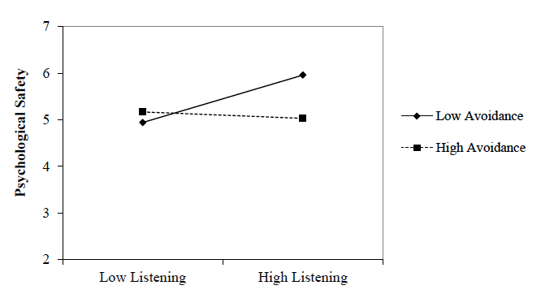
H2: Interaction examples
Study 2

Slide 15
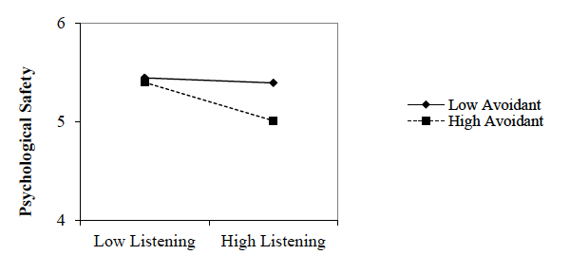
H2: Interaction examples
Study 5

Slide 16
Forest plot Meta-analysis of five interaction terms

Slide 17
Study 6 - Field Study
Psychological safety regressed on listening by avoidance-attachment style
129 working participants
poor listening
good listening
t(125) for interaction = 1.70, p < .05, one tailed

Slide 18
Discussion
The Boundaries of Listening
Listening increased psychological safety for people low on avoidance-attachment style, but this effect was consistently attenuated among people high on avoidance-attachment style
Elevating psychological safety for all requires stronger interventions than reported here (cf., Tyler, 2011).

Slide 19
Limitations
Lab studies have restricted external validity
Short conversation time
Untrained students
Newly encountered pairs
Additional studies (lab experiment and scenario experiment) provide support for H1
with trained listeners and sufficient conversation time - listening increased psychological safety

Slide 20
Future Research
Listening to people high in avoidance attachment style. How?
In the long run?
Technical topics?
Can listening increase team psychological safety?
Our preliminary studies suggest it does

Slide 21


