Slide 1

The Soft Power of Listening
Prof. Avi Kluger
School of Business Administration

Slide 2
CONCLUSION
1= 2

Slide 3
What is listening?
You know when you are being listened to!
Paying attention
Understanding
Being on your side (empathy, non-judgmental)
Opening
Notes:
What’s in it for me?
The first question anyone will ask you is this question…and if they aren’t, then they are thinking it.
What are you going to get in the next three hours? (This gives them the time frame)
You can sit here and listen.
But I you want to take it one step further – but if you want to take it one step further, to have an opportunity that most people don’t get:
you have the ability to upgrade significantly the way that you come across,
the way that you deliver messages
and as a result, the opportunities that will COME YOUR WAY.
If it’s the job opportunities that you have, how you are being viewed by your boss
I challenge you, encourage you to take everything you hear here in here today with THAT opportunitiy in mind.
Because at the end of the day you may be doing a fabulous job behind the scenes, but unless you can communicate the value of what you do to:
Your superiors
NO ONE will know about it.

Slide 4

What is NOT Listening?

Slide 5


What is NOT Listening?

Slide 6

What is NOT Listening?

Slide 7
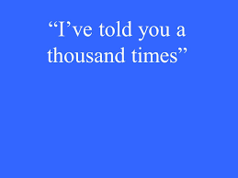
What is NOT Listening?

Slide 8
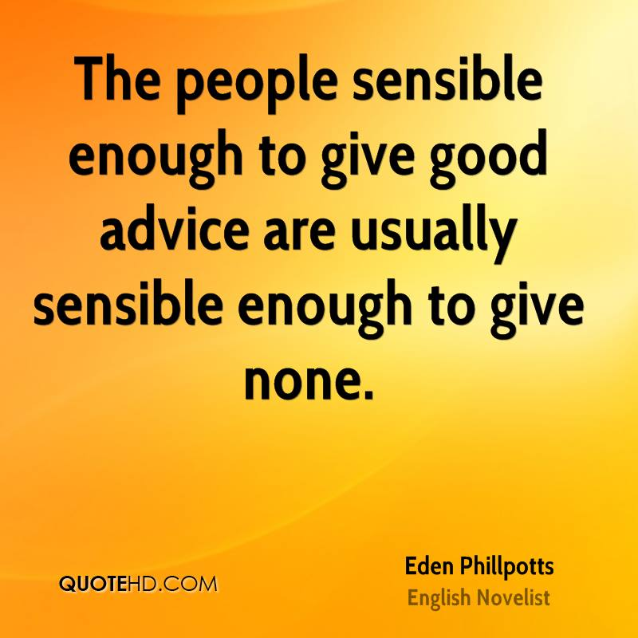

What is NOT Listening?

Slide 9

What is NOT Listening?

Slide 10

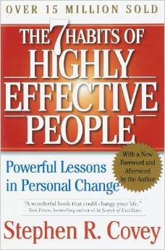


Slide 11

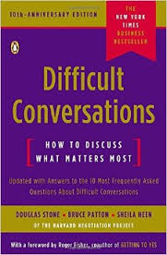
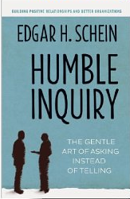

Slide 12



Slide 13




Theory

Slide 14
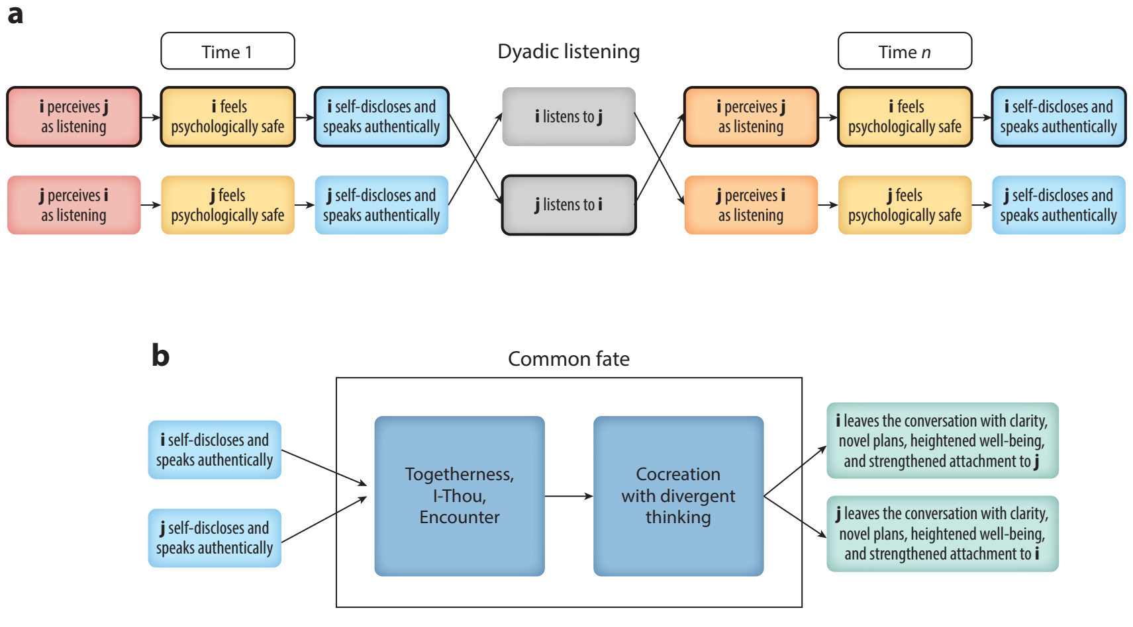
Posted with permission from the Annual Review of Organizational Psychology and Organizational Behavior, Volume 9;
copyright 2022 Annual Reviews, https://www.annualreviews.org/

Slide 15
272 | papers
307 | studies
930 | effect sizes
37 | different countries and regions: USA, 55.2%, Israel, 16.6%, Japan, 3.9%, The Netherlands, 3.5%, UK, 3.1%, and Germany, 2.5%
31.6% | randomized experiments
37.6% | pertained to the listener, as oppose to the speaker, or both
14.1% | exploratory (no hypothesis)

Slide 16
r

Slide 18
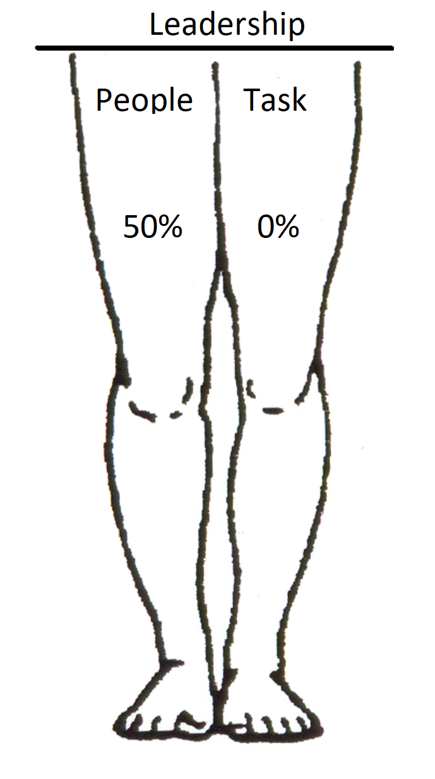
Listening and the two legs of leadership

Slide 19


Slide 20
Similarly …
You do not have to listen to all of your employees, customers, and colleagues
Just the ones you want to trust you, and follow you with their hearts.

Slide 21
CONCLUSION
1good listener = 2 people with plenty of benefits

Slide 22

Your first 3 steps
1. Time Sharing

Slide 23

Testimonial
“This exercise reminded me once again of why we dated and then got married 47 years ago”
“I enjoyed having five or more minutes to explain my thoughts without any interruption”.
Husband
Wife
Interaction

Slide 24


2. Ask for…
What else?

Slide 25
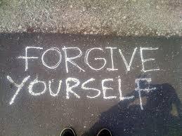
3.

Slide 26

What will be your first step?
?

Slide 27
Trainers: tacit theories about learning to listen
Lehmann, M., Cojuharenco, I., & Kluger, A. N. (2021, working paper). How to train listening?
Feeling safe to be authentic
Learning to listen requires being listened to (Real Play vs. role play)
Hinz, J., Stephens, J. P., & van Oosten, E. (in press). Towards a pedagogy of connection: A critical view of being relational in listening. Management Learning.
Being listened to → Trainee’s flourishing:
Learn about the self (discover conflicting voices within the self); accept its different parts
Discover and adopt new views of self through the other’s perspective:
Reactions of the speaker (verbal and non-verbal)
Resonance of materials shared while listening
Integrate the parts of the self
Developing deliberate knowledge about listening
Practice

Slide 28
Trainers: mapping assumptions to means
Assumptions | Tools
Feeling safe | Modeling (trainer’s self-disclosure; listening to objections & inviting reflections) “Yes…and,” silence, time-sharing, active listening
Being listened to | Frequent speaker-listener role switching; trainer’s listening to objections & inviting reflections; Listening Circles
Learn about the self | Without prompts: Time-sharing; “Yes, and …”; invite stories; Active Listening; Dialectical Behavior Therapy
 | Metaphor prompts: Clean Language; What Is Your Story?; Feedforward
 | Logical prompts: Negotiational-Self Method; Feedforward; Questions on reflections
Integrate the self | Prompt integration: Negotiational-Self Method; Feedforward for a problem
Deliberate knowledge | Demonstrations; Lectures; reading; reflections in class; written reflections
Practice | During class & homework

Slide 29
Epilogue
“Counsel in the heart of man is like deep water; but a man of understanding will draw it out.”
-- Proverbs 20:5
"מים עמוקים, עצה בלב-איש;
ואיש תבונה ידלנה."
(משלי פרק כ' פסוק ה')
Notes:
29

