Slide 1


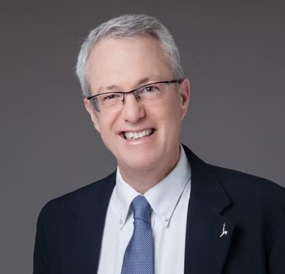



Avi Kluger,
The Hebrew University of Jerusalem
Co-developed with Dina Nir and Co-researched with Eyal Rechter & Dina Nir
Feedforward Using a Hobby
A combination of Feedforward (Kluger & Nir, 2010) and Positive Interpretation of Narrative Therapy (Shifra Wohlgelernter)
FFI Ambassadors Program
2026 Edition

Slide 2
01
Externalizes the hobby as a persona
02
Invites the interviewee to speak about themselves in the third voice
What Is Feedforward Using a Hobby?
A playful variant that
03
Uses playfulness to open honest reflection
04
Reveals values and what is
truly important in life
05
Carries the best of hobby
into other aspects of life — including work
2

Slide 3


Steps 1 & 2
Choose and Personify
Step 1 — Choose a hobby:
“What is your hobby (or an activity that you love)?” [choose one]
Step 2 — Personify it:
“If your hobby were a person, what would you call it?” (for example, “Doreen” for playing the piano)
1
2
3
4
5
6
10

Slide 4

Step 3
Speak with the Persona
Now, I would like to speak with “Doreen”.
“Doreen,” are you able to talk to me about “X” (the interviewee’s actual name)?
How does “X” feel when s/he meets with you?
What has your relationship been like recently?
What else can you tell me about X?
Guidelines:
Be playful — the goal is to make the interviewee speak about themselves in the third voice
Add questions as you see fit — the goal is to make the interviewee reflect on their hobby
1
2
3
4
5
6
4

Slide 5
Step 4
Bring in a Witness
Guidelines:
Continue to be playful
“X” talks about the relationship with “Doreen” through the eyes of a real person
Keep asking until the picture is rich: What else? Who else?
Who (a real person), is able to talk about your relationship with “Doreen”? What can this person tell me? What else? Who else?
1
2
3
4
5
6
5

Slide 6
Step 5
From Hobby to Values
Guidelines:
Continue to be playful
Zoom out — move from stories about the hobby to what they reveal
Help the interviewee name values and what is truly important in life
What do all the things we’ve learned about you and your hobby indicate about your values, about the things that are truly important to you in your life?
1
2
3
4
5
6
5

Slide 7
Step 6
Carry It Forward
Guidelines:
Continue to be playful
Close by carrying the best of the hobby into life and work
Encourage concrete ideas — in other aspects of life and at work
Consider your values and the things that are truly important to you in life that are expressed in your relationship with “Doreen.” How could you use this in a novel way in other aspects of your life? At work?
1
2
3
4
5
6
5

Slide 8
The Protocol at a Glance
What is your hobby (or an activity that you love)?
1
If your hobby were a person, what would you call it? (for example, “Doreen” for playing the piano)
2
“Doreen,” are you able to talk to me about “X”?
3
Who (a real person), is able to talk about your relationship with “Doreen”? What can this person tell me? What else? Who else?
4
What do all the things we’ve learned about you and your hobby indicate about your values, about the things that are truly important to you in your life?
5
Consider your values and the things that are truly important to you in life that are expressed in your relationship with “Doreen.” How could you use this in a novel way in other aspects of your life? At work?
6
8

Slide 9
References
Kluger, Avraham N., and Dina Nir. 2010. “The Feedforward Interview.” Human Resource Management Review 20 (3): 235–46. https://doi.org/10.1016/j.hrmr.2009.08.002
01
Wohlgelernter, Shifra. Positive Interpretation of Narrative Therapy — the narrative-therapy practice combined with the Feedforward Interview in this variant.
02
13

