Slide 1
Avi’s Stock Market Data Fetching Tool
CS50 Introduction to Programming with Python: Final Project Submission
December 2022

Slide 2
User inputs ticker
User inputs stock ticker, if invalid ticker provided, user re-prompted
Price data saved to .csv
.csv file of gathered data saved to folder
.csv price data file used to plot line graph of price against time, saved as a .png
'yfinance' looks up ticker
Ticker searched on YahooFinance, finds prices at 15 minute intervals from last 24 hours
Graph plotted and .png saved to folder

Slide 3
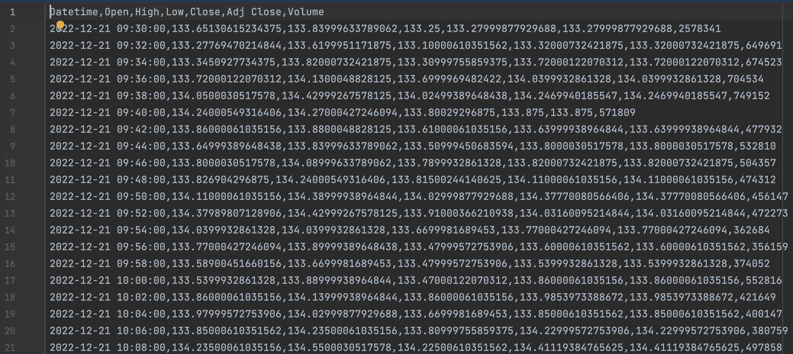
Sample .csv Price Data File

Slide 4
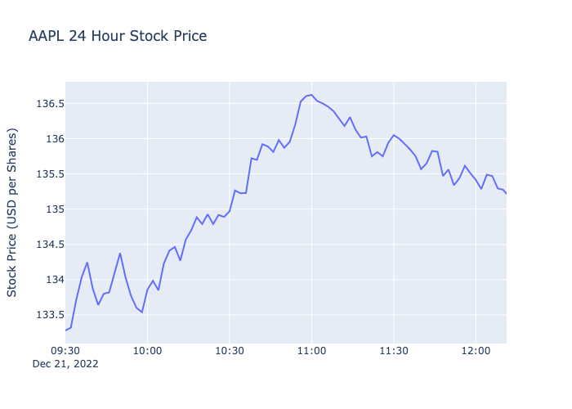
Sample .png Line Graph File

