Slide 1


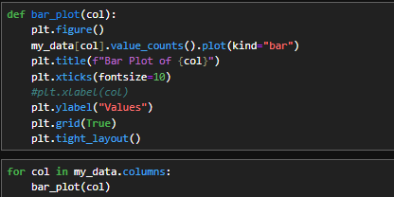
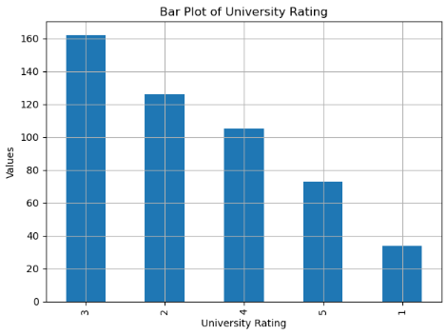
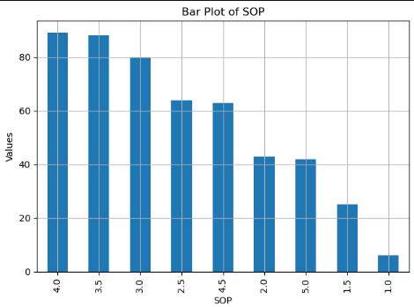
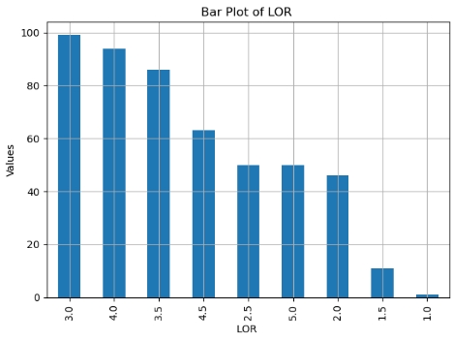
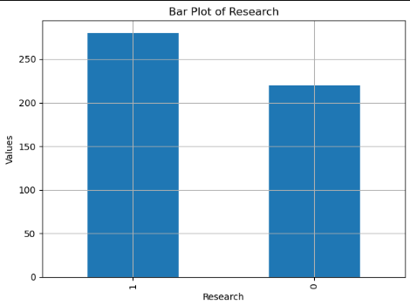
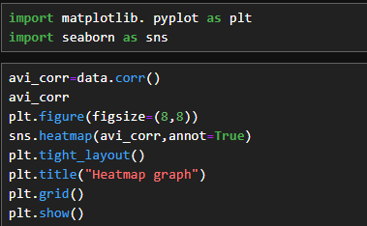
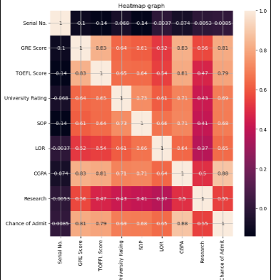
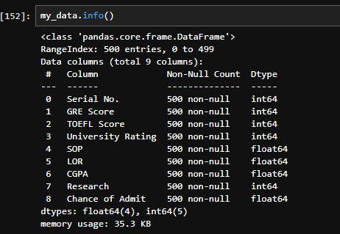
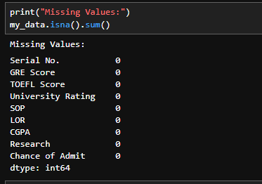
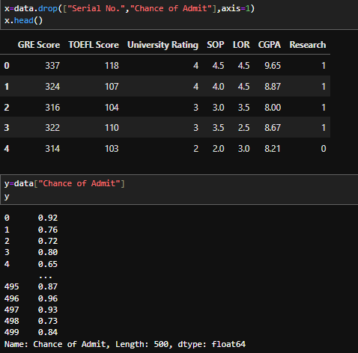
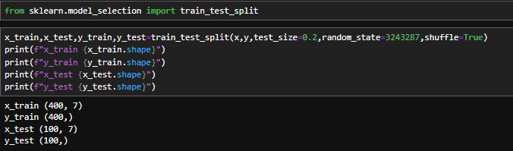
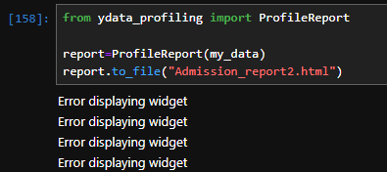
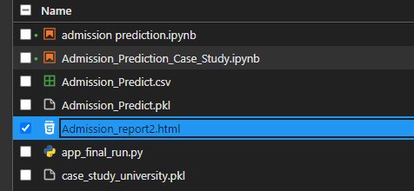
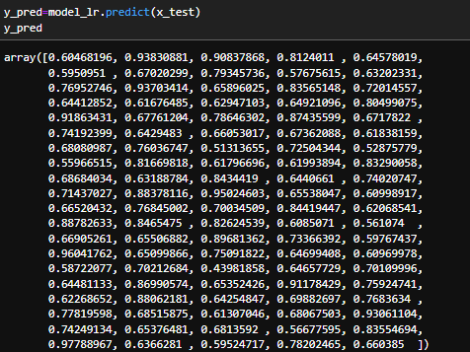
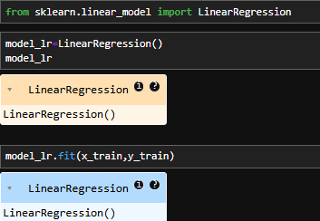
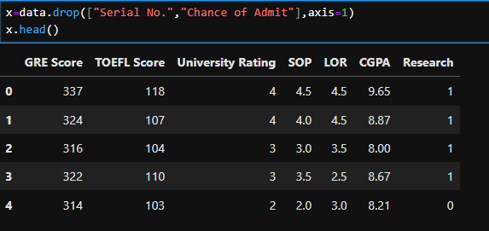
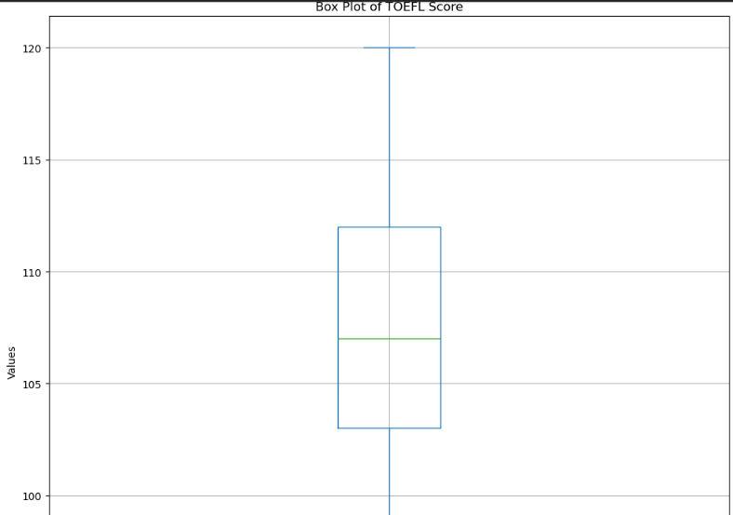
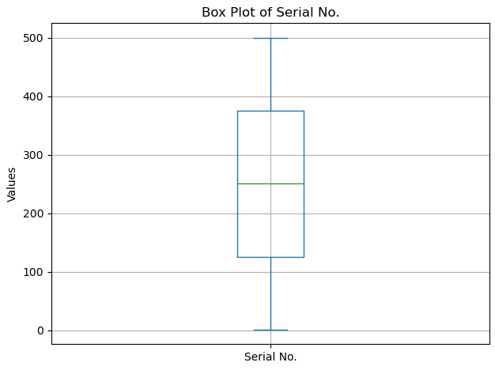
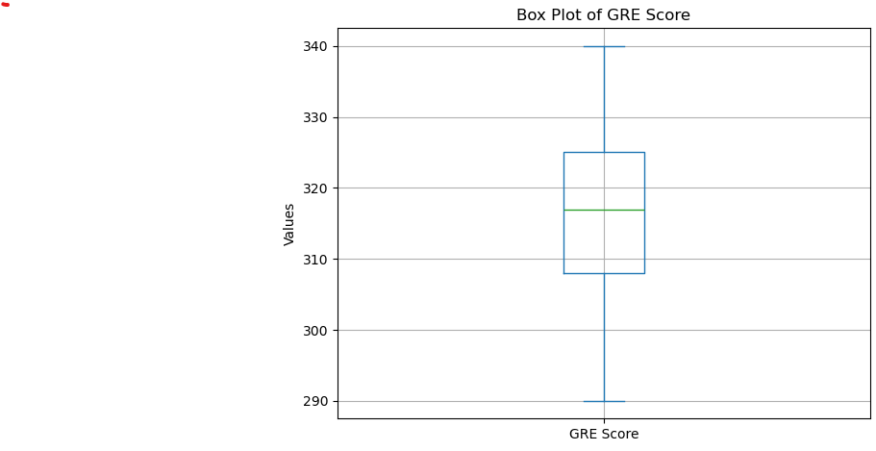
UNIVERSITY ADMISSION PREDICT
My name is Avinash Sahebrao Kale. Who make this poster on university admission Predication
At National Institute of Electronics and Information Technology.
Address: Government Polytechnic Campus, Near Shrinathji School, Varkund Nani Daman-396210
Problem Statement
Bar Plot: To compare the frequency of categorical variables in the dataset..
Deployment
We aim to develop a machine learning model to predict a student's chances of university admission based on their profile. Using past admission data, including GRE scores, GPA, and research experience, the model will identify patterns to forecast outcomes for future applicants
Deployment URL:
https://titanic-prediction-poster.streamlit.app/
GitHub Repository URL:
https://github.com/SumanKamti/Titanic_Prediction_Poster/
Data Validation
Key Columns Validated:
Column Name | Data Types | Missing Value | Outliers | Typing Errors
GRE Score | int64 | 0 | Yes | None
TOEFL Score | int64 | 0 | No | None
University Rating | int64 | 0 | No | None
SOP | float64 | 0 | Yes | None
Figure 4
Heat Map: To visualize correlations between numerical variables in the dataset.
Figure 1
Figure 2
Figure 3
Conclusion & Libraries Used
LOR | float64 | 0 | No | None
CGPA | float64 | 0 | No | None
Research | int64 | 0 | No | None
Chance of Admit | float64 | 0 | No | None
Model Development
Step1: Define the Independent (‘X’) and Dependent/Target (‘Y’).
Figure 1
Figure 2
UNIVERSITY ADMISSION PREDICT
My name is Avinash Sahebrao Kale. Who make this poster on university admission Predication
At National Institute of Electronics and Information Technology.
Address: Government Polytechnic Campus, Near Shrinathji School, Varkund Nani Daman-396210
Data Analysis
Step2: Split the Data into Training and Testing Sets.
Pandas Profiling:
Pandas Profiling is a powerful tool that automatically generates a detailed report of a DataFrame, providing a quick overview of the dataset’s structure and contents.
Step3: Choose and Initialize the Model.
Logistic Regression: is a linear model used for binary classification problems.
Hyperlink to Pandas Profiling Report: https://github.com/Catrutooo/University-Admission-Prediction/blob/main/Admission_report2.html
Step3: Choose and Initialize the Model.
Hyperlink to Pandas Profiling Report: https://github.com/Catrutooo/University-Admission-Prediction/blob/main/Admission_report2.html
Figure 1
Figure 1
Figure 2
Figure 2
Data Cleaning
Data Cleaning
Here we drop Chance of Admit and Serial No.
Classification Performance
Data Visualization
Accuracy: The overall percentage of correct predictions.
Confusion Matrix: A detailed breakdown of true positive, true negative, false positives, and false negatives.
Precision: The proportion of predicted survivors that were correctly identified.
Box Plot: To visualize the distribution of a continuous variable and detect outliers.
Recall: The proportion of actual survivors that were correctly identified.
F1 Score: The balance between precision and recall.
Figure 1
Figure 2
Figure 3

