Slide 1
Homework 2 – Prediction, Imputation
Avi Simkin – 312485816
Maximilian Matyash – 318828761

Slide 2
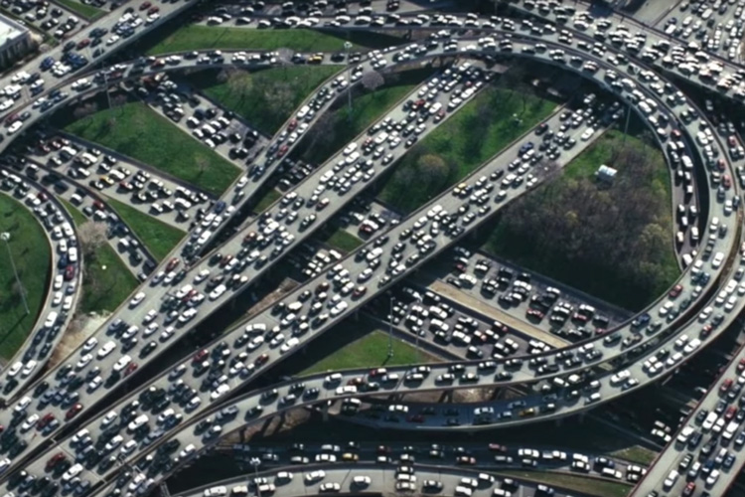
Initial Prediction

Slide 3
Task definition
We will be predicting congestion based on the following features: area ID, hour, weekend indicator, delay, latitude, longitude, speed
This is a binary classification task
Our classes are very imbalanced, the true category consists only about 1% of the entire data. To tackle this problem we just under sampled non-congestion records, as this makes it easier on us computationally and we strive more towards recall anyway.
Notes:
The area ID is the most granular subdivision we’ve seen and basically analogous to street segments.
We will also take long and lat as features to have both continuous and discrete features that represent the bus’s geographical location, hopefully this will help the model.

Slide 4
Model
We used a Random Forest model to predict the labels.
A forest model made a lot of sense to us since it can represent a natural way to describe traffic jams.
“Highway x will have heavy traffic from intersection a to intersection b between 8 am and 10 am”
Notes:
Forest models can learn ranges of features very well

Slide 5
Evaluation
We did a standard 80-20 split for training and evaluating.
We used f1 and recall as our success measures, as it's more interesting to know that there's a congestion rather than when there isn't but we also still want to perform well overall.

Slide 6
Initial Results
Ignoring the fact that we have uncertain data we got an initial baseline results of: f1 = 0.8 and recall = 1.0
We also tested on a smaller (still balanced) sample of the data and got an f1 of 0.76 and recall of 0.9
Notes:
In retrospect, if we did cross-validation we’d probably get numbers like the second result

Slide 7
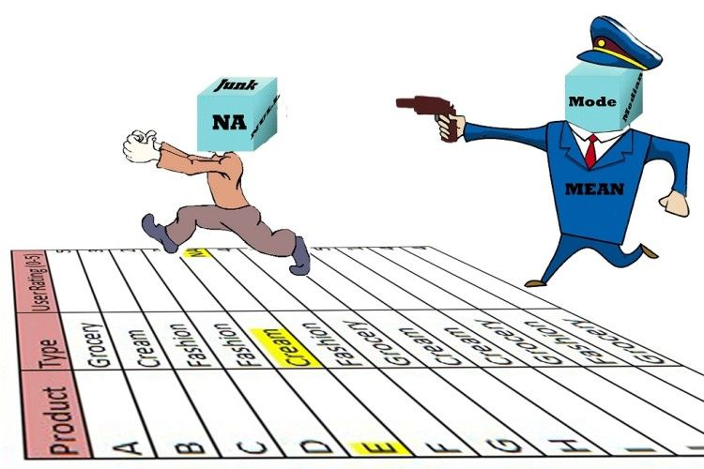
Imputation

Slide 8

Suspicious Columns
VechicleSpeed – some speeds in this column don't make sense, like negative speeds or speeds
Possible reason: bad GPS reception can corrupt location, thus also the speed calculation.
Delay – As we already know, bus lines on this dataset have routes that don't spend to areas that are very far from Dublin, thus delays that are over 15 mins, especially when there's no traffic, don't make a lot sense. Same goes from buses being more than 15 mins early
Possible reason: bad internet connection(which may be due overload on antennas, which can happens more on congestions)

Slide 9
Imputation Methods
Delete - Most naïve method is just deleting rows with uncertain data, but then we lose some information, especially if the uncertainty is not random.
Mean/Median - another method would be imputing the mean/median value for the column and hope for good. In this method we might still lose some information when uncertainty is not random.
Median + adding columns for uncertainty indicator - this way we won't have unreliable data corrupting the learning of linear estimator, while still taking into account the fact that something was corrupt.

Slide 10
Results Summary
Method | f1 | recall
no imputation | 0.76 | 0.9
median | 0.84 | 0.86
mean | 0.83 | 0.83
delete | 0.8 | 1
median + indicator | 0.89 | 0.94

Slide 11
Further ideas that weren't executed
More complex imputation methods – like MICE or imputing values using some regression model
Also taking into account locations that are likely to be faulty (as corrupted speeds can correspond to bad GPS locations)
Different imputations of delay to correspond with type of bus lines – for example, in-city line that have short routes should be treated differently than lines with long routes that go out of the city.

