Slide 1

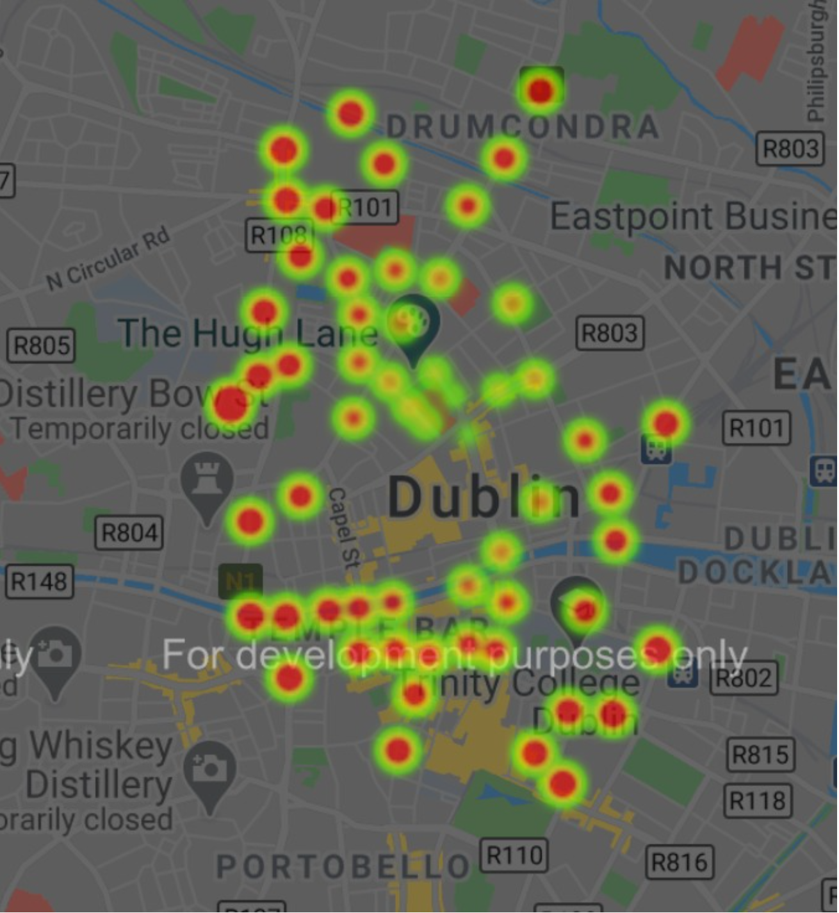
Predicting Congestion for Future Event Planning
Maximilian Matyash, Avi Simkin | January 2021
https://github.com/avi13s/DS_LAB_1
The Problem
In many cases municipalities and companies would like to close a street, for example to do maintenance work or organize a street festival. One of the key issues of such events is their impact on the traffic flow in the city which the municipality will want to minimize in order to keep the city efficient.
The Solution
We offer an API solution where our users can select an area and time window and we will provide them with a heatmap of average congestion probability in that area over the time window.​
A data frame of relevant area IDs (approximate to streets) is generated for the relevant time window, both of which we get from a user query, and the areas within the search zone are ranked based on the probability of congestion and distance from the center of the search area.
Methodology
We use a simple Neural network that uses geographical, and time features along with the number of traffic lights which we added from an external dataset. The model is constantly updated from an incoming data stream, and the latest model is loaded for a given query.
Limitations
Granularity – Area IDs are only an approximation of streets and sometimes aggregate multiple streets. Some users may want to go even finer and predict congestion on parts of streets.​
The results are ranked by their average probability of congestion which may be problematic for long time windows.​
There aren’t a lot of features for the model yet, and most of the bus data becomes obsolete.

Slide 2
Predicting Congestion for Future Event Planning
Maximilian Matyash, Avi Simkin | January 2021
https://github.com/avi13s/DS_LAB_1
Further explanations
The query consists of year, month, day, hour, minute, duration, longitude and latitude of the center of the search area and its radius.
Given the query, we generate a data frame of the centroids of areaIds in the search area for each hour of the duration. We then calculate the distance of each centroid to the center of the search area and normalize by the sum of those distances.
Afterwards, we compute the probability of not having congestion in each area using our model and multiply it by the normalize distance.
Finally, we order the results in descending order.
A heatmap is built using the resulting scores via gmplot and is saved as an html file which can then be viewed.
We integrated weather data into our model and there was no missing data, also in such data outliers are very important and may be more helpful than unreliable, so unfortunately imputation was not necessary for our case.

