Slide 1
Case Study – Architecture and Data Model

Slide 2
Preface
Introduction
Data Loading Guidelines
Incremental Load Guidelines
Quality Control Guidelines
Data Merge Guidelines
Scheduling Guidelines
Testing Guidelines
Alerting & Monitoring

Slide 3
Introduction
This deck includes high level solution/ steps to design any data warehousing solution
It contains below stages –
Identifying data sources and requirements - Requirement/Analysis
Data acquisition - Design and Coding
Implement business logic and Dimensional Modelling - Design and Coding
Build and populate data - Design and Coding
Build Reports - QA and Deployment
Monitoring - Alert and Monitoring

Slide 4
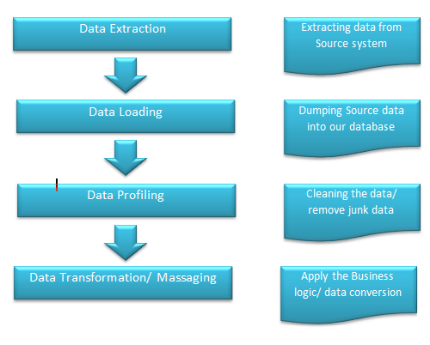
Data Loading Guidelines

Slide 5
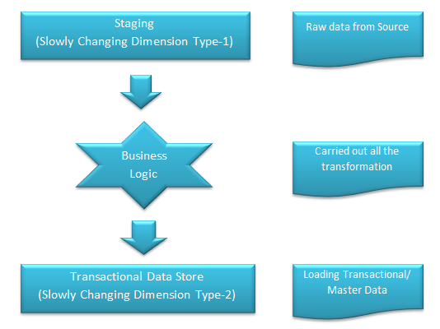
Incremental Load Guidelines

Slide 6
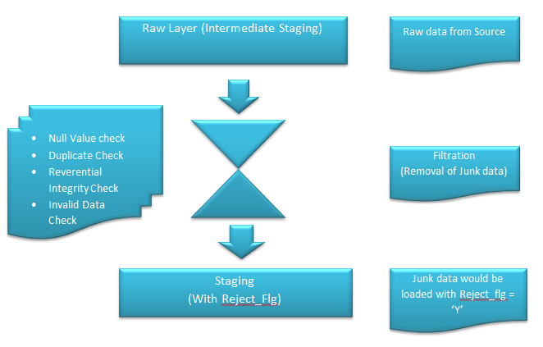
Quality Control Guidelines

Slide 7
Data Merge Guidelines
Components -
Source Data Component
Internal Data
Archived Data
External Data
Data Staging Component
Data Extraction
Data Transformation
Data Loading

Slide 8
Data Merge Guidelines…
Data Storage Components
SCD Type-1 tables
SCD Type-2 tables
Information Delivery Component
Metadata Component
Data dictionary
Data Catalog
Data Mart
It includes a subset of corporate-wide data that is of value to a specific group of users

Slide 9
Scheduling Guidelines
Entire data flow can be scheduled through Crontab depending upon the ETL tool/ database which we are using.
Schedule the cron job to run every minute. So, in an interval of one minute, the current date and time would be appended to the file
Example:
from crontab import CronTab cron = CronTab(user='username') job = cron.new(command='python example1.py') job.minute.every(1) cron.write()

Slide 10
Testing Pipeline
Understanding business requirements/analysis
Creating test plans and estimating time to completion
Designing test cases and selecting test data
Executing tests with bug reporting and closure
Report summary and analysis
Test completion

Slide 11
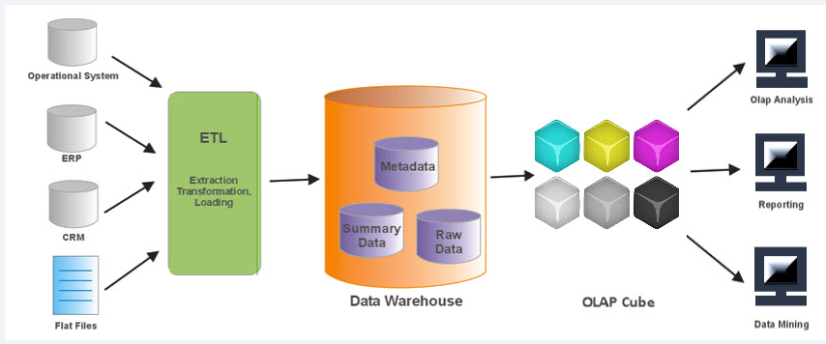
Test Planning Process

Slide 12
Test Execution Process
Validating required data /data sources: | Review metadata/data dictionary | Review archival/purge strategy | Test data prep
Data profiling: | Validate source to target mapping | Error logging, exception handling, recoverability | ETL testing (end to end)
Data quality and performance acceptance criteria: | Validate ETL/Data Warehouse architecture | Parallel Execution and Precedence | OLAP and cube testing
Data transformation rules: | Validate data model – Dimensional modeling and normalized approach | ETL pull logic – full/incremental | Report testing – drill down/drill through

Slide 13
Common ETL Testing Types
Test | Description
Metadata Testing | Metadata testing confirms that the table definitions conform to the data model and application design specifications. This test should include data type check, data length check, and index/constraint check.
Data Completeness Testing | Data Completeness testing validates that all the expected source data has been successfully loaded to the target. Tests include: Compare and Validate counts, aggregates (min, max, sum, avg), and actual data between the source and destination.
Data Quality Testing | Data Quality tests validate the accuracy of the data. Data profiling is used to identify data quality issues, and the ETL is designed to fix or handle these issue. Automating the data quality checks between the source and target system can help to mitigate problems post-implementation.

Slide 14
Common ETL Testing Types
Test | Description
Data Transformation Testing | Data Transformation comes in two flavour's: white box testing and black box testing. White box data transformation testing examines the program structure and develops test data from the program logic/code.
ETL Regression Testing | ETL Regression testing validates that the ETL produces the same output for a specific input before and after the change.
Incremental ETL Testing | Incremental ETL testing verifies that updates on the sources are getting loaded into the target system correctly.
ETL Integration Testing | ETL integration testing is end-to-end testing of the data in the ETL process and the target application.
ETL Performance Testing | ETL performance testing is end-to-end testing to ensure that the all steps in the ETL process are working with expected data volumes. One pitfall of this testing method is the lack of actual data to emulate appropriate volumes.

Slide 15
Alerting & Monitoring
Grafana alerting allows you to attach rules to your dashboard panels. When you save the dashboard, Grafana extracts the alert rules into a separate alert rule storage and schedules them for evaluation.

Slide 16
Create an alert rule
In Grafana, hover your cursor over the Grafana Cloud Alerting icon and then click Alerts and rules.
If you have more than one Prometheus or Loki data source, there will be a dropdown at the top for you to select the data source to create or edit rules.
Click Edit rules.
Click Add rule.

Slide 17
Thank You

