Slide 1
JSX
Overview of JSX
JSX syntax
JSX gotchas

Slide 2
Section 1: Overview of JSX
The story so far…
Introducing JSX
Transpiling JSX

Slide 3
The Story So Far…
In all the examples so far, we've created elements programmatically using React.createElement()
class Retailer extends React.Component {
render() {
return React.createElement(… … …)
}
}
function Retailer(props) {
return (
React.createElement(… … …)
)
}

Slide 4
Introducing JSX
React supports a lightweight syntax called JSX
Create React elements concisely and directly
Use XML to specify the elements you want to create
Elements can be HTML tags or your own components
const productsList =
<ul>
<li>Skis</li>
<li>Boots</li>
</ul>
const basket =
<Basket>
<Item>Skis</Item>
<Item>Boots</Item>
</Basket>

Slide 5
Transpiling JSX
Browsers don't understand JSX syntax
JSX syntax must be transpiled into "pure" React
You can use the Babel transpiler to do this
Add a <script> to download the Babel transpiler
Embed JSX inside <script type="text/babel">
<script src="…URL for Babel on unpkg.com…"></script>
<script type="text/babel">
… Put your JSX code here …
</script>

Slide 6
Section 2: JSX Syntax
JSX content
Using JSX for components
Simple example of JSX
Evaluating JavaScript expressions in JSX
Data-driven JSX
Passing properties to a component in JSX
Complete example

Slide 7
JSX Content
JSX elements can contain plain text
JSX elements can contain JS expressions in {} braces
const productsList =
<ul>
<li title="swans">Swans city shirt</li>
<li title="bloobs">Cardiff City shirt</li>
</ul>
const data = ["Swansea City shirt", "Cardiff City shirt"]
const summaryElem =
<div>There are {data.length} items</div>

Slide 8
Using JSX for Components
example1.html
function ItemsList() {
return (
<div>
<h1>JSX Example 1</h1>
<ul>
<li>Swansea shirt</li>
<li>Cardiff shirt</li>
<li>Lamborghini</li>
</ul>
</div>
)
}
const root = ReactDOM.createRoot(document.getElementById('root'))
root.render(<ItemsList/>)

Slide 9
Evaluating JavaScript Expressions in JSX
example2.html
function ItemsList() {
const timestamp = new Date().toLocaleTimeString()
return (
<div>
<h1>JSX Example 2</h1>
<ul>
<li>Swansea shirt</li>
<li>Cardiff shirt</li>
<li>Lamborghini</li>
</ul>
<small>Page generated at {timestamp}</small>
</div>
)
}
const root = ReactDOM.createRoot(document.getElementById('root'))
root.render(<ItemsList/>)

Slide 10
Data-Driven JSX
const data = ["Swansea shirt", … … … ]
function ItemsList() {
const timestamp = new Date().toLocaleTimeString()
return (
<div>
<h1>JSX Example 3</h1>
<ul>
{ data.map((item, i) => <li key={i}>{item}</li>) }
</ul>
<hr/>
<small>Page generated at {timestamp}</small>
</div>
)
}
const root = ReactDOM.createRoot(document.getElementById('root'))
root.render(<ItemsList/>)
example3.html

Slide 11
Passing Properties to a Component in JSX
example4.html
function ItemsList(props) {
return (
<div>
<h1>{props.heading}</h1>
<ul>
{props.items.map((item, i) => <li key={i}>{item}</li>)}
</ul>
<hr/>
<small>Page generated at {props.timestamp}</small>
</div>
)
}
const root = ReactDOM.createRoot(document.getElementById('root'))
root.render(
<ItemsList
heading={'JSX Example 4'}
items={data}
timestamp={new Date().toLocaleTimeString()}
/>
)

Slide 12
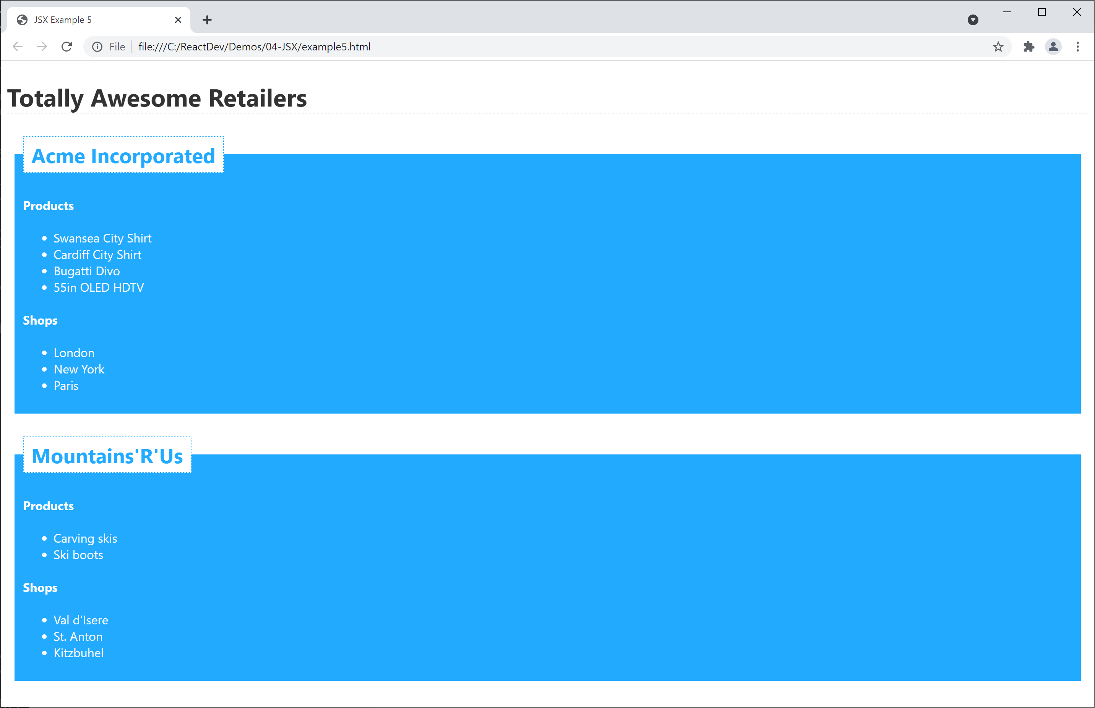
Complete Example
See complete example in exercise5.html

Slide 13
Section 3: JSX Gotchas
JSX gotchas - 1
JSX gotchas - 2

Slide 14
JSX Gotchas - 1
JSX is case-sensitive
JSX tags must be closed
const badElem1 = <SpotTheBug>oops</SpotTheBUG>
const badElem2 = <input type="text">

Slide 15
JSX Gotchas - 2
Adjacent JSX elements must be wrapped inside an enclosing tag
To assign a CSS class, use className (not class)
const badElem3 =
<h1>Greetings</h1>
<div>This won't work. Sorry!</div>
const badElem4 =
<div class="emphasis">Won't work!</div>

Slide 16
Summary
Overview of JSX
JSX syntax
JSX gotchas

