Slide 1
Sales Forecasting Using Machine Learning
Dataset: Global Superstore (Kaggle)
Tools: Python, Pandas, Scikit-learn, Matplotlib
Model: Machine Learning Regression Model
Author: Student Project

Slide 2
Project Objective
• Predict future sales using historical retail data
• Identify factors influencing sales performance
• Use machine learning to improve demand forecasting
• Help businesses make data-driven decisions

Slide 3
Business Problem
Retail companies often struggle with:
Inventory overstock or shortages
Poor demand prediction
Inefficient supply chain planning
Revenue loss due to inaccurate forecasting

Slide 4
Dataset Description
Dataset: Global Superstore Dataset (Kaggle)
Contains historical retail transactions including:
Order Date and Ship Date
Product Category and Sub-category
Sales, Profit, Quantity, Discount
Region, Segment, and Shipping Mode

Slide 5
Data Preparation
Key preprocessing steps:
• Handling missing values
• Removing irrelevant columns
• Encoding categorical variables
• Feature scaling where required
• Splitting data into training and testing sets

Slide 6
Exploratory Data Analysis
EDA revealed several important trends:
• Technology products generate highest revenue
• Sales vary across different regions
• Discounts strongly influence profit
• Seasonal patterns exist in sales trends

Slide 7
Machine Learning Model
Models Tested:
• Linear Regression (Baseline model)
• Random Forest Regressor (Advanced model)
Random Forest was selected due to its ability to capture complex relationships in data.

Slide 8
Model Performance Evaluation
Evaluation Metrics Used:
R² Score
Mean Absolute Error (MAE)
Root Mean Squared Error (RMSE)
Mean Absolute Percentage Error (MAPE)
Random Forest showed improved prediction accuracy.

Slide 9
Business Insights & Recommendations
• Focus on high-performing product categories
• Optimize discount strategies to protect profit
• Use forecasts for inventory planning
• Invest in regions with strong demand

Slide 10
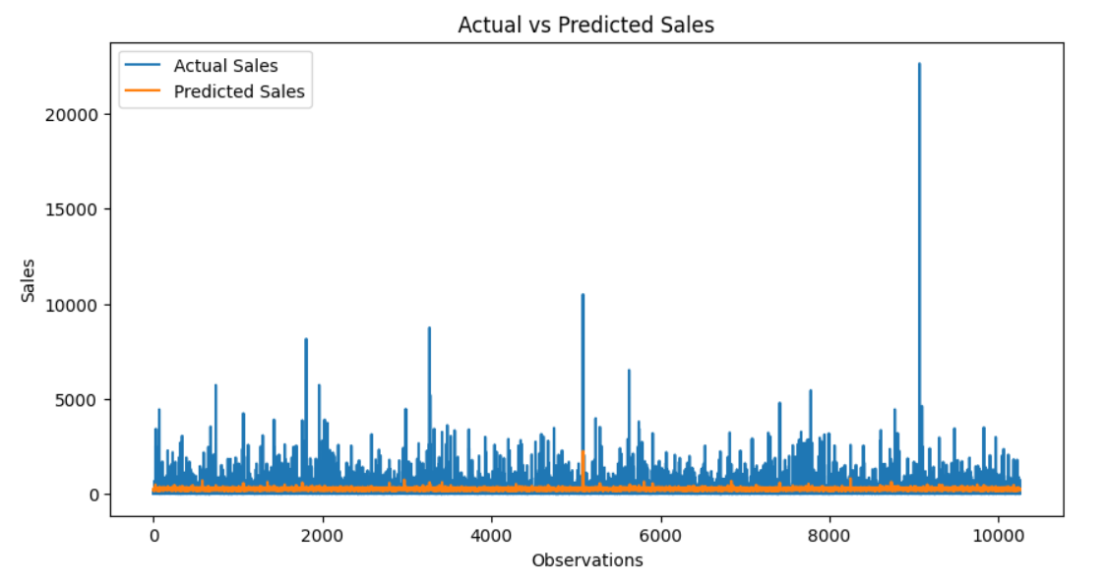
Actual vs Predicted Sales Line Chart

Slide 11
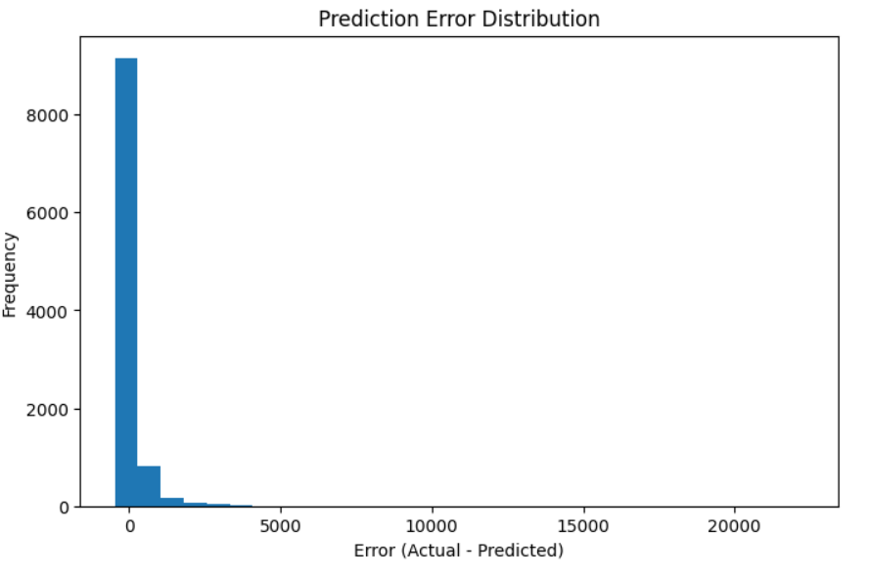
Prediction Error Distribution (Residual Histogram)

Slide 12
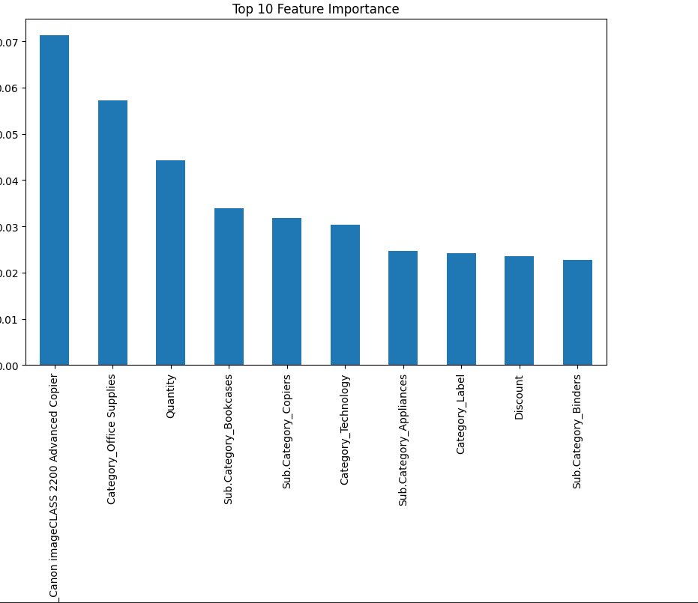
Feature Importance Chart (Random Forest)

Slide 13
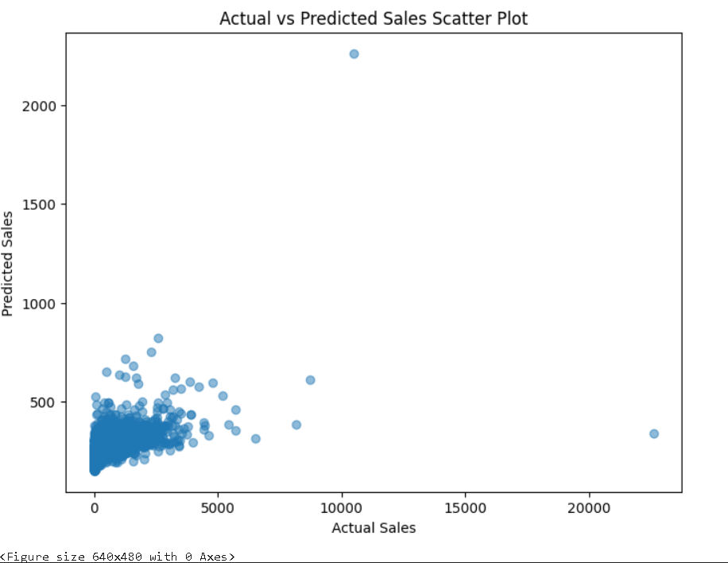
Actual vs Predicted Scatter Plot

Slide 14
Conclusion & Future Improvements
This project demonstrates how machine learning improves sales forecasting.
Future improvements:
• Use advanced models like XGBoost or LSTM
• Include external factors such as holidays
• Apply hyperparameter tuning for better accuracy

