Slide 1
EdTech company Data Analysis
Presented by:-
AVINASH KUMAR

Slide 2
Primary Objective:-
To collect CSV file in power Query Editor and make them clean such that Null value, error and outlier.
Analyzed customer acquisition to drive growth in Edtech Company.
Emphasize the aim of increasing number of enroll users.

Slide 3
Goals
To generate insights that can be help business team to in designing a better marketing strategy for Company and manger can also understand the target area.
To provide insights for Edtech Company , such as Total lead for each call, Not interested Leads, Lead Intreseted to Convert into enrolled etc.

Slide 4
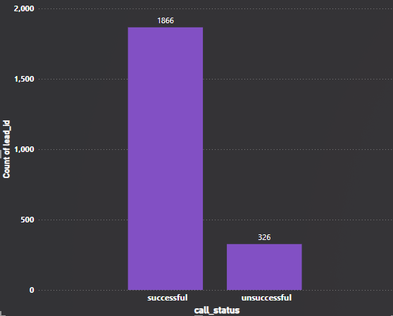
Number of leads for each call status

Slide 5
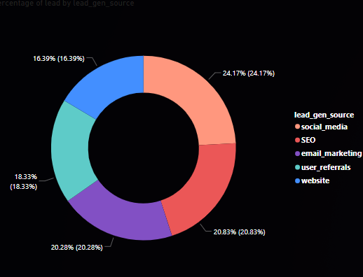
Percentage of lead generated by each lead_gen_source

Slide 6
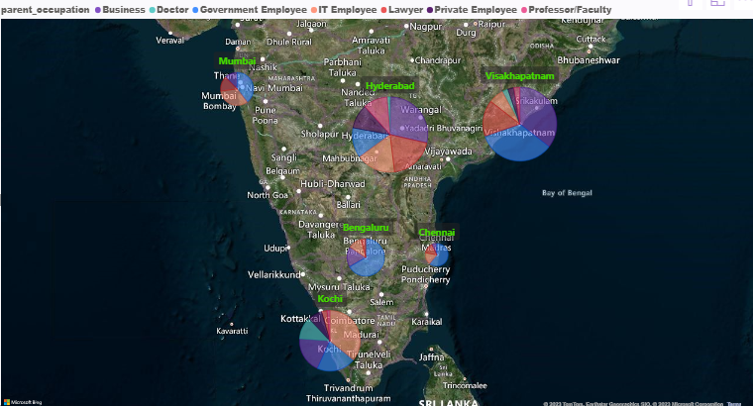
Number of lead in Each City as per Parent Occupation

Slide 7
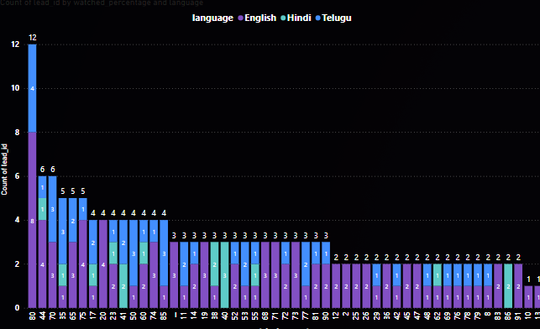
Watch Percentage in each language by Lead

Slide 8
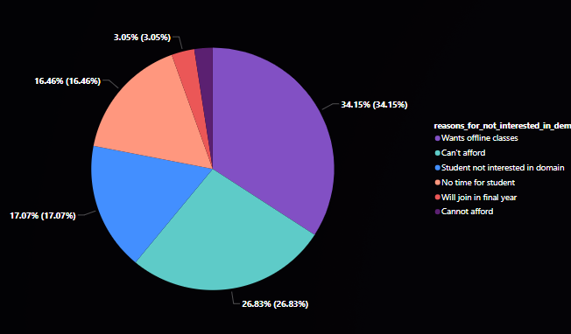
Watch Percentage in each language by Lead

Slide 9
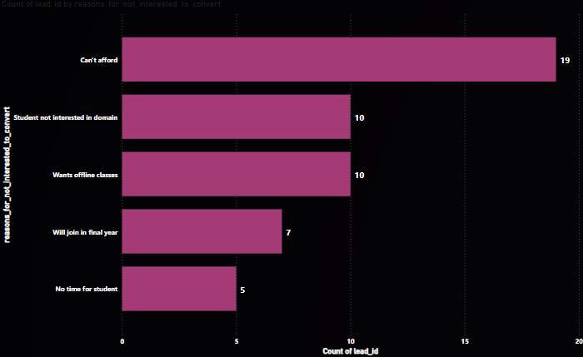
Lead Not interested to Convert

Slide 10
Challenges Face :- Lesson Learned :-
Determining the exact contribution of each marketing touchpoint to user enrollment was complex due to the multi-touch nature of the customer journey.
Determining the optimal allocation of marketing resources across various channels required continuous evaluation and adjustment.
Data Cleaning & Understanding is Important Steps to Create Insights.
During the analysis of customer acquisition, I learned the importance of segmenting users based on demographics, behavior, and preferences
Customer acquisition is an ongoing process. Regularly monitoring and analyzing enrollment metrics allowed us to quickly identify shifts in user behavior and market trends, helping us adapt our strategies in a timely manner

Slide 11
Future Scope:-
Analyzing customer acquisition and enrollment growth in an EdTech company is promising, as it aligns with the ongoing evolution of the education and technology sectors.
Expand the scope to include analyzing user engagement and retention rates beyond initial enrollment. Identify factors contributing to long-term engagement and create strategies to reduce churn and increase customer lifetime value

Slide 12
Thank You

