Slide 1












AVATAR CHANDRA(1516210019)
ANUBHAV MISHRA(1516210018)
ADITYA AGRAWAL(1516210007)
Under the guidance of
Mr. AMIT SRIVASTAVA

Slide 2



PROBLEMS
The objective of our project is to develop a GUI (Graphical User Interface) based software i.e. platform independent & user friendly and which can be fit into any college system. It will remove data redundancy and will be fast in operation.
The main problems with the present college management softwares are:
Platform dependency.
Data redundancy problems.
Slow in execution.
Do not cover all the modules that should be present for a college management software.
Threat to security levels.
Improper beginner tutorials.
Our software will overcome all these problems faced by any college management software.

Slide 3





Though a college management software is actually custom based, as it is developed for meeting the requirements of a particular college but we have created the project as a global one which can satisfy the needs of all college systems.
Features included in our software are:-
Platform Independent
As our software is coded in java so it is platform independent i.e. it can work on some operating system whether it be any version of Microsoft windows (98, Me, XP server, 7), Linux.
Reduced Data Redundancy
As we are using RDBMS (Relational Database Management System) in the back end of our software, so it will overcome the problems of data duplicacy.

Slide 4

Fast Execution
As our software is GUI based and it contains many new features which will make the execution faster than any other pre-existing softwares.
Cost Efficient
Due to the removal of data redundancy from the software, duplicity of data is eliminated and wastage of memory is also overcome. As we know that storage devices are cost consuming so by saving space we are saving money and providing a cost effective software.
Inbuilt Security
Our software includes better security levels with inbuilt anti-virus & anti-hacking facilities which will support the pre-installed anti- virus and anti-hack softwares.

Slide 5

The topic of our project is very diverse as it will manage a college which is itself a huge organization which imparts knowledge but for its proper working many other things work all the time along with studies.
The aim of this project is to manage each and every required section a software can handle with accuracy eliminating many mistakes that a person on job performs due to any reason and makes the operations even faster. Every department for us is a module and has independent working criteria but in one way or the other they are related with one other and collecting these modules a college is formed which we have to manage.

Slide 6




MINIMUM HARDWARE REQUIREMENTS:
P4 or higher
256 Mb RAM
Network Connections with 100 Mbps transfer rate
Server to control the database to be maintained by software.
1 Mb cache memory
10 Gb free disk space
Bar code reader for system
library
management

Slide 7
MINIMUM SOFTWARE REQUIREMENTS:
JDK 1.5 or later (previous versions will also work)
Our software is platform independent since it uses java
PACKAGE: WAMP.
SERVER: Apache Tomcat
Any RDBMS(Relational Database Management System)

Slide 8

Now we shall decide the modules that we have to work on:
Accounts
Academic
Training & Placement
Exam Cell
Library
Hostel
Cafeteria
Transportation
These are the modules which when managed properly a stable college management system is formed whose aim is to provide quality knowledge to its students and earn name and fame for itself and its students by placing them in good and highly paid jobs.

Slide 9













Slide 10













































































































A transparency in economic balance sheet is needed by every organization, so that it will look like a open book to all users. This will need a well maintained and organized account system.
This college management software has vast look upon this section. In the account module we have worked on how the work can be performed in a more easy and descent way. The scenes of concern are:-
Proper database management
Regular report generation
Transparency in data for all users
In addition to this, it includes all the records related to technical and non-technical staff. As all the possible aspects are worked upon here, so this will definitely help in fulfilling all the user needs.

Slide 11




Academics is the back bone of any college. The main point of concern for the college management is the Academic Section, so a software developer has to keep in mind the sub-modules according to the need of the users, which are mentioned below:
Dean Academics
H.O.D.
Faculty
Students
However, the above sub-modules have been categorized into different points but actually, if we notice them in depth all the sub- modules may affect each other in one or the other way.
All the records have to be maintained and with different access privileges for students, faculties & heads like view, view and update, update & managing facilities respectively as it is concerned with student records or faculty records, etc.
Apart from this, other privileges provided along with them are:
The capability to manage schedules, meetings and other tasks which are not in the tabular form but are very necessary to maintain.

Slide 12







The Department of Training & Placement is the major concern of any institute. From the very beginning the college lays greater emphasis on in-campus industrial training. Practical Training for Technical Students is an integral part of the curriculum and in-built into the programs of study. The students are introduced to industrial practices through training in the college workshops and in factories, installations, work etc.
Of course, arranging for the Training and Placements of students is the primary function, the department also takes initiative for developing right attitudes, soft skills-especially that of verbal communication, motivating our students to have strong technical as well as analytical capabilities, and exposing them to the nuances of economic and financial aspects related to their professional careers. This college management software has covered all maintenance of record.

Slide 13




A library is a collection of information, sources, resources, books,
and services, and the structure in which it is housed.
In this project we have given a good concern to the corresponding field. As in this module we have emphasized on:
Administrator privileges management;
Book circulation;
Advanced book search options;
Proper regulation of special items like CD’s and journals.
In this software we have taken care of how the hectic store of book and information material can be handled properly and easily.

Slide 14



Hostel is also a very important entity when college management is point of concern since everyone in the college does not belong to the same town in which the college is so they should be provided hostel facility so that they feel comfortable and do not feel any type of inconvenience in the town which they would have to face if they stay very far from college.
College hostel should take care of its structure more than any other private hostel. So hereby we are providing a system that manages the required data that a hostel management system would require. Following are the sub-divisions that are to be given individual emphasis on:
Mess
Sports
Committees
Academics classes
Extra curricular
This is all to manage and the created software will definitely help cover all these areas of concern.

Slide 15



Transportation is the need of any organisation. It makes a system efficient & working. This software contains an entire module of transportation. Subjects of matter covered in this module are:-
Proper routine of buses;
Transportation on specific events;
Easily guided halt charts.
This software has included many new facilities as per the transportation module is concern. In this software a student can easily access to the bus information just by giving his details. After a verification process he will be able to search whether which bus or route he should avail or what is the time of corresponding route.
The efficiency of this module in this software will help in making dynamic growth of the organisation.

Slide 16






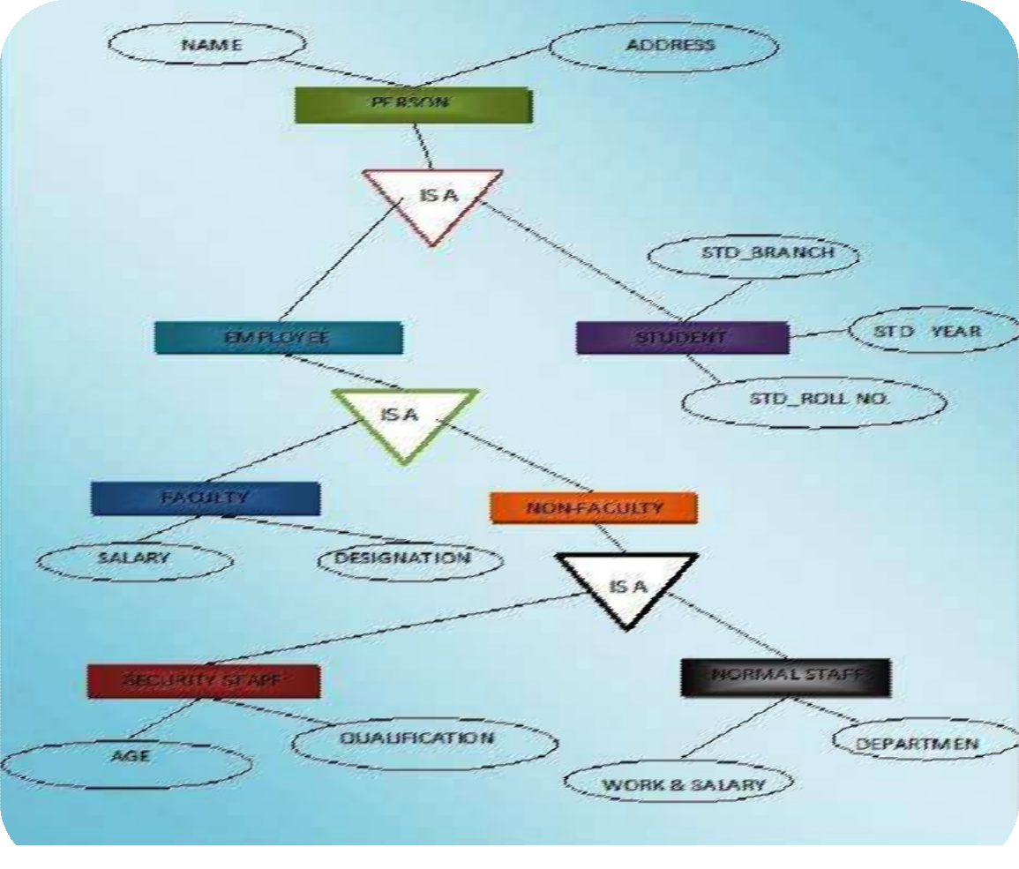

Slide 17
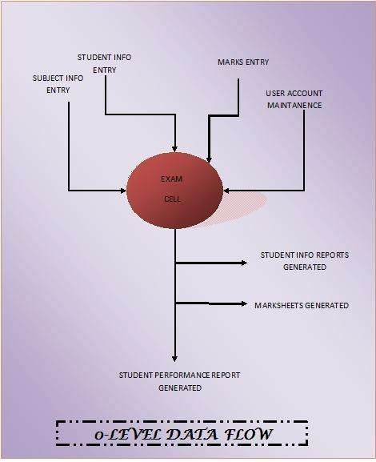
0 - Level DFD

Slide 18
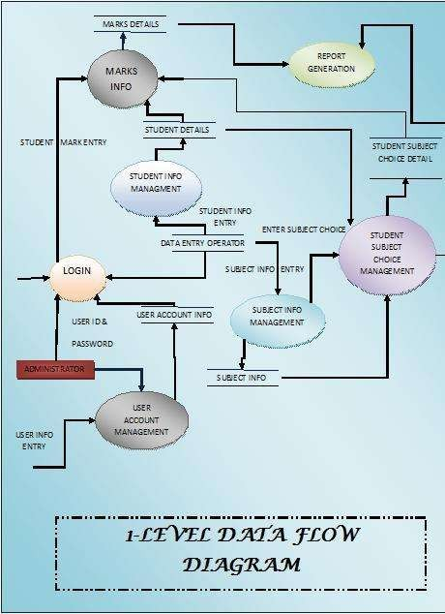


Slide 19





DATABASE MANAGEMENT SYSTEMS
- H. Korth
AN INTEGRATED APPROACH TO SOFTWARE ENGINEERING
-Pankaj Jalote

