Slide 1
Cas pratique: découpage d’un projet web
Le réseau social Music Fan

Slide 2
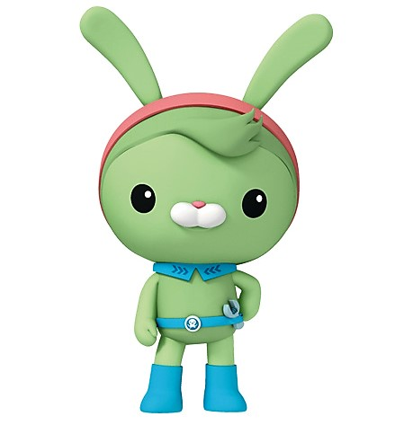
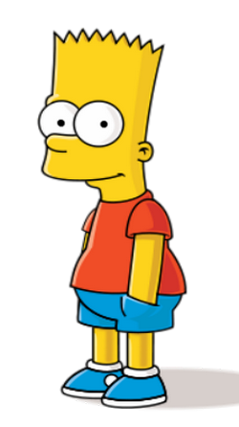
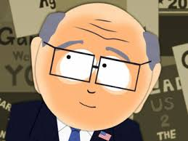
Starring
L’UX designer
Le End User
Le PO
Le Dev

Slide 3
Le réseau social Music Fan
Je suis un grand mélomane.
Je souhaite créer un site web où les fans de musique pourront poster des facts sur leurs artistes préférés.
J’en ai eu l’idée en voyant mes enfants surfer sur des réseaux sociaux comme Facebook et Twitter.
Personnellement j’aime tous types de musique et je souhaite que mon site soit ouvert à tous!
Mais attention: il faut que le site reste propre! Je ne veux pas qu’il se transforme en champ de bataille où les fans se déchirent.
J’aimerais que les fans discutent sur la base de facts authentiques, dans le respect des artistes et la passion de la musique.
Oki - Doki

Slide 4
Idée de Jean
Commencer par faire un sourcing auprès des utilisateurs
Rajouter un acteur UX
Faire une page face book autours de la question
Faire un questionaire + interview d’utilisateurs potentiels
Accumulation de données quali (q. ouvertes => créer un profil type = persona) quanti (q. fermées)
Persona = personne fictive qui représente un type d’utilisateur
Il a un objectif. Par exemple, la personne qui est résistante au changement ne veut pas se retrouvée perdue.
Voir le thème : 6 degrés de séparation

Slide 5
Analyse du besoin
Domaines
Je suis un grand mélomane.
Je souhaite créer un site web où les fans de musique pourront poster des facts sur leurs artistes préférés.
J’en ai eu l’idée en voyant mes enfants surfer sur des réseaux sociaux comme Facebook et Twitter.
Personnellement j’aime tous types de musique et je souhaite que mon site soit ouvert à tous! (classification?)
Mais attention: il faut que le site reste propre! Je ne veux pas qu’il se transforme en champ de bataille où les fans se déchirent.
J’aimerais que les fans discutent sur la base de facts authentiques, dans le respect des artistes et la passion de la musique. (commentaires?)
Langage
Besoin à analyser
Propositions

Slide 6
Découpage en MMF
MMF 1: Visitor’s browsing
US 1: Visitor’s browsing
MMF 2: Fan Creates a Fact
US 1: Sign Up
US 2: Sign In
US 3: Fan creates a Fact
MMF 3: Fan’s permissions
US 1: Fan deletes a Fact that he created
US 2: Fan updates a Fact the he created

Slide 7
Découpage en MMF
MMF 1: Visitor’s browsing (+ Slogan)
US 1: Visitor’s browsing artist page
US 2: Visitor’s browsing homepage (Slogan + artists list)
MMF 2: Fan creates artist’s profile
US 1: Sign Up
US 2: Login
US 3: Fan creates artist profile
MMF 3: Fan can add fasts
US 1: Add a fact

Slide 8
Product vision
Slogan/Motto: “Welcome on Music Fans
The community where you can share about your favorite artists and live your passion fully.”
We believe that music is a great unifier which brings peace and happiness to the World. Therefore our mission is to enable fans to share together and to live their passion for their favorite artists fully.
Note: This community is very young and as any community it takes time to build and grow. By being one of our early adopters, you can influence and participate to this wonderful journey. We’ll inform you regularly on the progression of the community and we will always value your opinion.
Note: this slogan is not set in stone. It should evolve and follow the direction of the project and be perfected

Slide 9
BDD: MMF 1 - Visitor’s Browsing (1/2)
Feature: Visitor's Browsing artist’s page As a Visitor In order to know more about an Artist I should be able to view the artist’s page Scenario: Get artist info Given Visitor on the platform When He selects an artist Then He should be able to access the artist’s infos
And View his profile
profile: Fullname / Main picture / Date creation / Description / Most famous tracks

Slide 10
BDD: MMF 1 - Visitor’s Browsing (2/2)
Feature: Visitor's Browsing artist’s page As a Visitor In order to know more about an Artist I should be able to view the artist’s page
Scenario: Visualize artist’s list Given Visitor is browsing When He arrives on the homepage Then He should see the list of all artists
And See the name & picture of each artist
And See the slogan

Slide 11
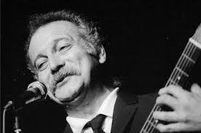
Démonstration au client de la MMF 1
OK!
Music Fan
Georges Brassens
Né à Sète le 22 Octobre 1921
Mort à Saint-Gély-du-Fesc le 29 octobre 1981

Slide 12
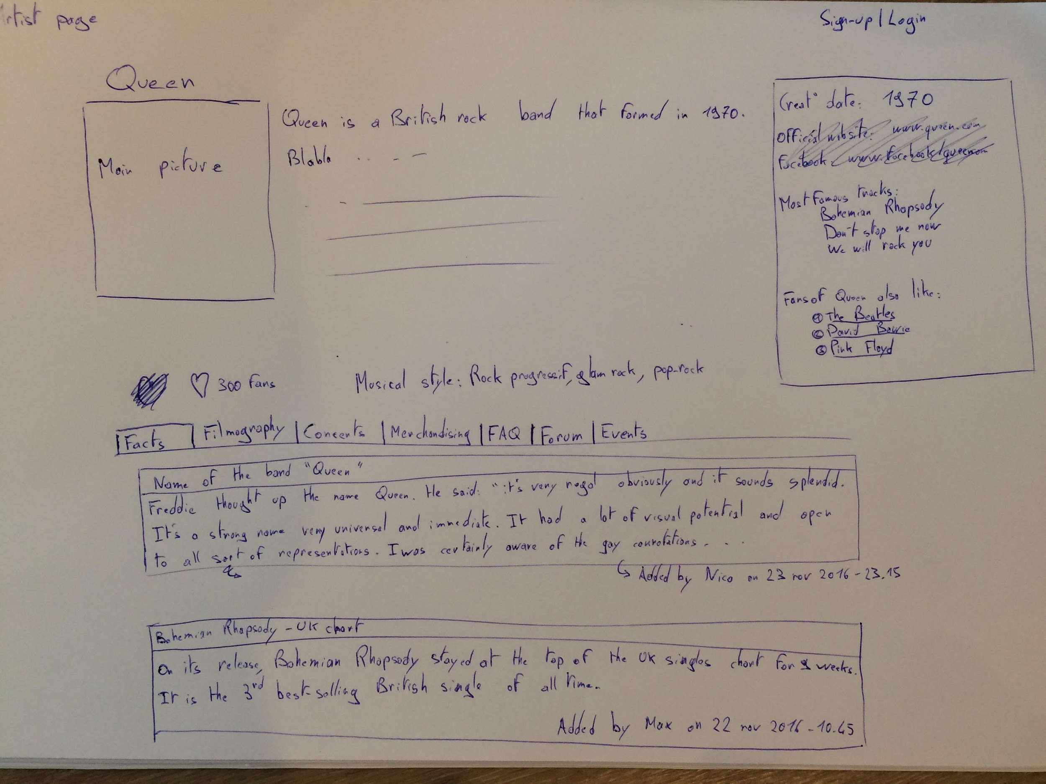

Slide 13
MMF2: Fan creates artist’s profile
US 1: Sign Up
As a Visitor, in order to create an artist, I need to create an account
US 2: Login
As a Visitor, in order to create an artist, I should be able to login
US 3: Fan creates an artist profile
As a Fan , in order to share something I know about an artist, I should be able to create a Fact

Slide 14
BDD: MMF 2 - Fan creates artist’s profile (1/6)
Feature: Fan creates artist’s profile As a Fan In order to create an artist
I need to have an account Scenario: Sign-up successful Given Visitor wants to register When He provides his account details And His account details are not in the system yet Then His account should be created
And He receives a confirmation email Scenario: Sign-up failed - Account already existing Given Visitor wants to register
When He provides his account details And His account details are already in the system Then Account already exists message should be displayed

Slide 15
Feature: Fan creates artist’s profile As a Fan In order to create an artist
I need to have an account Scenario: Visitor Sign-up is successful Given Visitor’s <login> and <password> When He registers And His account details are not in the system yet Then His account should be created
And He receives a confirmation email Scenario: Sign-up failed - Account already existing Given Visitor wants to register
When He provides his account details And His account details are already in the system Then Account already exists message should be displayed

Slide 16
BDD: MMF 2 - Fan creates artist’s profile (2/6)
Feature: Fan creates artist’s profile As a Fan In order to create an artist
I need to have an account Scenario: Sign-up failed - Account details not complete Given Visitor wants to register
When He provides his account details And Some details are missing Then ”Complete the missing data” message should be displayed

Slide 17
BDD: MMF 2 - Fan creates artist’s profile (3/6)
Feature: Fan creates artist’s profile As a Fan In order to create an artist
I need to have an account Scenario: Login successful Given Visitor wants to identify
When He enters his login details And He enters correct password Then Visitor is logged in And He receives greetings Scenario: Login failed Given Visitor wants to identify When He enters his login details And He enters wrong password Then He receives bad login / password message

Slide 18
BDD: MMF 2 - Fan creates artist’s profile (4/6)
Feature: Fan creates artist’s profile As a Fan In order to create an artist
I need to have an account Scenario: Visitor wants to create an artist - failed Given Visitor wants to create an artist
When He tries to create an artist Then Visitor receives a please identify message Scenario: Fan wants to create an artist - failed (Incomplete) Given Fan wants to create artist “Queen” When He tries to create artist And He didn’t a main picture
And He didn’t feel the date of birth
And He completed the other mandatory fields Then The artist is not created
And User receives message “Please complete main picture and date of birth”

Slide 19
BDD: MMF 2 - Fan creates artist’s profile (5/6)
Feature: Fan creates artist’s profile As a Fan In order to create an artist
I need to have an account Scenario: Fan wants to create an artist - failed (Same name) Given Fan wants to create artist “Queen” When He tries to create artist
And He fills the fullname “Queen” And Artist with fullname “Queen” is already in the system Then The artist is not created
And User receives message “An artist with same name is already registered”

Slide 20
BDD: MMF 2 - Fan creates artist’s profile (6/6)
Feature: Fan creates artist’s profile As a Fan In order to create an artist
I need to have an account Scenario: Fan wants to create an artist - success Given Fan wants to create artist “Queen” When He tries to create artist
And He fills the fullname “Queen”
And He fills all the mandatory fields And Artist with fullname “Queen” is not in the system Then The artist is created
And The artist is now visible

Slide 21
BDD: MMF 3 - Fan can add a fact (1/1)
Feature: Fact Management As a Fan In order to share knowledge to the community I want to post Facts about artists Scenario: Create a fact failed Given Visitor wants to create a fact
When He selects an artist And He tries to add a fact Then Visitor receives a please identify message Scenario: Create a fact successfully Given Fan wants to create a fact When He selects an artist And He creates a fact Then The fact is saved
And He receives a success message

Slide 22
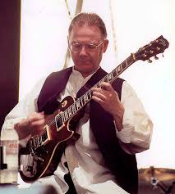
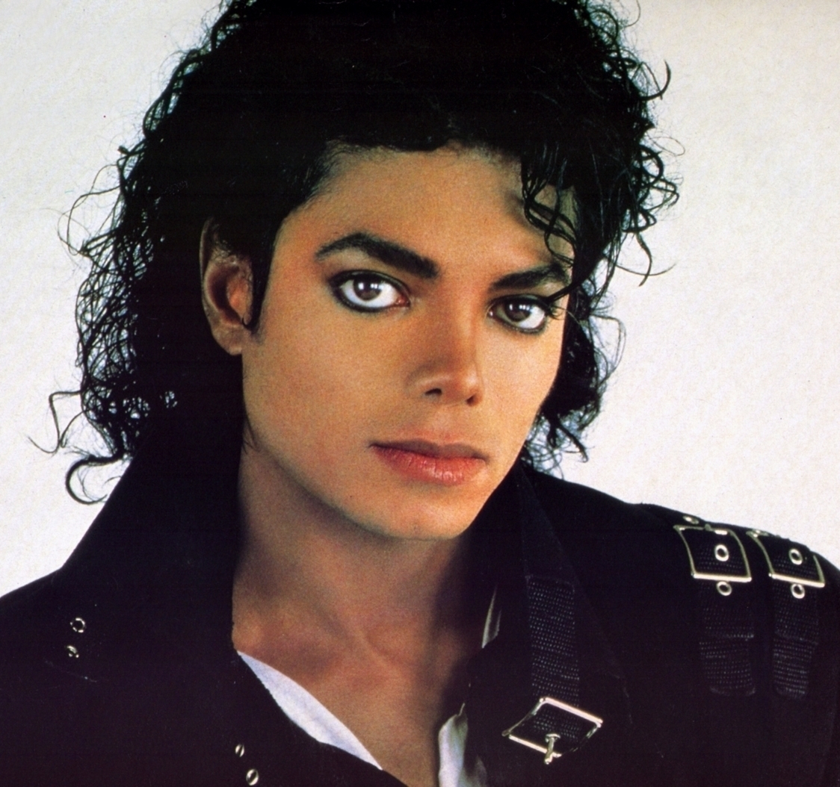
Démonstration au client de la MMF 2
Music Fan
Login / Sign up
J’adore
Georges Brassens
Né à Sète le 22 Octobre 1921, read more…
Robert Fripp
Né le 16 mai 1946 à Wimborne Minster, read more…
Michael Jackson
Né le 29 août 1958 à Gary (Indiana) read more…

Slide 23
Démonstration au client de la MMF 2
Music Fan
Il faudrait les regrouper par genre…
Mais quelque chose ne va pas: ces artistes n’ont rien à voir entre eux!
Login / Sign up
Georges Brassens
Né à Sète le 22 Octobre 1921, read more…
Robert Fripp
Né le 16 mai 1946 à Wimborne Minster, read more…
Michael Jackson
né le 29 août 1958 à Gary (Indiana) read more…

Slide 24
Démonstration au client de la MMF 2
Music Fan
Il faudrait pouvoir les créer!
Et si on aime d’autres artistes ?
Login / Sign up
Georges Brassens
Né à Sète le 22 Octobre 1921, read more…
Robert Fripp
Né le 16 mai 1946 à Wimborne Minster, read more…
Michael Jackson
né le 29 août 1958 à Gary (Indiana) read more…

Slide 25
Démonstration au client de la MMF 2
Super la création de Fact!
Music Fan
Georges Brassens
Né à Sète le 22 Octobre 1921
Mort à Saint-Gély-du-Fesc le 29 octobre 1981
On a bu un café ensemble, rue Mouffetard en 79…

Slide 26
Démonstration au client de la MMF 2
En revanche pour le « site propre »…
Music Fan
Georges Brassens
Né à Sète le 22 Octobre 1921
Mort à Saint-Gély-du-Fesc le 29 octobre 1981
On a sniffer un rail ensemble, rue Mouffetard en 79…

Slide 27
On pensait à rajouter une fonctionnalité: « Signaler comme inapproprié » pour que les Fans remontent eux-mêmes du contenu douteux…
En mode trottinette, on pensait à faire un simple envoi de mail à l’équipe (start-up oblige ☺).
En mode vélo, on s’est dit que les utilisateurs qui créeraient un artiste devraient jouer le rôle de modérateur sur cet artiste. Ce serait les destinataires des mails « signaler comme inapproprié ».
En mode moto, on pourrait faire un rapport dans leur espace perso… Oooouuuu, mais je dévie, là. On n’y est pas encore!

Slide 28
Le Product Backlog s’enrichit
MMF 4: Musical Style
US 1: Artists can have one or several musical style
US 2: Musical Style Header
MMF 5: Fan’s permissions 2
US 1: Fan reports Fact as inappropriate
US 2: Fan can tag an Artist with a Musical Style
MMF 6: Home Page
US 1: Most popular Artists
US 2: Recently visited Artists

Slide 29
BDD: Musical Style Feature (1/3)
Feature: Musical style As a Fan In order to explore artists I want to explore by musical style Scenario: Artist can have 0, one or several musical style(s)
Given An Artist
When An artist is already created Then The artist can have 0, 1 or several musical style(s)

Slide 30
BDD: Musical Style Feature (2/3)
Feature: Musical style As a Fan In order to explore artists I want to explore by musical style Scenario: Add a musical style to an artist Given Fan wants to add the musical style “Rock progressif” to the artist “Queen”
When He selects the artist “Queen”
And Queen already has the musical style “Glam rock” And He chooses to add a musical style
And From the list of musical styles, he selects “Glam rock” Then “Queen” has now musical styles “Rock progressif” and “Glam rock”

Slide 31
BDD: Musical Style Feature (3/3)
Feature: Musical style As a Fan In order to explore artists I want to explore by musical style Scenario: Explore artists threw musical styles Given Fan wants to find the “Rock” artists
When He sees the list of musical styles And He selects “Rock” Then Fan will see the list of all “Rock” artists

Slide 32
BDD: Fact Management 2 Feature (1/1)
Feature: Fact Management 2 As a Fan In order to share knowledge to the community I want to post Facts about artists Scenario: Fan reports Fact as inappropriate Given Fan consider that one fact about “Queen” is not appropriate
When He selects “Queen” And He reports one Fact as inappropriate Then This fact is flagged as “inappropriate” (no matter what was the previous state of the flag)
And The status of this flag has no impact on the publication of the fact
And User will see “Will be Reviewed” message

Slide 33
BDD: Home Page (1/2)
Feature: Home Page As a Visitor or Fan In order to explore the website
I want some suggestions on the home page Scenario: Most popular artists Given Visitor or Fan is on the home page
When Visitor or Fan is on the homepage Then Visitor or Fan will see the top 5 artists (based on number of facts)
Scenario: History of artists visited is saved Given Fan is registered
When Fan goes on “Queen” page on date/time “B”
And Fan already has “Rolling Stones” in his history at date/time A Then Fan will have history with “Rolling Stones” at date/time A & “Queen” at date/time B

Slide 34
BDD: Home Page (2/2)
Feature: Home Page As a Visitor or Fan In order to explore the website
I want some suggestions on the home page
Scenario: Recently visited artists Given Fan has at least one artist in his history
When Fan is on the homepage Then Fan will see the 5 last visited artists

Slide 35
Le Product Backlog s’enrichit encore...
MMF 7: Musical Taste
US 1: Fan can like artist
US 2: Other artists you may like
MMF 8: Artists concerts
US 1: Artist can have a list of concerts
US 2: Fan can add artist’s future concert

Slide 36
BDD: Musical taste (1/2)
Feature: Musical taste As a Fan In order to let the community know that I like one artist
I should be able to like any artist
Scenario: Fans can like an artist Given An Artist
When Artist is created Then Artist can have 0,1 or several concerts
And For each concert, the date/venue is mandatory
And The description can be empty
Scenario: Visitor or Fans can see other artists he may like Given Visitor or Fan is visiting an artist’s page
When Visitor or Fan is visiting an artist’s page Then Artist can have 0,1 or several concerts
And For each concert, the date/venue is mandatory

Slide 37
BDD: Artists concerts (1/2)
Feature: Artists concerts As a Fan In order to share date/venue of concert with the community
I can add concerts on an artist
Scenario: Artist can have a list of concerts Given Fan wants to like an artist
When Fan has selected an artist
And Fan doesn’t like the artist yet
And Fan likes the artist Then Artist can have 0,1 or several concerts
And For each concert, the date/venue is mandatory
And The description can be empty

Slide 38
Idées features en vrac
Forum (pour que les fans puissent créer des topics et échanger)
Concerts: liste des concerts passés et à venir
Concerts: comparateur de prix des différentes plateformes de ticketing
Concerts: alerte concert dans la région
Concerts: fans can share all their comments/pictures/videos for a specific concert
Merchandising: en tant que fan des Daft Punk, je veux voir les produits comme les t-shirts, posters, casque etc…
Interviews: The interviews of the artist
Filmography: all the movies/documentaries about the artist

