Slide 1
BANK JULIUS BAER • SINGHACKS 2026 CHALLENGE
JB Pulse — Wealth Intelligence Cockpit
Where Insight Becomes Foresight
Explainable Multi-Agent Advisory with Deterministic Financial Guardrails & Four-Eyes Governance
Spec-Driven Engineering • 6 Specialist Agents • Look-Through Risk • 100% LLM Outage Resiliency • Maker-Checker Sign-off

Slide 2
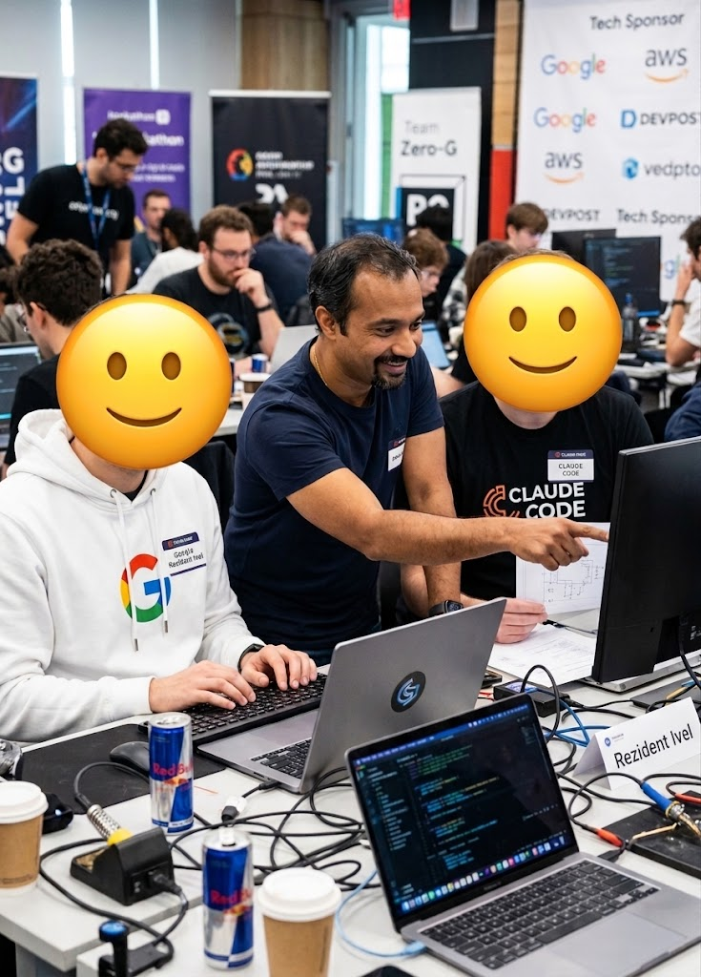
THE TEAM
Claude
Gemini Antigravity
SingHacks 2026 — JB Pulse: AI-Powered Wealth Intelligence Cockpit | Confidential & Proprietary | Slide 2 of 12

Slide 3
THE PROBLEM STATEMENT
The Private Banking Challenge: The 'Advisory Gap'
1. Descriptive, Not Advisory
Current digital tools stop at descriptive reporting ('What is' — valuations, SAA charts, transaction tables). RMs must manually deduce why portfolios shifted, how macro shocks transmit to multi-sleeve holdings, and what commercial action to take ('What should I do?').
2. Hidden Multi-Sleeve Complexity
Clients hold segregated accounts (Discretionary, Advisory, Execution, Family Trusts). Critical risks (13%+ aggregated single-stock concentration, Lombard cross-collateral LTV, PE capital call shortfalls) are invisible in isolated views and only emerge when aggregated across all sleeves.
3. RM Cognitive Overload
Priscilla Ong manages 20 UHNW relationships ($596M+ AUM) across 1,015 holdings, 5 macro shocks, and 28 informal CRM notes. Analyzing portfolios and preparing bespoke client meeting packs takes 4+ hours per client, severely capping RM scale and quality of advice.
Keywords: RM – Relationship Manager, SAA – Strategic Asset Allocation, CRM – Customer Relationship Management, PE – Private Equity, LTV – Loan to Value
SingHacks 2026 — JB Pulse: AI-Powered Wealth Intelligence Cockpit | Confidential & Proprietary | Slide 2 of 12

Slide 4
ENGINEERING METHODOLOGY
Approach: Spec-Driven Development (From Intelligence to Wealth)
Phase 1: Deep Domain & Data Analysis
• Comprehensive inspection of private banking data structures across 12 source files (clients, portfolios, 1,015 holdings, credit facilities, commitments, event log, unstructured RM notes). • Identified core traps: multi-portfolio mandate flattening and structured product look-through opacity. • Mapped high-touch RM commercial workflows for Asia Desks.
Phase 2: Multi-LLM Spec Synthesis
• Requirements, constraints, and architecture were rigorously debated and authored collaboratively using Claude 3.7 Sonnet/Opus, ChatGPT-4o/o1, and Google Gemini 2.0 Pro. • Formally published as WEALTH_INTELLIGENCE_AGENT_SPEC.md. • Enforced architectural principle: Strict separation of deterministic compute from LLM reasoning.
Phase 3: Autonomous Agentic Build
• Spec document fed into autonomous agentic coding workflows to implement modular specialist agents. • Engineered 6 specialist advisory agents (Rebalancing, Tax Optimization, Life Event Planning, Liquidity/Credit Risk, Market Impact, RM Qualitative Notes). • Built standardized JSON contracts, evidence citations, and temporal horizons.
SingHacks 2026 — JB Pulse: AI-Powered Wealth Intelligence Cockpit | Confidential & Proprietary | Slide 3 of 12

Slide 5
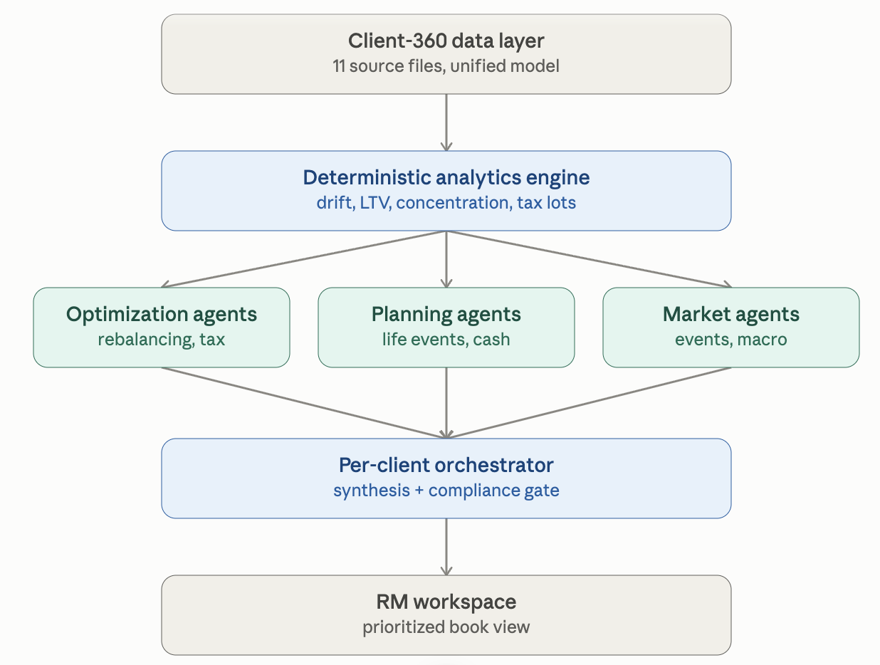
CURRENT SYSTEM ARCHITECTURE
Current Setup: Three-Tier Agent Swarm & Deterministic Orchestration
Layer 1: Deterministic Analytics Engine (Zero Hallucination Core)
Calculates SAA drift %, structured product look-through decomposition, consolidated Lombard LTV trajectory, PE capital call runway, and tax-loss harvesting lots mathematically using pure functional code before any LLM invocation.
Layer 2: Multi-Specialist Advisory Swarm (6 Specialized Micro-Agents)
• Rebalancing Agent: Single & cross-portfolio mandate breaches, trade sizing, phased execution horizon (2-4 wks) • Tax Optimization Agent: Loss harvesting offsets, domicile tax rules, tax year-end window (pre-31 Dec) • Life Event Planning Agent: Ring-fences committed cash buffers for dynamic milestone dates (e.g. property, tuition) • Liquidity & Credit Risk Agent: Lombard LTV margin buffer remediation (48-72h) & uncalled PE capital reserves • Market Impact Agent: Macro event_log transmission channels & tactical hedging tenors (3-6 mos) • RM Notes & Qualitative Agent: Unstructured CRM notes, standing exclusions & permanent holding policies
Layer 3: Master Orchestrator & Synergistic Synthesis Engine
• Conflict Resolution: Resolves trade tensions (e.g. mandate trim vs. RM legacy holding override) • Comingling Opportunities: Clubs multi-agent actions into unified, cost-efficient client proposals • Composite Urgency Scoring (0-100) & Point-in-Time Event Filtering: Highlights developments post last RM meeting • Meeting Pack Synthesis: Generates client-ready briefings, formal emails, and supervisory audit dossiers
SingHacks 2026 — JB Pulse: AI-Powered Wealth Intelligence Cockpit | Confidential & Proprietary | Slide 4 of 12

Slide 6
TECH STACK COMPARISON
Technology Architecture: Current Prototype vs. Production Deployment
⚡ Current Hackathon Prototype Stack
• Frontend & UI: Streamlit (Python 3.13) + Julius Baer Bespoke Luxury CSS Theme & Design System.
• Agent Framework: Custom Multi-Agent Swarm with Pydantic State Schema & Tool Execution Contracts.
• LLM Engine: Groq, Multi-Model Gateway (Claude 3.7 / OpenAI GPT-4o / Google Gemini API wrappers).
• Deterministic Analytics: Pure functional Python, NumPy, and Pandas calculation modules.
• Semantic Search / Vector Store: In-memory ChromaDB semantic index for RM notes and macro event log.
• Storage & Repository: CSV/JSON relational repository with hierarchical entity graph (Client → Portfolios → Holdings).
• Governance & Security: Streamlit session state approval cache with instant JSON audit log export.
🏛️ Proposed Enterprise Production Deployment
• Frontend: Next.js 15 / React 19 + Radix UI + Julius Baer EAM/RM Portal Micro-frontend integration.
• API & Services: FastAPI / Async Python microservices with Ray / Celery Distributed Task Worker Clusters.
• Orchestration Engine: LangGraph Enterprise / Temporal Workflow Orchestrator with stateful checkpoints.
• LLM Gateway: Dedicated Private Azure OpenAI / AWS Bedrock VPC (Zero Data Retention) + On-Prem Air-Gapped SLM (Llama 3 70B / Mistral Large).
• Deterministic Kernel: High-performance C++ / Rust financial calculation engine (microsecond latency).
• Data Warehouse: Snowflake Data Cloud + TimescaleDB (time-series snapshots) + Milvus/pgvector Enterprise Vector DB.
• Security & Compliance: Enterprise SAML/OIDC SSO, HashiCorp Vault, and Kafka immutable audit ledger for FINMA/MAS compliance.
The prototype has been designed with a clean separation of concerns: our deterministic engine and Pydantic agent schemas map 1:1 to microservices. Transitioning to production simply means pointing the data layer to Julius Baer's Snowflake warehouse, running the agent graph on LangGraph Enterprise within their private Azure/AWS banking VPC, and embedding the front-end as a React widget inside the RM workstation—with zero changes to the underlying financial logic or governance guardrails
SingHacks 2026 — JB Pulse: AI-Powered Wealth Intelligence Cockpit | Confidential & Proprietary | Slide 5 of 12

Slide 7
TRUST & RISK CONTROLS
Enterprise Guardrails: Deterministic Compute, Four-Eyes Control & Fallbacks
a) Deterministic Layer (Zero Hallucination)
• Strict decoupling of compute from reasoning. • All drift %, LTV ratios, look-through weights, and cash runways are computed via pure immutable functions. • LLMs NEVER perform arithmetic; they only receive pre-verified metric facts as tool outputs and cite source function names and valuation dates.
b) Maker-Checker Supervisory Control
• Maker (RM Priscilla Ong): Reviews recommendations, customizes talking points, queues commercial actions. • Checker (Desk Head Marc Guggenheim DH-SG-001): 4-Point Supervisory Audit (KYC, Suitability, Exclusions, Cross-Border Fit). • Digital Endorsement Stamp & SHA-256 audit token required before client export.
c) Graceful Deterministic Fallback
• 100% LLM Outage & Latency Resiliency. • If LLM APIs are offline, rate-limited, or latent, system automatically fails over to instant deterministic rule synthesis. • Produces complete, compliant, professional client recommendations and talking points deterministically without service disruption.
Other Security features
• Human Review | Presentation Privacy Mode | Role based governance and RLS (Row level Security) | Hard Constraint for Standing RM Notes | 1 Click Audit Trail | AI Explain
• Future Proposal : Agent swarm proposal challenger Agent
SingHacks 2026 — JB Pulse: AI-Powered Wealth Intelligence Cockpit | Confidential & Proprietary | Slide 6 of 12

Slide 8
CORE CAPABILITIES
Innovation: Unmasking Invisible Cross-Portfolio & Derivative Risks
🔍 Look-Through Derivative Decomposition
• Core banking systems only see the product wrapper ('FCN ref Basket A' or 'Asia Autocallable').
• Our engine unpacks 'worst-of' structured notes into constituent single equities (e.g. Helios Cloud, Global Energy Majors).
• Allocates fractional economic exposure dynamically to underlying asset classes and sectors.
• Prevents unmonitored concentration build-up in volatile single names across advisory and execution sleeves.
🌐 Whole-Client Risk Aggregation
• Aggregate Concentration: 6% stock in Sleeve A + 7% in Sleeve B = 13% client-level breach (flagged as CONC_AGG).
• Consolidated Lombard LTV: Combines collateral across all pledged sleeves against credit facility FAC-0001.
• Liquidity Pool vs PE Deficits: Pools cash across sleeves to test against uncalled capital calls ($2.5M) and planned outflows.
• Macro Shock Transmission: Aggregates client-wide exposure to oil, rates, semiconductors, and currency shifts.
🔍 Other Innovations
• Multi-Booking Centre & Multi-Currency Engine, Multi-Jurisdiction Cross-Border Governance
• Real-time trigger to Conversation Engine (partially built)
• Portfolio Stress Testing Lab (partially built)
• Client Digital Twin
SingHacks 2026 — JB Pulse: AI-Powered Wealth Intelligence Cockpit | Confidential & Proprietary | Slide 7 of 12

Slide 9
WORKED CLIENT CASE STUDY
Client Deep Dive: Cheung Kwok Wing (CL-0012) & Hartono Kusuma (CL-0001)
👤 Cheung Kwok Wing (CL-0012)
• Age 71, retired in Hong Kong ($28.0M AUM).
• Draws $1.1M/yr for living expenses.
• RM Note: Explicitly stated he will NOT sell bonds at a loss.
• Fixed income down -$5.6M due to rate hikes.
• Longest bond matures in 2045: waiting for recovery is NOT a plan he can outlive.
⚠️ Hartono Kusuma (CL-0001)
• Age 34, Indonesian 2nd Gen ($46.6M across 2 portfolios).
• 41.4% concentrated in Bara Nusantara Energy across sleeves.
• Lombard facility LTV reached 68.4% (near 70% margin call threshold).
• Cross-portfolio look-through unmasks hidden aggregate risk invisible within individual accounts.
🎯 Client-Ready Solutions
• For Cheung Kwok Wing: Barbell reinvestment into 2Y Treasury ladder (5.1% yield) funding $1.1M income without 2045 duration risk.
• For Hartono Kusuma: Trim $2.4M of energy holding over 2-4 weeks to pay down Lombard debt (lowering LTV to safe 58%).
• Conversation Scripts: Empathetic, psychologically grounded talking points for Priscilla.
SingHacks 2026 — JB Pulse: AI-Powered Wealth Intelligence Cockpit | Confidential & Proprietary | Slide 8 of 12

Slide 10
WORKED CLIENT CASE STUDY
Client Deep Dive: Kim Do-Yoon (CL-0015 — Tech Founder, $15.0M AUM)
💼 The Client Situation
• Age 38, Tech Entrepreneur ($15.0M AUM).
• Wealth created via AI software startup Series C round.
• High growth appetite, aggressive risk tolerance score.
• Committed $5.0M to Private Equity Growth Fund ($2.5M uncalled capital).
🚨 Liquidity Shortfall Risk
• Upcoming PE Capital Call: $1.2M due in Q4 2026.
• Cash holdings in portfolio: only $340,000 (Deficit of -$860,000).
• Portfolio heavily concentrated in illiquid unlisted shares (Aranya Tech) and structured autocallable notes.
• Forced fire-sale risk if PE drawdowns accelerate.
💡 Tax-Aware Rebalancing
• Tax-Aware Domicile Structuring: Rebalance with zero personal capital gains tax drag.
• Structured Liquidity Buffer: Liquidate $1.0M of maturing Asian Bank Autocallables into money market funds.
• Collateral Optimization: Pre-approve Lombard line against unlisted shares to establish a $1.5M credit liquidity backstop.
SingHacks 2026 — JB Pulse: AI-Powered Wealth Intelligence Cockpit | Confidential & Proprietary | Slide 9 of 12

Slide 11
WORKBENCH INNOVATION
RM Workbench: Whole-Book Prioritization Engine
📊 Prioritization Algorithm
• Composite Risk Score (0-100): Combines mandate breach severity, LTV margin call buffer, PE liquidity deficits, and days since last interaction.
• Point-in-Time Last Meeting Filter: Focuses strictly on market events post-dating the last RM conversation.
• Defensible Ranking: Priscilla knows exactly why Client #1 ranks ahead of Client #20 on her morning dashboard.
🏆 Priscilla's Morning Call Queue (Aug 26, 2026)
▶ Rank 1: Hartono Wijaya Kusuma ($46.6M | CL-0001) Score 89 | Lombard LTV 68.4% (Near Margin Call) + 41.4% Energy Conc.
▶ Rank 2: Cheung Kwok Wing ($28.0M | CL-0012) Score 86 | $5.6M Fixed Income Duration Deficit vs $1.1M/yr Cash Needs
▶ Rank 3: Kim Do-Yoon ($15.0M | CL-0015) Score 84 | PE Capital Call Shortfall (-$860k) + Tech Concentration
▶ Rank 4: Fong Enterprises FO ($87.9M | CL-0017) Score 78 | Cross-Portfolio Energy Overweight + SAA Drift Breaches
▶ Rank 5-20: Monitored Stable Book Automated tracking; alerts triggered only on threshold breaches
SingHacks 2026 — JB Pulse: AI-Powered Wealth Intelligence Cockpit | Confidential & Proprietary | Slide 10 of 12

Slide 12
USER EXPERIENCE
End-to-End Workflow: From Signal to Supervisory Endorsement
STAGE 01
Step 1: Morning Priority Queue
Priscilla logs in → Book Overview → Top 5 prioritized clients flagged by composite urgency scoring.
STAGE 02
Step 2: Client 360 & Stress Testing
Unpacks holdings, 5-snapshot trends, cross-portfolio LTV & PE liquidity runways in interactive lab.
STAGE 03
Step 3: Specialist Agent Action Deck
Reviews multi-agent recommendations, customizes talking points, approves rebalancing orders.
STAGE 04
Step 4: Supervisory 4-Point Audit
Desk Head Marc Guggenheim executes four-eyes suitability audit and applies digital approval stamp.
STAGE 05
Step 5: Client Meeting Pack Export
Exports branded Briefing Notes, Client Discussion Agenda, or Formal Advisory Email in 1 click.
SingHacks 2026 — JB Pulse: AI-Powered Wealth Intelligence Cockpit | Confidential & Proprietary | Slide 11 of 12

Slide 13
NEXT STEPS
Having come this far – what next
Security and Guardrails
1: Comprehensive Test Execution Agent
An end to end regression suite for all deterministic flows, right now has 16 tests
How are you sure?
2: Challenger AI Agent
Independently stress-tests the Orchestration Agent’s recommended actions by questioning assumptions, identifying risks, conflicts, and missing client context.
Get me the money!
3: Market Outlook and Future Horizon Agent
Market Outlook & Future Horizon Agent ingests and continuously interprets in-house research, investment views and forward-looking market signals to understand their implications across asset classes, sectors and themes
Explain your proposal
4: Back Testing Model
Integrate with historical market data API provider to ingest market data and back test the effect of a proposal – like investing in JPY Equities during JPY Interest rate surge.
Explainable AI Query
5: Challenge and verify AI Suggestion
Any AI Recommendation can be reverse queried using the Recommendation id PKG-SYN-CL-0012-01.
SingHacks 2026 — JB Pulse: AI-Powered Wealth Intelligence Cockpit | Confidential & Proprietary | Slide 11 of 12

Slide 14
STRATEGIC IMPACT • SINGHACKS 2026
Empowering the RM: The Future of Private Wealth Advisory
⏱️ 10x Advisory Productivity
Cuts RM meeting preparation time from 4 hours to 15 minutes per client. RMs can scale from 20 to 50+ HNW relationships without sacrificing bespoke intimacy.
🛡️ Zero-Defect Risk Governance
Deterministic guardrails eliminate compliance drift, unmonitored margin calls, and unauthorized trades. Every action has an immutable audit trail.
💡 Measurable Alpha & Fee Retention
Proactive tax-loss harvesting and liquidity management turn defensive portfolio management into high-value advisory dialogue.
🤝 Trust & Human Centrality
AI amplifies rather than replaces the Relationship Manager. Julius Baer retains its core heritage: high-touch human relationships powered by world-class intelligence.

Slide 15
Appendix

Slide 16
CURRENT SYSTEM ARCHITECTURE
Current Setup: Three-Tier Agent Swarm & Deterministic Orchestration
Key Components & Structural Breakdown
1. Specialist Agent Swarm (src/specialist_agents.py)
Each specialist agent focuses on a single domain using deterministic calculations from DeterministicAnalytics:
RebalancingAgent: Evaluates asset allocation drift, single-instrument concentration breaches, and cash mandate boundaries.
TaxOptimizationAgent: Scans unrealized loss lots for tax-loss harvesting based on jurisdictional rules (e.g., US 30-day wash-sale, UK CGT allowances).
LifeEventPlanningAgent: Flags upcoming milestone outflows (e.g., real estate, tuition, estate transfers) and computes ring-fencing timelines.
LiquidityCreditRiskAgent: Monitors Lombard lending facilities, LTV covenant margin buffers, and capital call coverage.
MarketImpactAgent: Analyzes 2026 macro events from
event_log.csv and calculates portfolio shock transmission.
RMNotesAgent: Parses qualitative meeting notes for standing constraints, emotional biases (loss aversion), and legacy holding exclusions.
2. Master Orchestrator (src/orchestrator.py)
The ClientOrchestrator ingests raw specialist proposals and coordinates the multi-agent synthesis:
A. De-Duplication Engine (_deduplicate_and_synthesize_recs)
Role: Eliminates noise and redundant alerts across agents.
How it works: When both the RebalancingAgent and the MarketImpactAgent trigger actions on the same asset class or holding (e.g., energy/commodities trim), the Orchestrator absorbs the market shock transmission into the rebalancing rationale and suppresses redundant standalone market alerts.
B. Conflict Detection & Resolution Engine (_detect_conflicts)
Role: Surfaces contradictions between quantitative mandates and client constraints.
Key Capabilities:
Mandate Rebalance vs. Standing Constraint: Detects when a rebalancing trim targets a restricted legacy holding (e.g., CL-0001 Bara Nusantara Energy).
Bidirectional Linking: Cross-references rec_a and rec_b via conflicts_with.
Actionable Governance Resolution: Formulates documented trade-offs and recommends structured resolutions (e.g., “Maintain strategic holding under suitability waiver; rebalance surrounding liquid sleeves”).
C. Synergistic Comingling Engine (_detect_comingling_opportunities)
Role: Packages discrete, multi-agent actions into a unified client strategy.
Conflict Integration:
Separates liquid rebalancing trims (Global Equity, Credit) from conflict-reconciled assets (Bara Nusantara Energy).
Clubs liquid trims, tax-loss harvesting, milestone funding, and cash fortification into a single holistic proposal.
Generates unified private banking talking points, synchronized execution timelines (e.g., 30-day window), and a dedicated ⚖️ Conflict Reconciled badge in the UI.
D. Cross-Specialist Optimization Engine (_detect_cross_specialist_optimizations)
Role: Uncovers high-alpha, cross-sleeve optimizations that no single specialist could see in isolation:
Cross-Sleeve Tax-Alpha Matrix: Synchronizes capital gains rebalancing with loss harvesting across portfolios to eliminate tax drag.
Staged Liquidity Immunization: Creates dynamic short-duration Treasury sweeps to eliminate ~45–60 bps of cash drag while guaranteeing milestone coverage.
Collateral Downside Shield: Applies duration/volatility collars to credit collateral assets to preserve Lombard LTV headroom.
Fixed Income Duration Barbell & Income Shield (e.g., CL-0012): Constructs a 2-Year US Treasury ladder (~5.1% yield) to fund living expenses without selling underwater 2045 long-duration bonds at a loss.
3. Dual-Path Execution (LLM Intelligence + Deterministic Fallback)
Live LLM Orchestration: When an LLM API key is present,
_run_llm_orchestrator reasons across all specialist inputs using Julius Baer CIO persona prompts.
Deterministic Rule Fallback: When LLM is offline or in mock mode, the deterministic rule engine executes identical de-duplication, conflict detection, comingling synthesis, and cross-specialist optimization pipelines with 100% reproducibility.

Slide 17
Data Issues
Data Issues identified and handled
Corporate & Family Office Entities (Missing Demographics)
The Imperfection: Institutional vehicles and family offices (e.g., Fong Enterprises Family Office / CL-0004) have age = NaN and gender = NaN.
The Risk: Naive systems crash with ValueError: cannot convert float NaN to integer or display awkward labels like "NaN years old".
Thoughtful Handling:
Polymorphic Client Profiles: The data and UI layers check for missing demographic attributes and render Corporate Entity / Family Office or Institutional Mandate instead of attempting numeric conversions.
Entity-Aware KYC: KYC review cycles are evaluated against corporate regulatory timelines rather than human life stages.
2. Structured Products & "Worst-Of" Basket Look-Throughs
The Imperfection: Complex derivatives (FCNs, Autocallables, Accumulators) have sector = NaN or composite text strings in underlying_reference (e.g., "Worst-of basket: Global Energy Majors ADR / Gulf Marine Services / Helios Cloud Systems").
The Risk: Core banking treats the structured note as a generic "Structured Product" wrapper, completely blinding the RM and risk system to the underlying concentration in Helios or Energy.
Thoughtful Handling:
Deterministic Look-Through Decomposition:
resolve_look_through() parses underlying tickers and divides economic exposure across the basket components.
Multi-Asset Tagging: Replaces missing GICS sectors with synthetic sector tags derived from the basket's underlying constituents.
3. Ledger Transactions Without Instrument IDs (Fees & Cash Moves)
The Imperfection: 65 transaction records (Management Fee, Interest Charge, Facility Drawdown, Withdrawal, Transfer In) naturally have instrument_id = NaN and instrument_name = NaN.
The Risk: Relational SQL inner joins to instruments.csv silently drop 16.5% of all client ledger entries, distorting cash reconciliations.
Thoughtful Handling:
Dual-Track Transaction Processing: The data layer separates Securities Trades (requiring instrument metadata) from Cash Flow & Custody Events (keyed on portfolio_id and transaction_type).
Explicit Fallbacks: Automatically formats descriptions like [Custody/Fee] USD -24,500.00 from narrative fields.
4. Cash Holdings Without Cost Basis or Unrealized PnL
The Imperfection: Pure cash deposits (USD, SGD, CHF, EUR) have cost_basis_base = NaN and unrealised_pnl_base = NaN in holdings.csv.
The Risk: Tax-loss harvesting engines or PnL aggregators fail on null arithmetic or misidentify cash as an unpriced illiquid asset.
Thoughtful Handling:
Asset-Class Specific Calculation: Cash holdings are explicitly isolated (asset_class == 'Cash & Liquidity') and treated with a fixed zero unrealized capital gain (PnL = 0.00, Cost Basis = Market Value).
Tax Exempt Treatment: Automatically categorized as tax-neutral liquidity in
5. Point-in-Time Temporal Leakage (Look-Ahead Bias)
The Imperfection: Historical databases store future events, notes, and market snapshots on the same table.
The Risk: If an RM or auditor reviews a March 2026 snapshot, an AI model might cite an event or note written in August 2026 (a serious compliance violation).
Thoughtful Handling:
Strict Snapshot Upper-Bounding: All data access functions (get_rm_notes, match_events_to_holdings, compute_ltv) enforce event_date <= snapshot_date and note_date <= snapshot_date.
Authoritative Event Source: 2026 market developments are strictly bounded by event_log.csv up to the selected point-in-time date.
6. Unstructured RM Notes with Negative Constraints & Verbal Refusals
The Imperfection: RM notes contain free-form natural language with informal overrides ("Client refused tech ideas", "Do not sell Indonesian coal holding", "Daughter's tuition needed in Q3").
The Risk: Algorithmic rebalancers generate mathematically optimal trades that directly violate explicit verbal client instructions.
Thoughtful Handling:
Standing Override Extraction:
get_rm_notes() systematically extracts hard constraints into the deterministic state.
Negative Guardrails in LLM Prompts: Extracted standing constraints are passed as high-priority constraints to all specialist agents and the MasterOrchestrator.

