Slide 1
Anti-Anti-VM Detection
Aviad Yifrah
Supervisor: Igor Smolyar
3/4/17

Slide 2
Malware analysis - basic
Malware researches often use VM in order to analyze file behavior.
The cons in this method are:
  Prevention of unwanted effects on the machine like infection/data leak/credential theft etc.
  Ability to revert machine status and compare by diff.
  Better sniffing ability.
  Etc.

Slide 3
Basic Malware anti VM methods
Because of that – very common behavior of malwares is to check if it is running inside VM.
There are a lot of methods to perform those checks.
Usually malwares check for evidence of the main virtualization products: VMWare, Virtual box, Qemu.
The main methods used by malwares focus on six main sections:
  VM common hardware configuration
  CPU opcodes.
  Typical Registry keys.
  Typical Files.
  Typical Processes.
  Typical Services.
There are more techniques which can be used like Timing Based techniques but those are the main methods I found.

Slide 4
Existing solutions
Manually configuration.
Cuckoo sandbox – https://cuckoosandbox.org/
malware analysis system which one of its components is a driver which hook syscalls – but its really hard to configure and had a lot of dependencies. Not plug&play.
https://github.com/wbenny/avmext -
Anti-Anti-VM solution via Windows Driver
https://github.com/nsmfoo/antivmdetection -
Script to create templates to use with VirtualBox to make vm detection harder

Slide 5
My goal – Unique advantages
Plug&Play – no dependencies, no need to install.
Easy to configure – just add file name\registry value\process name and it would automatically hooked.

Slide 6
Project goals & milestones
Learn WIN32 API user mode Hooking methods
Learn about code injection into windows process.
Seek for open source c library which implement hooking by code injection – found “MinHook” library.
Learn library usage examples.
Read articles about common VM detection Techniques used by malwares in order to evade from analysis by malware researchers.
Write simple to use, simple to configure, well documented, and stable tool that would hide VMWare machine characteristics as files, processes, and registry values from user mode process.
Found test cases/tools to check success.
Automate usage process.
Write documentation.
TODO list for Follow-up projects.

Slide 7
Into to win32 API Hooking
Replace the code of some function in process with our code while the process is running.
Two main methods:
  IAT (Import Address Table) hooking
  Inline hooking.

Slide 8
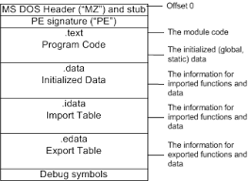
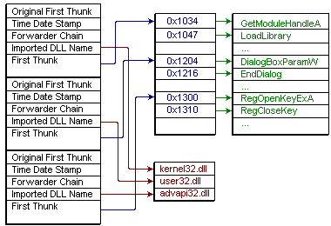
Import Address Table – PE format

Slide 9
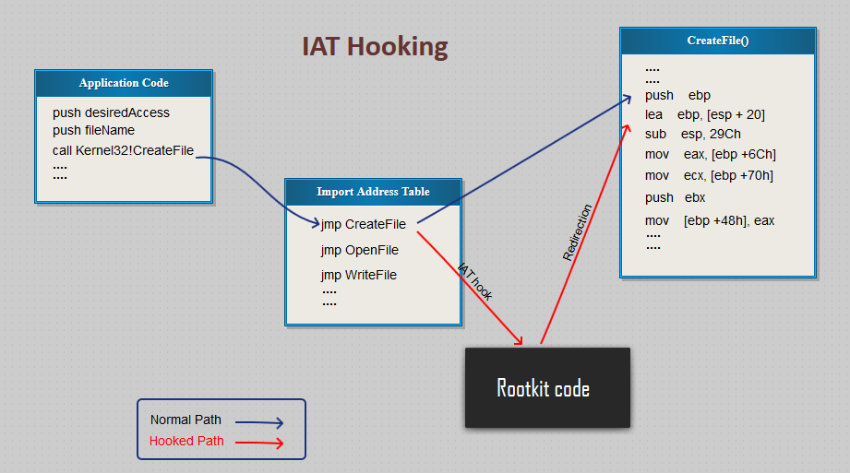
IAT Hooking
When calling arbitrary API indirectly in programming language the compiler does not link direct calls to the module but it links call to IAT on jmp instruction which will be filled by process loader while OS is loading process to the memory.
Process loader will fill out direct jmp instructions in IAT which is used by our calls from the program code
So, if we are able to find out specific function in IAT which we want to hook, we can easily change jmp instruction there and redirect code to our address.

Slide 10
Inline hooking
change a page protection.
rewriting first few instructions on the function entry point – usually function prologue (16 bytes ).
On this address we will insert relative jump to our code.
Copy original instruction into the end of the new function.
Add JMP instruction to the original function.

Slide 11
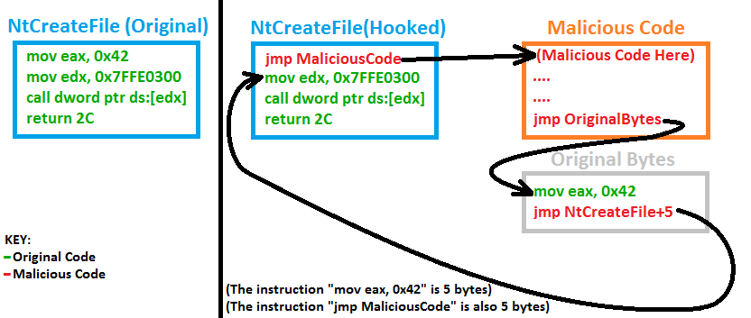
Inline hooking

Slide 12
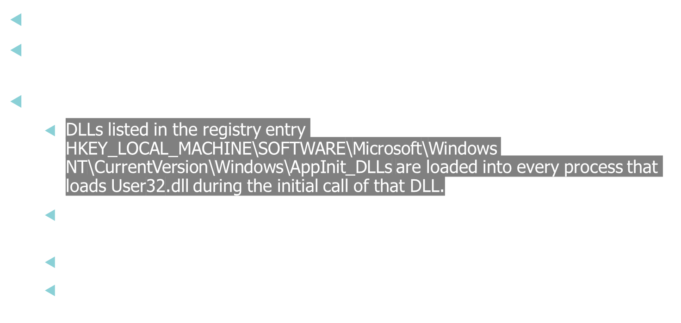
code injection - basic

Slide 13
MinHook – hooking open source library
https://www.codeproject.com/Articles/44326/MinHook-The-Minimalistic-x-x-API-Hooking-Libra
The Minimalistic x86/x64 API Hooking Library
Using inline hooking.
replaces the prologue of the target function with x86's JMP (unconditional jump) instruction to the detour function.
Updated open source and recommended by win32api developers.

Slide 14
VM common hardware configuration
No internet access/ external IP ownership
NIC with specific MAC address for those vendors.
Office RecentFiles property.
File name – consist of md5/”malware”/”test”…
No browser history.
Low RAM/small Hard disk.

Slide 15
Assembly opcodes checks
Checking CPU Instructions –
  CPUID:
    Opcode that allowing software to discover details of the processor.
    This instruction is executed with EAX=1 as input, the return value describes the processors features. The 31st bit of ECX on a physical machine will be equal to 0. On a guest VM it will equal to 1.
  Hypervisor brand”:
    by calling CPUID with EAX=40000000 as input,1 the malware will get, as the return value, the virtualization vendor string in EAX, ECX, EDX. For example: Microsoft: “Microsoft HV”, VMware : “VMwareVMware”.

Slide 16
Typical Registry keys
HKLM\SOFTWARE\Vmware Inc.\\\Vmware Tools
HKEY_LOCAL_MACHINE\HARDWARE\DEVICEMAP\Scsi\Scsi Port 2\Scsi Bus 0\Target Id 0\Logical Unit Id 0\Identifier
SYSTEM\CurrentControlSet\Enum\SCSI\Disk&Ven_VMware_&Prod_VMware_Virtual_S
SYSTEM\CurrentControlSet\Control\CriticalDeviceDatabase\root#vmwvmcihostdev
SYSTEM\CurrentControlSet\Control\VirtualDeviceDrivers

Slide 17
Typical processes
Vmware
  Vmtoolsd.exe
  Vmwaretrat.exe
  Vmwareuser.exe
  Vmacthlp.exe
VirtualBox
  vboxservice.exe
  vboxtray.exe

Slide 18
Typical files
VMware
  C:\windows\System32\Drivers\Vmmouse.sys
  C:\windows\System32\Drivers\vm3dgl.dll
  C:\windows\System32\Drivers\vmdum.dll
  Etc…
VirtualBox
  C:\windows\System32\vboxoglpassthroughspu.dll
  C:\windows\System32\vboxservice.exe
  C:\windows\System32\vboxtray.exe
  Etc…

Slide 19
Typical services
VMTools
Vmhgfs
VMMEMCTL
Vmmouse
Vmrawdsk
Vmusbmouse
Vmvss
Vmscsi
Vmxnet
vmx_svga
Vmware Tools
Vmware Physical Disk Helper Service

Slide 20
Project description
I focused on hooking win32 API calls to prevent detection by files, reg keys and processes.
Project files:
  HidingDLL.dll – main DLL which injected into processes and implement hooking.
  files_blackList.txt + process_blackList.txt + registry_blackList.txt |
  – black list configuration files.
  editReg.exe – edit appInit_Dlls and LoadAppInit_DLLs registry value to point to our dll.
hooked functions:
  MessageBox (test case - training)
  RegOpenKeyExA
  GetFileAttributesA
  CreateFileW
Hooking failure: Process32First, Process32Next.

Slide 21
Project flow
1. Change registry value appinit_dlls
RegOpenKeyExA
2. New process
3. Load(inject) My.dll
Dll inject
Check if value exist in file
Return ERROR_KEY_DELETED
4. registry_blackList.txt
Exist in black list
Not exist in black list
Continue original RegOpenKeyExA

Slide 22
How to use:
create win7 32bit vmware machine.
Download https://github.com/AlicanAkyol/sems and run sems.exe to view vm detection result.
Copy runFiles directory (all files listed above are included inside) to VM and run editReg.exe
Diff between the results.

Slide 23
How to configure
Read minhook api documentation
Create new dll project in visual studio
Add minhook.h to include path
Change relevant (through VS and OS version) libMinHook.lib to the right name.
Carefully inject dll to process in any way u choose

Slide 24
Testing
Tested over win 7 32.
Test case was with open source anti VM tool named sems.exe:
  https://github.com/AlicanAkyol/sems
  Described by its author as:
  sems is a tool which is created to help malware researchers by checking their environments for the signatures of any virtualization techniques, malware sandbox tools or well know malware analysis tools. sems is using the same techniques and looking for the same footprints that evasive malwares do in order to detect if it is running in a controlled environment. So it is useful for malware researchers to check if the analysis environment is inevasible.

Slide 25
TODO list:
Add support in process(debug failure) + services(complicated) hooking!!
Evade detection by anti-hooking functions.
Hook more relevant functions.
Add ability to configure answer returned by hook function.
Add another evasion techniques from checks listed above.
Kernel mode hooking for better evasion.

Slide 26
references
Hooking:
  https://www.codeproject.com/Articles/44326/MinHook-The-Minimalistic-x-x-API-Hooking-Libra
  http://vxheaven.org/lib/vhf01.html
AppInit_DLLs: https://support.microsoft.com/he-il/kb/197571
Anti VM methods:
  https://www.sans.org/reading-room/whitepapers/forensics/detecting-malware-sandbox-evasion-techniques-36667
  https://www.zscaler.com/blogs/research/malicious-documents-leveraging-new-anti-vm-anti-sandbox-techniques
  https://www.cyberbit.net/endpoint-security/anti-vm-and-anti-sandbox-explained/
  http://resources.infosecinstitute.com/anti-debugging-and-anti-vm-techniques-and-anti-emulation/#gref
anti vm\sandbox malware samples\PoC :
  Sems tool:https://github.com/AlicanAkyol/sems

