Slide 1
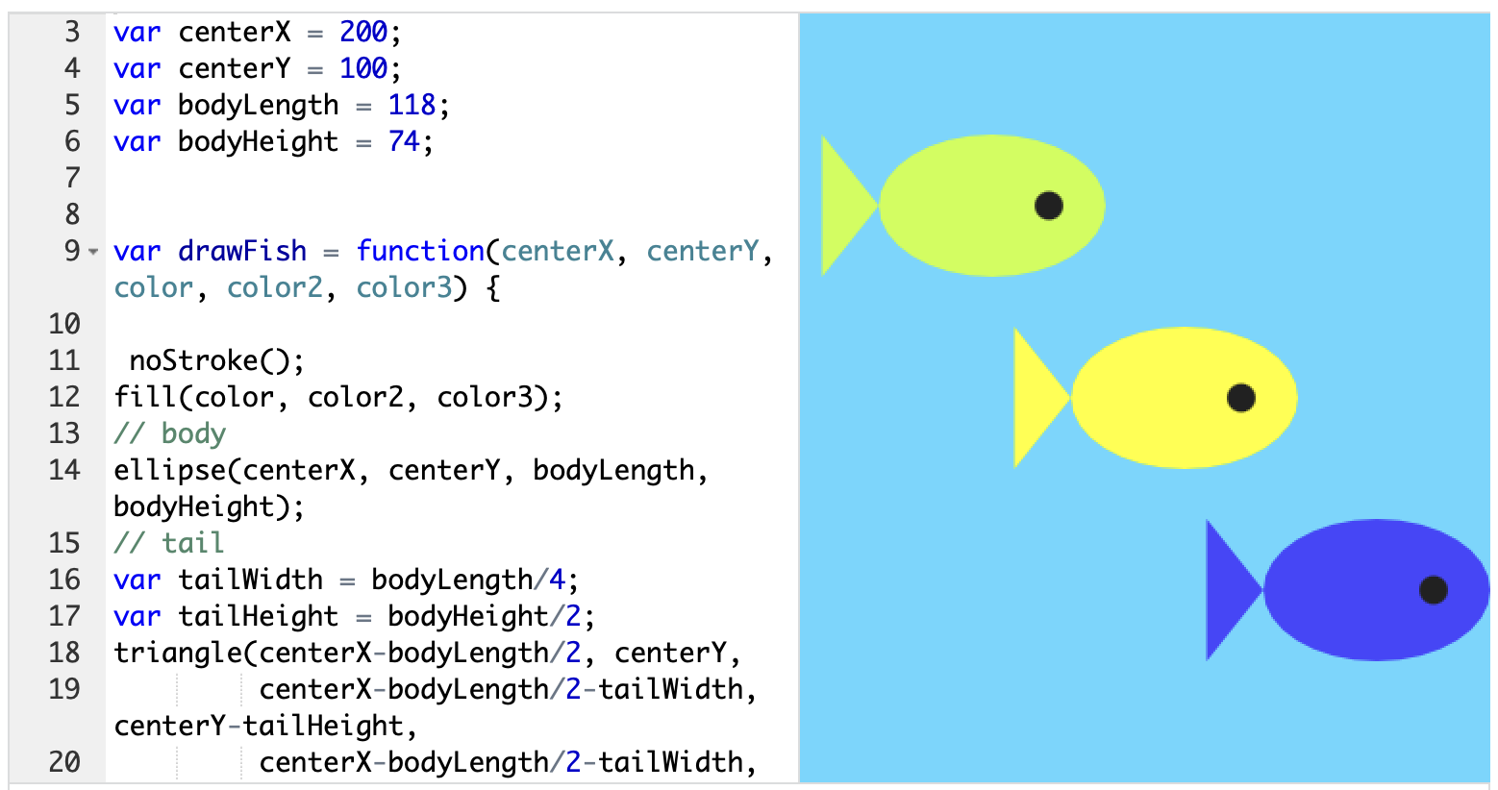
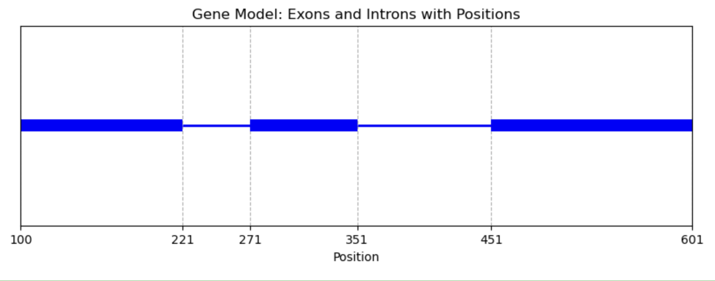
Journey to Master’s Program
Interested in genetics
Why are living things the way they are?
Became interested in programming for web design
Later interested in applications to biology

Slide 2
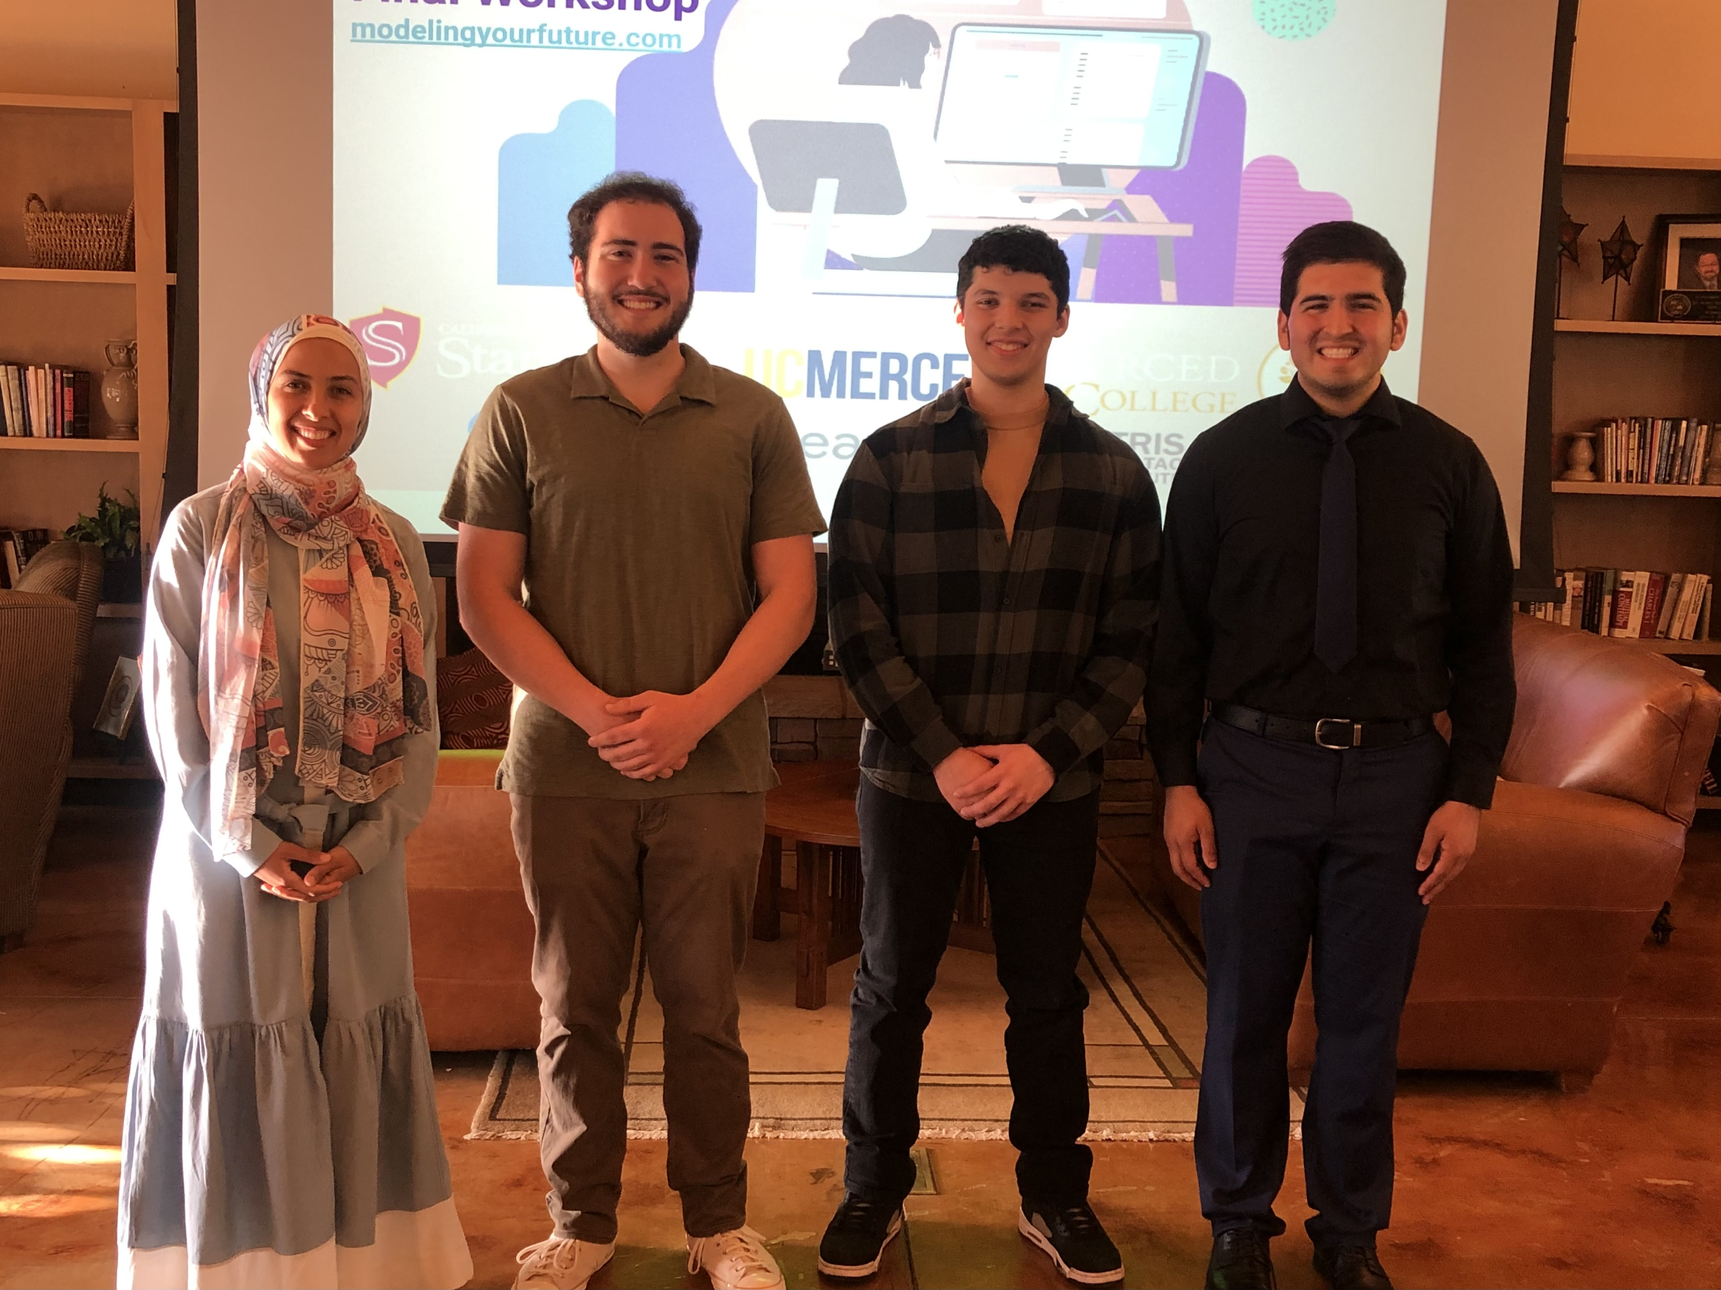
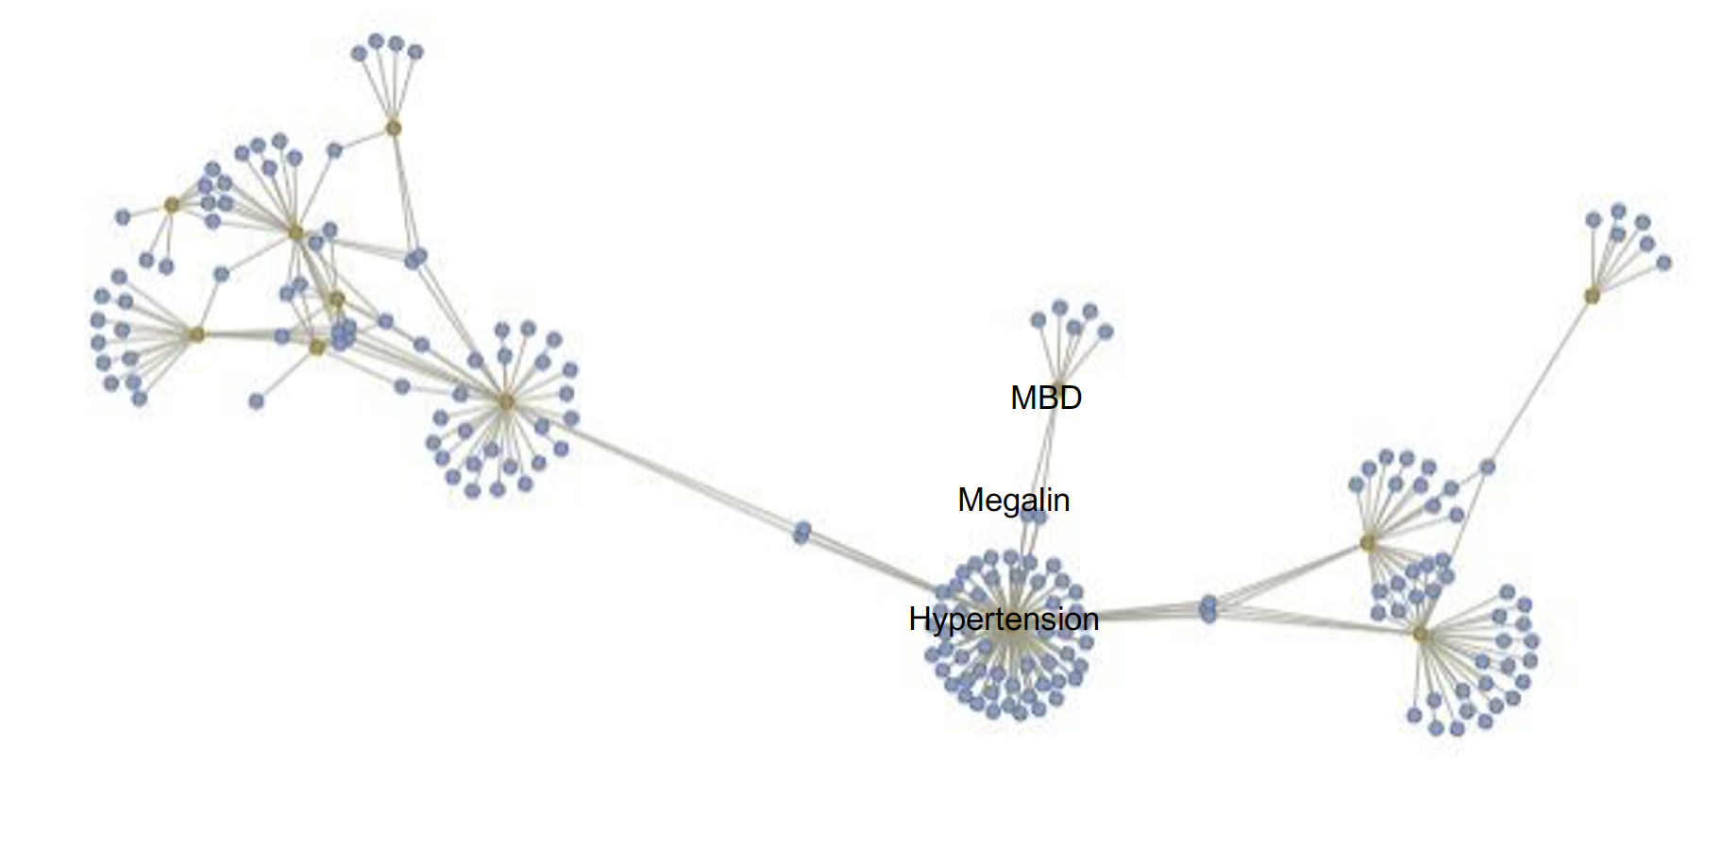
Journey to Master’s Program
Undergraduate research in computational biology
Supplemental instruction for four years
Career Goal: College professor and genomics researcher

Slide 3
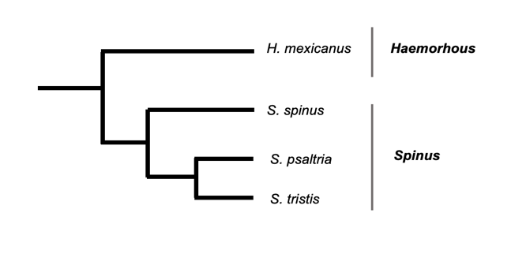
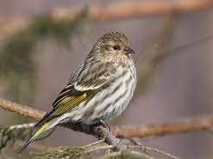
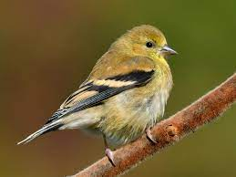
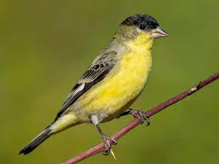
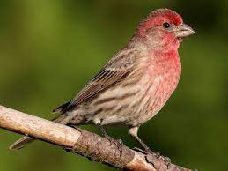
Introduction
Members of Spinus are more susceptible to Salmonella than Haemorhous
Notes:
(Van Laar et al., 2022; Zuccon et al., 2012)

Slide 4
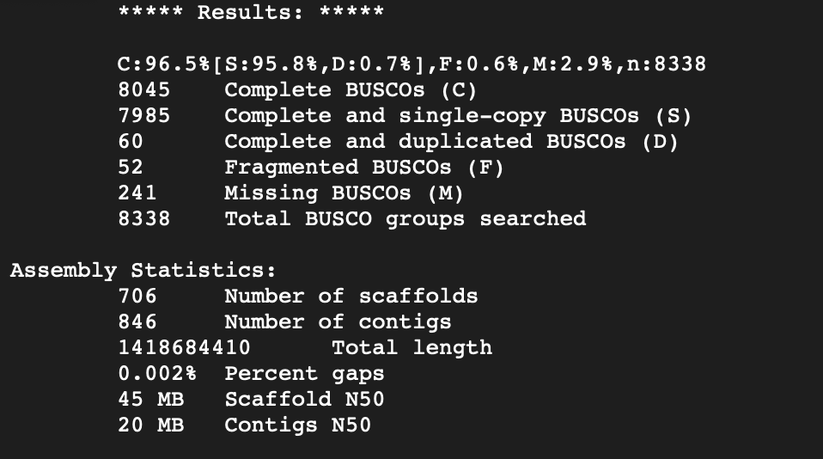
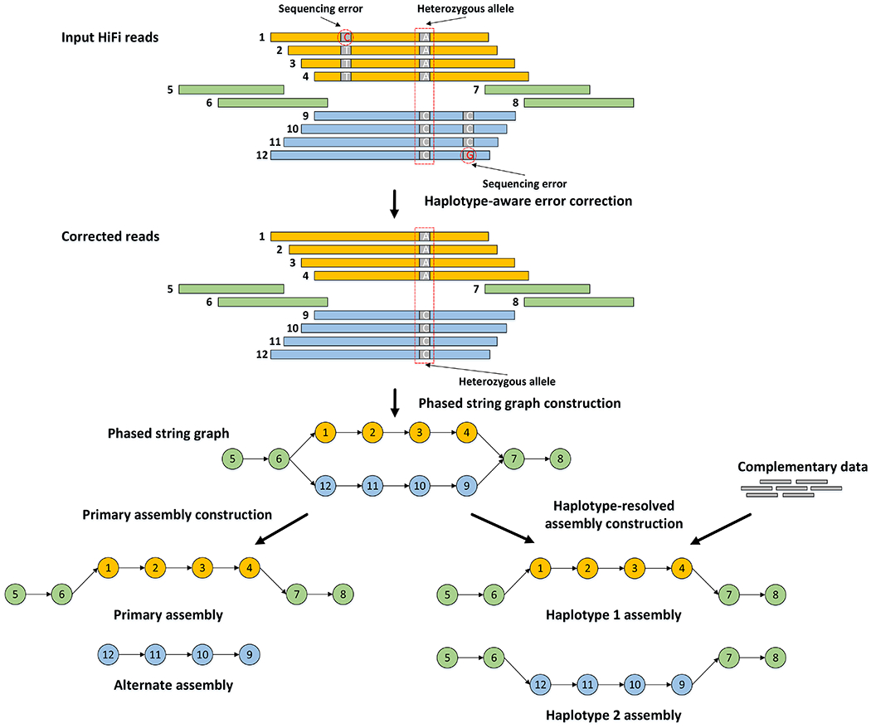
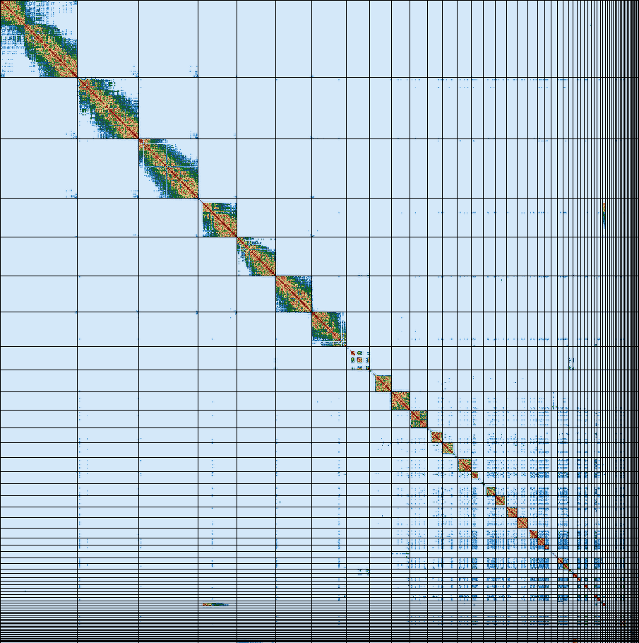
Comparative Genomics

Slide 5
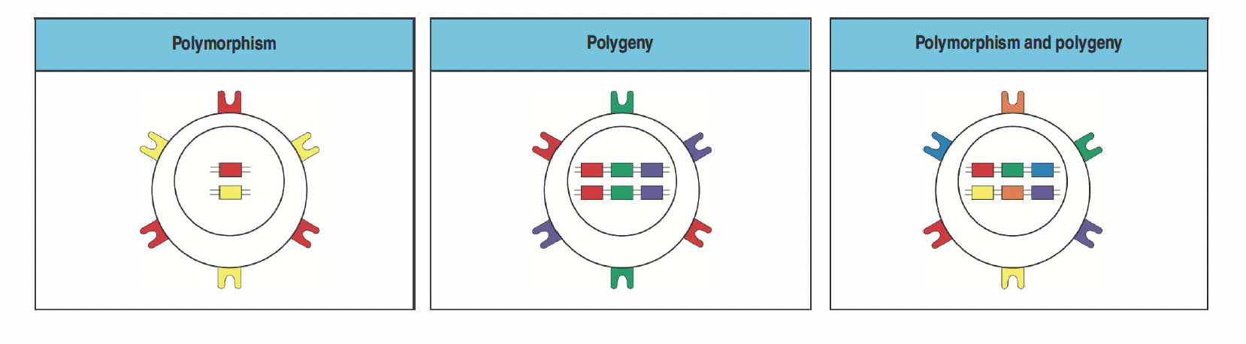
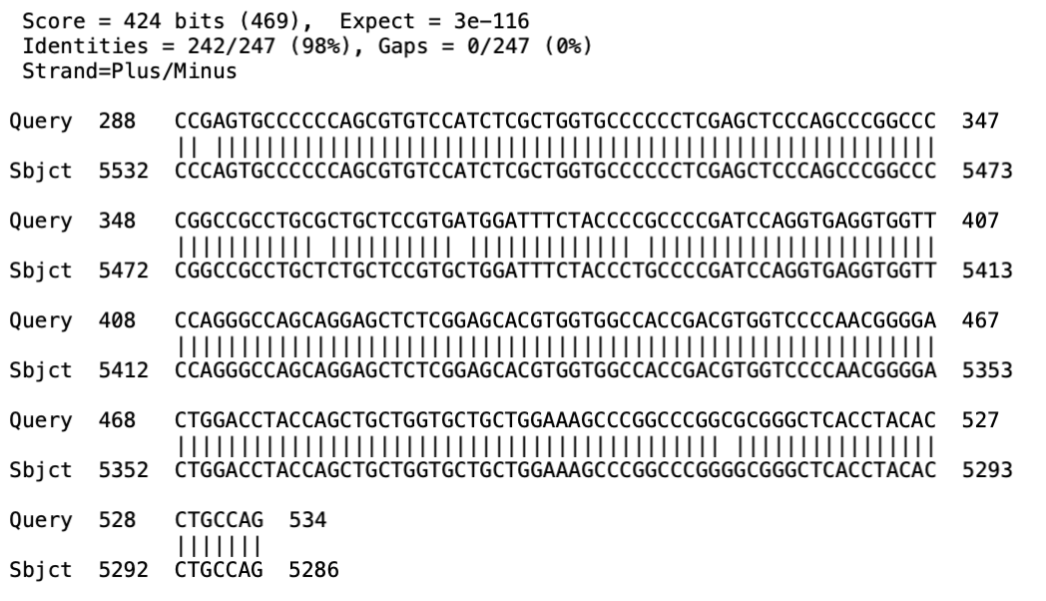
Major Histocompatibility Complex (MHC)
MHC initiates secondary immune response
Diverse MHC → can handle greater variety of pathogens

