Slide 1
Jair Torres
Comparative Immunogenomics of Songbirds with Differential Susceptibility to Salmonella
Master of Science in Biological Sciences
Advisor: Dr. Tricia Van Laar
Stanislaus State
Notes:
Competitors are asked to fill in.

Slide 2
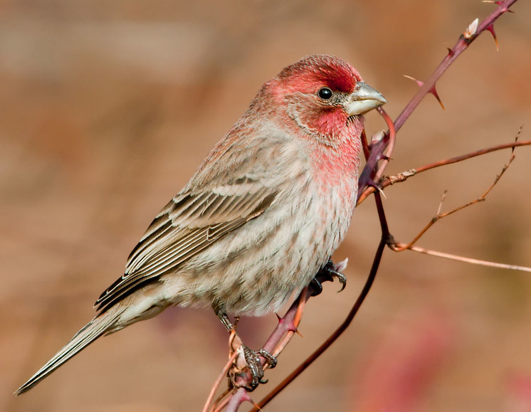
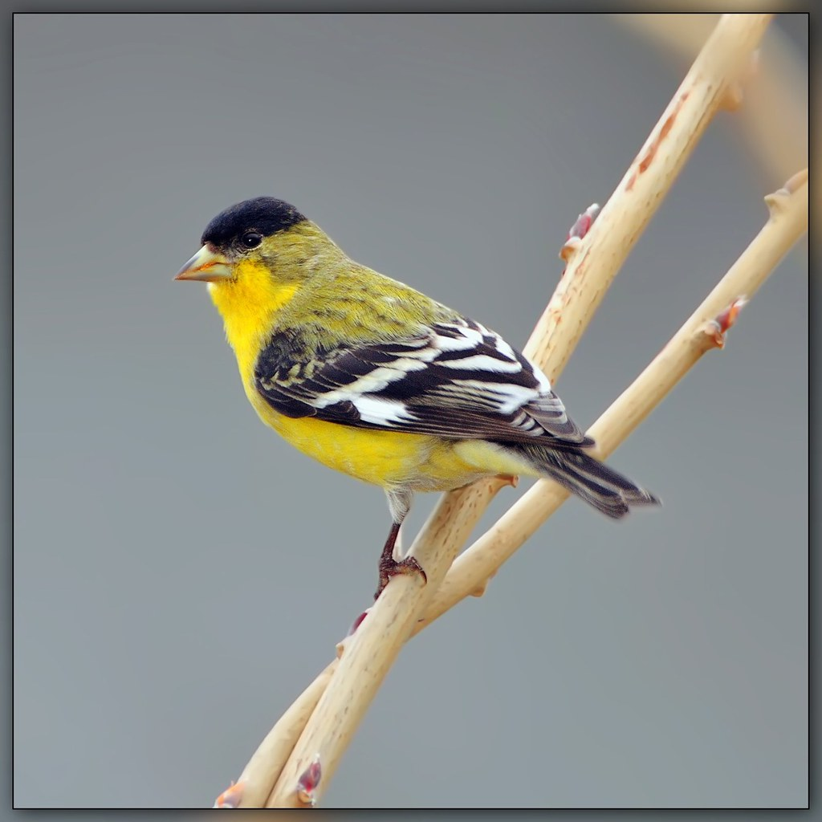
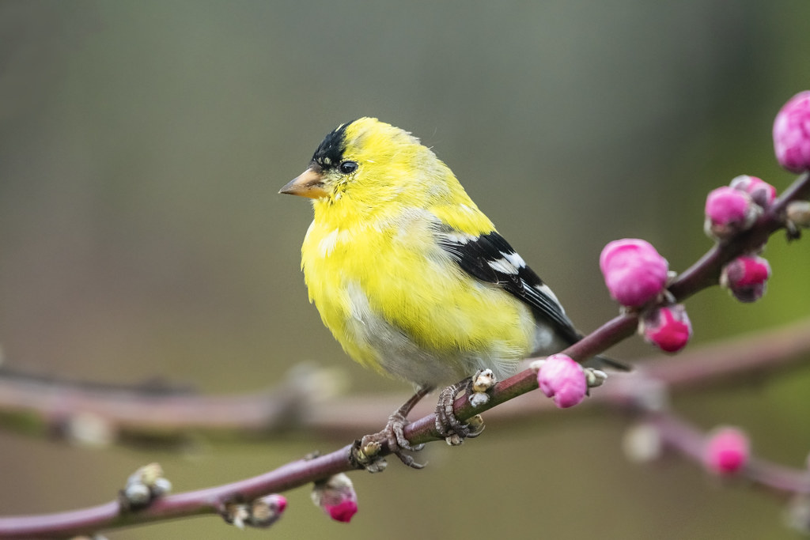
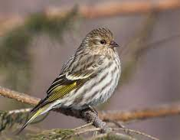
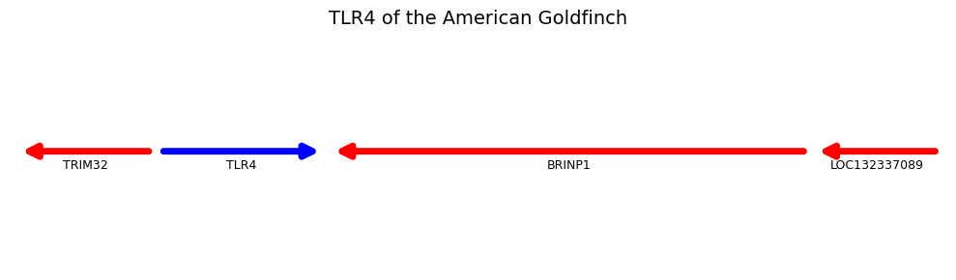
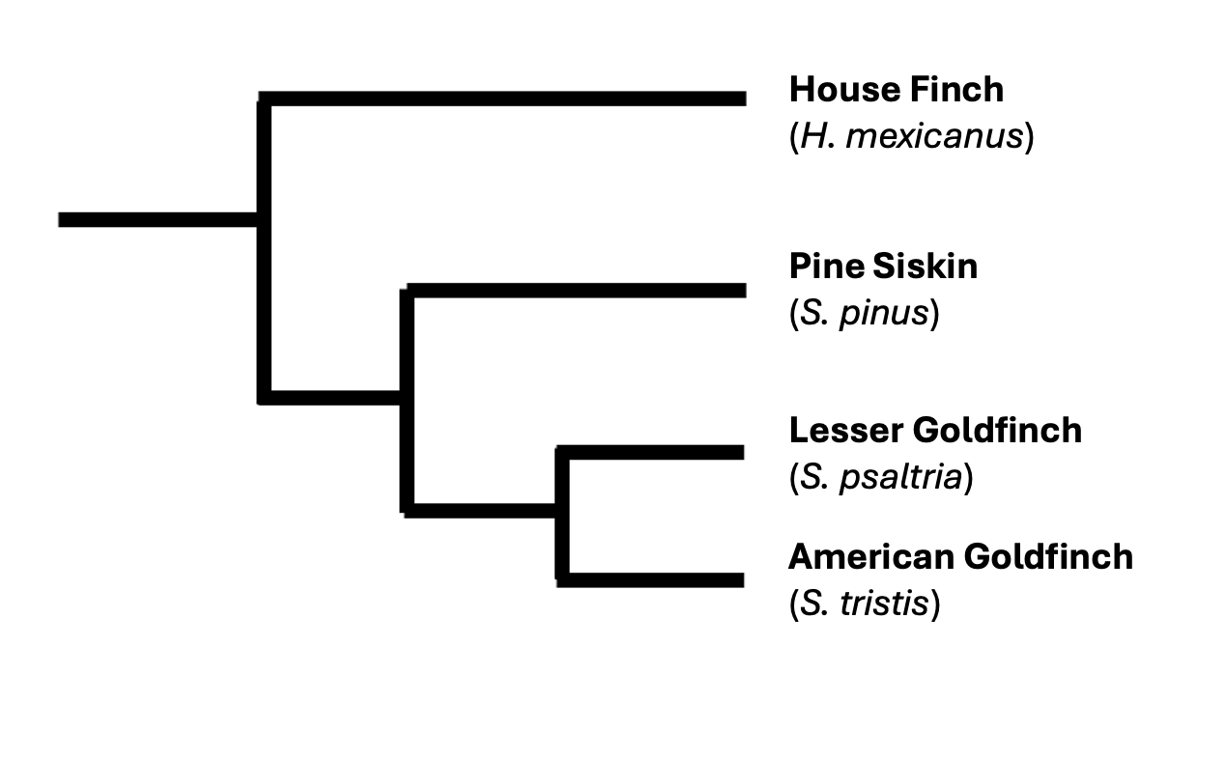
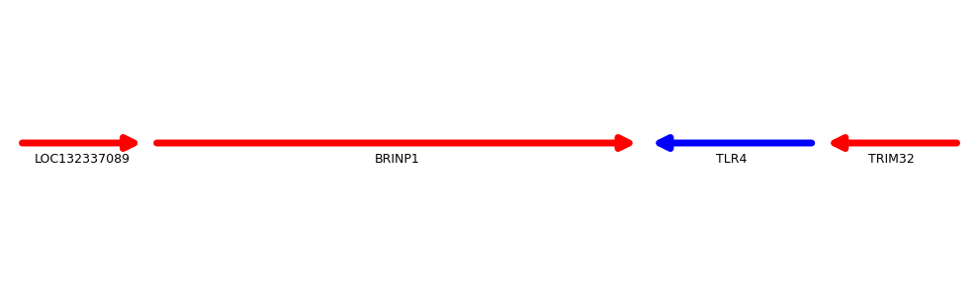
American Goldfinch TLR4
TRIM32
TLR4
BRINP1
LOC132337089
House Finch TLR4
LOC132337089
BRINP1
TLR4
TRIM32
Notes:
This is the slide competitors will add their research content.

