Slide 1
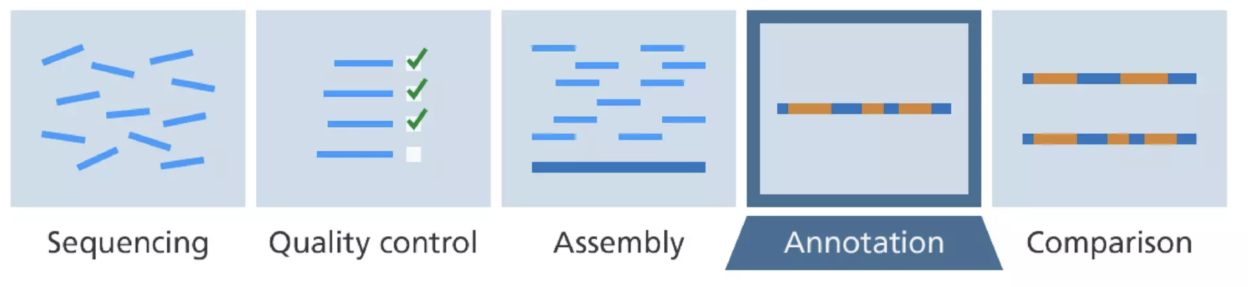
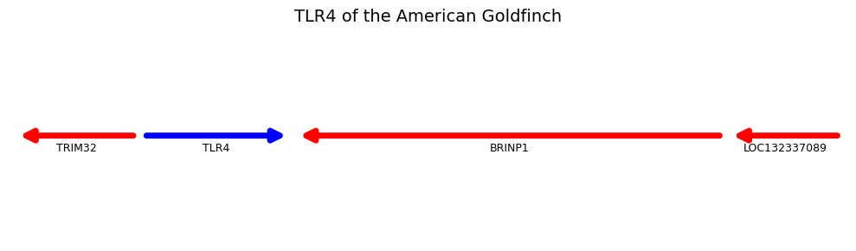
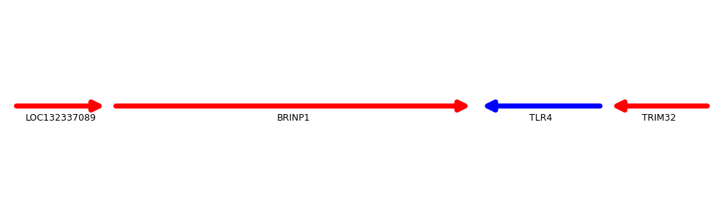
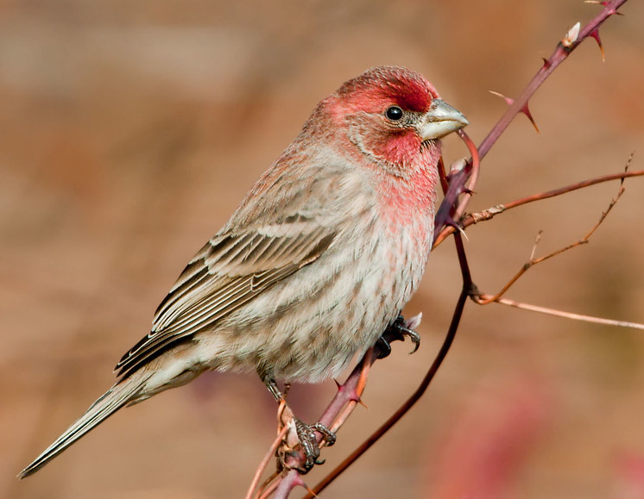
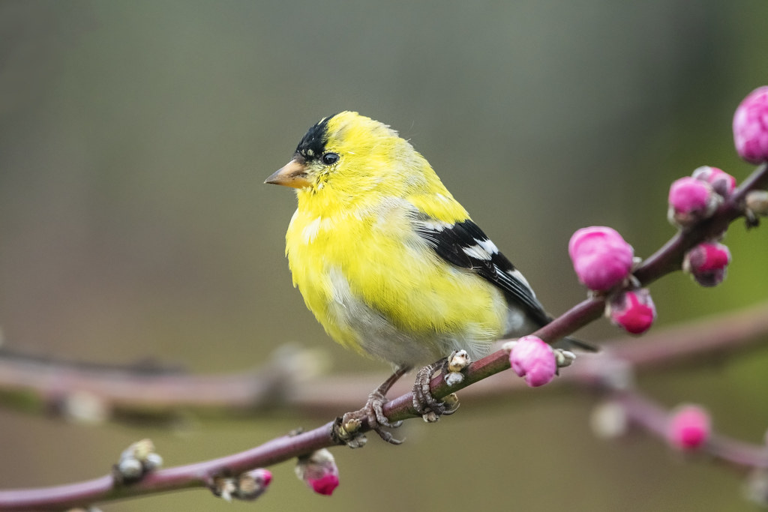
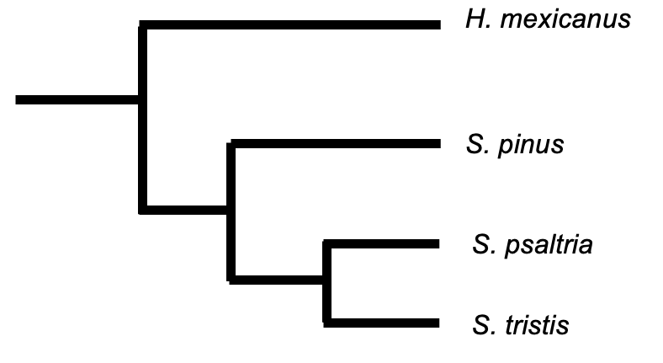

Comparative Genomic Analysis of the TLR4 Gene in the House Finch (Haemorhous mexicanus) and American Goldfinch (Spinus tristis)
Jair Torres, Tricia Van Laar, Joel Slade
Department of Biological Sciences, California State University Stanislaus
Introduction
Methodology
Wild songbirds are important sources of human Salmonella infections¹. Humans become infected by interacting with these birds at bird feeders or by handling exposed pets. In addition to demonstrating the importance of these songbirds in human health, these outbreaks show that not all birds are equally likely to spread Salmonella. For example, the House Finch (Haemorhous mexicanus) seems to be resistant to Salmonella, while similar birds like the American Goldfinch (Spinus tristis) are more susceptible to infection². This is especially intriguing because these birds are closely related and interact frequently in nature³. This study aims to identify and compare the immune genes of these birds to determine why the House Finch seems to be more resistant to Salmonella than the American Goldfinch. Here, we focus on toll-like receptor 4 (TLR4) gene, which is critical in fighting off various bacterial infections and has not previously been identified in the American Goldfinch.
Figure 2. Comparative genomics involves sequencing, assembling, annotating, and comparing the genes of interest in the House Finch and American Goldfinch. This approach was used to identify and compare TLR4.
Results
American Goldfinch TLR4
House Finch TLR4
Figure 3. The TLR4 gene (blue) experienced an inversion in the American Goldfinch genome after diverging from the House Finch.
Discussion
The TLR4 gene was successfully found in the American Goldfinch genome. Identification of the correct TLR4 gene is supported by two main lines of evidence: similarity and synteny. The sequence of the American Goldfinch TLR4 was highly similar to the House Finch TLR at 96% identity. Furthermore, the genomic region containing TLR4 is similar in both species, suggesting high synteny (Fig. 3). While the TLR4 is highly conserved in the American Goldfinch opposite, it did experience an inversion; that is, it is found on the positive DNA strand, unlike in the House Finch which is on the negative strand.
References
Figure 1. The House Finch (Haemorhous mexicanus) and the American Goldfinch (Spinus tristis) are closely related as both are finches (family Fringillidae).
CDC, 2021, https://www.cdc.gov/salmonella/typhimurium-04 -21/index.html
Zuccon, D., at al., Molecular Phylogenetics and Evolution 2012, 62, 581-596.
Hall, A.J., et al., Journal of wildlife diseases 2008, 44, 585-593

