Slide 1

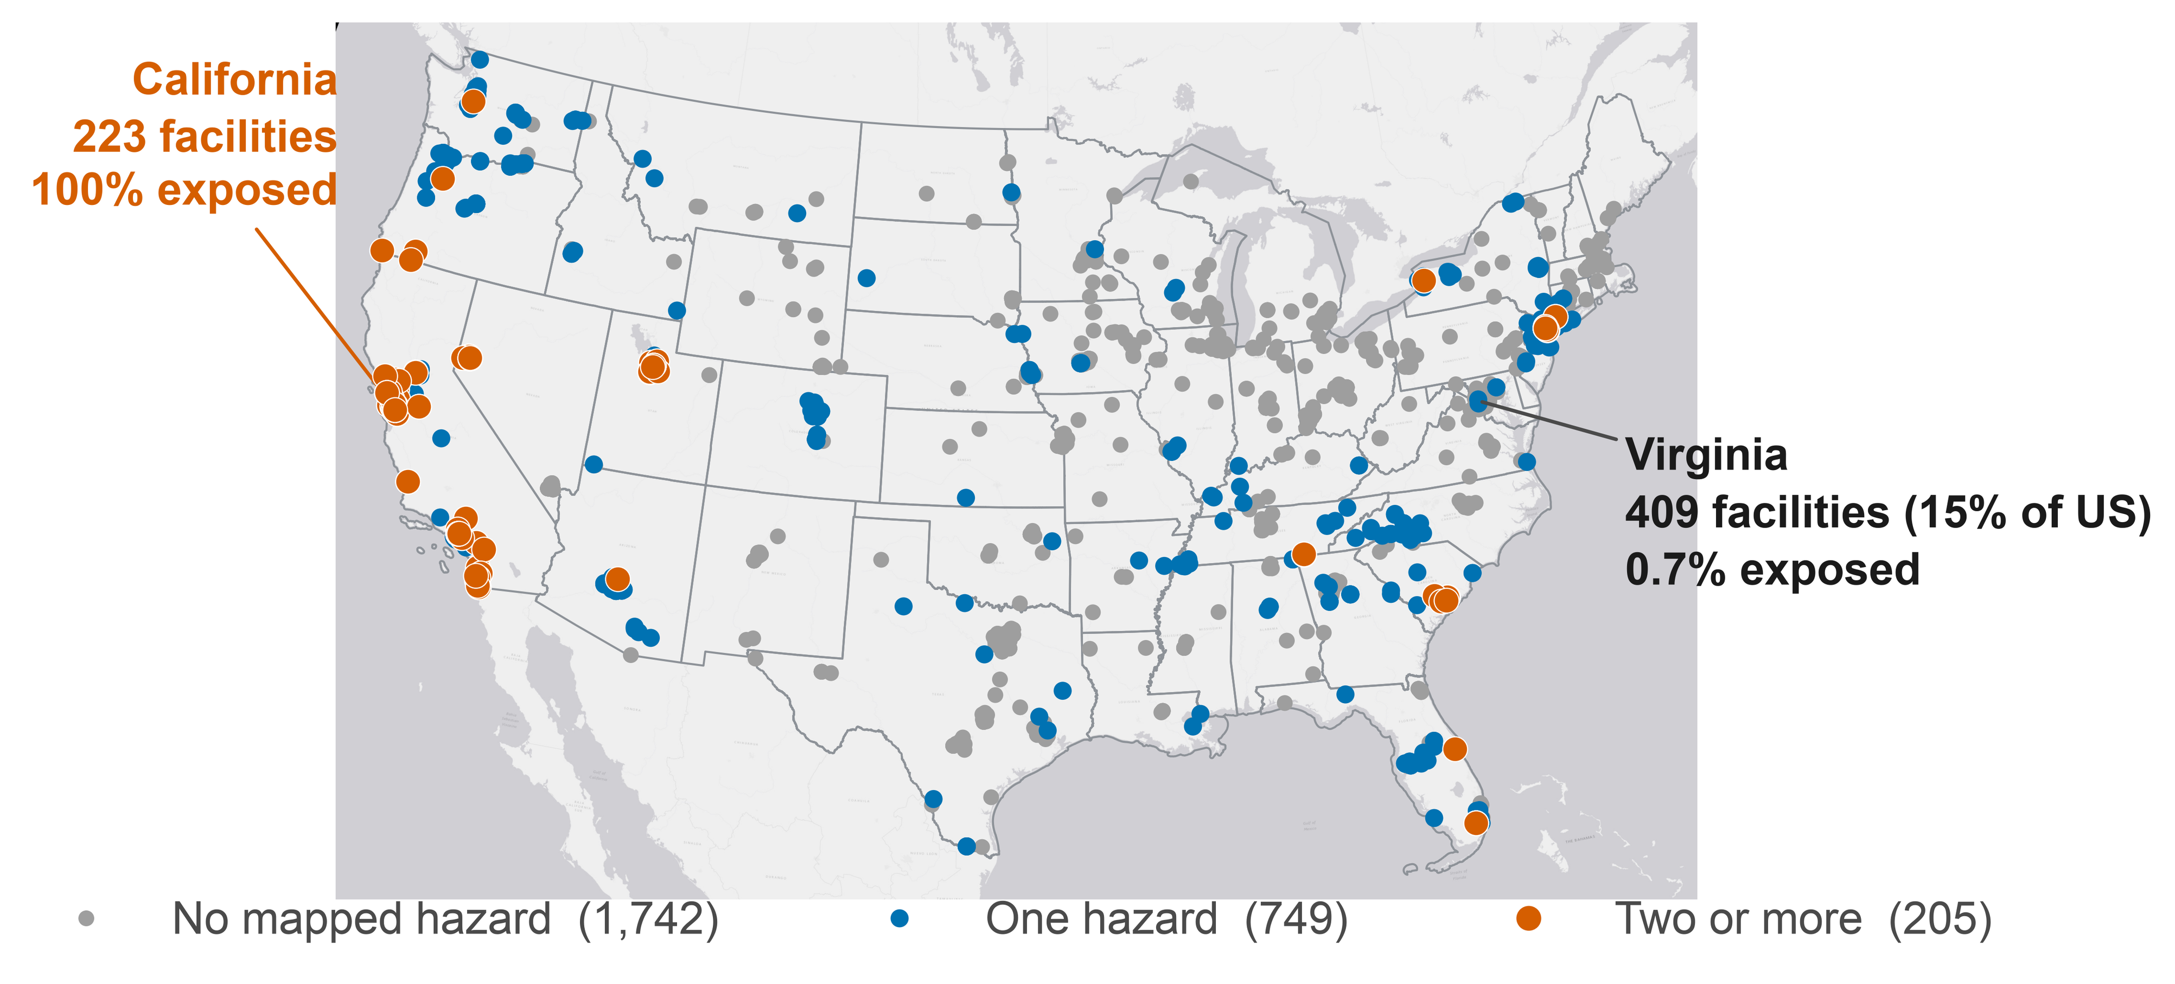
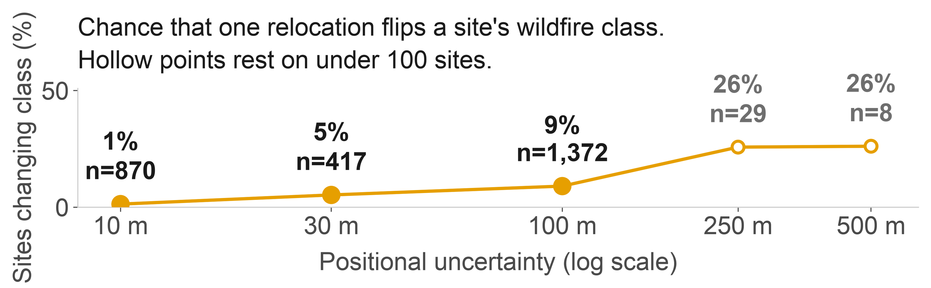
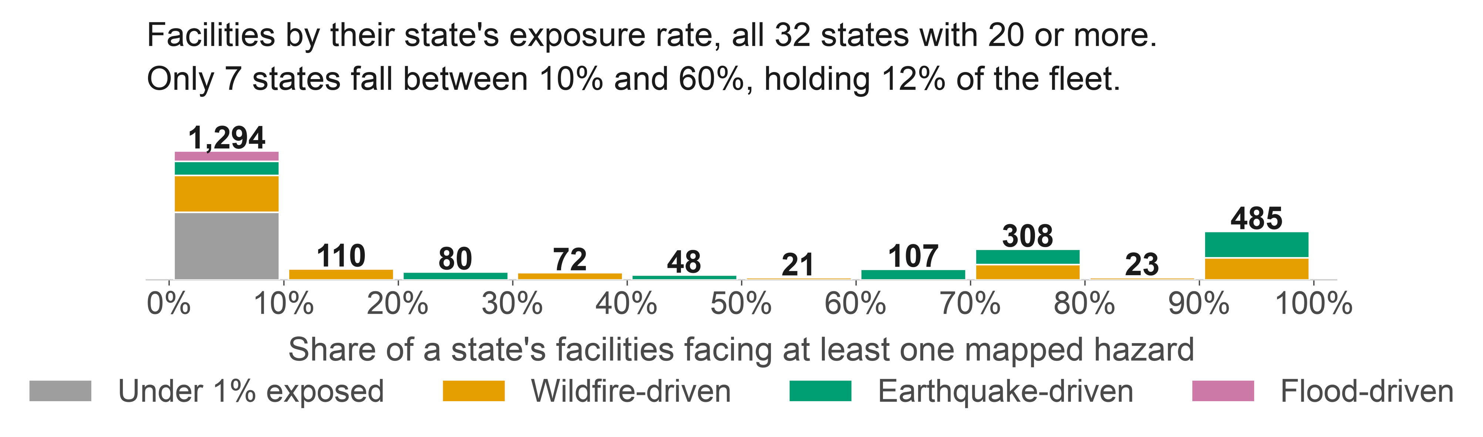
A Multi-Hazard Assessment of 2,696 US Data Centers
Aspiring Scientists Summer Internship Program
2026
Avilash Angirekula¹, Dennies Bor¹, Alice Fox¹, Edward J. Oughton¹
¹Department of Geography and Geoinformation Sciences, College of Science, George Mason University
Background
Results
Conclusions
• AI and cloud demand has concentrated US computing into a few dozen metro clusters that face earthquakes, wildfire and flooding.
• Existing sources are proprietary, or give city-level coordinates never checked against a building.
• We built a free, public, building-level inventory of the contiguous US, and tested how much the answer moves when a coordinate is wrong.
• We measured exposure, meaning whether a site lies in a hazard zone. We did not model damage, so nothing here is a loss estimate.
2,696
954
952
563
• A single national rate is close to meaningless. Only 7 of 32 states with 20 or more sites fall between 10% and 60% exposed.
• We did not measure any site's water use, but the basins under the largest clusters are already over-drawn, and a hazard screen misses them.
• New Jersey and California are both 100% exposed for opposite reasons, so one score hides what a site faces.
• Next: fragility curves, to turn exposure into loss.
facilities located
face a mapped hazard
in a high water-stress basin
water-stressed only
Hazard and water stress pick out largely different buildings. Counting both raises the share under a physical constraint from 35% to 56%.
Two robustness checks
Sampling across a whole footprint instead of its centre changed the answer for 29 of 326 comparable sites. Taller buildings looked more exposed nationally, but that vanished within states.
Limitations
• Coverage is uneven. 83% of our Virginia sites come from OpenStreetMap against 48% of our California ones, so part of the gap between states reflects who did the mapping.
• Hail and wind come from eyewitness reports, so within a state their rates track the number of other sites within 40 km (Spearman 0.39 and 0.34). We left both out, along with lightning, tornado and hurricane.
• No public source lists power capacity, so a server room counts the same as a 100 MW campus.
• 40 sites shown as clear sit outside FEMA's mapped extent and 8 outside the wildfire raster, so 35% is a floor.
Fig 1. One third of US data centers face a mapped hazard. Of the 205 facing two or more (orange), California holds 119, with smaller clusters in Utah, Nevada and New Jersey.
Materials and Methods
Fig 3. Wildfire class under coordinate error.
We merged OpenStreetMap, PeeringDB and Wikidata into one record per site across the contiguous US, matching on name and distance, with written evidence kept for all 194 merges.
Against FEMA USA Structures footprints, 1,681 coordinates fall inside a building, 993 match the nearest and 22 have no match. A second non-OSM source confirmed 1,546, and we re-checked the 1,150 least certain with an AI-assisted pipeline we then reviewed.
Our first seismic layer failed validation against USGS reference values (22 of 150 sites within 10%), so we replaced it:
952 sites lie in a high or extremely-high water-stress basin, almost exactly the 954 facing a mapped hazard, but only 389 are the same sites. Some of the largest clusters are stressed while their hazard maps read clear: Virginia is 0.7% hazard-exposed and 31% water-stressed, Illinois 2.7% and 95%.
Which hazard dominates depends on the region. New Jersey reaches 100% through wildfire alone and 0% through earthquake, California 96% earthquake. Nationally 646 sites are exposed to wildfire, 448 to earthquake and 71 to flood.
Widening the wildfire buffer from 2.4 km to 5 km takes the wildfire count from 646 to 953, so that result is a statement about the buffer as much as about the site.
Major Citations
Dillon, G.K. (2023) Wildfire Hazard Potential for the United States, 270-m, v2023. USDA Forest Service. doi:10.2737/RDS-2015-0047-4
USGS (2026) ASCE 7-22 Seismic Design Maps web service. earthquake.usgs.gov/ws/designmaps
FEMA (2026) National Flood Hazard Layer. hazards.fema.gov
Oughton, E.J. and Weigel, R. (2026) A Comparative Multi-Hazard Risk Assessment of the US High-Voltage Transmission Network. Zenodo. doi:10.5281/zenodo.20331026 (CC BY 4.0)
FEMA and ORNL (2024) USA Structures. gis.fema.gov
WRI (2023) Aqueduct 4.0 Water Risk Atlas.
Fig 1 basemap: Esri Light Gray Canvas. Tiles © Esri, DeLorme, NAVTEQ.
Earthquake
USGS ASCE 7-22 shaking, 2% chance in 50 yr
Wildfire
USFS Hazard Potential 270 m, max in 2.4 km
Flood
FEMA flood layer, 1-in-100-year floodplain
Acknowledgements
Water stress
WRI Aqueduct 4.0, river-basin scale
Uncertainty
500 relocations per site, 10-500 m by precision
This research was made possible through the support of George Mason University's College of Science, which supports the ASSIP Program.
DB and EO were supported by the National Science Foundation National Center for Atmospheric Research (NCAR) Innovator Supplemental Funding grant entitled “A Multi-Hazard, Multi-Infrastructure Vulnerability Assessment for the Continental United States (CONUS)”
A site counts as exposed if it lies within 2.4 km of land rated High or Very High for wildfire, inside a FEMA Special Flood Hazard Area, or at peak ground acceleration of 0.30 g or above. Wildfire is buffered because 2,284 sites sit on non-burnable land, where the pixel under the building says nothing.
Fig 2. The fleet piles up at both ends. Colour shows which hazard drives each state.
Notes:
READ ME: 2026 ASSIP Poster Template Instructions
Read this section before using the template.
Questions? Email Dr. Haymond Still at cosassip@gmu.edu
This is a template for you to use as is or modify WITH MENTOR’S input.
The poster dimensions will print as 27 inches high x 36 inches wide. Do not change the poster dimensions, as the pricing and turnaround time I’ve negotiated with Print Services accounts for this sizing.
Be sure to delete the instructions in the text boxes (my instructions are all in italics). You may mess around with the particular font used if you like; just keep it clean and professional. (No Comic Sans!!)
You can change the header names, locations and presence as agreed upon by your mentor. For example, you may or may not have a Major Citations section. Or, you may need more room for your methods section or want to combine your results and conclusions. This is fine.
Try to keep the font sizes within the specified ranges for legibility. If you have a super long title, for example, I recommend that you make the title box wider and let the title run across two lines, rather than shrink the title text to fit my box. Again, feel free to resize any boxes as necessary to fit the boxes to your content.
For the poster session printed version, leave the two logos in the left and right corners as is, and the colors as is, for consistency.
Your mentor must approve the poster!
Remember to save the finished poster as a PDF under the file name:
MentorsLastName_YourFirstName_YourLastName_2026ASSIP_POSTER
Submit the PDF of the saved poster to Dr. Haymond Still no later than 5pm on Tuesday, August 4th to our Canvas course site.
If you miss the deadline, I won’t have time to get your poster printed!!

