Slide 1

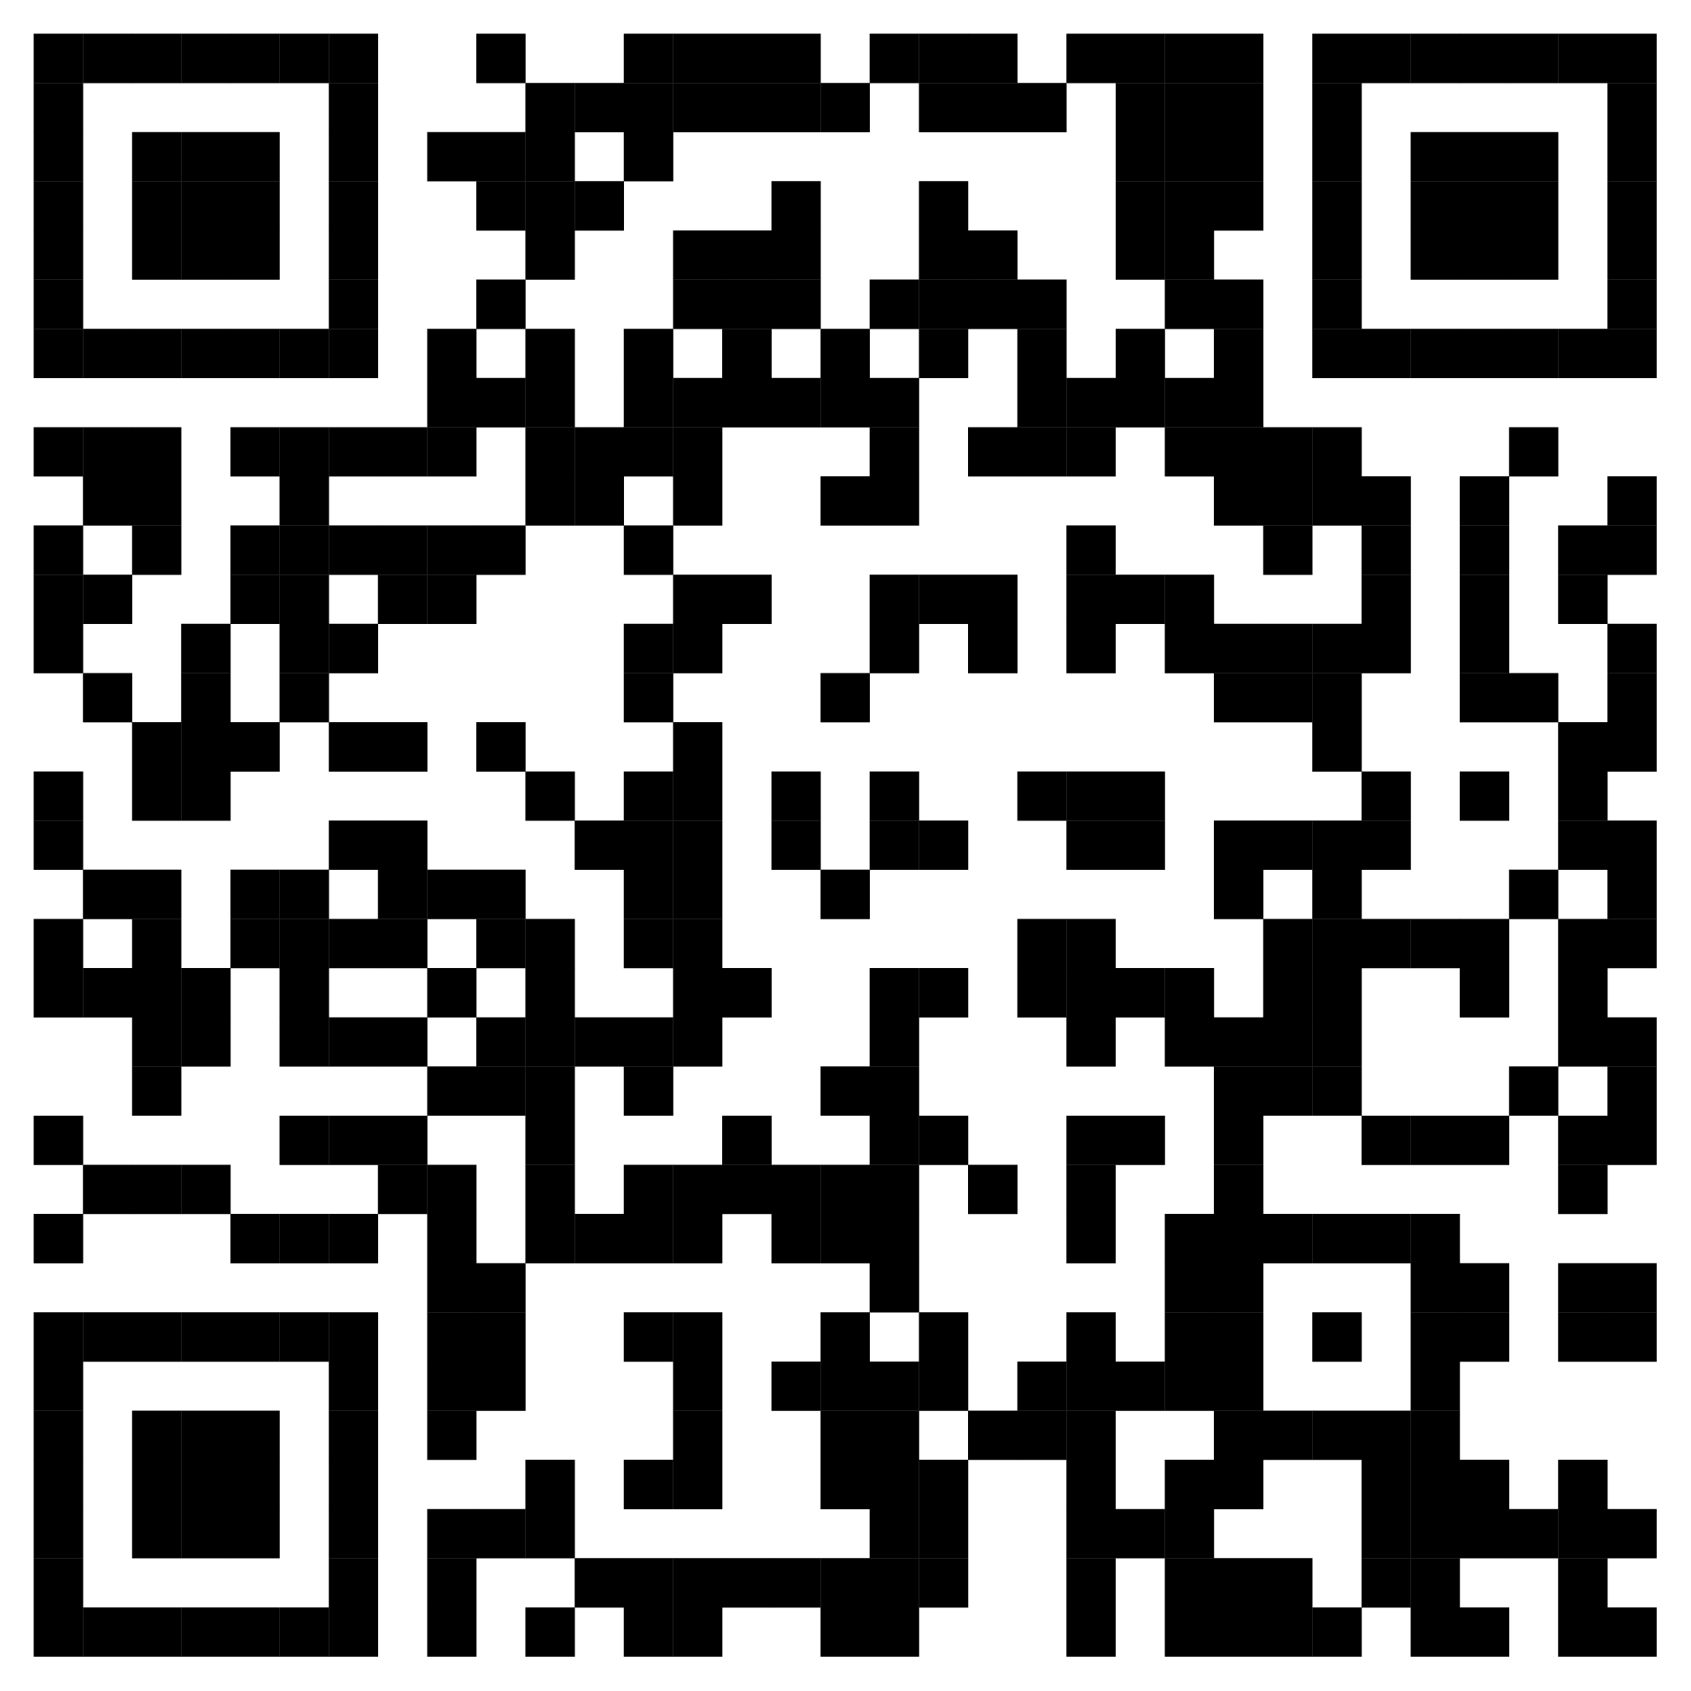
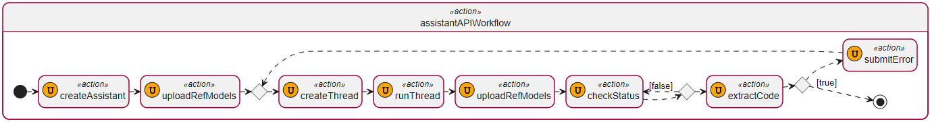
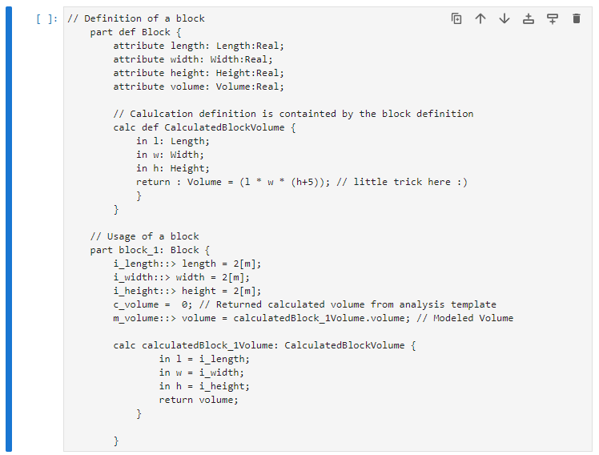
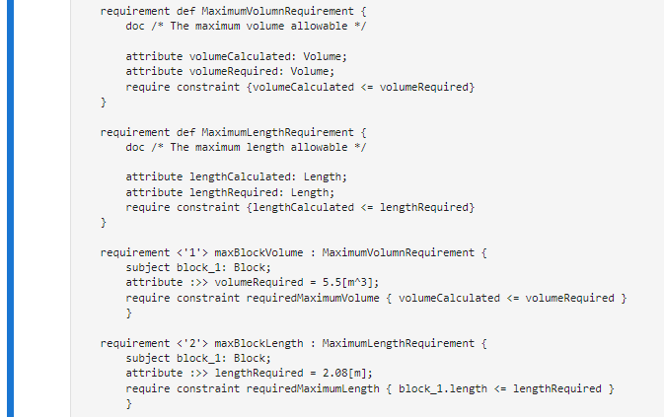


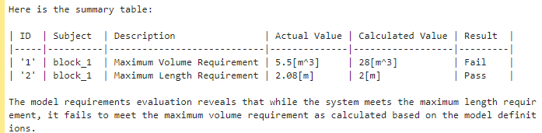
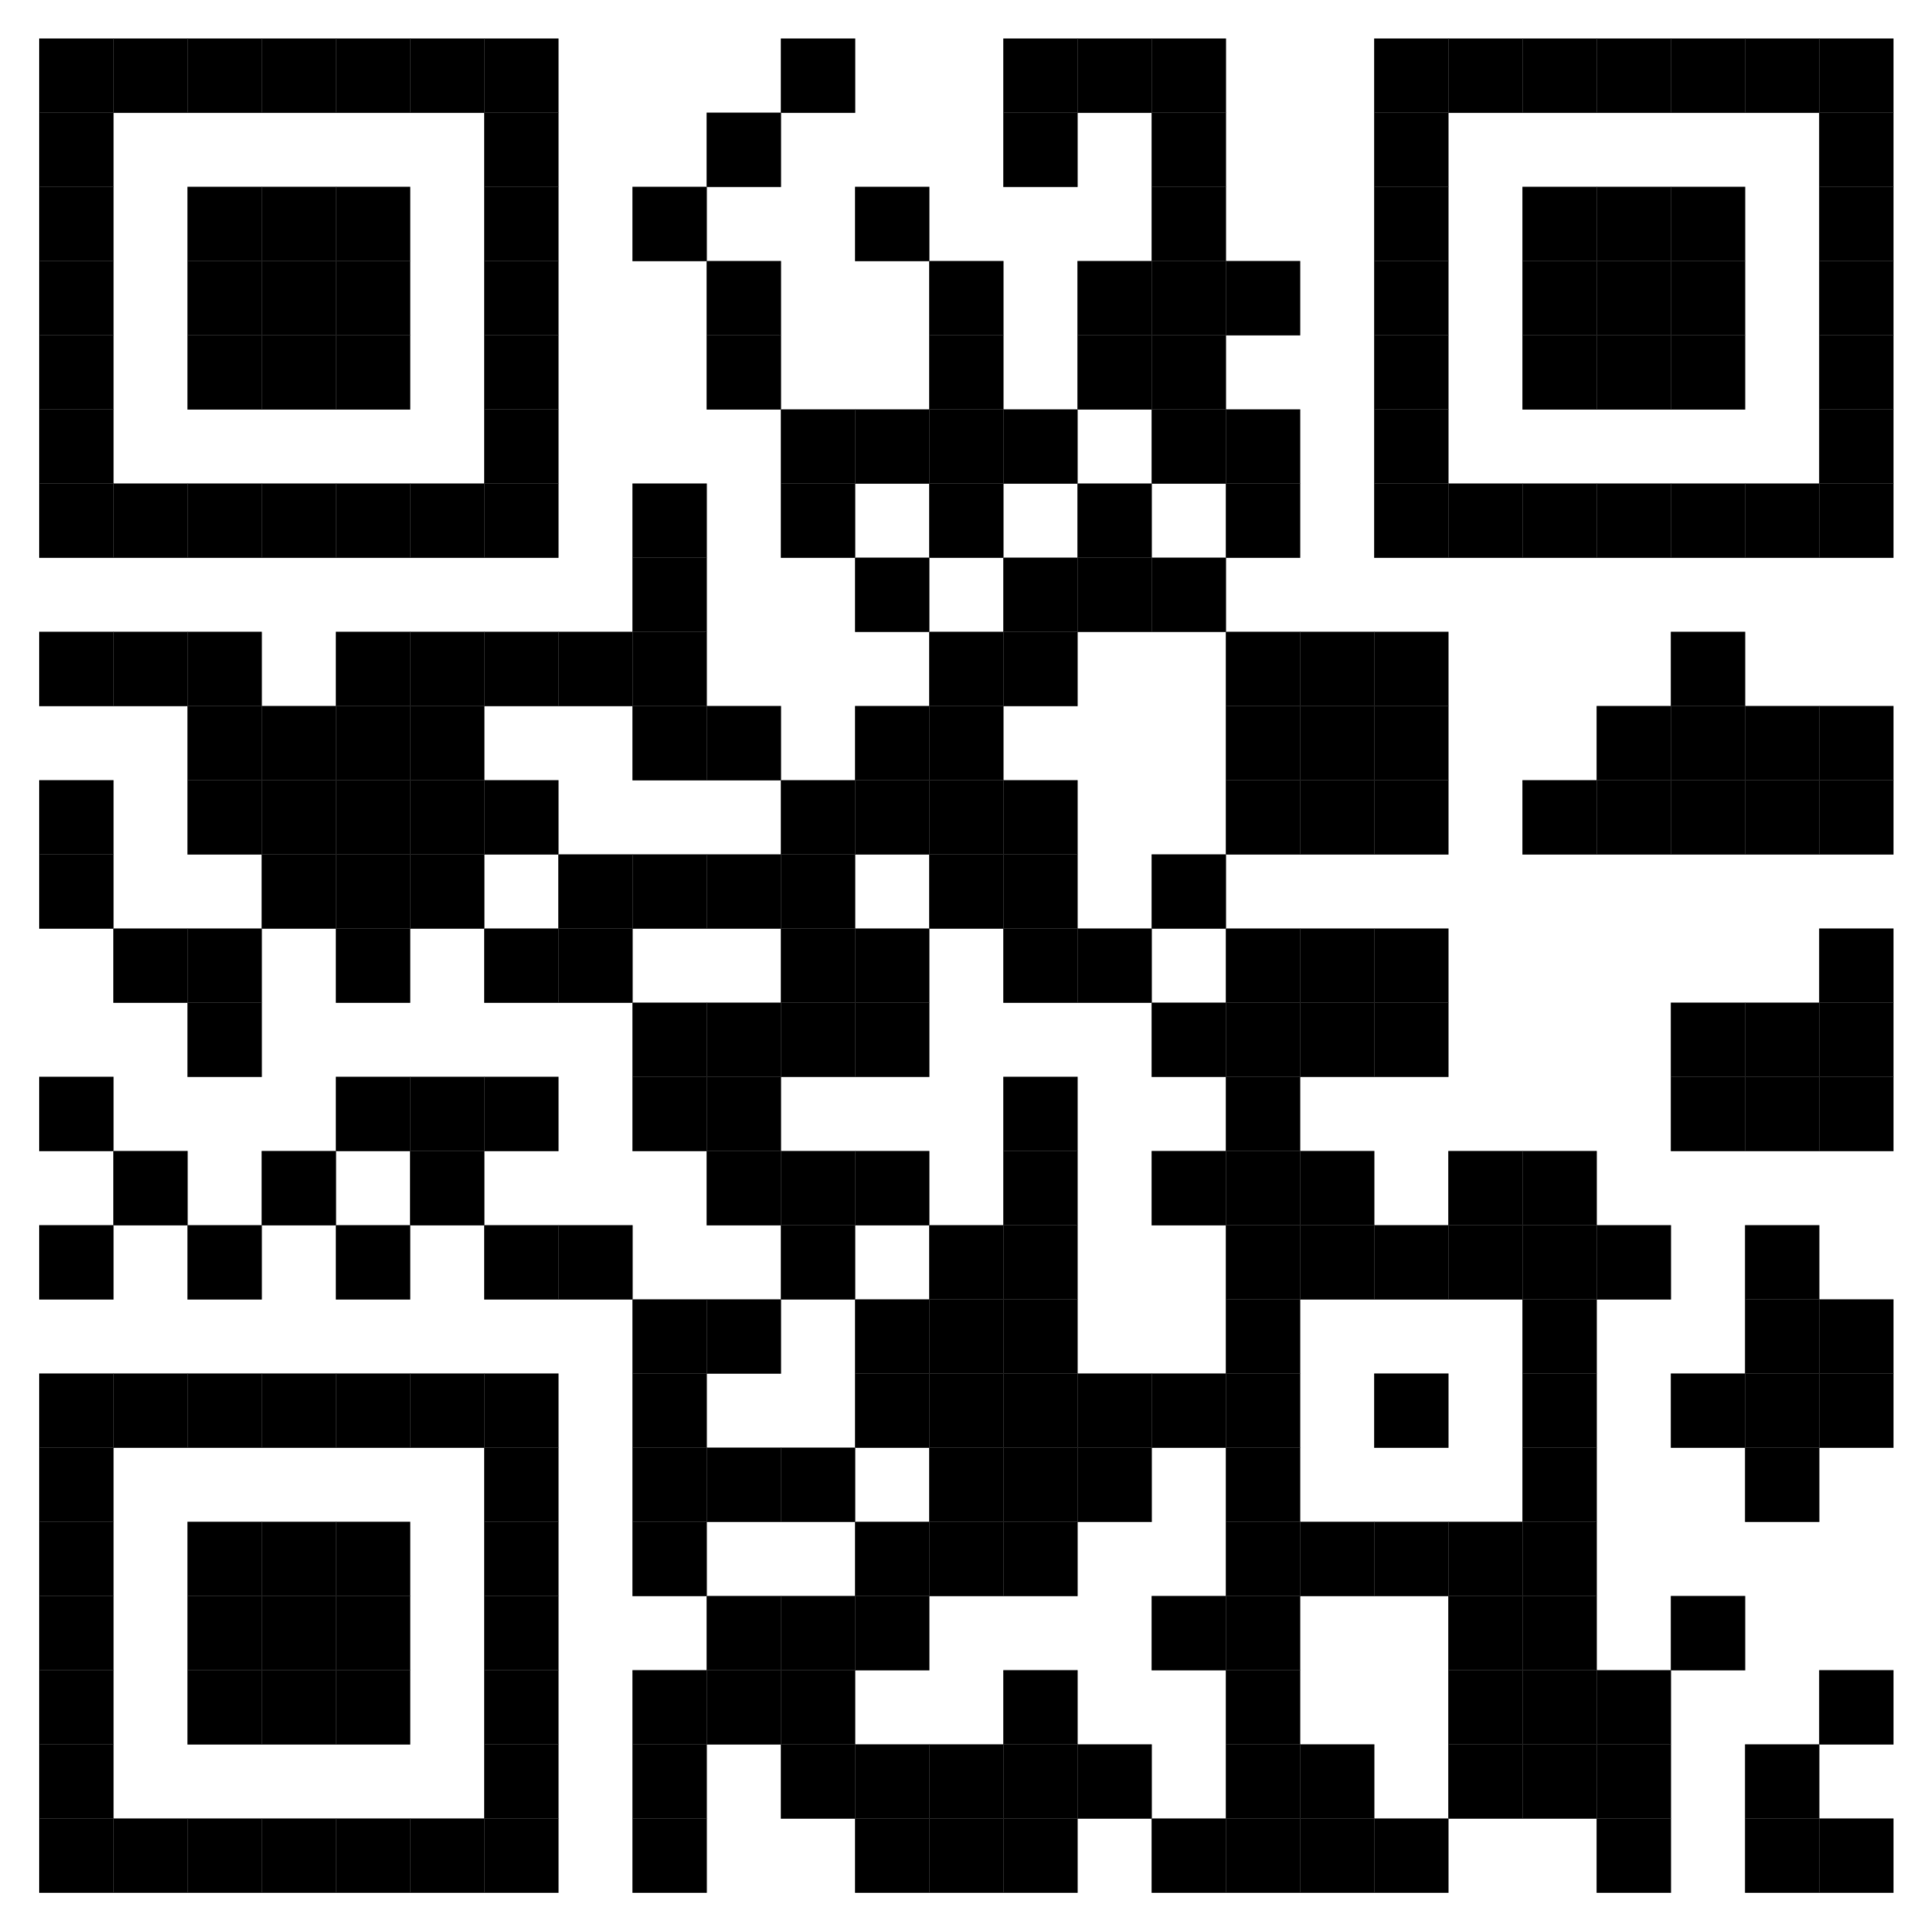
LLMs for Direct Interaction with SysML v2 John K. DeHart
AVIAN
Purpose / Problem
Data / Results
Purpose: This study explores the integration of Large Language Models (LLMs) with Systems Modeling Language version 2 (SysML v2) to streamline systems engineering processes. The primary goal is to leverage LLMs to enhance the readability and usability of SysML v2, thereby reducing the technical barriers associated with traditional API interactions.
Problem: The interaction with SysML v2 typically requires navigating complex APIs, which can detract from its user-centric design. This complexity introduces a significant learning curve and potential inefficiencies in model management, hindering the overall effectiveness of systems engineering workflows.
Data:
Case Study 1: Modification of a SysML v2 model defining a physical beam’s characteristics through natural language commands.
Case Study 2: Implementation of an API endpoint and testing front end for querying system models using natural language.
Case Study 3: Validation of a complex SysML v2 model, including non-standard calculations and requirements evaluation, using an AI assistant.
Results:
Case Study 1: Demonstrated successful modification of SysML v2 models via LLM-generated Python code.
Case Study 2: Showed effective interaction with SysML v2 models through an API, enabling complex queries and real-time model updates.
Case Study 3: Highlighted the AI assistant's ability to accurately interpret and validate complex model requirements, maintaining model integrity and enhancing usability.
Objectives / Goals
Objectives:
Evaluate the feasibility of using LLMs to directly interact with SysML v2 models.
Understand the potential benefits and limitations of integrating LLMs with SysML v2.
Develop a streamlined methodology for systems engineers to manage models using natural language.
Goals:
Simplify SysML v2 model manipulation through natural language.
Enhance the accessibility and efficiency of systems engineering workflows.
Provide evidence-based insights into the integration of LLMs and SysML v2 for improved model management.
Calculation Model
Train
Train
Requirements Model
AI Assistant
Prompt
Methods / Description
Response
Methods:
Experimental Setup:
Utilized SysML v2 for constructing text-based system models.
Implemented OpenAI’s Assistants to process natural language queries and generate Python code.
Stored SysML v2 models in a file system and interfaced with the LLM through a scripting environment.
Workflow:
Created an Assistant in the OpenAI Playground or via API.
Uploaded reference SysML v2 models to the Assistant.
Interacted with the models through natural language commands, which the Assistant processed to generate and execute code for model modifications.
Descriptions:
SysML v2: Enhanced for human readability and model expressiveness, making it suitable for integration with LLMs.
LLMs: Used for interpreting and generating SysML v2 constructs based on natural language inputs, facilitating a more intuitive interaction with system models.
Integration Approach: Combined the structured data management capabilities of SysML v2 with the natural language processing strengths of LLMs to streamline the modeling process and reduce the need for specialized API knowledge.
Conclusions
Conclusions: The integration of LLMs with SysML v2 offers significant improvements in usability, efficiency, and accessibility. By enabling direct, natural language interactions with system models, LLMs reduce the reliance on complex API navigation and allow systems engineers to focus on core design and analysis tasks. However, it is crucial to address potential challenges such as automation bias, error handling, and model reliability to ensure the successful adoption of this technology.
Future Work: Further research is needed to empirically validate these approaches and explore deeper interoperability with existing systems engineering ecosystems. Additionally, developing domain-specific LLM training methodologies and ethical guidelines will be essential for advancing this integration.
Contacts / References
John K. DeHart Sr. Principle System Engineer / Sr. Principle Digital Engineer jdehart@avian.com

