Slide 1

정보 과제 연구
다층 퍼셉트론 모델과 오차 역전파의 이해
30724 정성훈

Slide 2
연구 주제와 목적
정보 과제 연구
다층 퍼셉트론 모델과 오차 역전파의 이해
30724 정성훈

Slide 3
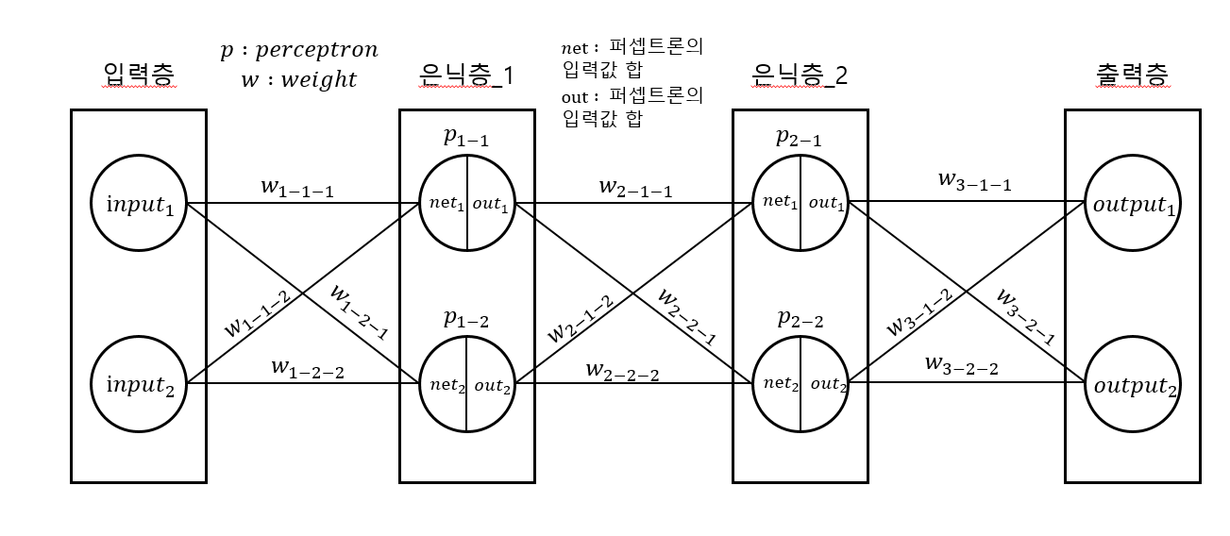
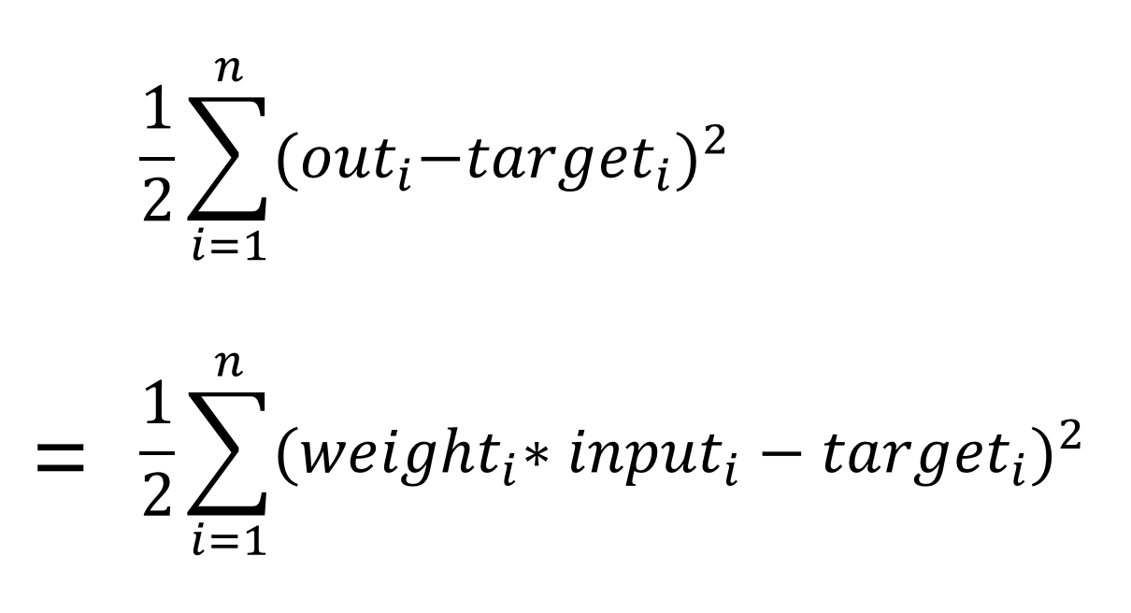
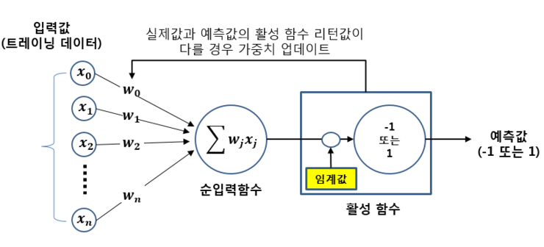

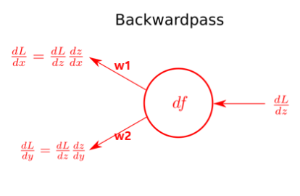
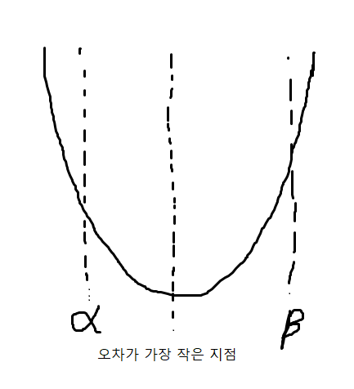
이론적 배경과 선행 연구
연구 주제와 목적

Slide 4
연구 주제와 목적
이론적 배경과 선행 연구

Slide 5
이론적 배경과 선행 연구

Slide 6
이론적 배경과 선행 연구

Slide 7
이론적 배경과 선행 연구

Slide 8

이론적 배경과 선행 연구

Slide 9







이론적 배경과 선행 연구

Slide 10
활동 및 과정
이론적 배경과 선행 연구

Slide 11
이론적 배경과 선행 연구
활동 및 과정
#include <stdio.h>
#include <math.h>
#include <stdlib.h>
#include <time.h>
#include <string.h>
#define E 2.718281
#define _CRT_SECURE_NO_WARNINGS
double learning_rate = 0.1;
double label[200][2] = {{0.01, 0.99}, {0.01, 0.99}, {0.01, 0.01}, {0.01, 0.01}}; //출력 데이터의 target값(정답)
int input_n = 150, layer = 1;
struct perceptron{
double sub[200][4];
double delta[200];
double net[200];
double out[200];
double weight[4];
};
struct hidden_layer{ //은닉층
int length = 2;
struct perceptron perceptron[2];
};
struct input_layer{ //입력층
int n = 4;
int length = 2;
double input[200][10];
};
struct output_layer{ //출력층
int length = 2;
struct perceptron perceptron[2];
};
double sigmoid(double input){ //활성화함수 시그모이드
return 1/(1+pow(E, -1*input));
}
static struct hidden_layer hidden_layer[1];
static struct input_layer input_layer[1];
static struct output_layer output_layer[1];
void foward_pass(void){ //입력값을 통해 출력값
for(int i = 0; i < input_layer[0].n; i++){
for(int j = 0; j < hidden_layer[0].length; j++){
hidden_layer[0].perceptron[j].net[i] = 0;
for(int o = 0; o < input_layer[0].length; o++){
hidden_layer[0].perceptron[j].net[i] += input_layer[0].input[i][o]*hidden_layer[0].perceptron[j].weight[o];
}
hidden_layer[0].perceptron[j].out[i] = sigmoid(hidden_layer[0].perceptron[j].net[i]);
}
}
for(int i = 0; i < input_layer[0].n; i++){
for(int j = 0; j < output_layer[0].length; j++){
output_layer[0].perceptron[j].net[i] = 0;
for(int o = 0; o < hidden_layer[layer-1].length; o++){
output_layer[0].perceptron[j].net[i] += hidden_layer[layer-1].perceptron[o].out[i]*output_layer[0].perceptron[j].weight[o];
}
output_layer[0].perceptron[j].out[i] = sigmoid(output_layer[0].perceptron[j].net[i]);
}
}
}
void back_prapagation(void){ //오차역전파 : 출력값과 target값을 비교하여서 perceptron들의 weight를 조정
for(int i = 0; i < input_layer[0].n; i++){
for(int j = 0; j < output_layer[0].length; j++){
output_layer[0].perceptron[j].delta[i] = (output_layer[0].perceptron[j].out[i]-label[i][j])*(1-output_layer[0].perceptron[j].out[i])*output_layer[0].perceptron[j].out[i];
for(int k = 0; k < hidden_layer[layer-1].length; k++){
output_layer[0].perceptron[j].sub[i][k] = output_layer[0].perceptron[j].delta[i]*hidden_layer[layer-1].perceptron[k].out[i];
}
}
}
for(int i = 0; i < input_layer[0].n; i++){
for(int j = 0; j < hidden_layer[layer-1].length; j++){
hidden_layer[layer-1].perceptron[j].delta[i] = 0;
for(int k = 0; k < output_layer[0].length; k++){
hidden_layer[layer-1].perceptron[j].delta[i] += output_layer[0].perceptron[k].delta[i]*output_layer[0].perceptron[k].weight[j];
}
hidden_layer[layer-1].perceptron[j].delta[i] *= hidden_layer[layer-1].perceptron[j].out[i]*(1-hidden_layer[layer-1].perceptron[j].out[i]);
for(int k = 0; k < input_layer[0].length; k++){
hidden_layer[layer-1].perceptron[j].sub[i][k] = hidden_layer[layer-1].perceptron[j].delta[i]*input_layer[layer-1].input[i][k];
}
}
}
for(int i = 0; i < input_layer[0].n; i++){
for(int j = 0; j < hidden_layer[layer-1].length; j++){
for(int k = 0; k < input_layer[0].length; k++){
hidden_layer[layer-1].perceptron[j].weight[k] -= learning_rate*hidden_layer[layer-1].perceptron[j].sub[i][k];
}
}
}
for(int i = 0; i < input_layer[0].n; i++){
for(int j = 0; j < output_layer[0].length; j++){
for(int k = 0; k < hidden_layer[layer-1].length; k++){
output_layer[0].perceptron[j].weight[k] -= learning_rate*output_layer[0].perceptron[j].sub[i][k];
}
}
}
}
double cost_function(void){ //출력값과 타겟값(label)의 오차를 비교, 나중에 모델의 학습정도를 평가하는 기준으로 사용함
double temp = 0;
for(int i = 0; i < input_layer[0].n; i++){
temp += (output_layer[0].perceptron[0].out[i]-label[i][0])*(output_layer[0].perceptron[0].out[i]-label[i][0]);
temp += (output_layer[0].perceptron[1].out[i]-label[i][1])*(output_layer[0].perceptron[1].out[i]-label[i][1]);
}
return temp;
}
int main(){
int temp;
printf("학습 데이터 :");
scanf("%d", &temp);
if(temp == 1){ //iris(붓꽃)데이터의 csv파일을 불러와 input_layer에 넣음
char str_tmp[1024];
FILE *pFile = NULL;
int index = 0;
pFile = fopen("D:/ANN-by-c-main/ANN-by-c-main/iri", "r" );
if( pFile != NULL )
{
printf("csv file detected!\n");
fgets( str_tmp, 1024, pFile );
while( !feof( pFile ) ){
fgets( str_tmp, 1024, pFile );
char *ptr = strtok(str_tmp, ",");
int cnt = 0;
double num = atof(ptr);
ptr = strtok(NULL, ",");
while (ptr != NULL)
{
if(cnt == 4){
label[index][0] =0.01;
if(strcmp(ptr, "setosa\n") == 0){
label[index][1] = 0.01;
}
else if(strcmp(ptr, "versicolor\n") == 0){
label[index][1] = 0.55;
}
else{
label[index][1] = 0.99;
}
}
else{
double num = atof(ptr);
input_layer[0].input[index][cnt] = num/10;
}
ptr = strtok(NULL, ",");
cnt++;
}
double temp = input_layer[0].input[index][1];
input_layer[0].input[index][1] = input_layer[0].input[index][2];
input_layer[0].input[index][2] = input_layer[0].input[index][1];
index++;
}
}
fclose( pFile );
}
else{ //xor문제의 데이터를 input_layer에 넣음
input_layer[0].input[0][0] = 0.99;
input_layer[0].input[0][1] = 0.01;
input_layer[0].input[1][0] = 0.01;
input_layer[0].input[1][1] = 0.99;
input_layer[0].input[2][0] = 0.99;
input_layer[0].input[2][1] = 0.99;
input_layer[0].input[3][0] = 0.01;
input_layer[0].input[3][1] = 0.01;
}
//random weight
srand((unsigned)time(NULL));
//first hidden layer
for(int i = 0; i < hidden_layer[0].length; i++){
for(int j = 0 ; j < input_layer[0].length; j++){
hidden_layer[0].perceptron[i].weight[j] = ((rand()*rand())%1000000)*0.000001;
}
}
//leftover hidden layer
for(int k = 1; k < layer; k++){
for(int i = 0; i < hidden_layer[k].length; i++){
for(int j = 0 ; j < hidden_layer[k-1].length; j++){
hidden_layer[k].perceptron[i].weight[j] = ((rand()*rand())%1000000)*0.000001;
}
}
}
//output layer
for(int i = 0; i < output_layer[0].length; i++){
for(int j = 0 ; j < hidden_layer[layer-1].length; j++){
output_layer[0].perceptron[i].weight[j] = ((rand()*rand())%1000000)*0.000001;
}
}
printf("input_n : ");
scanf("%d", &input_n);
input_layer[0].n = input_n;
for(int i = 0; i < input_n; i++){
printf("%lf %lf\n", input_layer[0].input[i][0], input_layer[0].input[i][1]);
printf("label[%d] : %lf %lf\n", i, label[i][0], label[i][1]);
}
printf("학습횟수 : ");
int cnt;
scanf("%d", &cnt);
for(temp = 1; temp <= cnt; temp++){
foward_pass();
if(temp%1000 == 1){
printf("**%d번째 학습**\n", temp);
for(int i = 0; i < input_layer[0].n; i++){
printf("out[%d][1] : %lf\n", i, output_layer[0].perceptron[1].out[i]);
}
printf("cost : %lf\n", cost_function());
}
save = cost_function();
back_prapagation();
}
}

Slide 12
활동 및 과정
#include <stdio.h>
#include <math.h>
#include <stdlib.h>
#include <time.h>
#include <string.h>
#define E 2.718281
#define _CRT_SECURE_NO_WARNINGS
double learning_rate = 0.1;
double label[200][2] = {{0.01, 0.99}, {0.01, 0.99}, {0.01, 0.01}, {0.01, 0.01}}; //출력 데이터의 target값(정답)
int input_n = 150, layer = 1;
struct perceptron{
double sub[200][4];
double delta[200];
double net[200];
double out[200];
double weight[4];
};
struct hidden_layer{ //은닉층
int length = 2;
struct perceptron perceptron[2];
};
struct input_layer{ //입력층
int n = 4;
int length = 2;
double input[200][10];
};
struct output_layer{ //출력층
int length = 2;
struct perceptron perceptron[2];
};
double sigmoid(double input){ //활성화함수 시그모이드
return 1/(1+pow(E, -1*input));
}
static struct hidden_layer hidden_layer[1];
static struct input_layer input_layer[1];
static struct output_layer output_layer[1];
void foward_pass(void){ //입력값을 통해 출력값
for(int i = 0; i < input_layer[0].n; i++){
for(int j = 0; j < hidden_layer[0].length; j++){
hidden_layer[0].perceptron[j].net[i] = 0;
for(int o = 0; o < input_layer[0].length; o++){
hidden_layer[0].perceptron[j].net[i] += input_layer[0].input[i][o]*hidden_layer[0].perceptron[j].weight[o];
}
hidden_layer[0].perceptron[j].out[i] = sigmoid(hidden_layer[0].perceptron[j].net[i]);
}
}
for(int i = 0; i < input_layer[0].n; i++){
for(int j = 0; j < output_layer[0].length; j++){
output_layer[0].perceptron[j].net[i] = 0;
for(int o = 0; o < hidden_layer[layer-1].length; o++){
output_layer[0].perceptron[j].net[i] += hidden_layer[layer-1].perceptron[o].out[i]*output_layer[0].perceptron[j].weight[o];
}
output_layer[0].perceptron[j].out[i] = sigmoid(output_layer[0].perceptron[j].net[i]);
}
}
}
void back_prapagation(void){ //오차역전파 : 출력값과 target값을 비교하여서 perceptron들의 weight를 조정
for(int i = 0; i < input_layer[0].n; i++){
for(int j = 0; j < output_layer[0].length; j++){
output_layer[0].perceptron[j].delta[i] = (output_layer[0].perceptron[j].out[i]-label[i][j])*(1-output_layer[0].perceptron[j].out[i])*output_layer[0].perceptron[j].out[i];
for(int k = 0; k < hidden_layer[layer-1].length; k++){
output_layer[0].perceptron[j].sub[i][k] = output_layer[0].perceptron[j].delta[i]*hidden_layer[layer-1].perceptron[k].out[i];
}
}
}
for(int i = 0; i < input_layer[0].n; i++){
for(int j = 0; j < hidden_layer[layer-1].length; j++){
hidden_layer[layer-1].perceptron[j].delta[i] = 0;
for(int k = 0; k < output_layer[0].length; k++){
hidden_layer[layer-1].perceptron[j].delta[i] += output_layer[0].perceptron[k].delta[i]*output_layer[0].perceptron[k].weight[j];
}
hidden_layer[layer-1].perceptron[j].delta[i] *= hidden_layer[layer-1].perceptron[j].out[i]*(1-hidden_layer[layer-1].perceptron[j].out[i]);
for(int k = 0; k < input_layer[0].length; k++){
hidden_layer[layer-1].perceptron[j].sub[i][k] = hidden_layer[layer-1].perceptron[j].delta[i]*input_layer[layer-1].input[i][k];
}
}
}
for(int i = 0; i < input_layer[0].n; i++){
for(int j = 0; j < hidden_layer[layer-1].length; j++){
for(int k = 0; k < input_layer[0].length; k++){
hidden_layer[layer-1].perceptron[j].weight[k] -= learning_rate*hidden_layer[layer-1].perceptron[j].sub[i][k];
}
}
}
for(int i = 0; i < input_layer[0].n; i++){
for(int j = 0; j < output_layer[0].length; j++){
for(int k = 0; k < hidden_layer[layer-1].length; k++){
output_layer[0].perceptron[j].weight[k] -= learning_rate*output_layer[0].perceptron[j].sub[i][k];
}
}
}
}
double cost_function(void){ //출력값과 타겟값(label)의 오차를 비교, 나중에 모델의 학습정도를 평가하는 기준으로 사용함
double temp = 0;
for(int i = 0; i < input_layer[0].n; i++){
temp += (output_layer[0].perceptron[0].out[i]-label[i][0])*(output_layer[0].perceptron[0].out[i]-label[i][0]);
temp += (output_layer[0].perceptron[1].out[i]-label[i][1])*(output_layer[0].perceptron[1].out[i]-label[i][1]);
}
return temp;
}
int main(){
int temp;
printf("학습 데이터 :");
scanf("%d", &temp);
if(temp == 1){ //iris(붓꽃)데이터의 csv파일을 불러와 input_layer에 넣음
char str_tmp[1024];
FILE *pFile = NULL;
int index = 0;
pFile = fopen("D:/ANN-by-c-main/ANN-by-c-main/iri", "r" );
if( pFile != NULL )
{
printf("csv file detected!\n");
fgets( str_tmp, 1024, pFile );
while( !feof( pFile ) ){
fgets( str_tmp, 1024, pFile );
char *ptr = strtok(str_tmp, ",");
int cnt = 0;
double num = atof(ptr);
ptr = strtok(NULL, ",");
while (ptr != NULL)
{
if(cnt == 4){
label[index][0] =0.01;
if(strcmp(ptr, "setosa\n") == 0){
label[index][1] = 0.01;
}
else if(strcmp(ptr, "versicolor\n") == 0){
label[index][1] = 0.55;
}
else{
label[index][1] = 0.99;
}
}
else{
double num = atof(ptr);
input_layer[0].input[index][cnt] = num/10;
}
ptr = strtok(NULL, ",");
cnt++;
}
double temp = input_layer[0].input[index][1];
input_layer[0].input[index][1] = input_layer[0].input[index][2];
input_layer[0].input[index][2] = input_layer[0].input[index][1];
index++;
}
}
fclose( pFile );
}
else{ //xor문제의 데이터를 input_layer에 넣음
input_layer[0].input[0][0] = 0.99;
input_layer[0].input[0][1] = 0.01;
input_layer[0].input[1][0] = 0.01;
input_layer[0].input[1][1] = 0.99;
input_layer[0].input[2][0] = 0.99;
input_layer[0].input[2][1] = 0.99;
input_layer[0].input[3][0] = 0.01;
input_layer[0].input[3][1] = 0.01;
}
//random weight
srand((unsigned)time(NULL));
//first hidden layer
for(int i = 0; i < hidden_layer[0].length; i++){
for(int j = 0 ; j < input_layer[0].length; j++){
hidden_layer[0].perceptron[i].weight[j] = ((rand()*rand())%1000000)*0.000001;
}
}
//leftover hidden layer
for(int k = 1; k < layer; k++){
for(int i = 0; i < hidden_layer[k].length; i++){
for(int j = 0 ; j < hidden_layer[k-1].length; j++){
hidden_layer[k].perceptron[i].weight[j] = ((rand()*rand())%1000000)*0.000001;
}
}
}
//output layer
for(int i = 0; i < output_layer[0].length; i++){
for(int j = 0 ; j < hidden_layer[layer-1].length; j++){
output_layer[0].perceptron[i].weight[j] = ((rand()*rand())%1000000)*0.000001;
}
}
printf("input_n : ");
scanf("%d", &input_n);
input_layer[0].n = input_n;
for(int i = 0; i < input_n; i++){
printf("%lf %lf\n", input_layer[0].input[i][0], input_layer[0].input[i][1]);
printf("label[%d] : %lf %lf\n", i, label[i][0], label[i][1]);
}
printf("학습횟수 : ");
int cnt;
scanf("%d", &cnt);
for(temp = 1; temp <= cnt; temp++){
foward_pass();
if(temp%1000 == 1){
printf("**%d번째 학습**\n", temp);
for(int i = 0; i < input_layer[0].n; i++){
printf("out[%d][1] : %lf\n", i, output_layer[0].perceptron[1].out[i]);
}
printf("cost : %lf\n", cost_function());
}
save = cost_function();
back_prapagation();
}
}
연구 결과

Slide 13
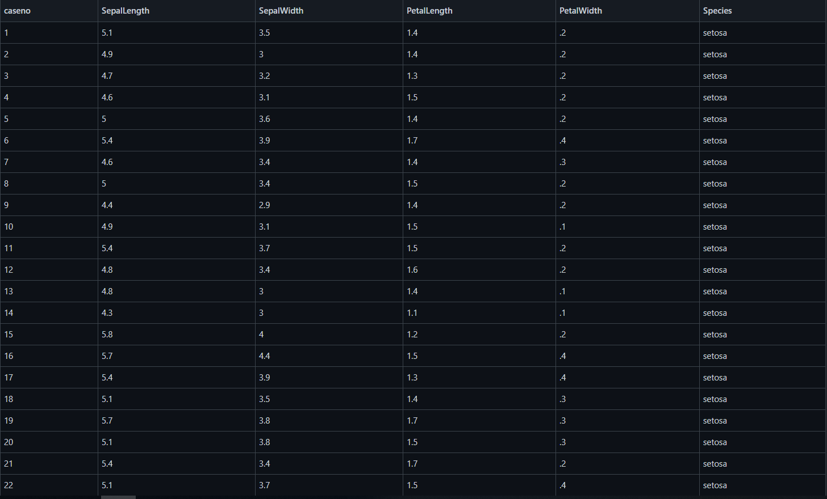
#include <stdio.h>
#include <math.h>
#include <stdlib.h>
#include <time.h>
#include <string.h>
#define E 2.718281
#define _CRT_SECURE_NO_WARNINGS
double learning_rate = 0.1;
double label[200][2] = {{0.01, 0.99}, {0.01, 0.99}, {0.01, 0.01}, {0.01, 0.01}}; //출력 데이터의 target값(정답)
int input_n = 150, layer = 1;
struct perceptron{
double sub[200][4];
double delta[200];
double net[200];
double out[200];
double weight[4];
};
struct hidden_layer{ //은닉층
int length = 2;
struct perceptron perceptron[2];
};
struct input_layer{ //입력층
int n = 4;
int length = 2;
double input[200][10];
};
struct output_layer{ //출력층
int length = 2;
struct perceptron perceptron[2];
};
double sigmoid(double input){ //활성화함수 시그모이드
return 1/(1+pow(E, -1*input));
}
static struct hidden_layer hidden_layer[1];
static struct input_layer input_layer[1];
static struct output_layer output_layer[1];
void foward_pass(void){ //입력값을 통해 출력값
for(int i = 0; i < input_layer[0].n; i++){
for(int j = 0; j < hidden_layer[0].length; j++){
hidden_layer[0].perceptron[j].net[i] = 0;
for(int o = 0; o < input_layer[0].length; o++){
hidden_layer[0].perceptron[j].net[i] += input_layer[0].input[i][o]*hidden_layer[0].perceptron[j].weight[o];
}
hidden_layer[0].perceptron[j].out[i] = sigmoid(hidden_layer[0].perceptron[j].net[i]);
}
}
for(int i = 0; i < input_layer[0].n; i++){
for(int j = 0; j < output_layer[0].length; j++){
output_layer[0].perceptron[j].net[i] = 0;
for(int o = 0; o < hidden_layer[layer-1].length; o++){
output_layer[0].perceptron[j].net[i] += hidden_layer[layer-1].perceptron[o].out[i]*output_layer[0].perceptron[j].weight[o];
}
output_layer[0].perceptron[j].out[i] = sigmoid(output_layer[0].perceptron[j].net[i]);
}
}
}
void back_prapagation(void){ //오차역전파 : 출력값과 target값을 비교하여서 perceptron들의 weight를 조정
for(int i = 0; i < input_layer[0].n; i++){
for(int j = 0; j < output_layer[0].length; j++){
output_layer[0].perceptron[j].delta[i] = (output_layer[0].perceptron[j].out[i]-label[i][j])*(1-output_layer[0].perceptron[j].out[i])*output_layer[0].perceptron[j].out[i];
for(int k = 0; k < hidden_layer[layer-1].length; k++){
output_layer[0].perceptron[j].sub[i][k] = output_layer[0].perceptron[j].delta[i]*hidden_layer[layer-1].perceptron[k].out[i];
}
}
}
for(int i = 0; i < input_layer[0].n; i++){
for(int j = 0; j < hidden_layer[layer-1].length; j++){
hidden_layer[layer-1].perceptron[j].delta[i] = 0;
for(int k = 0; k < output_layer[0].length; k++){
hidden_layer[layer-1].perceptron[j].delta[i] += output_layer[0].perceptron[k].delta[i]*output_layer[0].perceptron[k].weight[j];
}
hidden_layer[layer-1].perceptron[j].delta[i] *= hidden_layer[layer-1].perceptron[j].out[i]*(1-hidden_layer[layer-1].perceptron[j].out[i]);
for(int k = 0; k < input_layer[0].length; k++){
hidden_layer[layer-1].perceptron[j].sub[i][k] = hidden_layer[layer-1].perceptron[j].delta[i]*input_layer[layer-1].input[i][k];
}
}
}
for(int i = 0; i < input_layer[0].n; i++){
for(int j = 0; j < hidden_layer[layer-1].length; j++){
for(int k = 0; k < input_layer[0].length; k++){
hidden_layer[layer-1].perceptron[j].weight[k] -= learning_rate*hidden_layer[layer-1].perceptron[j].sub[i][k];
}
}
}
for(int i = 0; i < input_layer[0].n; i++){
for(int j = 0; j < output_layer[0].length; j++){
for(int k = 0; k < hidden_layer[layer-1].length; k++){
output_layer[0].perceptron[j].weight[k] -= learning_rate*output_layer[0].perceptron[j].sub[i][k];
}
}
}
}
double cost_function(void){ //출력값과 타겟값(label)의 오차를 비교, 나중에 모델의 학습정도를 평가하는 기준으로 사용함
double temp = 0;
for(int i = 0; i < input_layer[0].n; i++){
temp += (output_layer[0].perceptron[0].out[i]-label[i][0])*(output_layer[0].perceptron[0].out[i]-label[i][0]);
temp += (output_layer[0].perceptron[1].out[i]-label[i][1])*(output_layer[0].perceptron[1].out[i]-label[i][1]);
}
return temp;
}
int main(){
int temp;
printf("학습 데이터 :");
scanf("%d", &temp);
if(temp == 1){ //iris(붓꽃)데이터의 csv파일을 불러와 input_layer에 넣음
char str_tmp[1024];
FILE *pFile = NULL;
int index = 0;
pFile = fopen("D:/ANN-by-c-main/ANN-by-c-main/iri", "r" );
if( pFile != NULL )
{
printf("csv file detected!\n");
fgets( str_tmp, 1024, pFile );
while( !feof( pFile ) ){
fgets( str_tmp, 1024, pFile );
char *ptr = strtok(str_tmp, ",");
int cnt = 0;
double num = atof(ptr);
ptr = strtok(NULL, ",");
while (ptr != NULL)
{
if(cnt == 4){
label[index][0] =0.01;
if(strcmp(ptr, "setosa\n") == 0){
label[index][1] = 0.01;
}
else if(strcmp(ptr, "versicolor\n") == 0){
label[index][1] = 0.55;
}
else{
label[index][1] = 0.99;
}
}
else{
double num = atof(ptr);
input_layer[0].input[index][cnt] = num/10;
}
ptr = strtok(NULL, ",");
cnt++;
}
double temp = input_layer[0].input[index][1];
input_layer[0].input[index][1] = input_layer[0].input[index][2];
input_layer[0].input[index][2] = input_layer[0].input[index][1];
index++;
}
}
fclose( pFile );
}
else{ //xor문제의 데이터를 input_layer에 넣음
input_layer[0].input[0][0] = 0.99;
input_layer[0].input[0][1] = 0.01;
input_layer[0].input[1][0] = 0.01;
input_layer[0].input[1][1] = 0.99;
input_layer[0].input[2][0] = 0.99;
input_layer[0].input[2][1] = 0.99;
input_layer[0].input[3][0] = 0.01;
input_layer[0].input[3][1] = 0.01;
}
//random weight
srand((unsigned)time(NULL));
//first hidden layer
for(int i = 0; i < hidden_layer[0].length; i++){
for(int j = 0 ; j < input_layer[0].length; j++){
hidden_layer[0].perceptron[i].weight[j] = ((rand()*rand())%1000000)*0.000001;
}
}
//leftover hidden layer
for(int k = 1; k < layer; k++){
for(int i = 0; i < hidden_layer[k].length; i++){
for(int j = 0 ; j < hidden_layer[k-1].length; j++){
hidden_layer[k].perceptron[i].weight[j] = ((rand()*rand())%1000000)*0.000001;
}
}
}
//output layer
for(int i = 0; i < output_layer[0].length; i++){
for(int j = 0 ; j < hidden_layer[layer-1].length; j++){
output_layer[0].perceptron[i].weight[j] = ((rand()*rand())%1000000)*0.000001;
}
}
printf("input_n : ");
scanf("%d", &input_n);
input_layer[0].n = input_n;
for(int i = 0; i < input_n; i++){
printf("%lf %lf\n", input_layer[0].input[i][0], input_layer[0].input[i][1]);
printf("label[%d] : %lf %lf\n", i, label[i][0], label[i][1]);
}
printf("학습횟수 : ");
int cnt;
scanf("%d", &cnt);
for(temp = 1; temp <= cnt; temp++){
foward_pass();
if(temp%1000 == 1){
printf("**%d번째 학습**\n", temp);
for(int i = 0; i < input_layer[0].n; i++){
printf("out[%d][1] : %lf\n", i, output_layer[0].perceptron[1].out[i]);
}
printf("cost : %lf\n", cost_function());
}
save = cost_function();
back_prapagation();
}
}
연구 결과

Slide 14
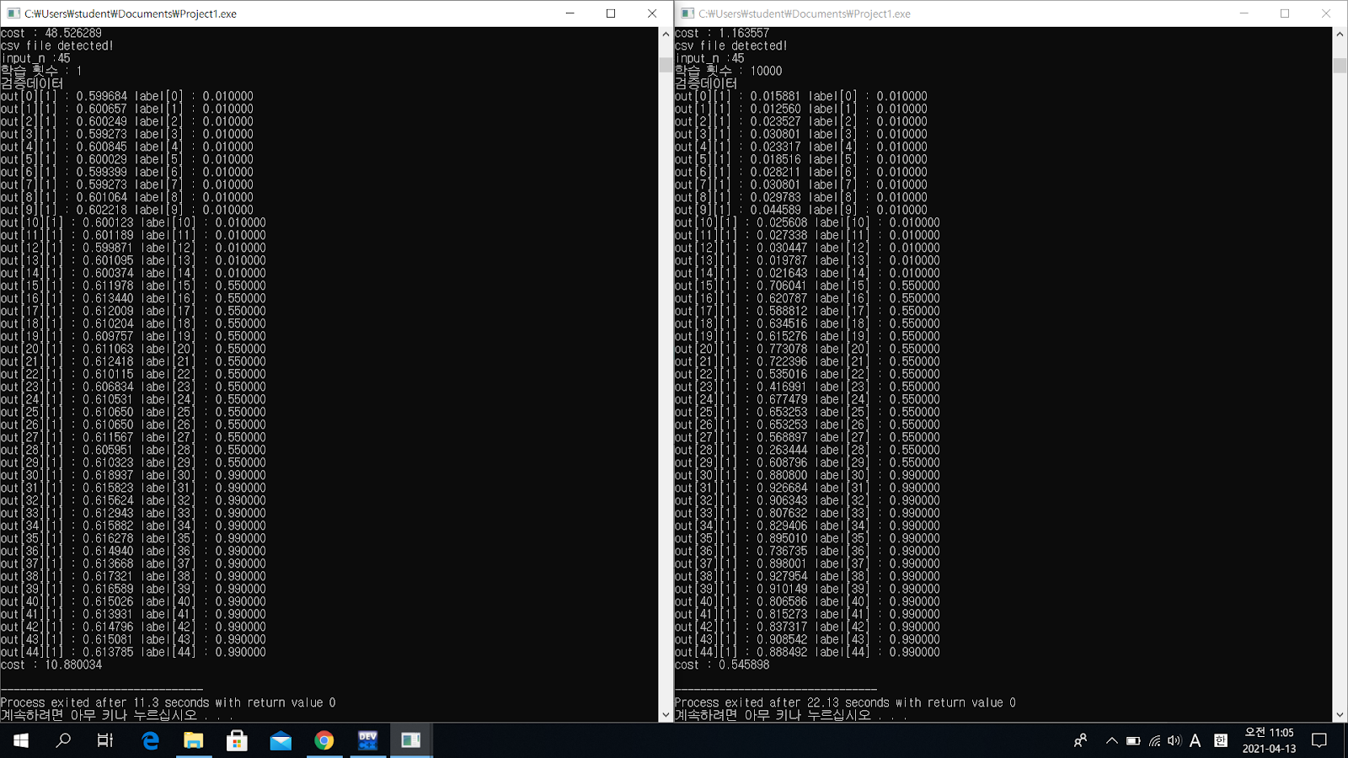
연구 결과

Slide 15
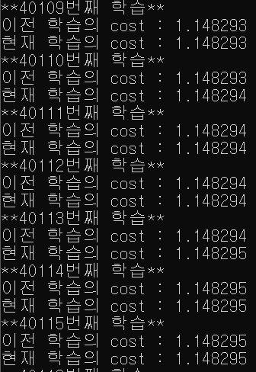
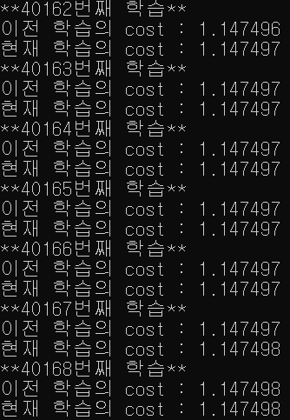
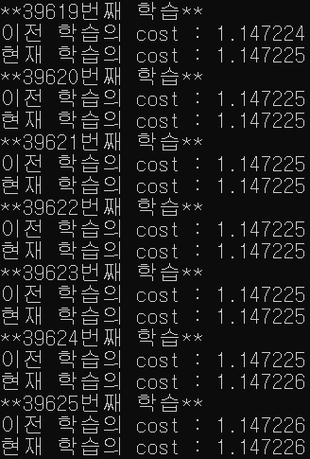
연구 결과

Slide 16
연구 결과

Slide 17
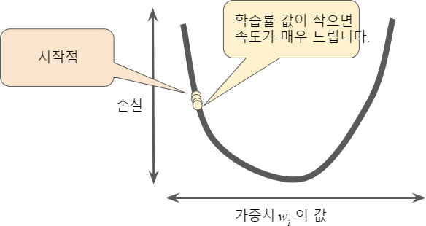
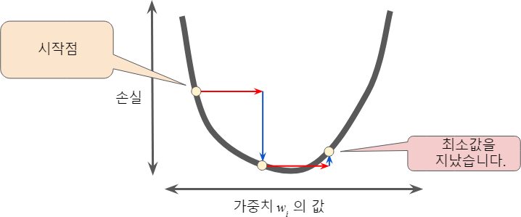
연구 결과
몰라!!!!!!!!!

Slide 18
연구 결과

Slide 19
연구 결과

Slide 20
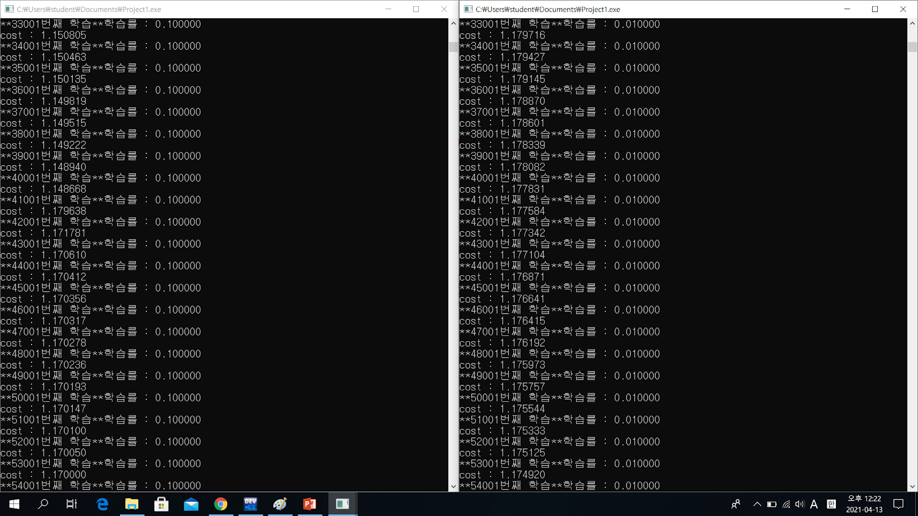
연구 결과

Slide 21
결론
연구 결과

Slide 22
연구 결과
결론
“쌀국수 먹을래?”
-정성훈(2003~)-

