Slide 1
Battle of the Neighborhoods: Mount Pleasant West

Slide 2
Introduction
There are a lot of affordable hotels in the Toronto Downtown.
A lot of affordable Toronto hotels are located on the outskirts without proper transit coverage.
Tourists are asking for an accommodation that is: reasonably priced, not too far away from the downtown, have venue nearby and have rapid transit coverage

Slide 3
Data Description
- Neighborhood Spatial Data provided by the City of Toronto.
- Foursquare data - to source venues, such as restaurants, parks, cinemas, etc
- Google Maps.

Slide 4
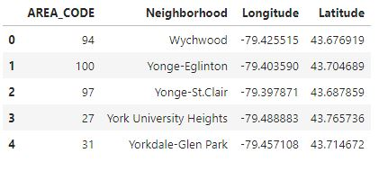
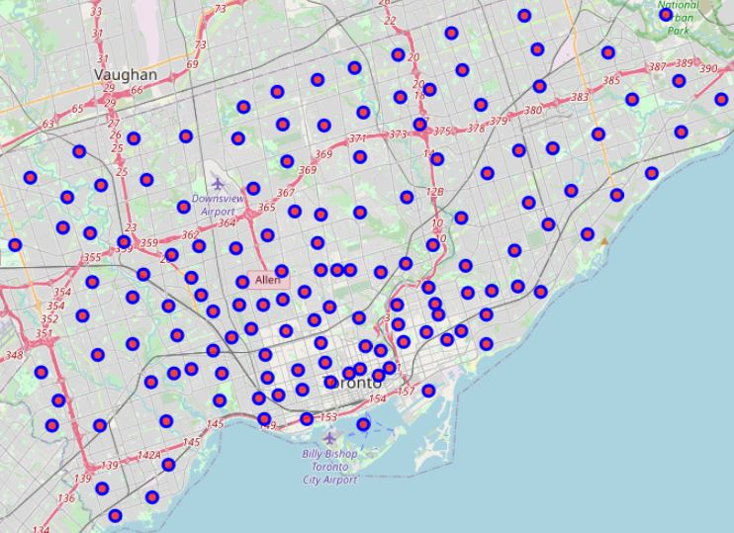
All neighborhoods were located using the Geospatial Data provided by the City of Toronto

Slide 5
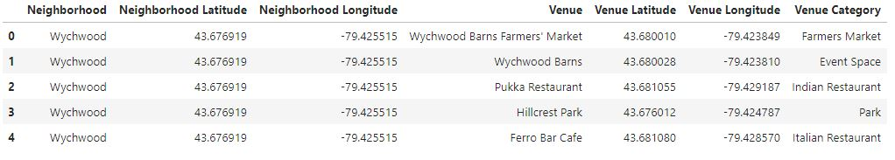
Foursquare API
First query – locating maximum 50 venues around each neighborhood center
3387 venues;
306 unique categories.

Slide 6
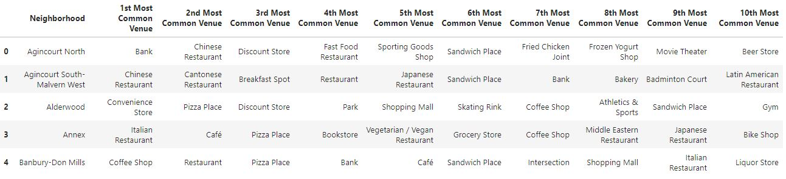
Top 10 venues in each neighborhood
This data gives a clear vision on each neighborhood – what is the most popular venue in each area.

Slide 7
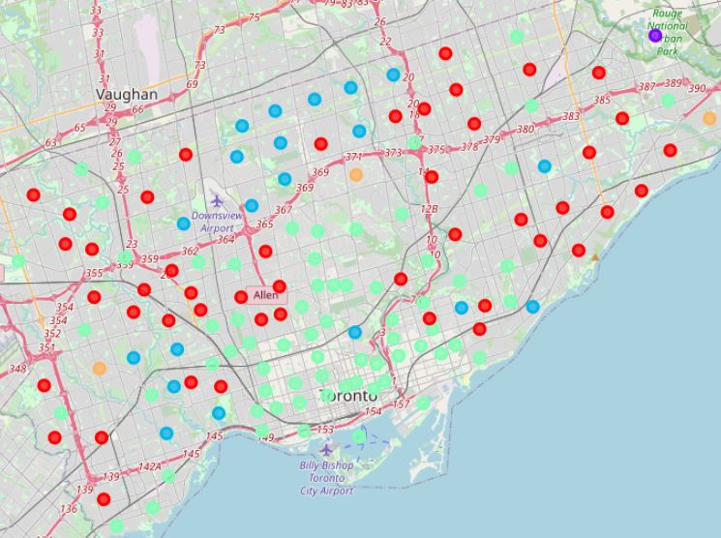
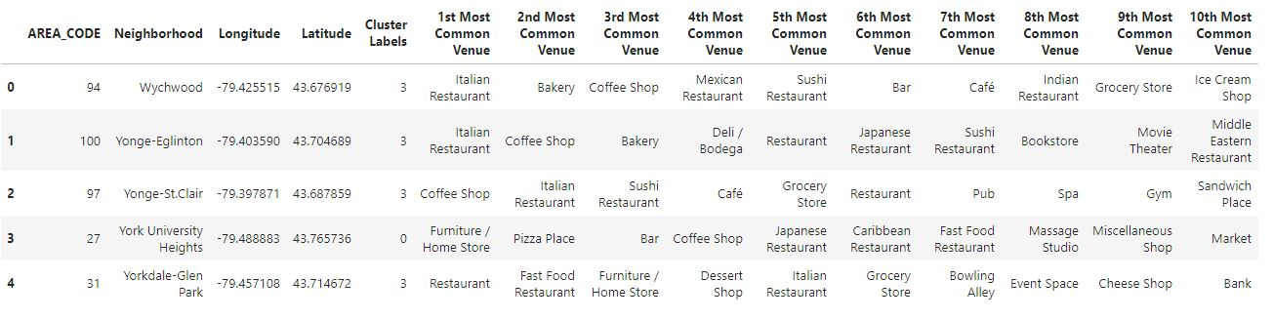
Clustering
All neighborhoods were divided into the 5 clusters

Slide 8
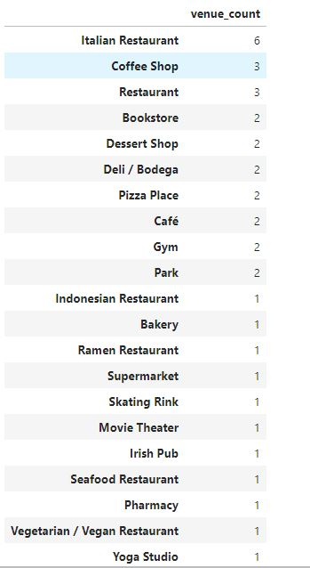
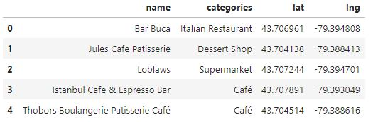
Mount Pleasant West
Analyzing the neighborhood using the Foursquare API, it turned out that there are a lot of diverse venues at the neighborhood that make this are very attractive for future hotel guests.

Slide 9
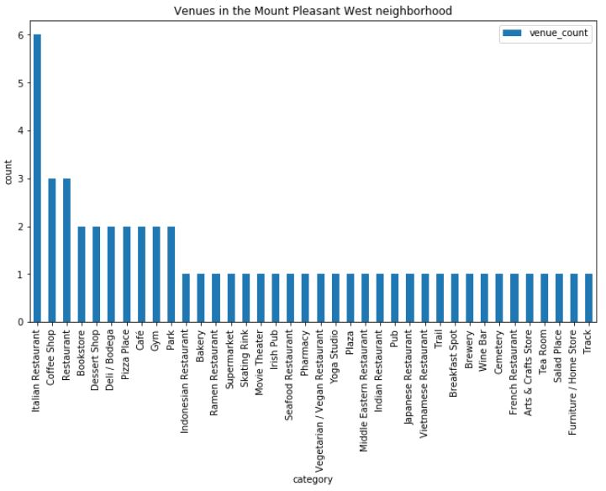
Local Venues
There are possibilities not only to have a great dinner, but also places for physical indoor and outdoor activities.

Slide 10
Accesibility
Toronto Downtown is an area with a regulated use of a private automobile. Public transit is the most optimum way to get around.
It turned out that there is an Eglinton Subway Station only 481 meters away, which makes this neighborhood an easy accessible location.

Slide 11
Conclusion
Future hotel guest can benefit not only from everything that neighborhood has to offer, but also from the convenient rapid transit link to the Downtown core of Toronto.
Final hotel location depends on the various factors, such as real estate availability and the stakeholders decision.

