Slide 1


ETL Pipeline Deployment On AWS
PG-DBDA Mar 2024
Submitted By:
Group No: 04
Roll No. Name.
243522 Vrukodar Jadhav
243505 Avi Bansal
Mr. Abhijit Nagargoje
Project Guide

Slide 2


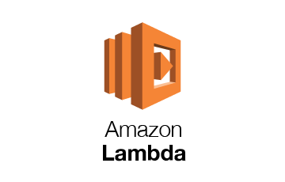
Services Used :-

Slide 3
Amazon S3 (Simple Storage Service) is a scalable cloud storage service used for storing and retrieving large amounts of data. It offers a secure, durable, and highly available storage solution, ideal for storing data like files, backups, or logs.
AWS Lambda is a serverless compute service that allows you to run code in response to events without provisioning or managing servers. It's often used for tasks like processing data in S3 or triggering workflows in response to events.
Amazon Redshift is a fully managed data warehouse service designed for large-scale data processing and complex queries. It enables fast query performance on large datasets, making it ideal for OLAP (Online Analytical Processing) tasks.

Slide 4
Steps Involved In ETL
Define your AWS access key and secret key
Creating bucket to store Input streaming data
Creating Streaming Data
Loading raw data to the S3 bucket
Creating S3 bucket for storing output
Execute AWS Lambda code to combining streaming data(AmazonS3FullAccess : add policy to lambda) + Add pandas layer
Redshift (Load s3 bucket into redshift)
Load s3 bucket into table trial and make it public
GRANT SELECT ON TABLE "dev"."public"."trial" TO PUBLIC;

Slide 5
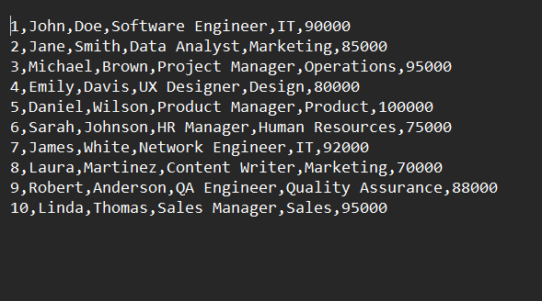
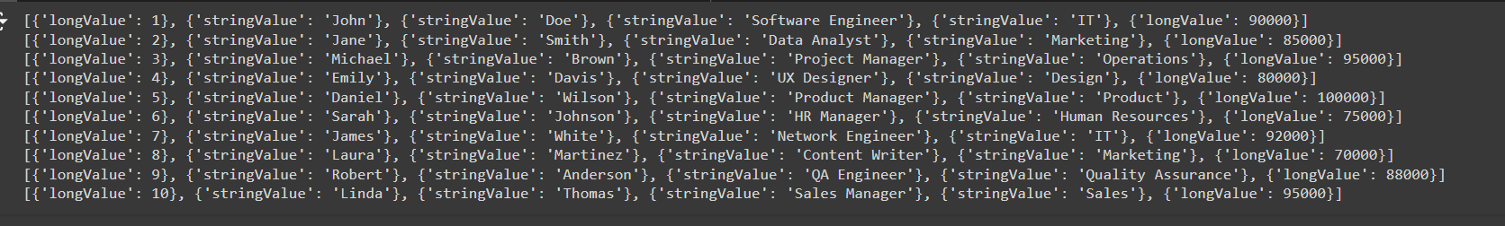
Input Data
Output Data

