Slide 1
Java File I/O

Slide 2
Java brings various Streams with its I/O package that helps the user to perform all the input-output operations.
These streams support all the types of objects, data-types, characters, files etc to fully execute the I/O operations.
Java I/O (Input and Output) is used to process the input and produce the output.
Java uses the concept of a stream to make I/O operation fast. The java.io package contains all the classes required for input and output operations.
We can perform file handling in Java by Java I/O API.

Slide 3
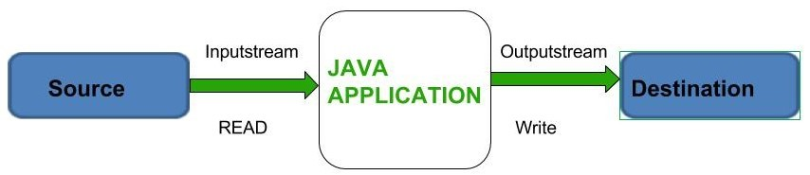

Slide 4
Types of Streams:
Input Stream: These streams are used to read data that must be taken as an input from a source array or file or any peripheral device. For eg., FileInputStream, BufferedInputStream, ByteArrayInputStream etc
Output Stream: These streams are used to write data as outputs into an array or file or any output peripheral device. For eg., FileOutputStream, BufferedOutputStream, ByteArrayOutputStream etc.

Slide 5
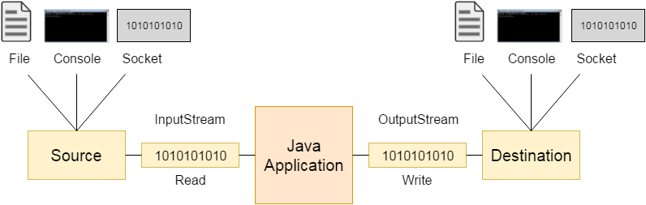
Java OutputStream and InputStream

Slide 6
Depending on the types of file, Streams can be divided into two primary classes which can be further divided into other classes :
ByteStream: This is used to process data byte by byte (8 bits). Though it has many classes, the FileInputStream and the FileOutputStream are the most popular ones. The FileInputStream is used to read from the source and FileOutputStream is used to write to the destination.
CharacterStream: In Java, characters are stored using Unicode conventions (Refer this for details). Character stream automatically allows us to read/write data character by character. Though it has many classes, the FileReader and the FileWriter are the most popular ones. FileReader and FileWriter are character streams used to read from the source and write to the destination respectively

Slide 7
File
The File class from the java.io package, allows us to work with files.
To use the File class, create an object of the class, and specify the filename or directory name:

Slide 8
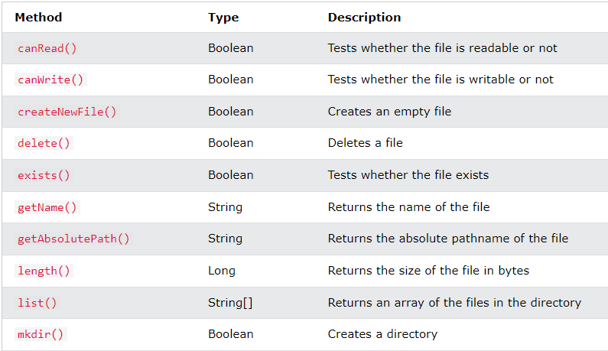

Slide 9
Java BufferedReader Class
Java BufferedReader class is used to read the text from a character-based input stream.
It can be used to read data line by line by readLine() method.
It makes the performance fast.
It inherits Reader class.

Slide 10
FileReader fr=new FileReader("D:\\testout.txt");
BufferedReader br=new BufferedReader(fr);
System.out.println("File contents : ");
String s = null;
while ((s = br.readLine()) != null)
{
System.out.println(s);
}

Slide 11
Java BufferedReader Class
Java BufferedReader class is used to read the text from a character-based input stream.
It can be used to read data line by line by readLine() method.
It makes the performance fast. It inherits Reader class.

Slide 12
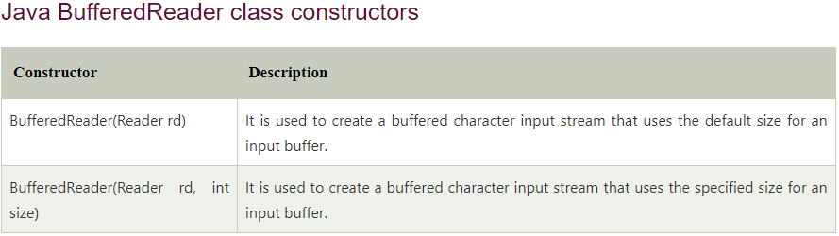

Slide 13
BufferedReader bf=new BufferedReader(new FileReader(sc.next()));
PrintWriter pw=new PrintWriter(new FileWriter(sc.next()));
String line=null;
while((line=bf.readLine())!=null)
{
pw.println(line);
}

Slide 14
Serialization and Deserialization in Java
•Serialization in Java is a mechanism of writing the state of an object into a byte-stream. It is mainly used in Hibernate, RMI, JPA, EJB.
•The reverse operation of serialization is called deserialization where byte-stream is converted into an object.
•The serialization and deserialization process is platform-independent, it means you can serialize an object on one platform and deserialize it on a different platform.

Slide 15
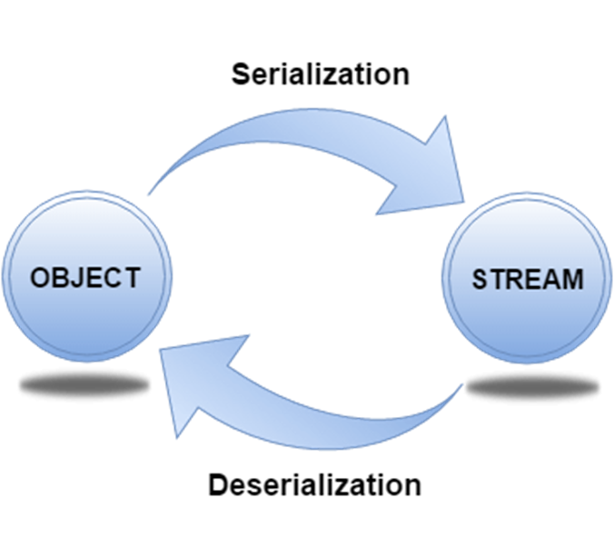
Advantages of Java Serialization
•It is mainly used to travel object's state on the network

Slide 16
java.io.Serializable interface
•Serializable is a marker interface (has no data member and method). It is used to "mark" Java classes so that the objects of these classes may get a certain capability. The Cloneable and Remote are also marker interfaces.
•The Serializable interface must be implemented by the class whose object needs to be persisted.
•The String class and all the wrapper classes implement the java.io.Serializable interface by default.

Slide 17
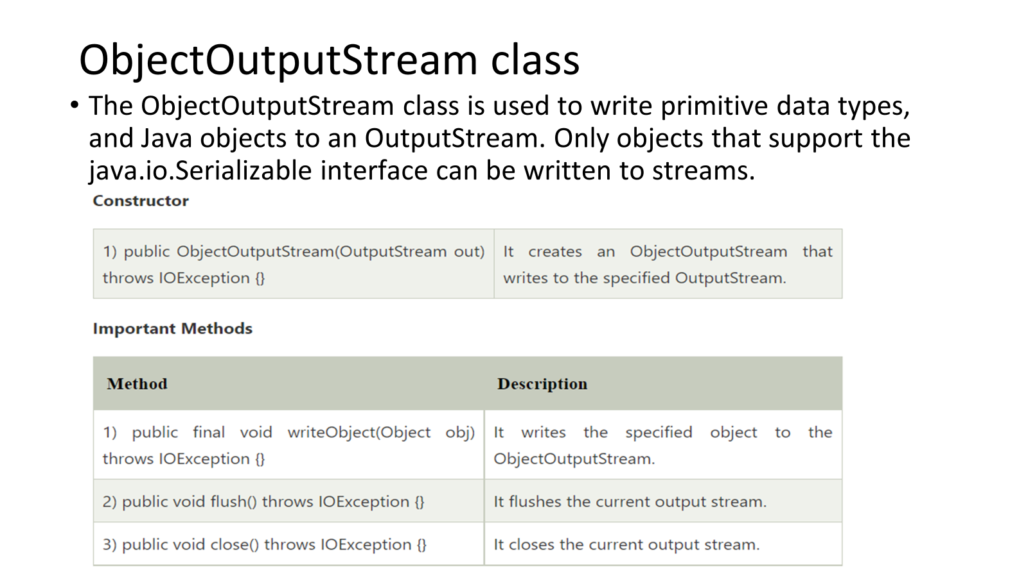

Slide 18
