Slide 1

Build a system to recommend products or content to users based on the historical clickstream data
Size of the dataset: 165474 rows and 14 columns.

Slide 2
Objective
By leveraging historical clickstream data, the system aims to predict and suggest products or content that align with the users' preferences and behaviors, ultimately driving higher conversion rates and improving the overall shopping experience.

Slide 3
User Behaviour analysis is one of the key component our project which represent what kind of information we can analyse from Raw data by Pre-Processing it. Contains data segmentation pattern detection Feature engineering.
Pre-Processing and User Behaviour Analysis

Slide 4
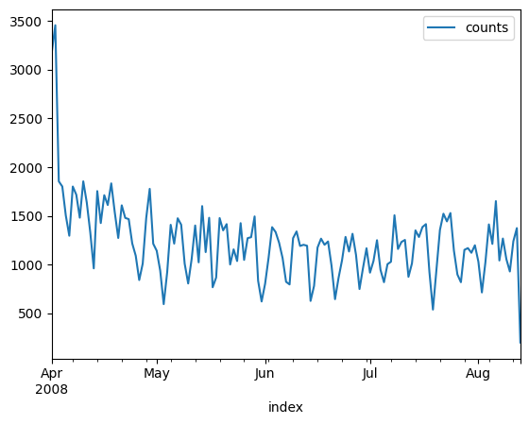
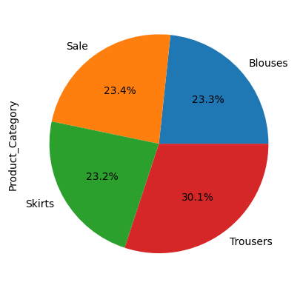
Clicks count during the interval Apr 2008 -Sep 2008
What Kind of Clothing Is most Sold

Slide 5
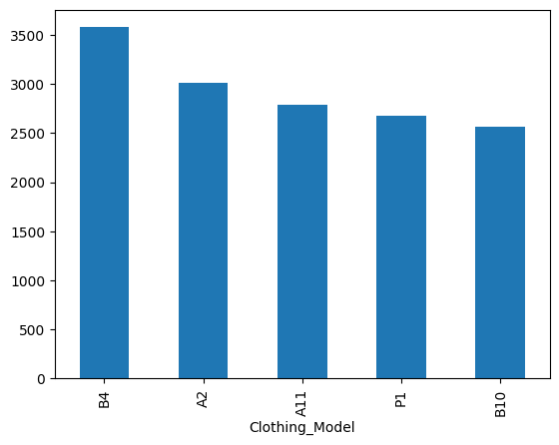
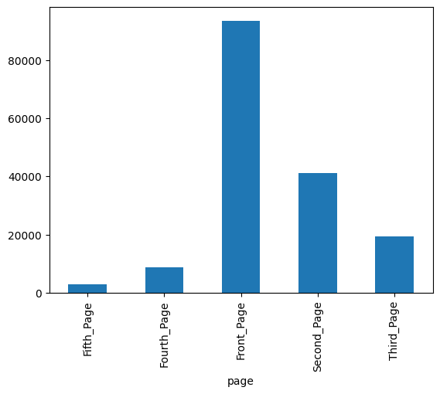
What Kind of pages contribute most Clicks
Top 5 Clothing Model

Slide 6
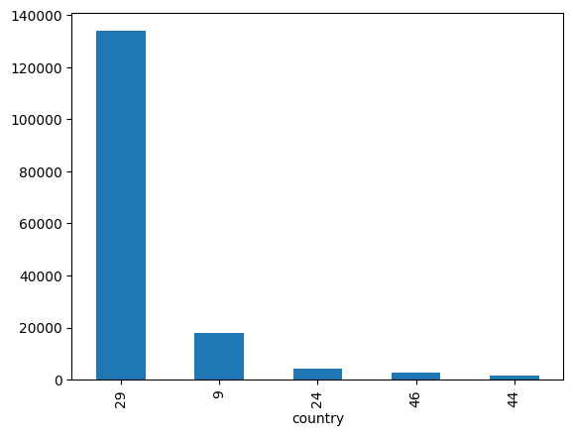
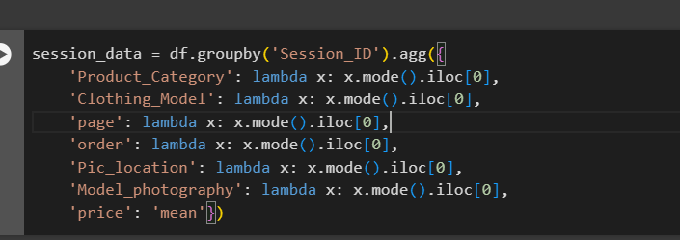
Which Country Contribute most Clicks
Data Engineering

Slide 7
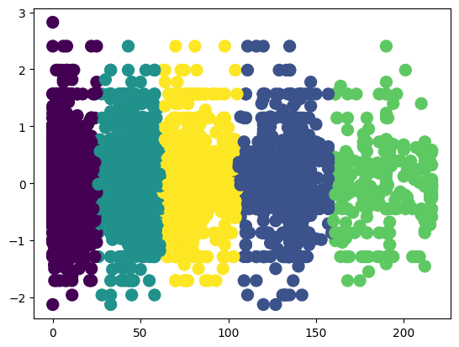
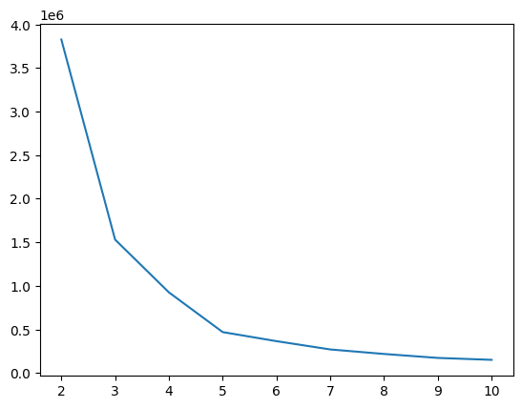
Customer Segmentation Based on Session Average Clicks Using K-means

Slide 8
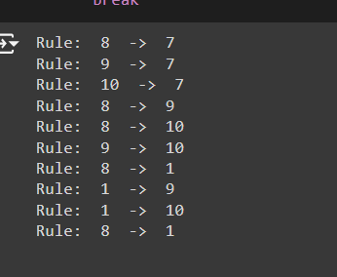
Pattern Detection - Sequence Of clicks in a different Session
Using Apriori algorithm : - Finding patten in the Sequence of Clicks

Slide 9
Model Selection
Collaborative Filtering:
User-based,
Item-based.
Errors:
MSE
RMSE

