Slide 1
SECURE DATA HIDING IN IMAGES USING STEGANOGRAPHY
CAPSTONE PROJECT
Presented By : Abhishek Sahu
Student Name : Abhishek Sahu
College Name : St. Francis De Sales College
Department : Computer Science

Slide 2
OUTLINE
Problem Statement
Technology used
Wow factor
End users
Result
Conclusion
Git-hub Link
Future scope

Slide 3
Problem Statement
In today's digital age, secure data transmission is crucial. Traditional encryption methods can be easily detected and intercepted. There is a need for a more covert method to hide sensitive information within seemingly innocuous files. Steganography offers a solution by embedding data within images, making it difficult to detect without the proper tools

Slide 4
Technology used
Programming Language: Python
Libraries: OpenCV, NumPy
Platform: Windows/Linux/MacOS
Tools: Visual Studio Code

Slide 5
Wow factors
Invisible Data Hiding: Embeds secret messages into images, making them invisible to the naked eye.
Passcode Protection: Ensures only authorized users can access hidden messages.
Robust Security: Uses lossless PNG format to preserve hidden data integrity.
User-Friendly: Simple command-line interface for easy encryption and decryption.
Cross-Platform: Works seamlessly on Windows, macOS, and Linux.

Slide 6
End users
Government Agencies: For secure communication.
Military: For covert operations.
Businesses: To protect sensitive corporate data.
Individuals: For personal data security.

Slide 7
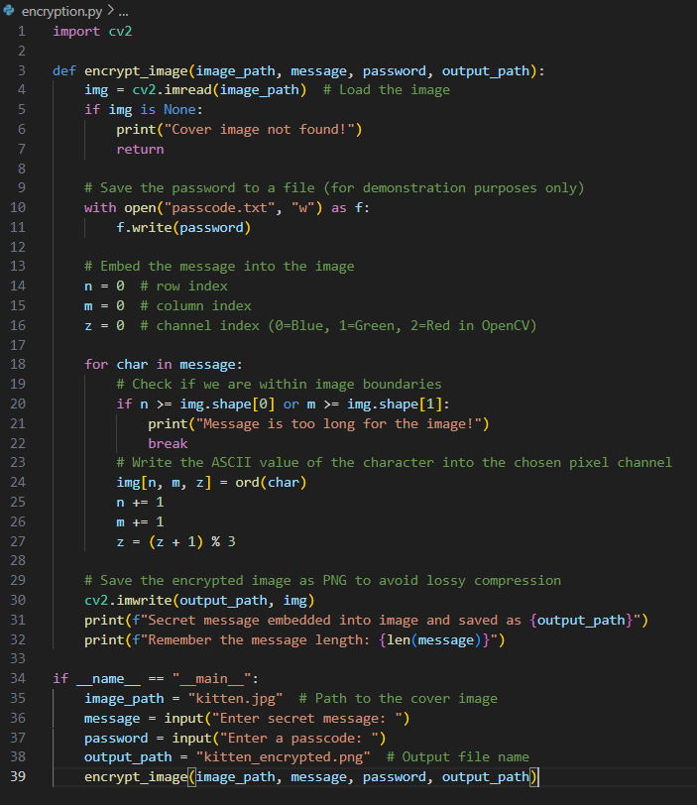
Results

Slide 8
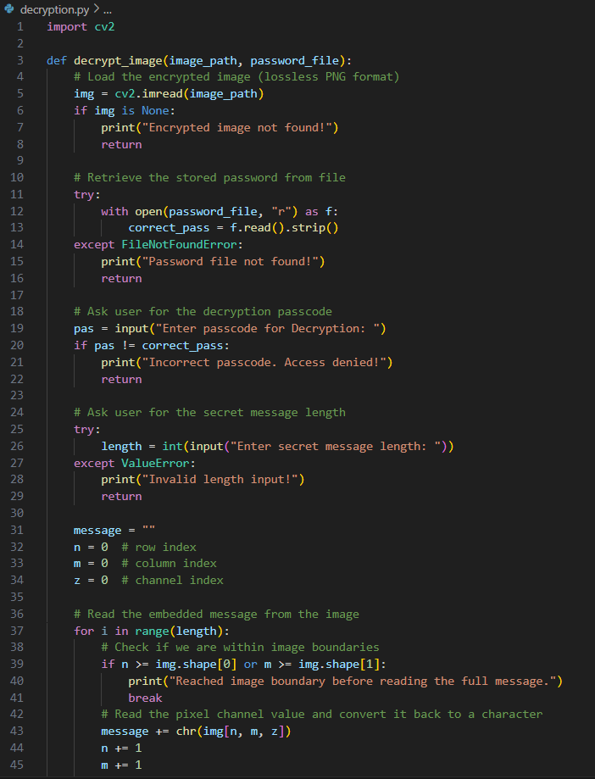
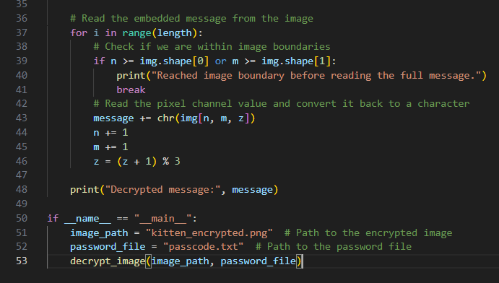
Results

Slide 9
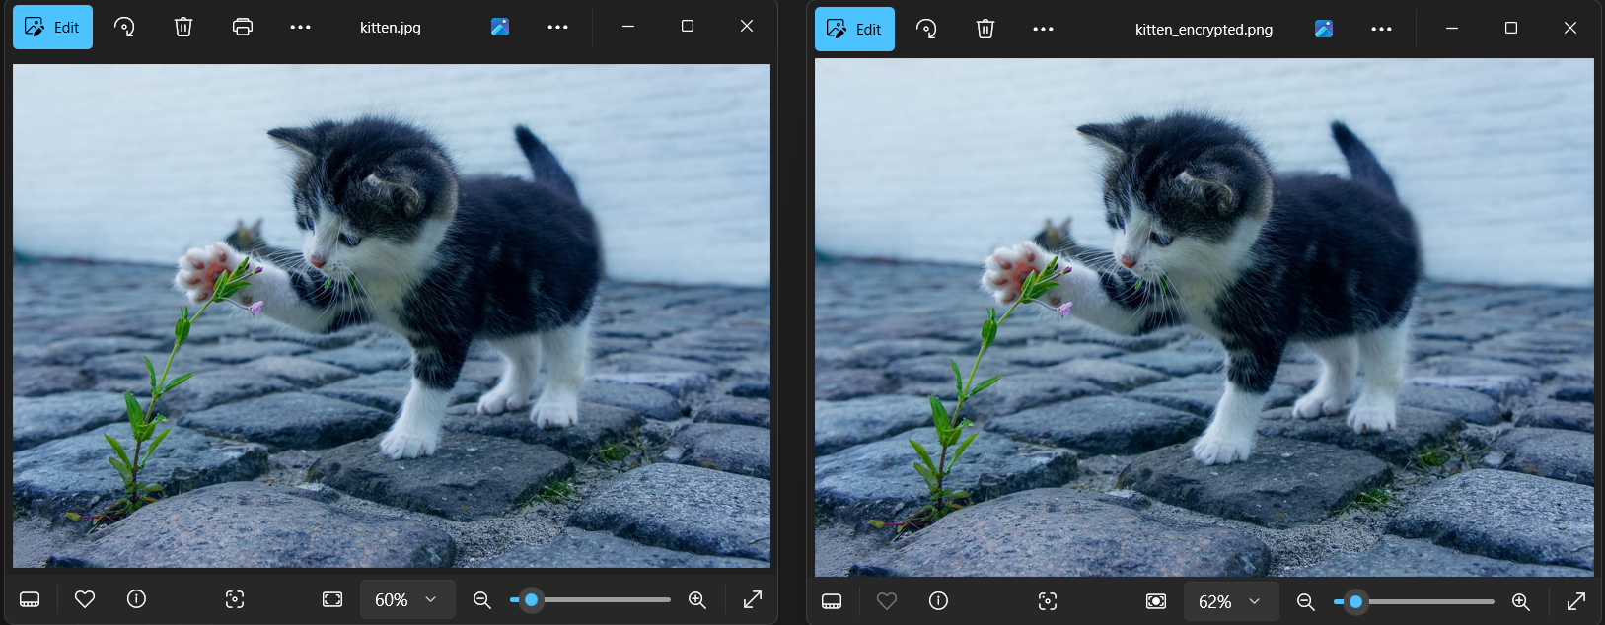
Results

Slide 10
Conclusion
The "Secure Data Hiding in Images Using Steganography" project successfully demonstrates a method to securely hide data within images. By embedding the message length and integrating encryption, the project ensures that sensitive information remains hidden and secure, making it difficult for unauthorized users to detect. The project aligns with the need for covert and secure data transmission in various sectors.

Slide 11
GitHub Link
Github Repository : https://github.com/avicado0/steno-project

Slide 12
Future scope(optional)
Enhanced Security: Integrate advanced cryptographic techniques.
User Interface: Develop a user-friendly GUI for easier use.
Multi-Platform Support: Ensure compatibility across different operating systems.
Error Handling: Improve robustness with better error handling mechanisms

Slide 13
THANK YOU

