Slide 1
Network on Chip - 3D Cube
Karthik C. G. Rao
Gagandeep Singh Billing
Neha Singh
Avichal Karia

Slide 2
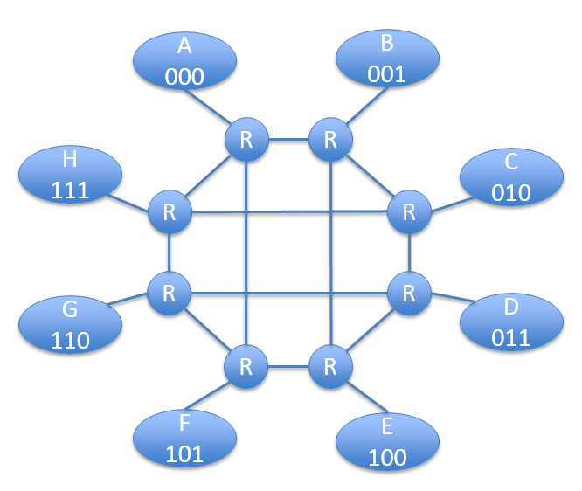
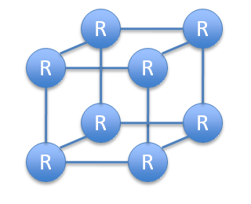
Routing Topology – Cube
expansion

Slide 3
Routing Topology – Cube

Slide 4
Major Blocks
Router
Asynchronous Block
Routing Logic Block (RLB)
Arbiter
Huffman Encoder
& Decoder
Error Detection & Correction

Slide 5
Implementation of the Topology(Router)
Arbiter
(Async-Rcv)
RLB 3
(Async-Send)
Arbiter
(Async-Rcv)
R
RLB 4
(Async-Send)
RLB 2
(Async-Send)
Arbiter
(Async-Rcv)
RLB 1
(Async-Send)
Arbiter
(Async-Rcv)

Slide 6
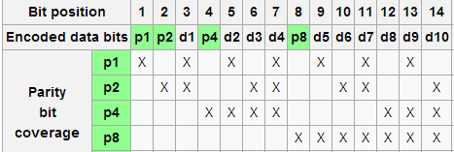
Huffman Encoding (15,10)
Huffman Encoding:
Data Bits: {d1, d2, d3, d4}
Source ID: {d5, d6, d7}
Destination ID: {d8, d9, d10}
P1 = d1 + d2 + d4 + d5 + d7 + d9
P2 = d1 + d3 + d4 + d6 + d7 + d10
P4 = d2 + d3 + d4 + d8 + d9 + d10
P8 = d5 + d6 + d7 + d8 + d9 + d10
Bits P1, P2, P4 and P8 represent the even parity of the encoded data.
Huffman Encoding and Decoding
To support Double Error Detection, we add an overall Parity bit P:
P = P1 + P2 + d1 + P4 + d2 + d3 + d4 + P8 + d5 + d6 + d7 + d8 + d9 + d10

Slide 7
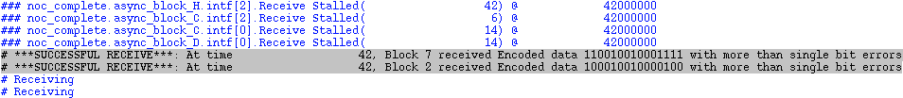
Huffman Decoding (15,10)
Huffman Decoding:
The packet received is checked for errors.
Single bit errors are corrected on the fly invisible to the network
Double bit Errors are reported
Single Bit Error Detection and Correction
By recalculating the values of P1, P2, P4 and P8 we get the position of the erroneous bit if any of these are non-zero.
Bit P should be 1 if single error was detected.
In case where the data is received correctly, all the parity bits will hold a zero value.
Multiple Bit Error Detection
Parity Bit P = 0 with either P1, P2, P4 or P8 set indicates errors in 2 or more bits.

Slide 8
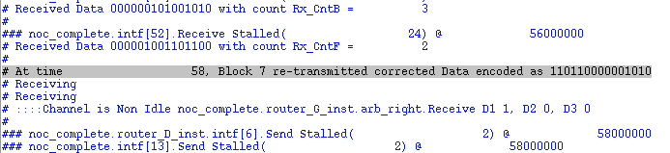
Huffman Decoding (15,10)
Packet Retransmission:
The packet received is checked for errors.
If there was a single bit error in the address bit, this packet is corrected and retransmitted back on the network towards the right destination.

Slide 9
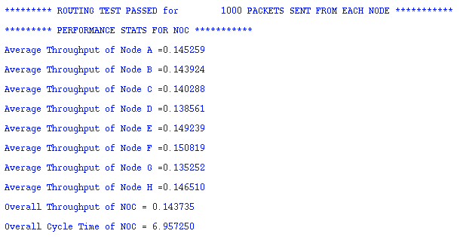
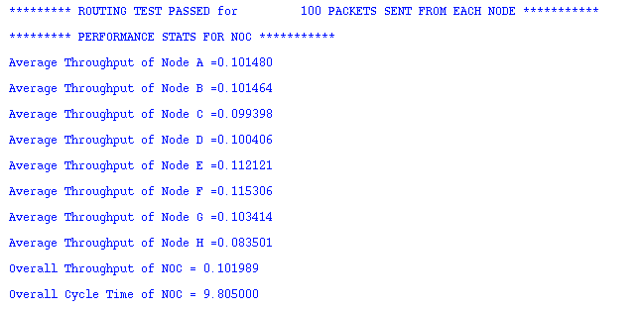
Performance
With no errors inserted:
With errors inserted:

Slide 10
Testbench: Top Level Diagram
Data Gen0
Data Buck0
Queue0
Data Gen1
Data Buck1
Queue1
.
.
.
.
.
.
.
.
Data Gen7
Data Buck7
Queue7

Slide 11
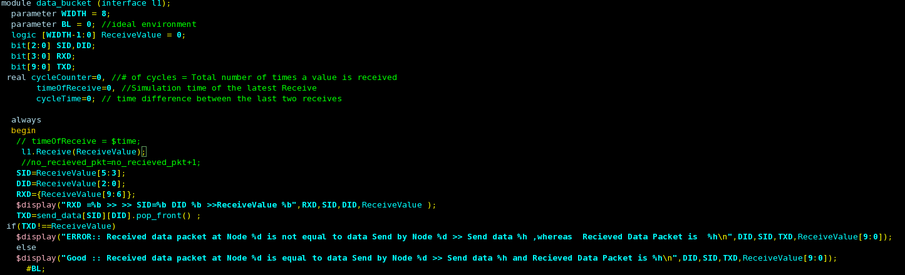
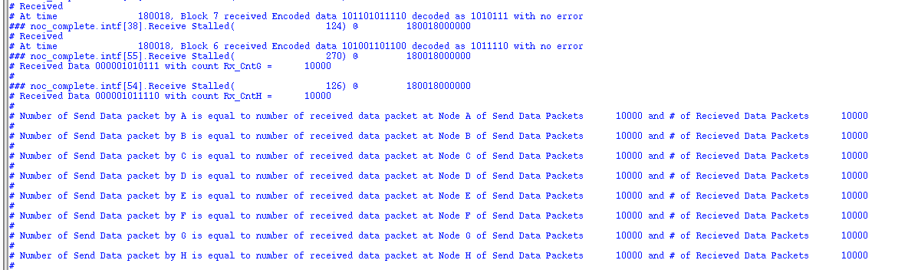
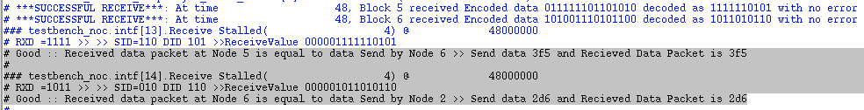
Data Correction & Self-Checking Test-bench
Corrective actions are taken separately for a faulty data bit, address bit.
The test bench self checks the number of packets sent and received, acknowledges the completion.

Slide 12
Thank You
Questions?

