Slide 1
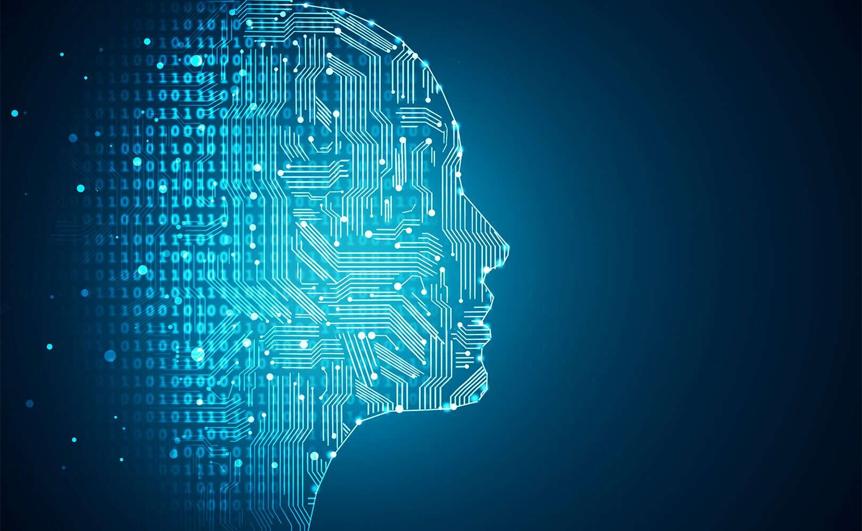
MINI - Project PRESENTATION
MINI - PROJECT PRESENTATION
Machine Learning
Submitted To:
Ms. Chingakham Neeta Devi
Ms. Sanasam Renubala Devi

Slide 2
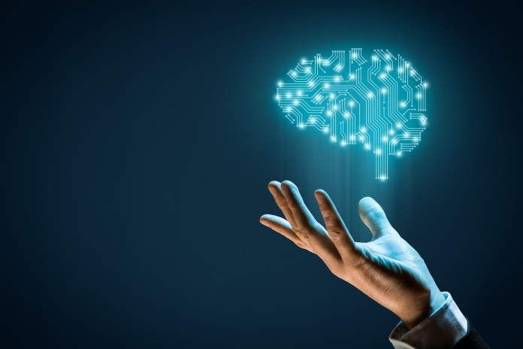
Project Members
Coding
Md. Asad Akhtar Ansari ( 17103028 )
Avichal Srivastava ( 17103004 )
Data Cleaning and Training
Vikas Kumar ( 17103026 )
Rahul Kumar ( 17103040 )
Testing and Debugging
Akash Singh ( 17103030 )

Slide 3


DYNAMIC FACIAL EMOTION RECOGNITION
Using the concepts of Machine Learning
and Deep Learning…
THE ULTIMATE
CHAMPION

Slide 4

What is the need??

Slide 5
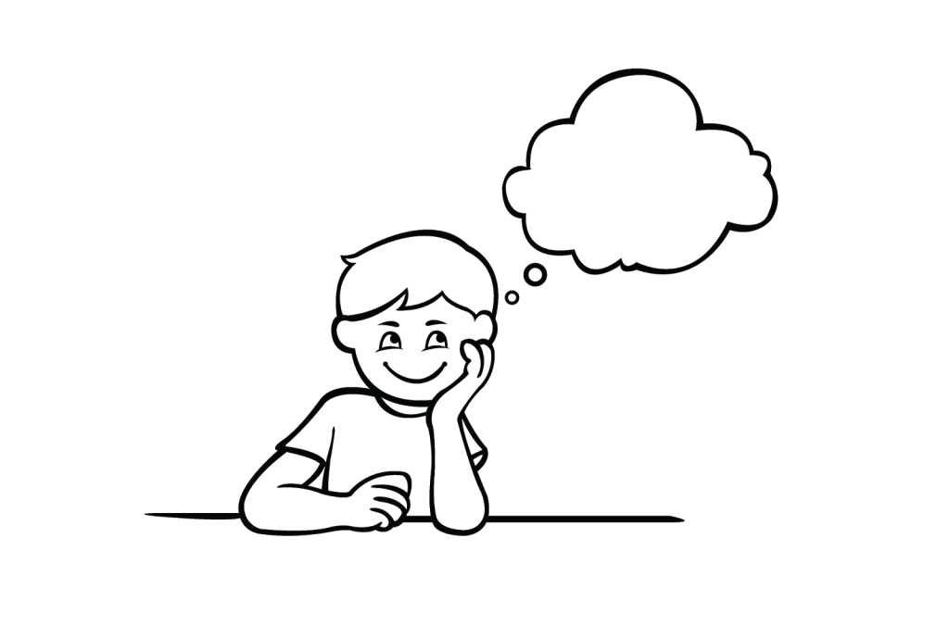
20

Slide 6
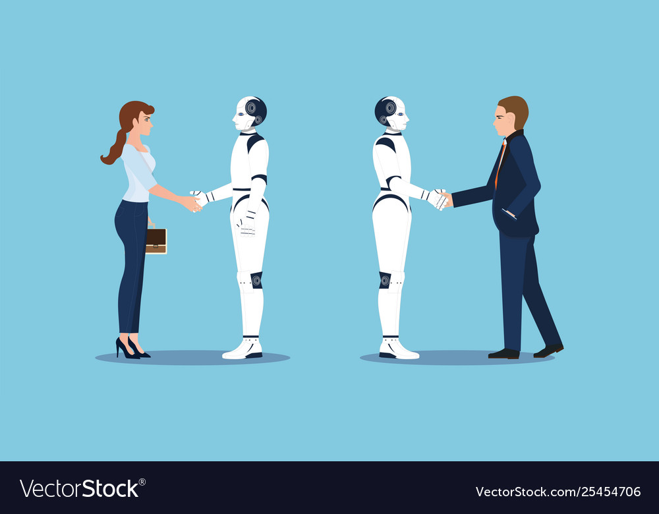
ROBOTS ARE THE NEXT-HUMANS

Slide 7
We want to narrow the gap between the humans and robots.
We want to have a time where Robots are the Next- Humans, like more or less humans, to make our lives easier and comfortable, thereby contributing towards a better future.
To achieve that goal, Facial Recognition has a very important role to play.
Therefore, we have chosen this project over other projects.
Our project captures the image of the person in front of the camera, and displays the exact emotion on his face.

Slide 8

STRIKING FEATURES
Dynamic Face Detection
Multiple Face Detection
Great Accuracy ( Accuracy > 70% )
Trained On Large Training Set
( Size > 24000 images )
Simple And Compact Code
Graphical User Interface
Modifications And
Upgradations Possible
Error and Exception Handling
and many more…

Slide 9
Before going into the details of the project, let us first see a live demo of it…

Slide 10

What are we doing??
Step 1
→Collect Sample Images and feed it to the system for
data cleaning.
→Data Cleaning : The process of detecting the face from the
sample images and extracting only the facial emotion from it ).
→Performed by face_crop.py
Step 2
→Train the system, based on the cleaned data, to identify and
learn the distinguishing characteristics of the five different classes of
emotions, namely Angry, Happy, Sad, Surprise and Neutral.
→Performed by retrain.py
Step 3
→Run the program using label.py which will dynamically call label_image.py that will capture
continuous images using webcam and subsequently pass to label.py for dynamic classification.
→Performed by label.py and label_image.py

Slide 11
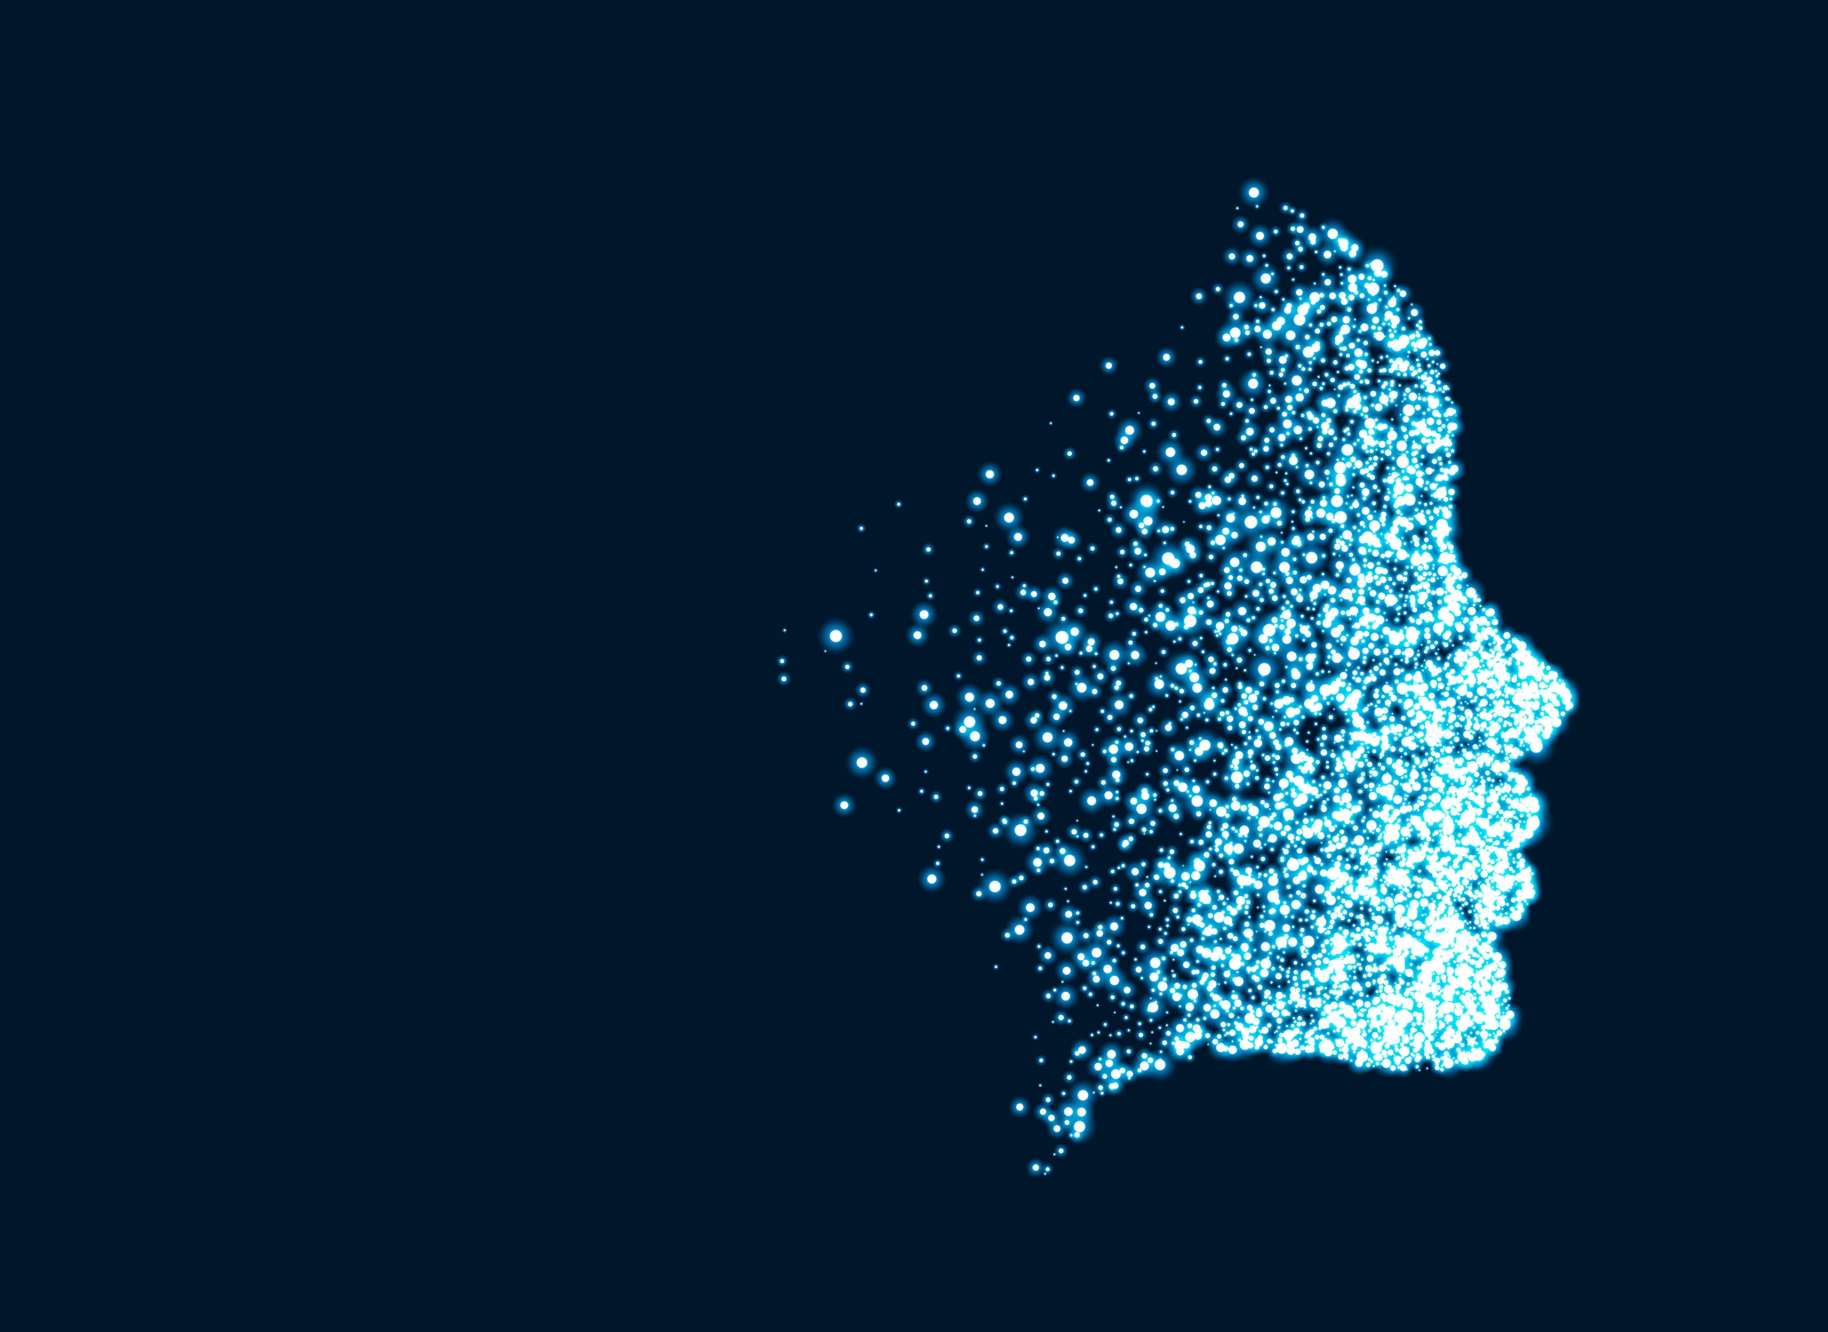
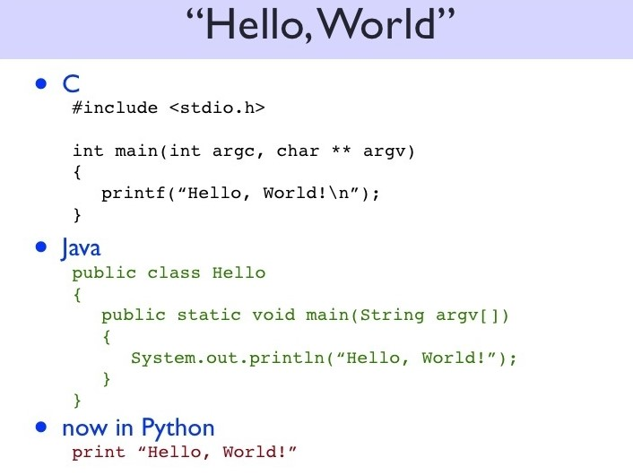
Python IDLE
Numpy Library
Tensorflow Library
OpenCV Library
and thats all…
PROJECT REQUIREMENTS
ALGORITHMS
Deep Neural Networks
MobileNets Classification ( Depth Based Classifier )
HAAR Cascade Algorithm for Cleaning(Croping) the data.
ANN (Artificial Multi-Layer Neural Network)

Slide 12

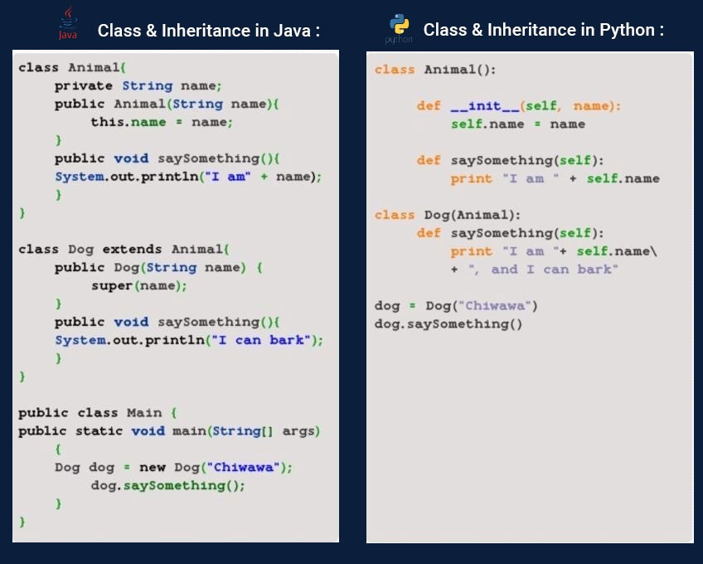
APPLICATIONS
Human Behaviour Understanding
Detection of Mental Disorders
Detection of Synthetic Human
Expressions
Sentiment Analysis
Face Perception
Facial Recognition
and many more…

Slide 13
Since this is a mini-project and subject to further modifications, any queries and suggestions are most welcome…
HOPE YOU LIKED OUR PROJECT !!

Slide 14


