Slide 1

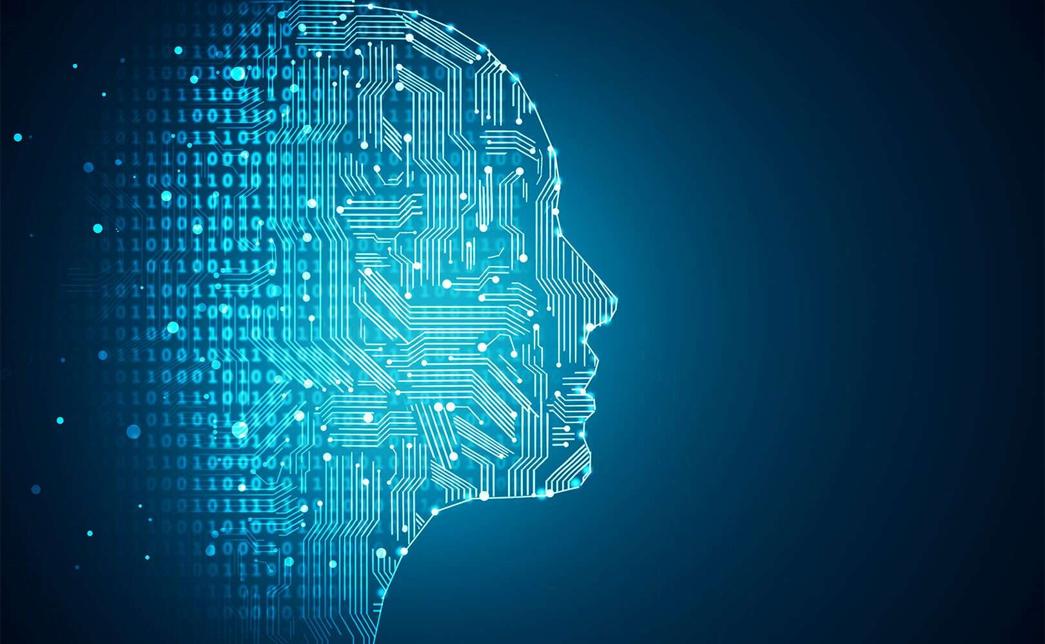
MINI - Project PRESENTATION
FINAL YEAR PROJECT PRESENTATION
Machine Learning
Team XTREME

Slide 2
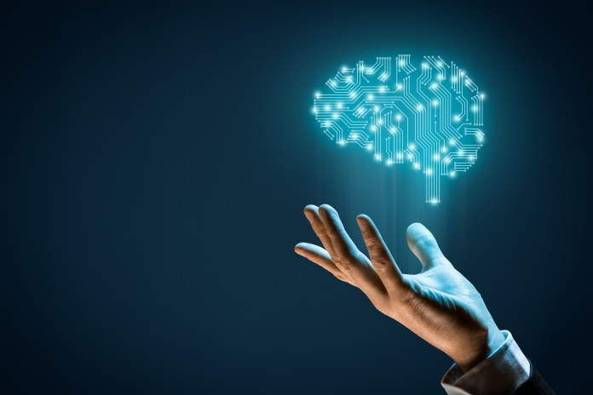
Project Members
Avichal Srivastava ( 17103004 )
Vikas Kumar ( 17103026 )
Himanshu Sharma ( 17103001 )
Project Supervisor:
Ms. Chingakham Neeta Devi

Slide 3



Text Extraction and Recognition from Natural Scene Images Using Tesseract
THE ULTIMATE
CHAMPION

Slide 4


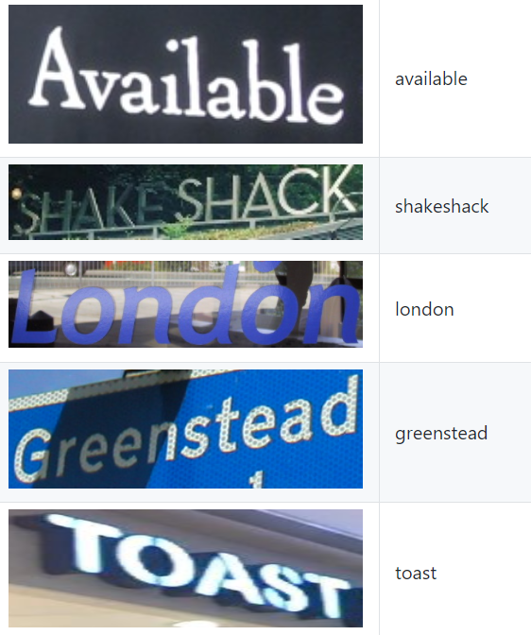
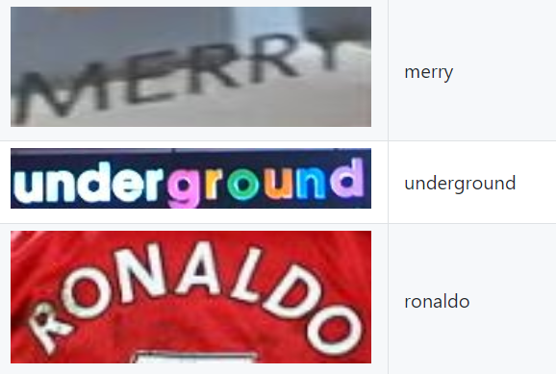
Goal Of The Project
The project takes a natural scene image
containing a text as an input and then,
cleans it, processes it and prints the
text present in the image as an output.

Slide 5
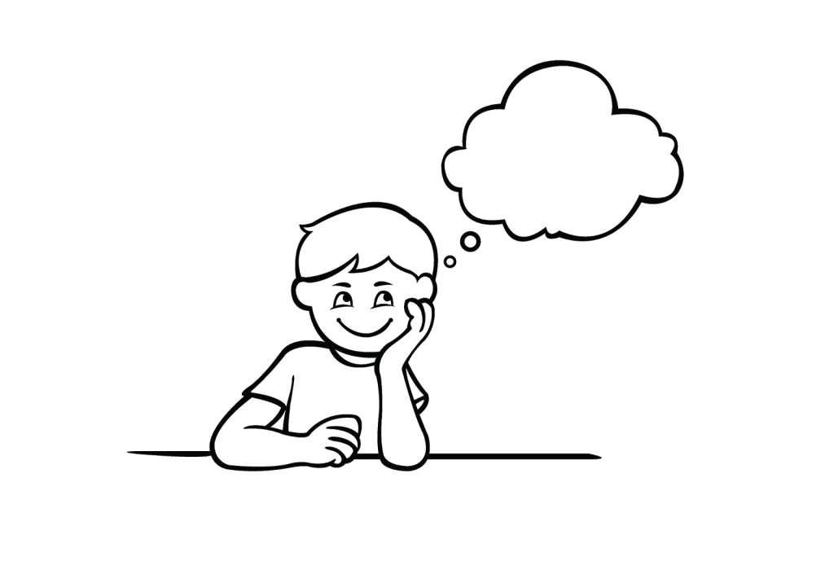
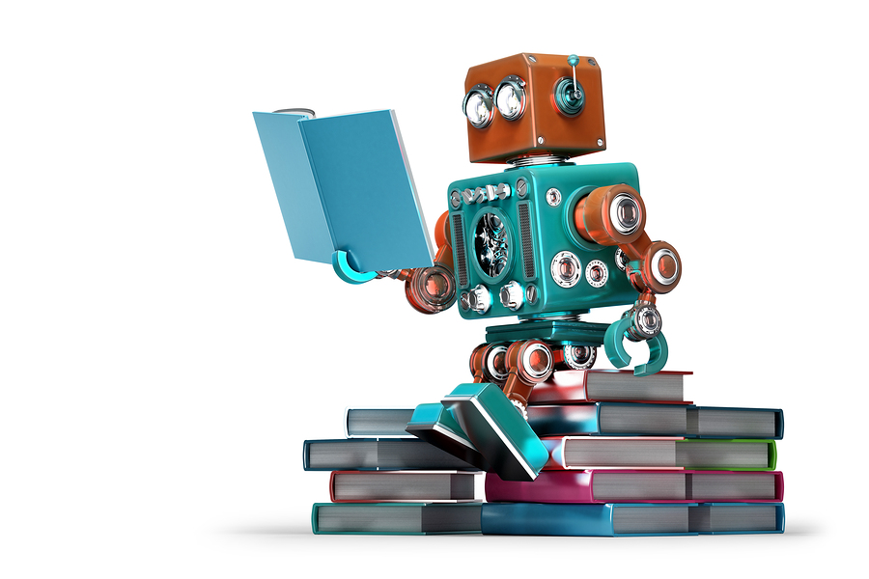
Why did we choose this project ?
20
Today, most information is available either on paper or
in the form of images or videos.
2. The current technology is restricted to extracting
text against clean backgrounds and still
has major scope of improvement.
3. There is a need for a system to
extract text from general
backgrounds.
4. Technological Supremacy.

Slide 6
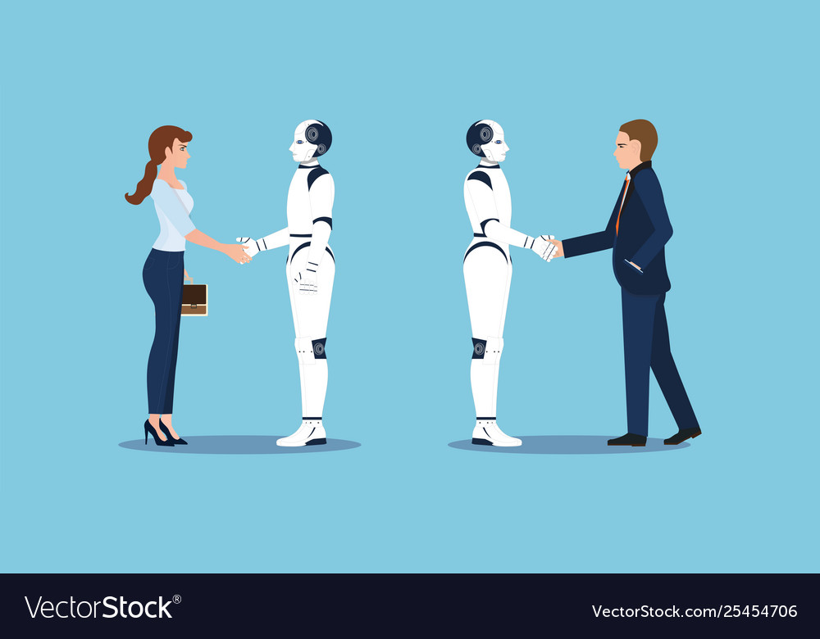
ROBOTS ARE THE NEXT-HUMANS

Slide 7

Project Applications and Scope
Banking Sector (Customers data/ Checks/ Bank receipts)
Digital Libraries (Read information from scanned pages)
Government Sector (Form Processing)
Car Number Plate Recognition System
Robotics (For giving commands)
Inter-language Translations
And many more…

Slide 8


Main Principle
Optical Character Recognition
Optical character recognition or optical character reader (OCR) is the electronic
or mechanical conversion of images of typed, handwritten or printed text into
machine-encoded text, whether from a scanned document, a photo of
a document, or a scene-photo.
Tools Used
EAST Text Detector
For Text Detection
2. Tesseract
For Text Recognition

