Slide 1
Mid Semester Progress Report
Team XTreme
Text Extraction and Recognition from Natural Scene Images using Tesseract
Team Members
Avichal Srivastava (17103004)
Vikas Kumar (17103026)
Himanshu Sharma (17103001)
Supervised & Guided By
Neeta Mam

Slide 2
STATUS SUMMARY
EAST Test Detector has been implemented end to end.
Tesseract Test classifier implemention has been done.
Basic Image smoothening and pre-processing is implemented.
Things pending to be completed
Integration of EAST Test detector with Tesseract
Applying advanced pre-processing techniques
Testing the final project with a big dataset.

Slide 3
3
REQUIREMENTS
Python 3 - We have used python as it contains many libraries that makes the task faster and easier. Also, the python is much more expressive and understandable than other languages.
OpenCV 3.4 - Used for image processing. EAST is based on OpenCV. Also, the image is being smoothened using the inbuilt libraries of OpenCV.
NumPy – The image captured is processed by converting it into data points and stored as a NumPy array. NumPy helps to efficiently group datasets using established Python and NumPy concepts.
Tensorflow 1.5 - TensorFlow is an open source software library for high performance numerical computation. Its flexible architecture allows easy deployment of computation across a variety of platforms (CPUs, GPUs, TPUs), and from desktops to clusters of servers to mobile and edge devices.
Pytesseract – The library which has been developed to efficiently convert text in images into computer format using a well trained model provided the image passed is free from distortion and noises, etc.
A Good CPU for a faster image processing

Slide 4
INSTALLING THE
PACKAGES
pip install pytesseract
pip install imutils.object_detection
pip install numpy==1.17.4
pip install opencv-python==3.4.0.14
pip intsall tensorflow-gpu==1.5.0

Slide 5


PROGRESS
EAST Text Detector
“frozen_east_text_detection.pb” is the trained model file containing graph definitions and weights of the model based on Tensorflow. This is the model that will classify at which all places text is present in the image.
“images” folder contains the set of testing images.
“opencv_text_detection_image.py” is our main driving program which takes the image and the model file as an input and displays the image with highlighted text as a result.
Invocation: “python opencv_text_detection_image.py --image images/filename.jpg --east frozen_east_text_detection.pb”

Slide 6
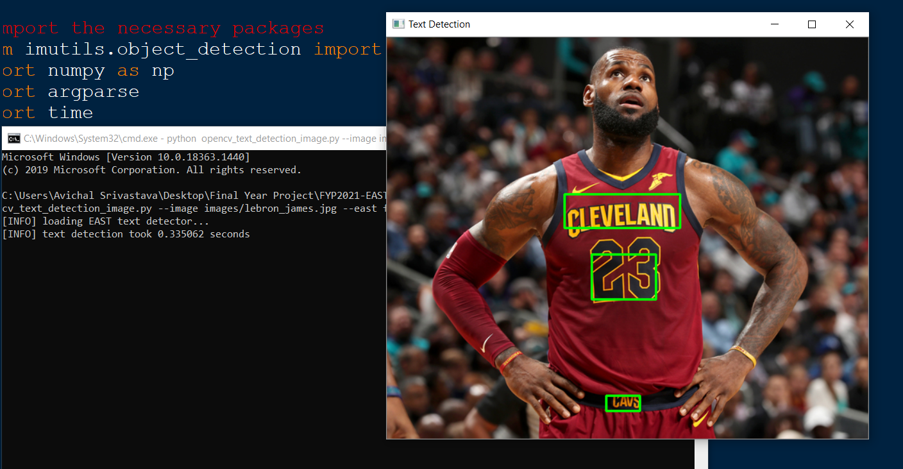
Working (EAST)

Slide 7
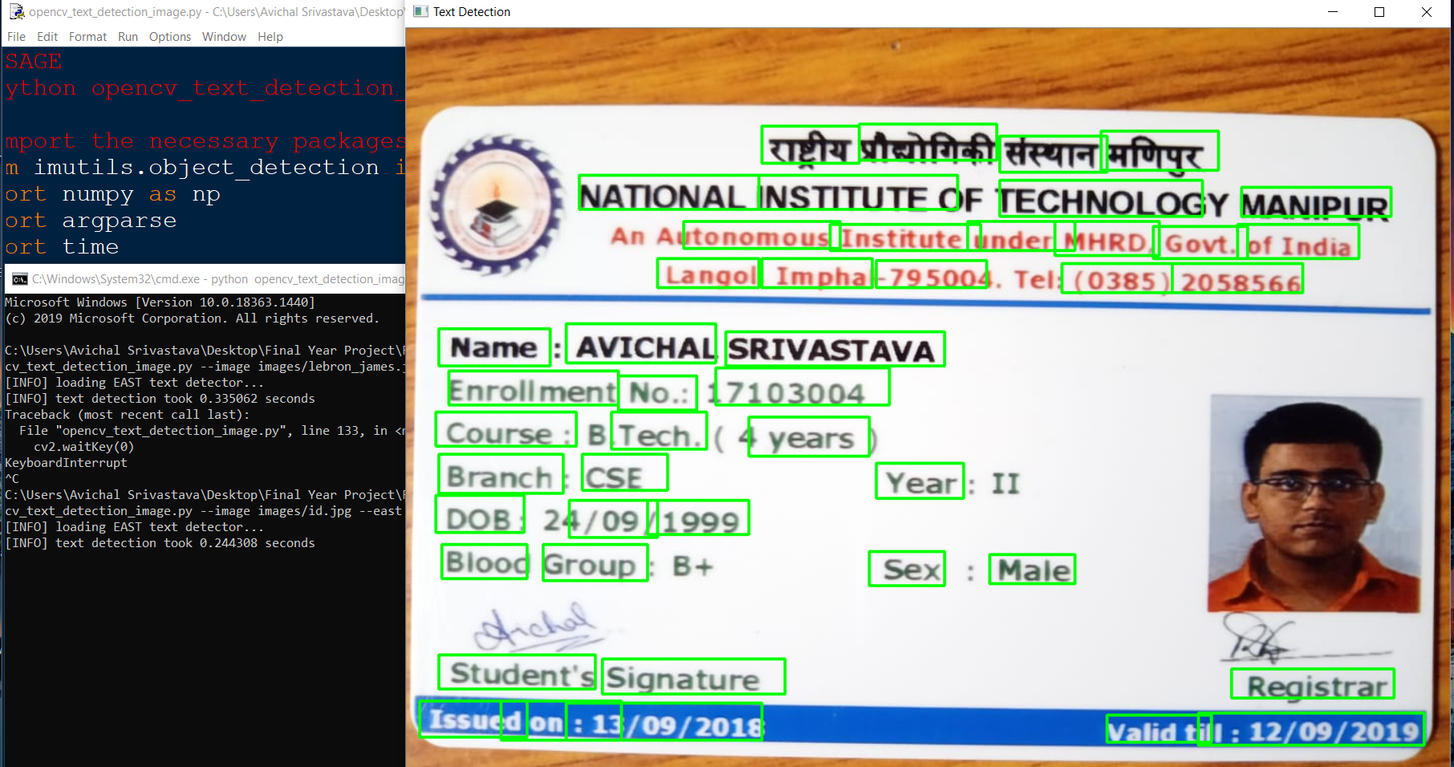
Working (EAST)

Slide 8
PROGRESS
Tesseract Text Recognizer
“tesseract_prog.py” is our main driving program which takes the image file as an input and smoothens it and then sends to pytesseract function to convert to text.
“image_to_string” function of pytesseract is being used in the program to identify the text.
Three image smoothening functions using OpenCV functions are used to increase the quality of detection. This is often termed as image pre-processing.
Three techniques used: Grayscaling, Blurring, Image thresholding.
Invocation: “python tesseract_prog.py”

Slide 9
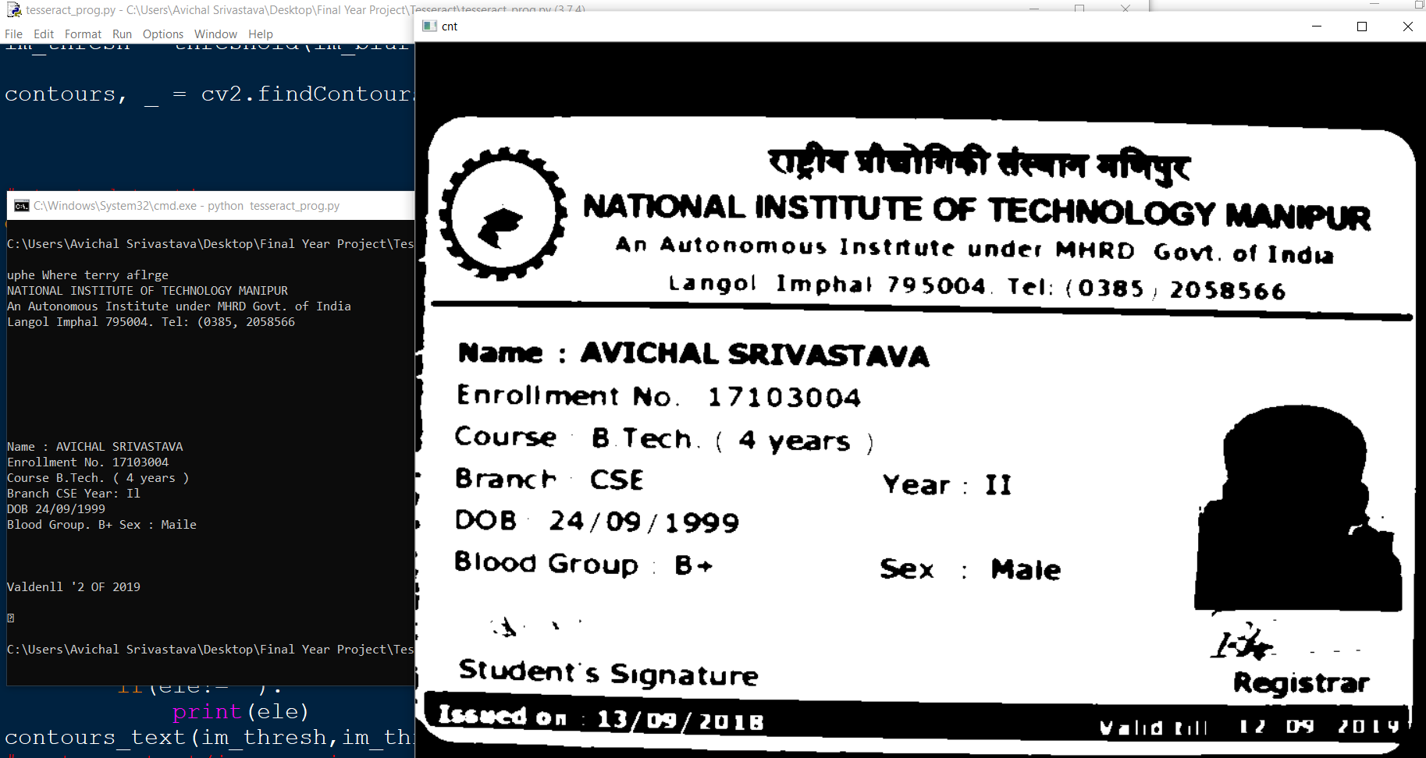
Working (Tesseract)

Slide 10
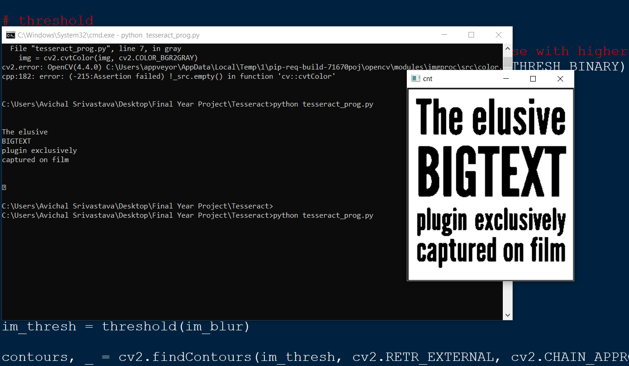
Working (Tesseract)

Slide 11
GOALS FOR FINAL REVIEW
Integrate EAST with Tesseract to achieve better accuracy.
Enhance image pre-processing techniques.
Test the final project with a big dataset and describe the maximum accuracy achieved.

Slide 12
THANK YOU

