Slide 1
Super Market system
Pseudo Live Project
TEAM 1
Team Lead – Gunj Manseta

Slide 2
Problem Statement
The purpose of this project is to develop an Super Market System. Super Market System provides different facilities to customers. Application consists of three users as given below.
Admin
Employee
Customer
Admin Transactions are as follows
Add and Remove Employees
Add and Remove Products
Add and Update Stocks and Offers
Update his password

Slide 3
Problem Statement
Employee Transactions are as follows
Update his Name and Password
Billing
Customer Transactions are as follows
Customer Types
New Customer
Customer Id is auto generated and mobile number is asked from the Customer
Existing Customer
Existing Customer needs to enter the unique Customer Id
Functionalities
Search Products By Category and Add to Cart
Display Cart
Sort the cart by Product Category and Display.
Sort the cart by Product Cost and Display.
Sort the cart by Product Name and Display.
Place Order

Slide 4
System Requirements
Microsoft Windows 98, XP , 7+.
Memory: 128 MB of RAM (512MB or more recommended)
Software: Microsoft visual Studio

Slide 5
Functional Specifications
The Admin is provided with a unique User id and password.
The Customer is provided with a unique User id and password.
The Customer is provided with a unique User id and password.
Admin has the privilege to add and remove Employees ,add and remove Products , update stocks if needed and the offers and even modify his password.
The Customer has the privilege to search and add to the cart ,sort the cart with respect to the Product Category , Cost and Name and Place the order.
Employee has the privilege to Bill the cart generated as per the Customer needs and modify his personal details.

Slide 6
Functional Specifications (contd…)
Billing is been done by taking the offers into the final bill and the price is reduced with respect to the discount on the product.
This Billing is done by the Employee.
Employee can add points to the customer card and can provide discount with the card points also.
When a customer try to search for a product which is not present in the database ,it will throw Exception.
Validation has been done almost to all the ids and password fields and it will throw Exceptions when it doesn’t match with the contents in the database(files).

Slide 7
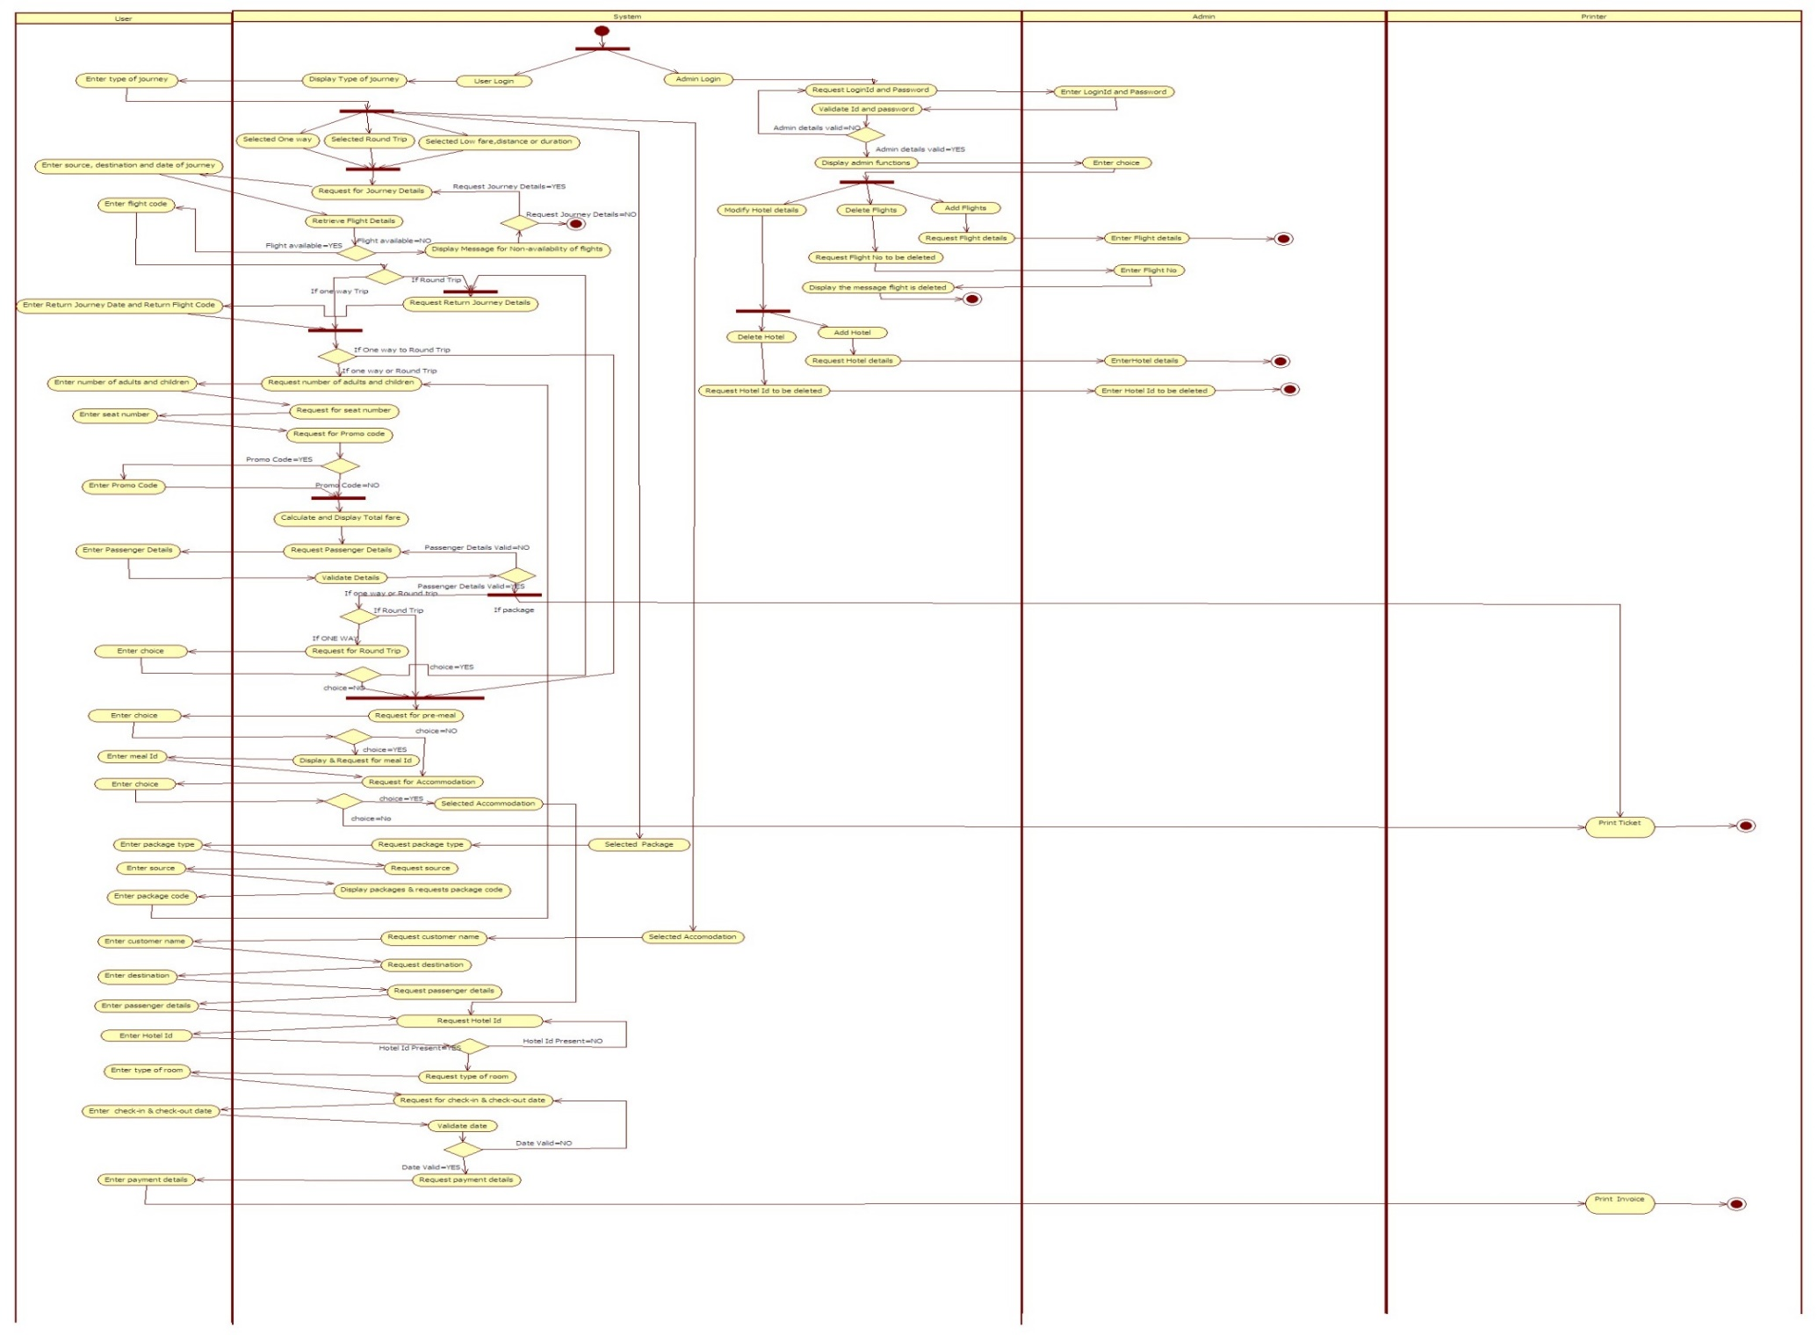
ACTIVITY DIAGRAM

Slide 8
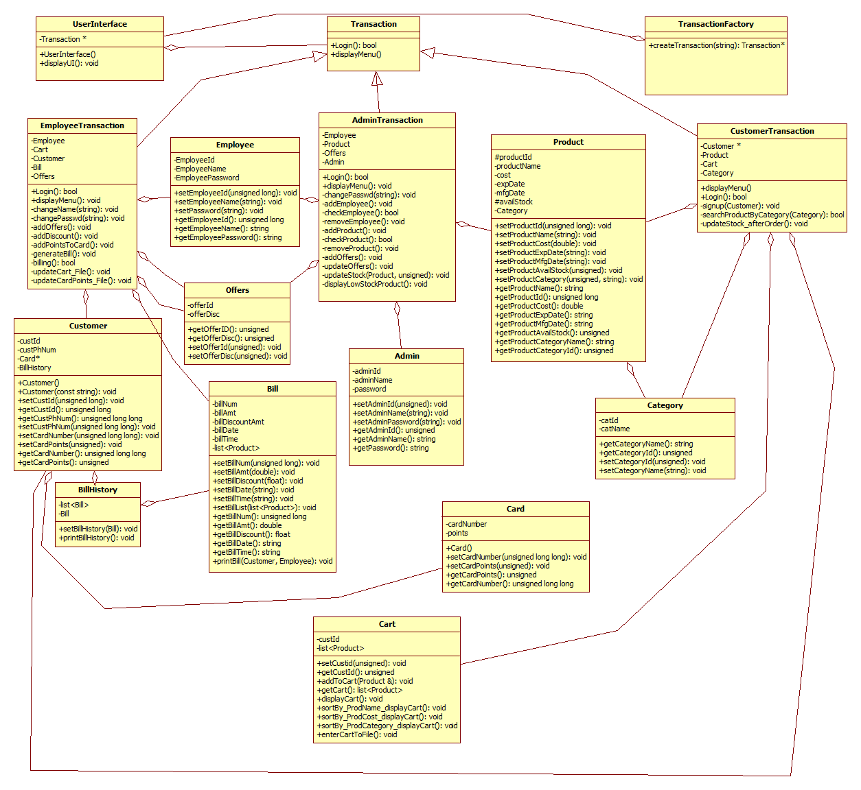
Class Diagram

Slide 9
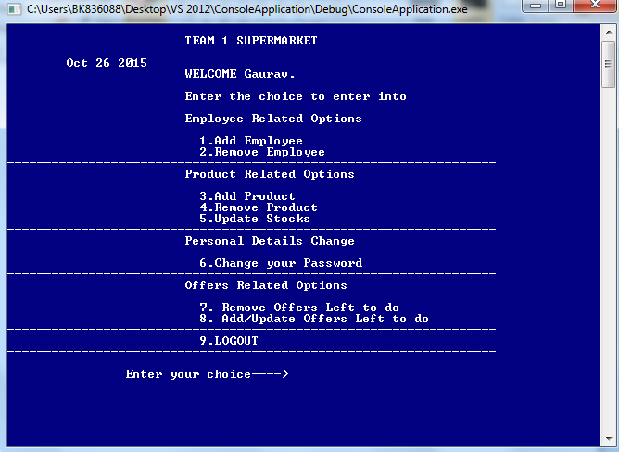
Admin Transaction

Slide 10
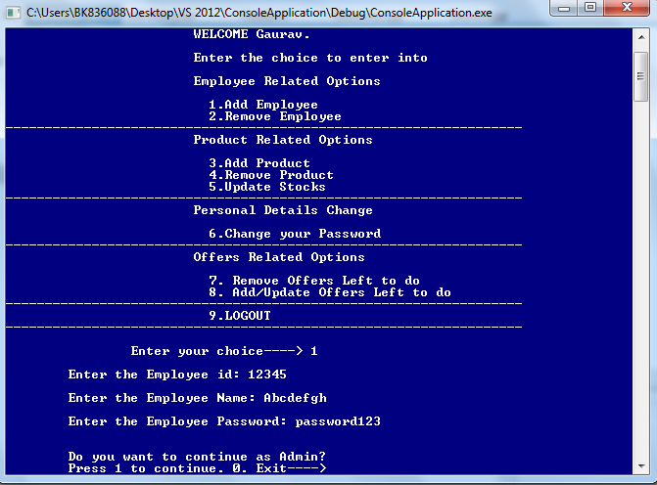
Admin Transaction

Slide 11
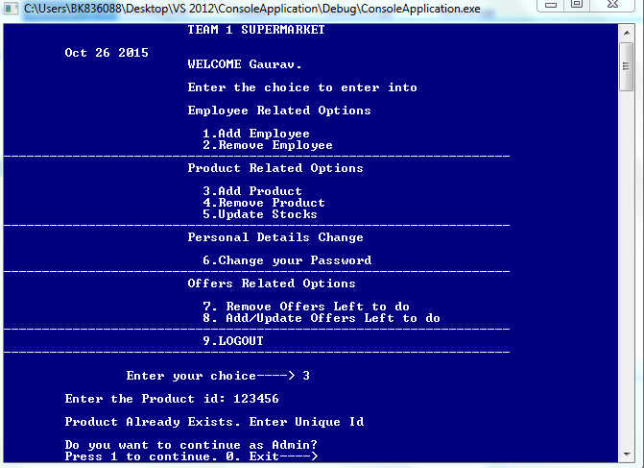
Admin Transaction

Slide 12
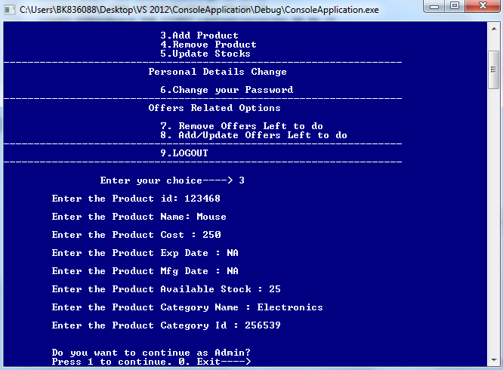
Admin Transaction

Slide 13
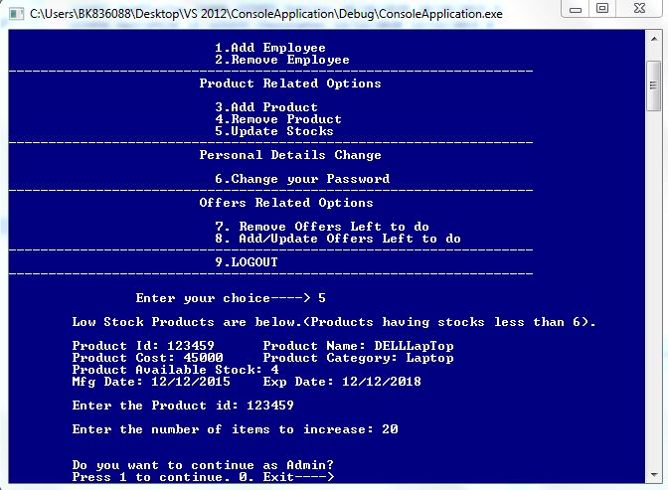
Admin Transaction

Slide 14
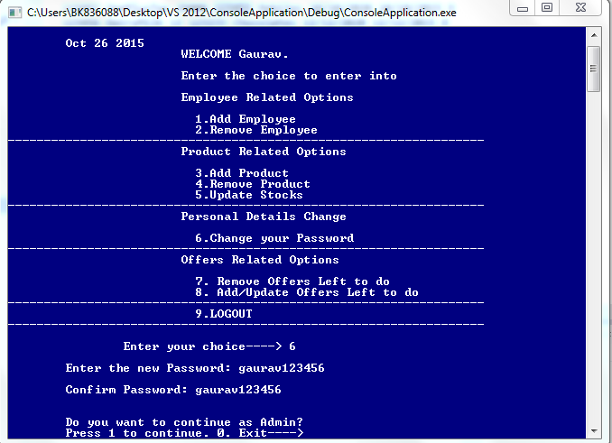
Admin Transaction

Slide 15
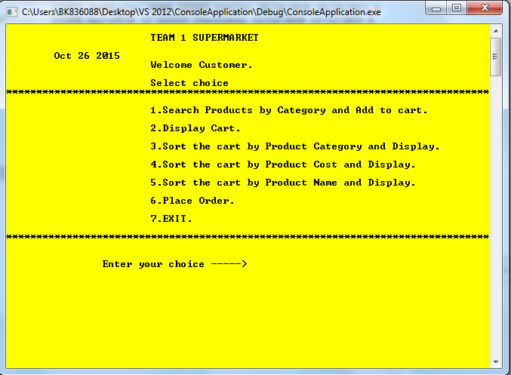
Customer Transaction

Slide 16
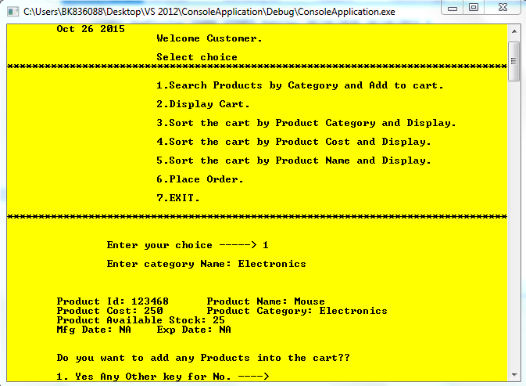
Customer Transaction

Slide 17
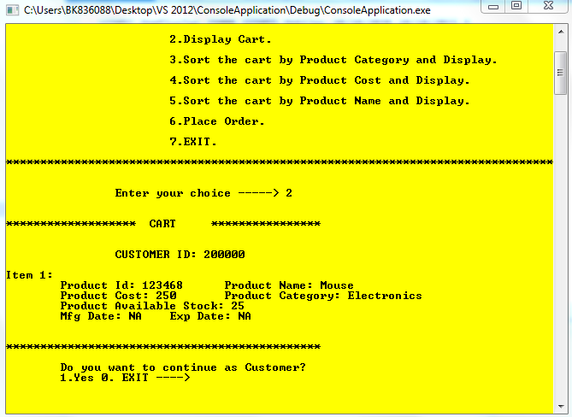
Customer Transaction

Slide 18
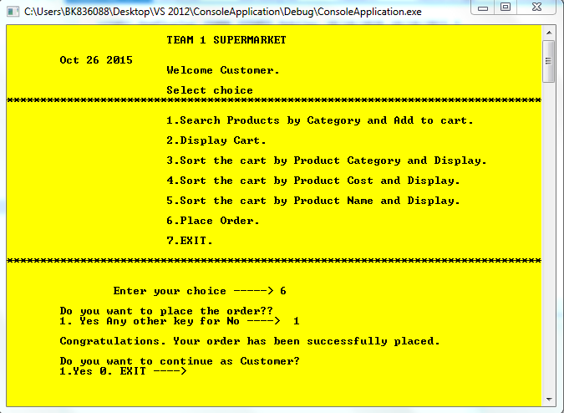
Customer Transaction

Slide 19
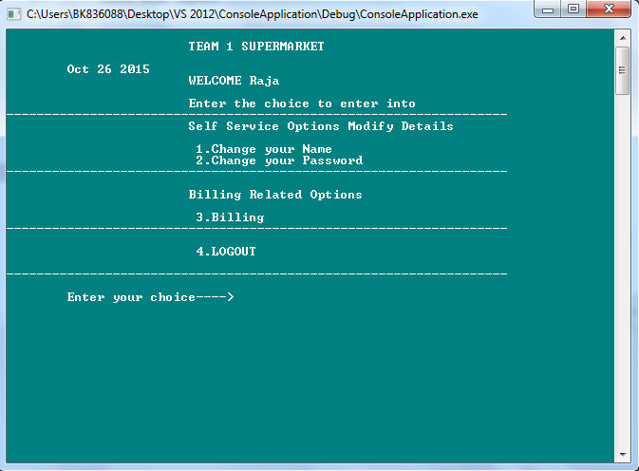
Employee Transaction

Slide 20
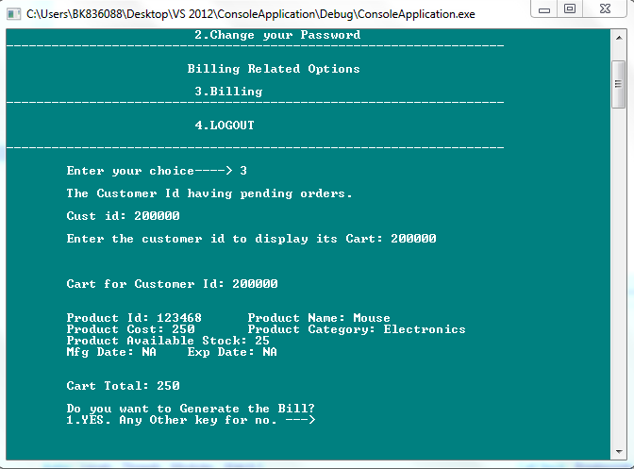
Employee Transaction

Slide 21
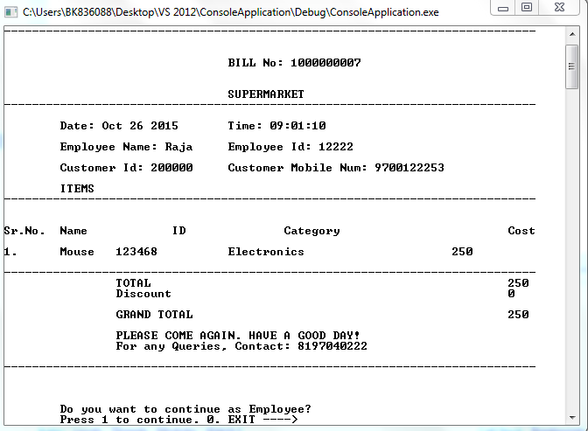
Employee Transaction(Bill)

Slide 22
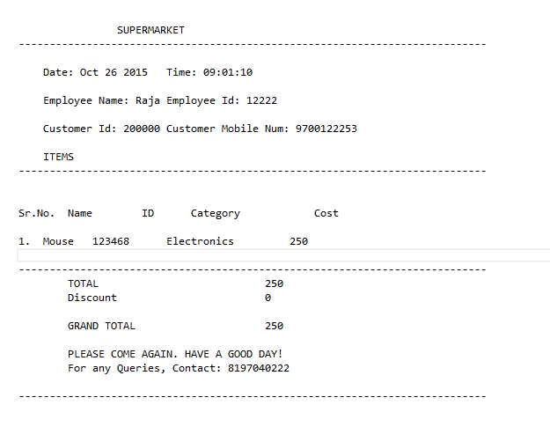
Bill History

Slide 23
Thank YOU

Slide 24
Q & A ?

