Slide 1



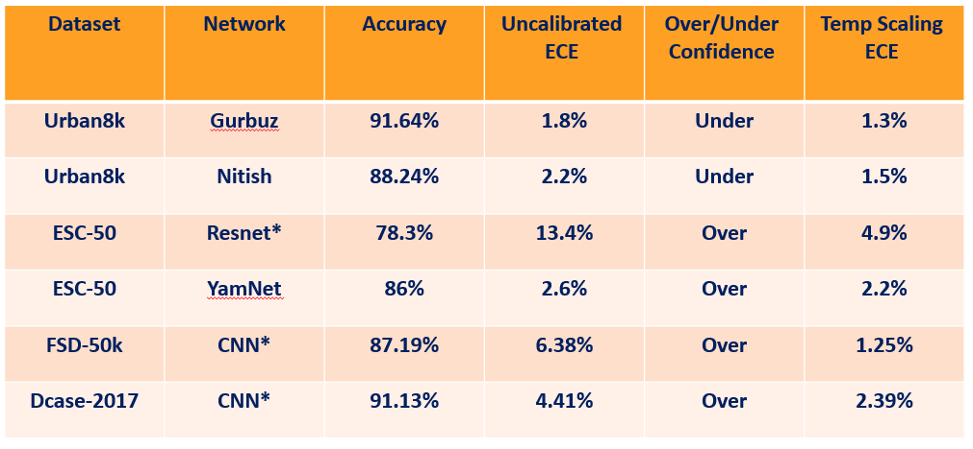

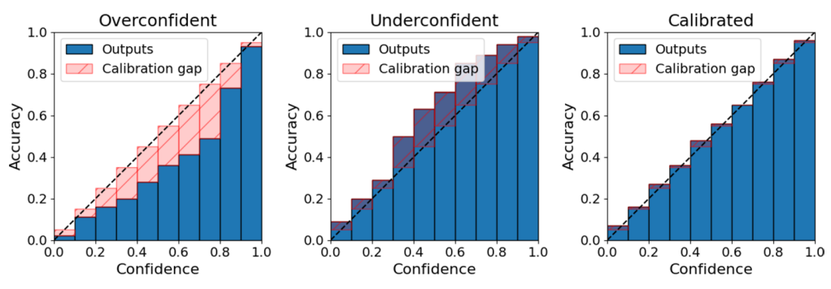

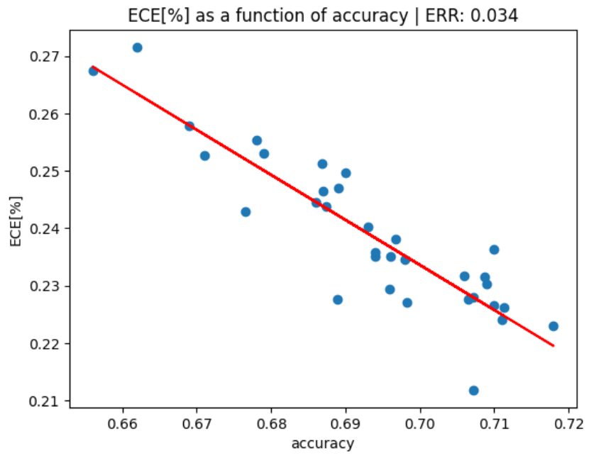

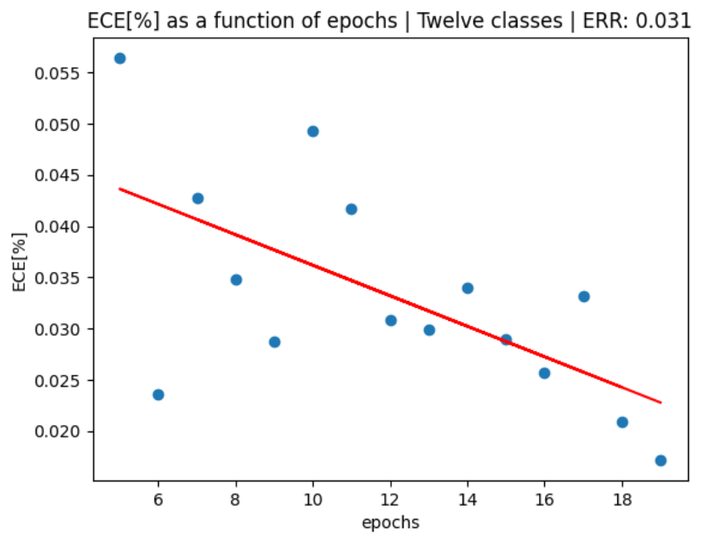
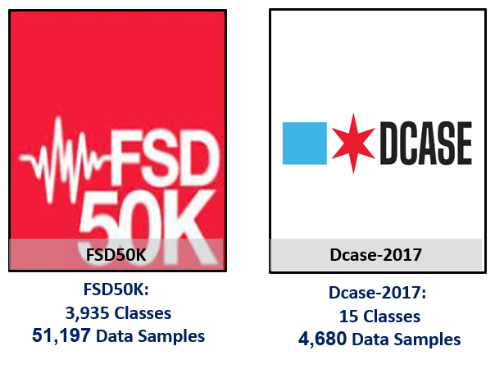

Calibration of Deep Neural Networks
Yonatan Leibovich and Avichay Ashur, Supervised by Yair Moshe
Introduction
Fixing Miscalibration
Results
Deep Neural Networks (DNNs) are a type of learned functions which consist of multiple layers between the input and output layers.
It has been shown that DNNs suffer from miscalibration, meaning there is a discrepancy between predicted probabilities and actual outcomes.
For instance, if a DNN is 90% confident in its predictions for 100 samples, we expect it to be correct for 90 samples, and wrong for 10 samples. The objective of calibration is to achieve this alignment.
We chose to focus on post-processing methods that address miscalibration after model training:
Histogram Binning: Divides the interval [0,1] into bins and solves an optimization problem to adjust the probability of each prediction, aiming to reduce the ECE
Isotonic Regression: Similar to histogram binning but with the added flexibility of adjusting the number and size of the bins.
Platt Calibration: A parametric method that applies an additional layer after the softmax function, optimizing its parameters to reduce the ECE:
Temperature Scaling: Similar to Platt calibration, but with the parameter W replaced by a scalar T and b=0. One appealing aspect of temperature scaling is that it does not affect the model’s accuracy.
As expected, audio classification DNNs also suffer from miscalibration
*Self trained models
Hyper-parameter Values
Our analysis on the FSD-50K dataset revealed correlation between model accuracy and ECE:
Examples of overconfident and underconfident networks
Goals
Learn and understand state-of-the-art calibration methods for DNNs.
Test and compare leading calibration methods on audio classification DNNs.
Investigate the correlation between DNN hyper-parameter values and miscalibration.
Chosen Datasets
To get a comprehensive understanding and obtain reliable results, we selected multiple datasets for our analysis.
We identified four major and diverse audio datasets that are suitable for our study.
Challenges
Our analysis on the DCASE-2017 dataset revealed correlation between ECE and number of training epochs:
Limited research on calibration of audio DNNs.
Extensive data collection, processing and manipulation is required.
Need to create multiple models with parameter variations to assess the relationship between hyper-parameter values and miscalibration.
Measuring Miscalibration
Conclusions
Miscalibration for Audio: Calibration issues have been observed to significantly impact the audio field, aligning with earlier predictions.
Dataset Distribution and Network Calibration: Network calibration appears to be sensitive to variations in dataset distribution.
Calibration Effects on Confidence Levels: Networks often exhibit both over and under confidence. Implementing isotonic or histogram calibration methods might improve both accuracy and calibration reliability.
Hyperparameter values and Calibration: The choice of hyperparameter values (e.g., number of epochs, batch size) can significantly influence network calibration.
Expected Calibration Error (ECE) quantifies the accuracy of the model compared to its confidence.
For instance, if a model correctly classifies 100% of the samples but its confidence is only 80%, its ECE is:
$$ECE=\left|1−0.8\right|=0.2$$
July 2024

