Slide 1



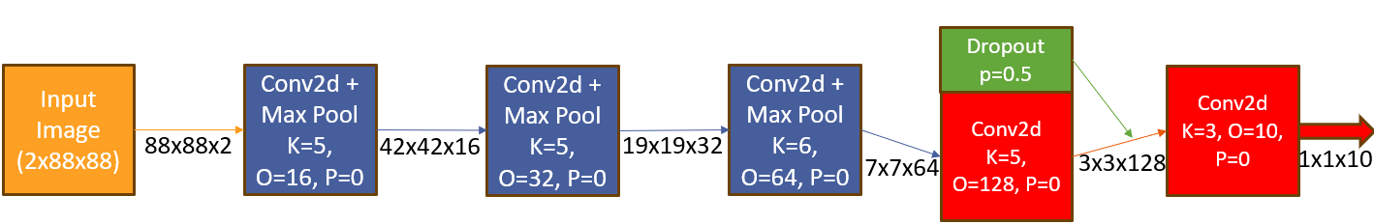
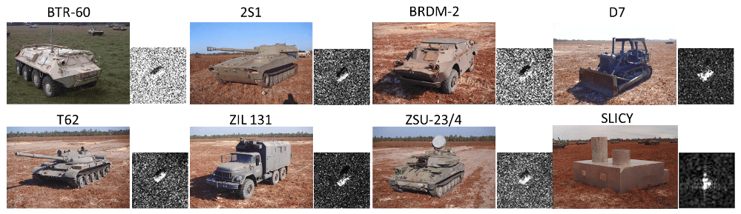
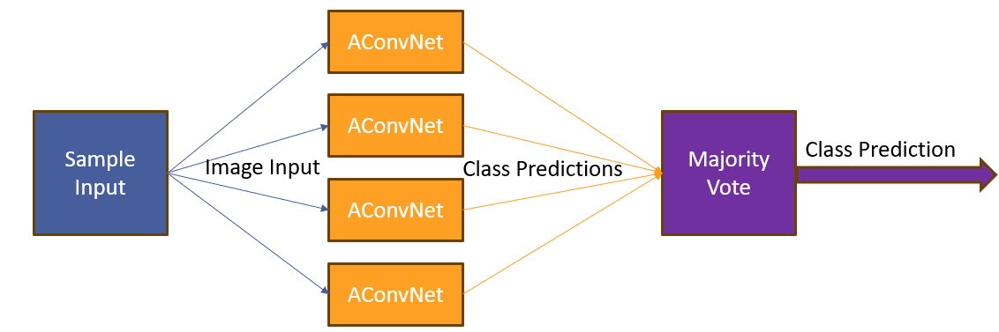
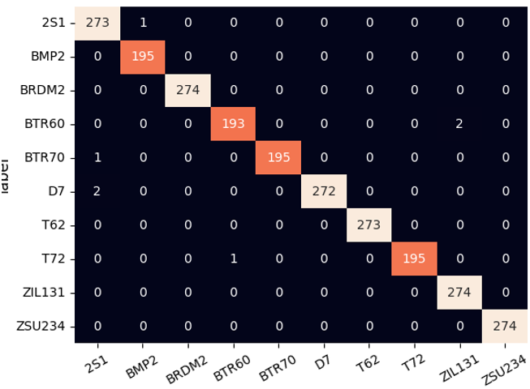
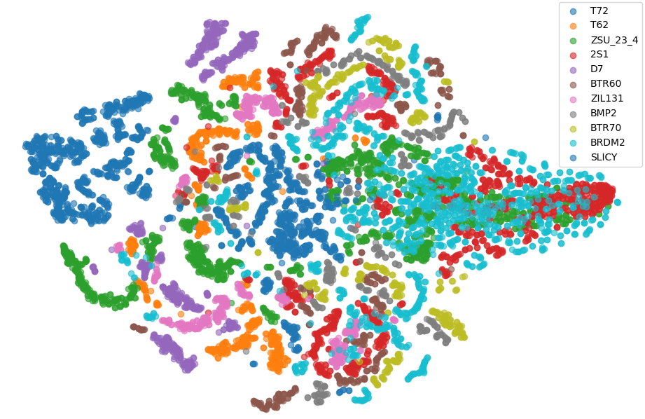
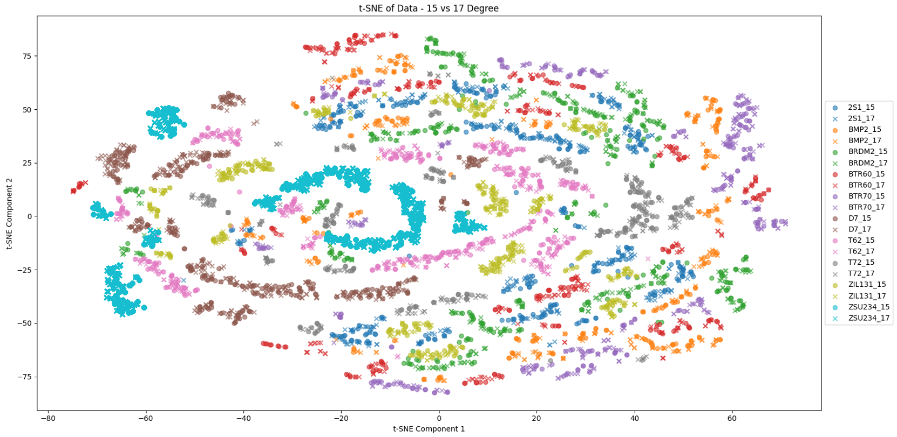
SAR Target Classification Using Deep Learning
Avichay Ashur, Supervised by Dr. Meir Bar zohar
Introduction
SAR Pros / Cons
Chosen Solution
Deep learning is a powerful technique that can be used to train robust classifier. It has shown its effectiveness in diverse areas ranging from image analysis to natural language processing
A major task for SAR-related algorithms has long been object detection and classification, which is called automatic target recognition (ATR).
To illustrate this workflow, we will use the MSTAR dataset published by the Air Force Research Laboratory. Our goal is to develop a model to classify ground targets based on SAR imagery.
SAR Pros:
Can be mounted on aircraft or spacecraft.
Capable of generating high resolution images.
Independent of weather, can work during the day and the night.
Resolution doesn't depend on flight altitude.
SAR Cons:
Takes long time (minutes to hours) to generate a single image.
Image depend on environmental conditions – different reflection coefficient.
Need to know moving speed, height and target location
Very difficult to visual interpretate without specialized training.
High computational requirements for data processing.
Our solution is – Ensemble AConvNet.
AConvNet is built from 5 CNN Layers +3 Max Pool Layers.
Total params: 300k | 1.1MB memory size.
AConvNet Architecture
We trained 4 different AConvNet networks and perform Majority vote to select the class prediction.
Our final model Accuracy is 99.71%, improvement of 0.15% of the previous best performing network.
Images example from the MSTAR dataset
Goals
Learn and understand the principles of Synthetic Aperture Radar.
Understand and reproduce the current implementations for classifying SAR images.
Try to improve the performances of current networks on MSTAR dataset.
MSTAR Datasets
Ensemble AConvNet Architecture
Challenges
Total* | ZIL131 | BMP2 | BTR60 | BTR70 | D7 | T62 | T72 | 2S1 | BRDM2 | ZSU234 | SLICY | Deg
2,425 | 274 | 195 | 195 | 196 | 274 | 273 | 196 | 274 | 274 | 274 | 274 | 15° | Test
2,747 | 299 | 233 | 256 | 233 | 299 | 299 | 232 | 299 | 298 | 299 | 298 | 17° | Train
1,402 | 0 | 0 | 0 | 0 | 0 | 0 | 288 | 288 | 420 | 406 | 288 | 30° | Test
1,148 | 0 | 0 | 0 | 0 | 0 | 0 | 0 | 303 | 423 | 422 | 303 | 45° | Test
7,722 | 573 | 428 | 451 | 429 | 573 | 572 | 716 | 1,164 | 1,415 | 1,401 | 1,163 | Total
Very small dataset – training set consist of 2,747 images only.
Class imbalance.
Very subtle differences between the classes.
High variability in the target appearance
Images suffer from Speckle noise, hard to model and to denoise.
MSTAR Dataset sample split.
*Total images without ‘SLICY’ class
17 Degree is the biggest group, and therefore used as the training set.
The dataset suffer from class imbalance.
For the bigger angles (30°/45(° the data is even more limited.
Confusion matrix of Ensemble AConvNet on Test set
Results Comparison
Background
Size [MB] | Accuracy | Network
14.37 | 70.72 | Random Forest
16.9 | 90.98 | KNN
4141 | 92.02 | KNN – 49 Patches Augmention
7.07 | 92.37 | Matlab Network
3.4 | 93.81 | 1 layer Transformer
5.8 | 94.31 | 2 layers Transformer
0.301 | 97.4 | SSR Network
3.91 | 97.7 | 1 layer Bidirectional LSTM
254 | 97.91 | VGG16
43.2 | 98.1 | 2 layers Bidirectional LSTM
22.7 | 98.47 | 2 Layer LSTM
3.7 | 99.05 | 1 Layer LSTM
1.16 | 99.1 | AConvNet - Random Patch
1.16 | 99.34 | AConvNet – 49 x Patch
44.5 | 99.56 | Resnet-18 – 81 x Patch
4.64 | 99.71 | Ensemble AConvNet - OURS
Synthetic Aperture Radar (SAR) is a form of radar that is used to create 2D/3D images of objects.
SAR basic principles:
Radar Signal Transmission: The SAR sends out pulses of radio waves.
Echo Collection: The radar collects the echoes reflected from the ground target.
Data Integration: The radar integrates the received signals over time and space.
Signal processing: Advanced signal processing techniques used to create a final image with enhanced resolution.
SAR image processing require knowing:
Target Azimuth: Pitch Angle.
Flight Altitude: Z Height.
Flying Speed: Direction and Amplitude.
Data Visualization – t-SNE
Yellow = Classical Method, Blue = Deep Learning Architecture, Green = AConvNet Based Architecture, Orange = Our Solution
T-SNE Visualization of MSTAR Dataset All Degrees
Conclusions
In this project, we successfully enhanced the current results on the MSTAR dataset.
Our chosen solution not only improved the accuracy but also reduced the network’s weight by 90% of the previous best-performing network..
We explored various approaches, including classical and deep learning methods, through our research, and compared their accuracies..
T-SNE Visualization of MSTAR Dataset Classes – 15 ° vs 17° Degree
July 2024

