Slide 1

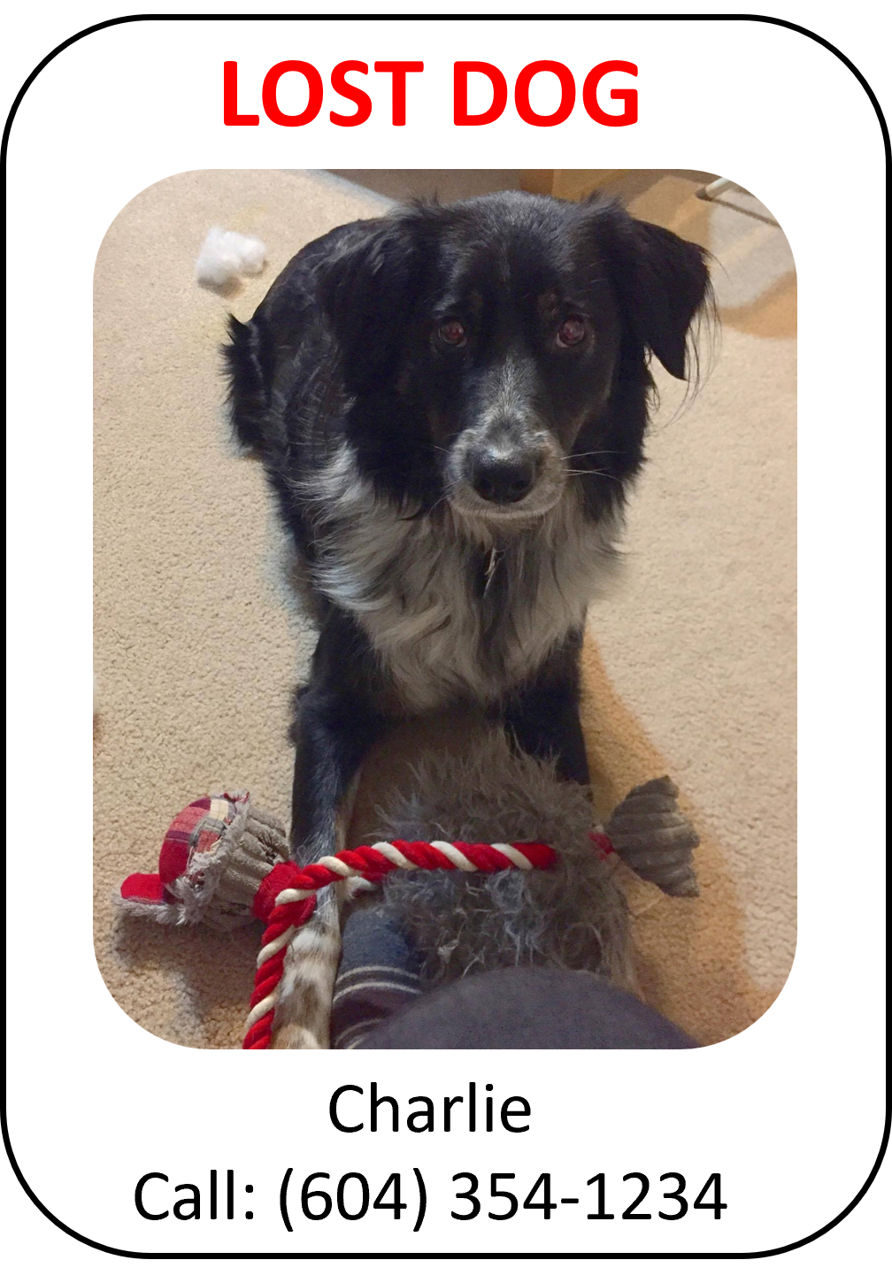
Dog Finder Application CMPT 733
Aidan Vickars, Rushabh Kaushal, Anant Awasthy, & Karthik Srinatha
Notes:
In this video we present an update of our progress towards completing our project for CMPT 733, where we are developing an android application to assist users to find lost dogs.

Slide 2

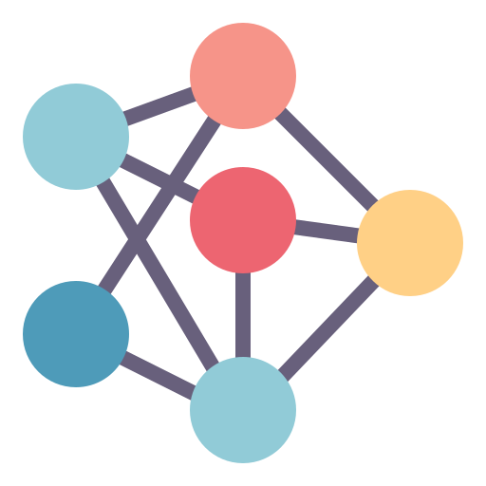
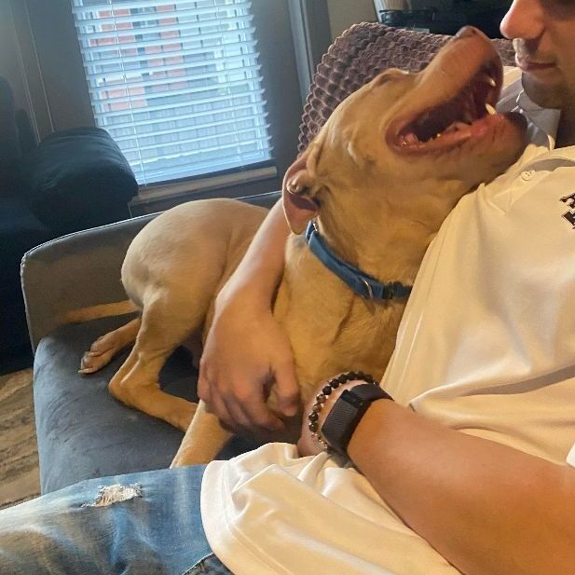
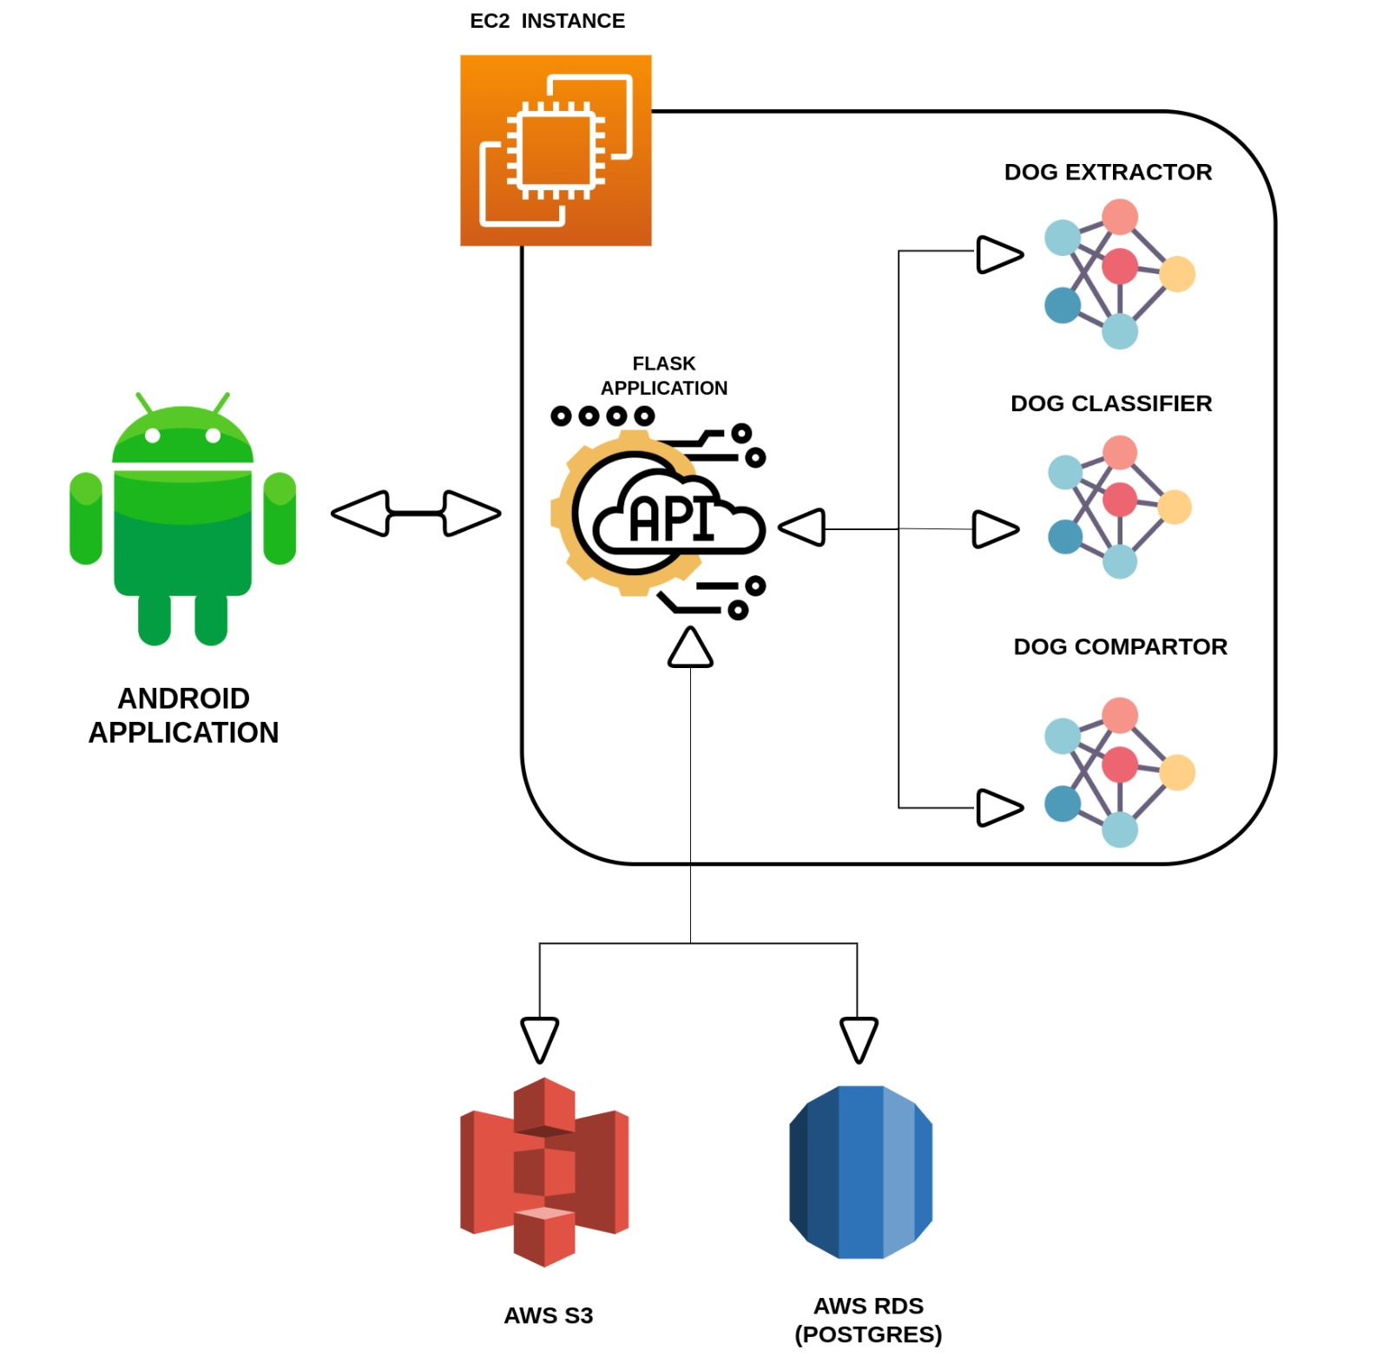
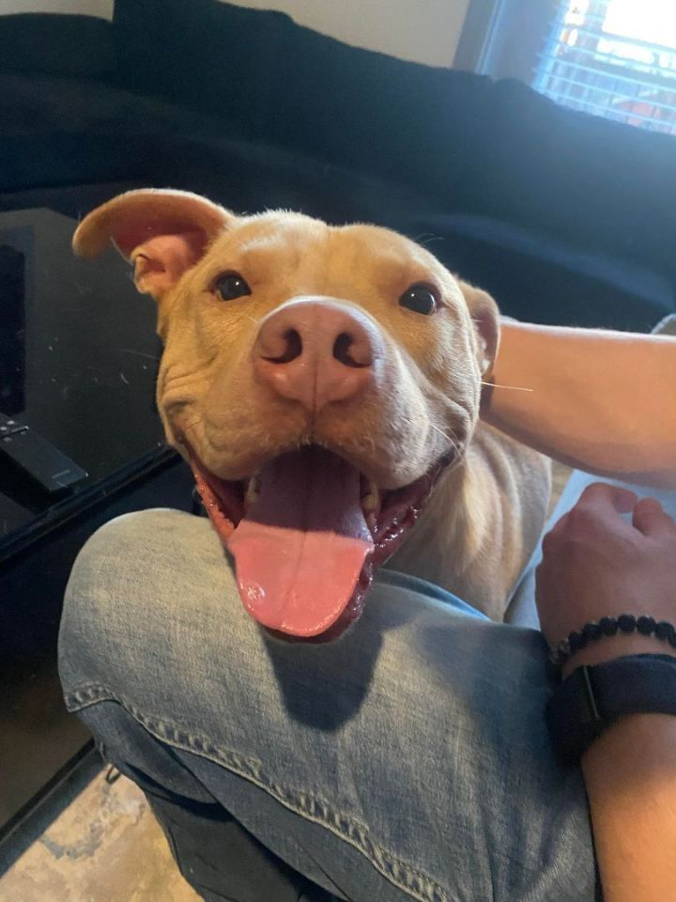
How it works
DOG EXTRACTOR
DOG CLASSIFIER
DOG COMPARATOR
LOST DOG
TOP K BREEDS CLASSIFICATION
COMPARE USING TOP K BREEDS AND LOCATION AS FILTERS
EX OUTPUT: 0.65
RETURN TOP N RESULTS
FOUND DOG
TOP K BREEDS CLASSIFICATION
Notes:
In our application, we have developed a series of convolutional neural networks that match lost dogs with found dogs and vice versa. Initially, the user will submit an image of a dog that has been lost or found.
ANIMATION
In the 1st step the image is passed to our first model: the Dog Extractor Model that returns a bounding box of the dog that we use to crop the image.
ANIMATION
In the 2nd step the cropped image is passed to the second model: the Dog Classifier model that determines the k most likely breeds the dog corresponds to.
ANIMATION
In the 3rd step the cropped image is passed into the third model: the Dog Comparator model that compares the lost dog with the found dogs and vice versa and returns similarity scores for all the comparisons. We use breed and location to reduce the number of comparisons.
ANIMATION
Finally, in the 4th and last step we return the top n most likely matches

Slide 3
How it works – At a Higher Level
Notes:
At a higher level, we have developed a FLASK API to act as the back end for our app.
The API runs on an EC2 instance with all three models as well.
To supplement this, we use:
A S3 bucket to store the raw images
And a relational database to store the meta data such as the dogs location, and their lost or found designation.

Slide 4
Motivation
Why is it an important project?
Why we chose it?
Why is it challenging?
Notes:
Our motivation for this project can be split into three categories
ANIMATION
Why is it an important project?
ANIMATION
Why we chose it?
ANIMATION
And Why is it challenging

Slide 5
Motivation
Why is it an important project?
Real world applications with potential for significant impact. Example: The BC SPCA’s existing “Pet Search” web application.
Meaningful contribution to work in dog-identification
Example Image in Data Set
Notes:
There are two reasons why this is an important project.
ANIMATION
The first is our project has real world applications. The most notable example is the possibility of integration with existing applications like the BC SPCAS “pet search” web app that can be used to find lost or found dogs.
ANIMATION
The second is that our project is a meaningful contribution to the work in dog-identification. Existing work only uses an unrealistic data made up of almost perfect front-facing images of dog faces. In contrast we have created a realistic dataset that contains multiple images for thousands of dogs in a variety of positions.

Slide 6
Motivation
Why we chose it?
Opportunity to make a real difference.
Opportunity to develop a product and deploy a data pipeline and ML models in a production environment.
DOG EXTRACTOR
DOG CLASSIFIER
DOG COMPARATOR
Opportunity to perform deep data analysis to understand the strength and weaknesses of our models.
Notes:
As to why we chose this project
ANIMATION
The first is of course the potential to make a real difference.
ANIMATION
The second is the opportunity to develop a product as well as deploy a pipeline and ml models in a production environment.
In class we often have the chance to develop models and pipelines, but we never have the opportunity to deploy them. It is for this reason that this project is an excellent learning opportunity.
ANIMATION
Opportunity to perform deep data analysis to understand the strength and weaknesses of our models.

Slide 7

Motivation
Why is it challenging?
Computer Vision???
No experience in computer vision. Every model and technique used was entirely new to us.
No experience deploying ML models and data pipelines in a production environment.
Image Source
Notes:
Finally, why is this project challenging
ANIMATION
This first is as a team none of us have any experience in computer vision. This project has been a lesson in understanding new techniques.
ANIMATION
Second, as a team deploying models and data pipelines is completely new.

Slide 8
Progress Report
Completed
Majority of front and back-end app development
The Dog Extractor model
Created a new data set containing multiple images for thousands of dogs by scraping PetFinder.com
The Dog Comparator model
High level analyses of Dog Extractor & Dog Comparator models
Determining the optimum cut offs to use in each model respectively
Notes:
Moving on to the progress report. To date we have completed
ANIMATION
Majority of front and back-end app development
ANIMATION
The Dog Extractor model
ANIMATION
Created a new data containing multiple images for thousands of dogs by scraping PetFinder.com
ANIMATION
The Dog Comparator model
ANIMATION
High level analyses of the Dog Extractor & Dog Comparator models
Determining the optimum cut offs to use in each model respectively

Slide 9

Demo
Notes:
This is a demo of the work done to date

Slide 10
Progress Report
In Progress
Integrate the Dog Comparator model into the app ~ By March 10th
Complete the Dog Classifier model ~ By March 13th
Final Report (actively updated as items are completed) ~ By March 27th
Notes:
Our work that is currently in progress:
ANIMATION
Integrate the Dog Comparator model into the app ~ ETA by March 10th
ANIMATION
Complete the Dog Classifier model ~ ETA By March 13th
You will likely notice that your in progress is currently quite light. This is because upon completion of the Dog Classifier model, completing the To be Completed items shown on the next page will be possible.

Slide 11
Progress Report
To be Completed
Integrate Dog Classifier model into app ~ By March 20th
^{APP COMPLETED}
Analyses of the entire model pipeline (i.e. How well the models perform together ) ~ By March 20th
Low level analyses and visualizations of models ~ By March 20th
Ex: Analyze performance of the Dog Extractor model on different dog sizes
Ex: Analyze performance of the Dog Classifier model on different breeds
Ex: Analyze performance of the Dog Comparator model on different breeds
Presentation and Video ~ By March 31st
^{PROJECT COMPLETED}
Notes:
Integrate Dog Classifier model into app ~ By March 20th
^{APP COMPLETED}
ANIMATION
^{APP COMPLETED}
Analyses of the entire model pipeline ~ By March 20th
Ex: How well the models perform together)
ANIMATION
Low level analyses and visualizations of models ~ By March 20th
Ex: Analyze performance of the Dog Extractor model on different bounding box sizes
Ex: Analyze performance of the Dog Classifier model on different breeds
Ex: Analyze performance of the Dog Comparator model on different breeds
ANIMATION
Final Report (actively updated as items are completed) ~ By March 27th
ANIMATION
Presentation and Video ~ By March 31st
^{PROJECT COMPLETED}

