Slide 1

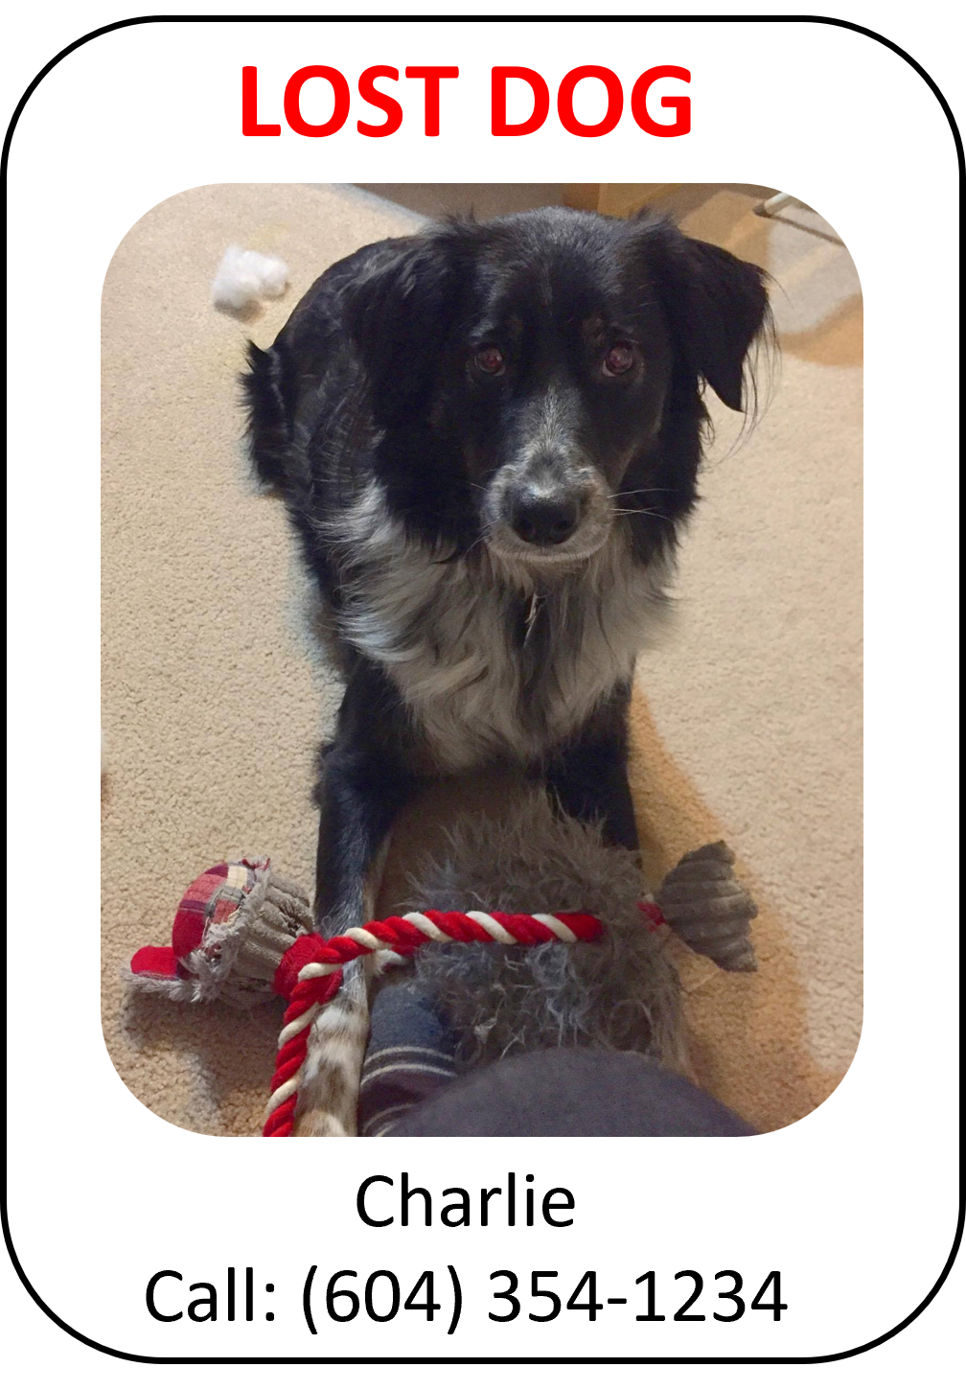
Dog Finder Application CMPT 733
Aidan Vickars, Rushabh Kaushal, Anant Awasthy, & Karthik Srinatha
Notes:
In this video we present our project for CMPT 733, where we developed an android application to assist users to find lost dogs.

Slide 2

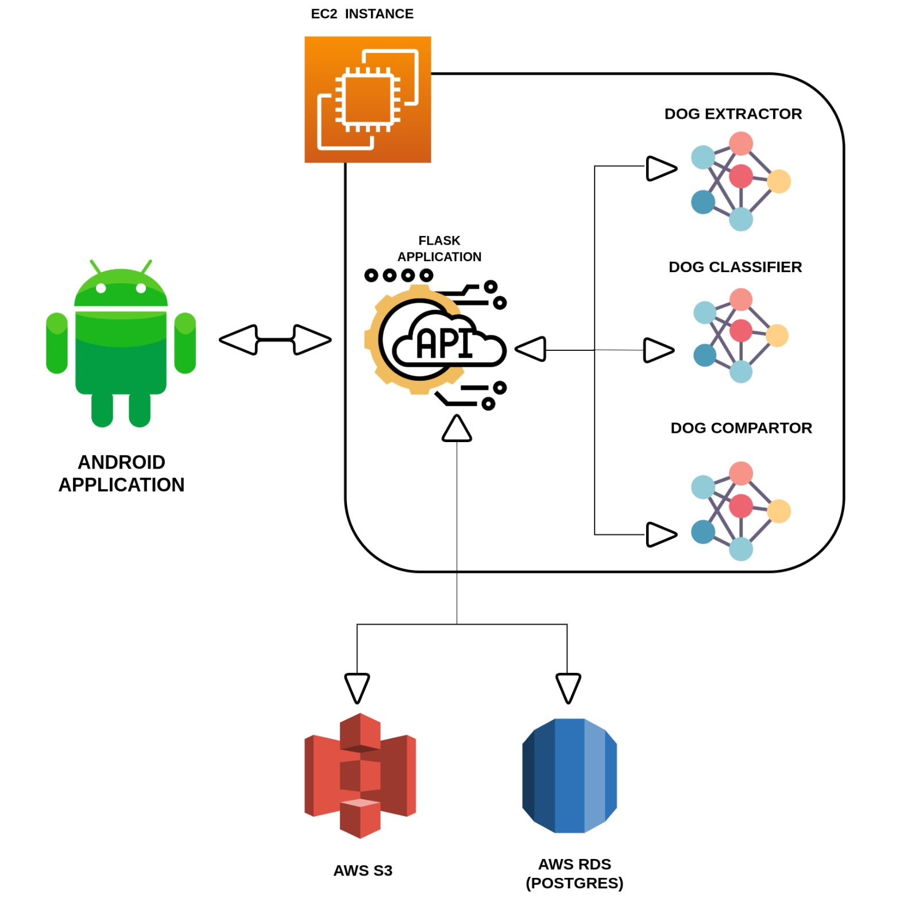

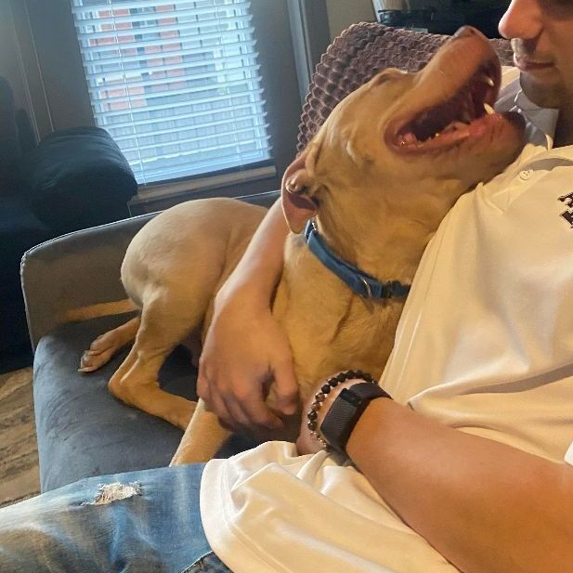
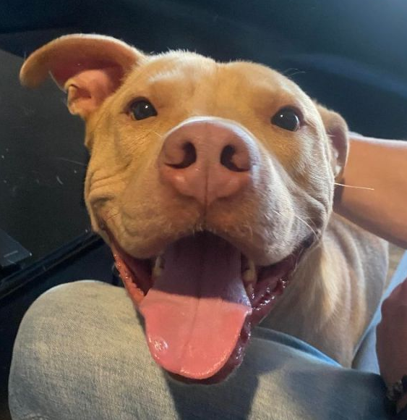
How it works
DOG DATA RECORDED
Contact Information
Bounding Box
Location
QUERY ENCODINGS OF FOUND DOGS BY LOCATION & BREED
RECORD TOP
DOG EXTRACTOR
DOG CLASSIFIER
DOG COMPARATOR
USER SUBMITS LOST DOG
RETURN TOP 15 RESULTS
?
TOP BREED CLASSIFICATION
SAVE ORIGINAL UNCROPPED IMAGE
Notes:
In our application, we have developed a series of convolutional neural networks that match lost dogs with found dogs and vice versa. Initially, the user will submit an image of a dog that has been lost or found.
ANIMATION
In the 1st step the image is passed to our first model: the Dog Extractor Model that returns a bounding box of the dog that we use to crop the image.
ANIMATION
In the 2nd step the image is passed to the second model: the Dog Classifier model that determines the most likely breed of thedog
ANIMATION
In the 3rd step the cropped image is passed into the third model: the Dog Comparator model that compares the lost dog with the found dogs and vice versa and returns similarity scores for all the comparisons. We use breed and location to reduce the number of comparisons.
ANIMATION
Finally, in the 4th and last step we return the top 15 most likely matches

Slide 3
Questions
Can a dog-identification model accurately determine if two dogs are the same using the entire body of each dog (i.e., images are not normalized)?
Can we construct a pipeline that can accurately match lost and found dogs together?

Slide 4
Data
3 Data-Sets:
Open Images Dataset
Filtered the data to only images of dogs
Removed any greyscale images
Converted all other images to RGB
PetFinder.com Dataset
Scraped multiple images for thousands of dogs from petfinder.com
Cleaned the dataset by applying the Dog Extractor model to remove images that (1) did not contain a dog and (2) contained multiple dogs
Standardized the dog breeds in the dataset
Stanford Dogs Dataset

Slide 5
Results
Dog Extractor Model:
Achieved MAP of 0.74 on test data
Achieved MAP of 0.72, 0.73, and 0.74 on small, medium and large dogs respectively

Slide 6
Results
Dog Classifier Model:
Notes:
There are two reasons why this is an important project.
ANIMATION
The first is our project has real world applications. The most notable example is the possibility of integration with existing applications like the BC SPCAS “pet search” web app that can be used to find lost or found dogs.
ANIMATION
The second is that our project is a meaningful contribution to the work in dog-identification. Existing work only uses an unrealistic data made up of almost perfect front-facing images of dog faces. In contrast we have created a realistic dataset that contains multiple images for thousands of dogs in a variety of positions.

Slide 7
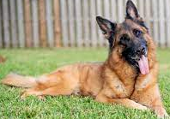
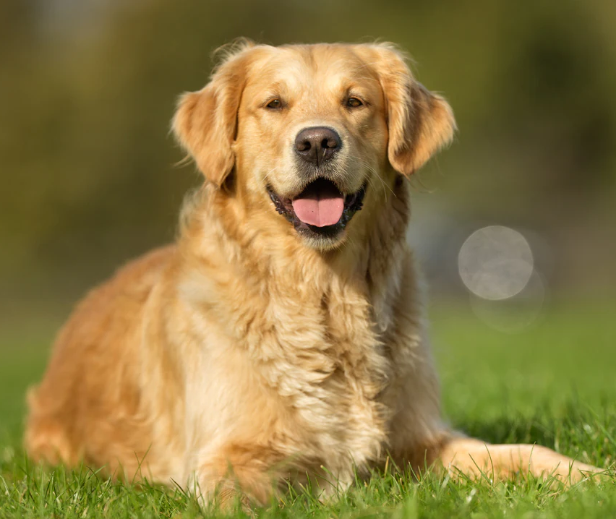
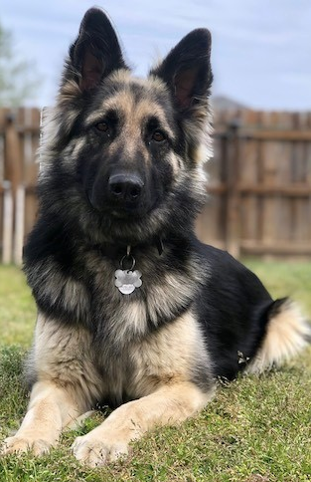
Results
Dog Comparator Model:
Achieved Classification Accuracy of 89% over randomly selected images of either the same or different dogs
?
Achieved Classification Accuracy of 79% over randomly selected images of the same or different dogs (of the same breed)
?
Notes:
For the dog comparator model, we present that results of two tests.
1.) In the first test we randomly selected two images of either the same dog, or of different dogs and computed the classification accuracy. We achieved a classification accuracy of 89%. This was a 2% reduction in accuracy compared to previous work in this area. However, we placed zero restrictions on the images.
2.) In the second test, we increase the difficulty such that when two images of different dogs are compared, we constrained them to be from the same breed. In this test we achieved a decreased but still respectable accuracy of 79%

Slide 8
Results
Pipeline:
Number of Lost Dogs | Number of Found Dogs | Number of Dogs Returned | Matching Accuracy
1000 | 100 | 15 | 89%
500 | 100 | 15 | 98%
Notes:
To assess the accuracy of the pipeline, we performed two tests:
1.) In the first, we designated 1000 dogs as lost and 100 dogs as found. We then calculated the percentage of lost dogs that we returned in the top 15 matches with respect to the found dogs. We achieved an accuracy of 89%.
2.) In the second test we reduced the number of lost dogs to 500. We achieved an accuracy of 98%.
This tells us that using a single image of a lost and found dog respectively, we can accurately match lost and found dogs together. We suspect that in real life, the accuracy would be ~100% after we filter by location.

Slide 9
Demo
Notes:
This is a demo of the work done to date

