Slide 1

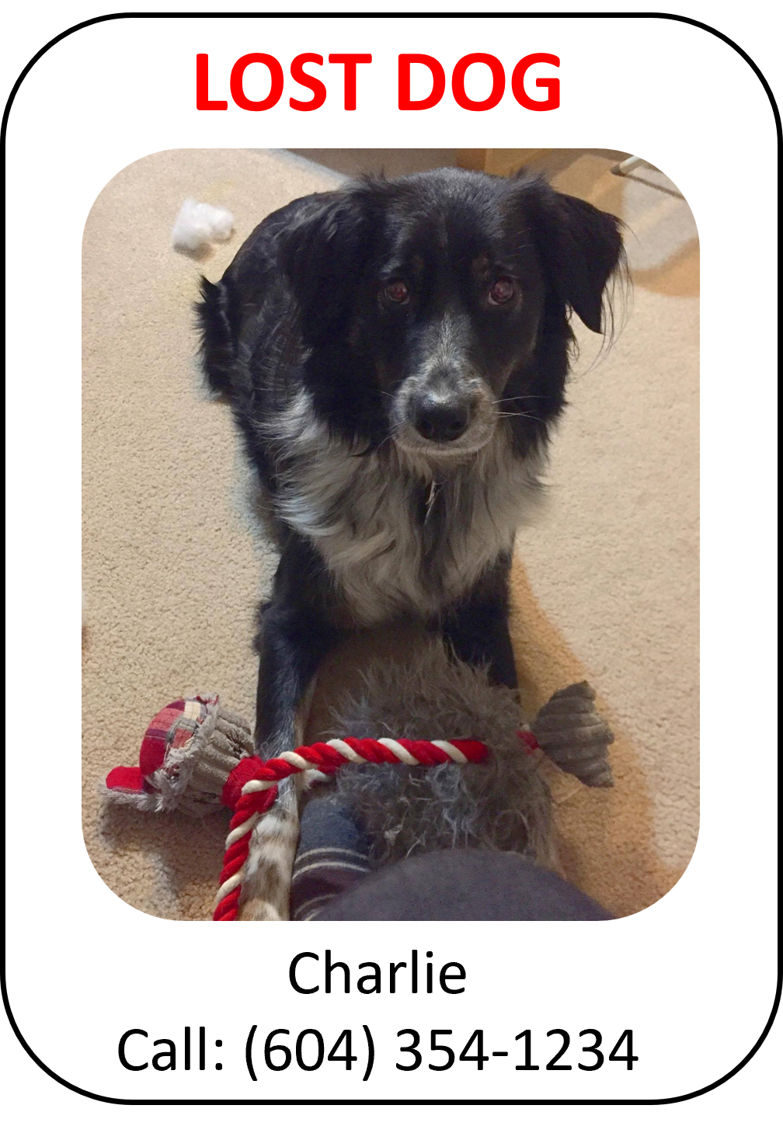
Dog Finder Application CMPT 733
Aidan Vickars, Rishabh Kaushal, Anant Awasthy, & Karthik Srinatha
Notes:
Welcome to our presentation for our project for CMPT 733, where we developed an android application to help users to find lost dogs.

Slide 2

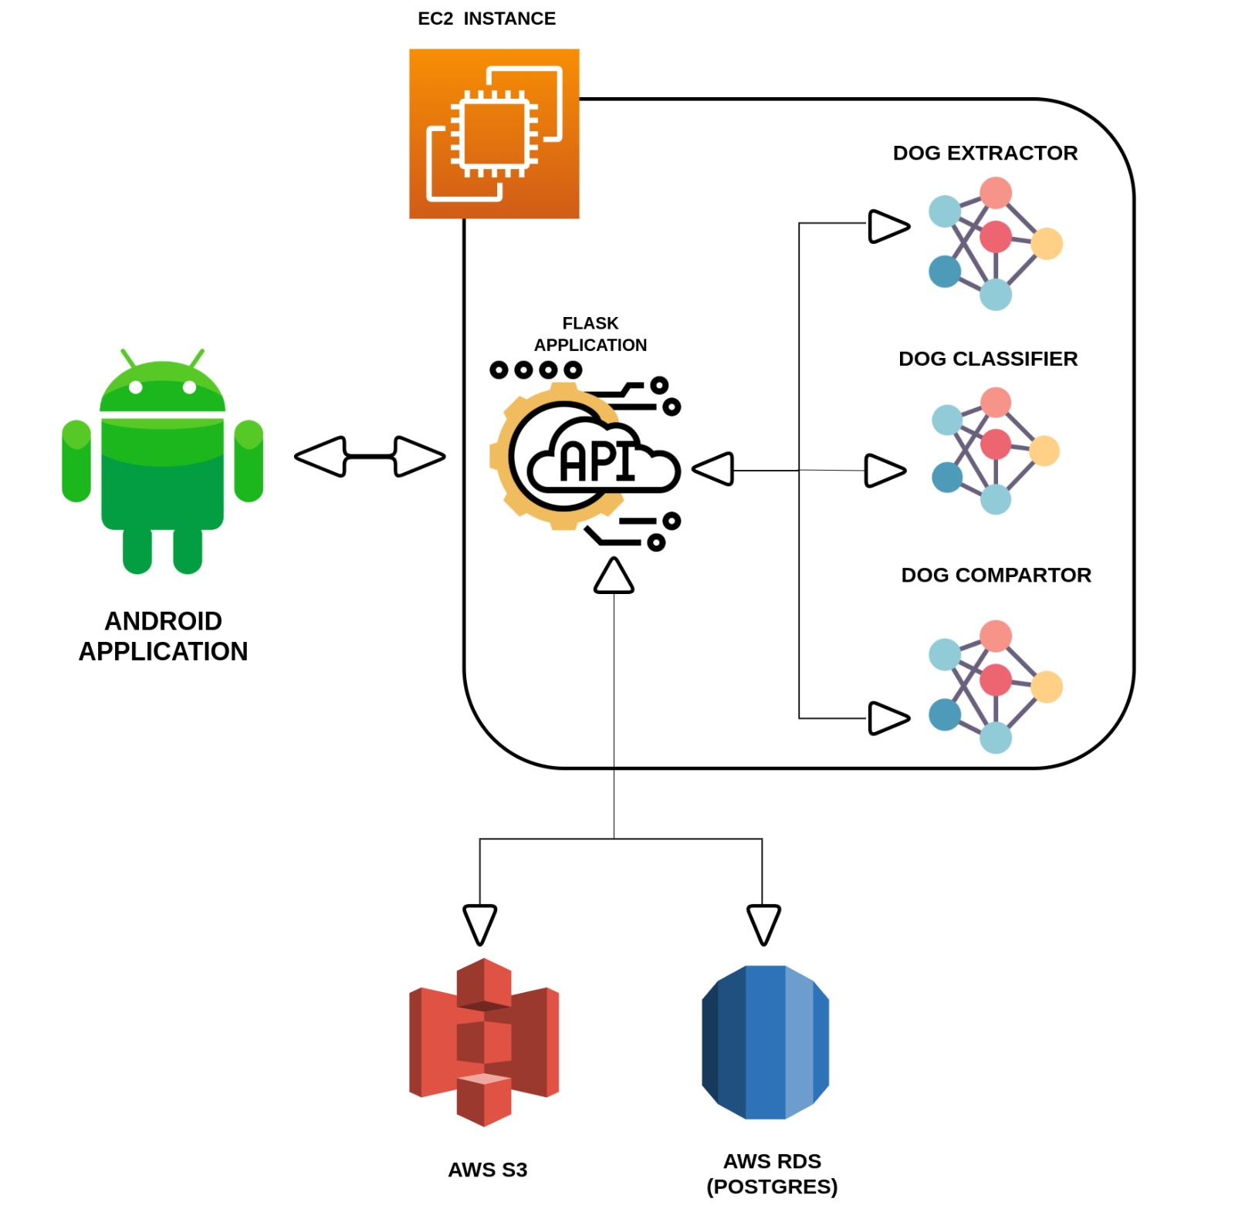

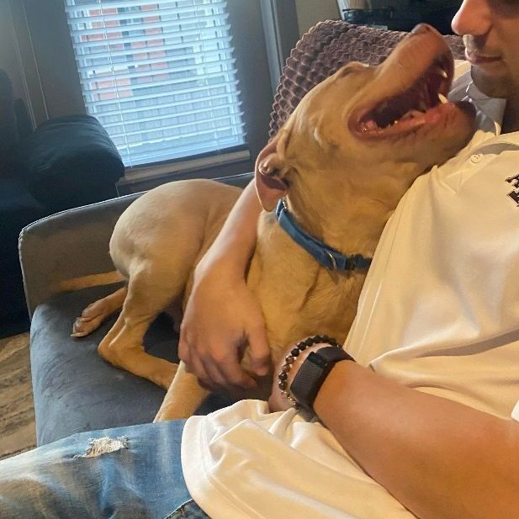
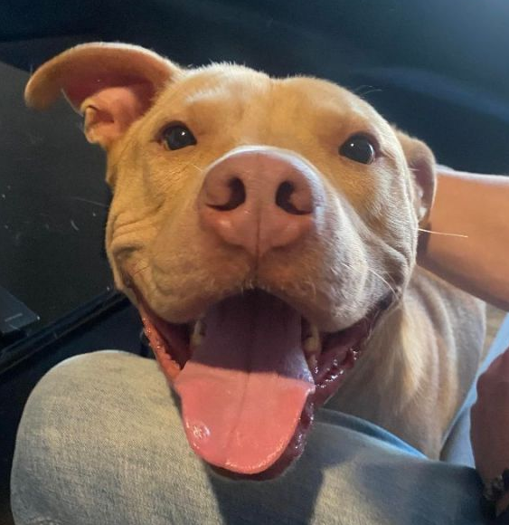
Pipeline
DOG DATA RECORDED
Contact Information
Bounding Box
Location
QUERY ENCODINGS OF FOUND DOGS BY LOCATION & BREED
RECORD TOP BREED
DOG EXTRACTOR
DOG CLASSIFIER
DOG COMPARATOR
USER SUBMITS LOST DOG
RETURN TOP 15 RESULTS
?
TOP BREED CLASSIFICATION
SAVE ORIGINAL UNCROPPED IMAGE
Notes:
In our application, we have developed a pipeline that consists of a series of convolutional neural networks that match lost dogs with found dogs and vice versa. Initially, the user will submit an image of a dog that has been lost or found.
ANIMATION
In the 1st step the image is passed to our first model: the Dog Extractor Model that returns a bounding box of the dog that we use to crop the image.
ANIMATION
In the 2nd step the image is passed to the second model: the Dog Classifier model that determines the most likely breed of the dog
ANIMATION
In the 3rd step the cropped image is passed into the third model: the Dog Comparator model that compares the lost dog with the found dogs and vice versa and returns similarity scores for all the comparisons. We use breed and location to reduce the number of comparisons.
ANIMATION
Finally, in the 4th and last step we return the top 15 most likely matches to the user

Slide 3
Questions
Can a dog-identification model accurately determine if two dogs are the same using the entire body of each dog (i.e., no position restrictions)?
Can we construct a pipeline that can accurately match lost and found dogs together?
Notes:
In this project we aim to answer two questions:
ANIMATION
The first is “Can a dog-identification model accurately determine if two dogs are the same using the entire body of each dog?” In essence what this means is that we place no restrictions on the position of the dogs in each image.
ANIMATION
The second is “Can we construct a pipeline that can accurately match lost and found dogs together?”

Slide 4
Data
3 Data-Sets:
Dog Extractor: Open Images Dataset
Contained ~20 000 images of different dogs with annotated bounding boxes.
Dog Classifier: Stanford Dogs Dataset
Contained ~20 000 images with 120 different breeds from around the world.
Dog Comparator: Pet Finder Dataset
Scraped multiple images for ~8000 dogs from petfinder.com with characteristics such as breed, location, and age.
Notes:
To answer these questions, we used three datasets:
ANIMATION
1.) For the dog extractor model, we used the open images dataset that contains roughly 20 000 images of different dogs with annotated bounding boxes
ANIMATION
2.) For the Dog classifier model, we used the Stanford dogs dataset that contains roughly 20 000 images of 120 different breeds from around the world
ANIMATION
3.) Finally, for the dog comparator we created the Pet Finder Dataset. Where we scraped multiple images for approximately 8000 dogs from petfinder.com with characteristics such as breed, location and age.

Slide 5
Test Results
DOG EXTRACTOR
DOG CLASSIFIER
DOG COMPARATOR
MAP:
0.74
Top 1 Accuracy: 85%
Top 1 Accuracy: 89%
Notes:
Now, for the test results of each model:
ANIMATION
The Dog Extractor model achieved a mean average precision or MAP of 0.74
ANIMATION
The dog classification model achieved a top one accuracy of 85%
ANIMATION
The dog comparator model achieved a top one accuracy of 89%
In all three cases, the models performed very well!

Slide 6
Demo
Notes:
Now, before discussing the results of the pipeline, Anant will start the demo of the application

Slide 7
Results
Pipeline:
Number of Lost Dogs | Number of Found Dogs | Number of Dogs Returned | Matching Accuracy
~1000 | ~100 | 15 | 89%
~500 | ~50 | 15 | 98%
Notes:
To assess the accuracy of the pipeline, we performed two tests:
1.) In the first, we designated 1000 dogs as lost and 100 dogs as found using the test data. We then calculated the percentage of lost dogs that we returned in the top 15 matches with respect to the found dogs. We achieved an accuracy of 89%.
2.) In the second test we reduced the number of lost dogs to 500 and the number of found dogs to 50 using the validation data. We achieved an accuracy of 98%.
This demonstrates that the pipeline accurately matches lost and found togethers using only a single image.
Now, here is Anant to show the results of the App.

