Slide 1
Introductory Search Engine Presentation
By:
Alex Vickers, Chelsea Beichner,
Leon King, Craig Datko, & Andrew Zhang

Slide 2
Topic: Current Events
Examples include:
Disasters – natural and man-made
Government Events – elections and hot political topics
Community Events – state fairs, community planning
Civil Importance – protests, riots, movements

Slide 3
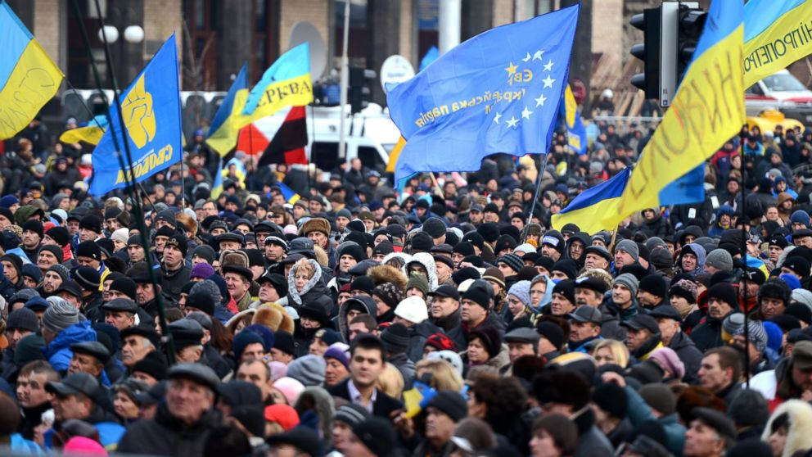
Current Events – Why?
Notes:
Staying up to date on local and worldwide events of interest is of extreme importance.
Example – Searching for Ukraine might bring up many different results, but most likely one is curious as to the current state of the country. Cut the excess and only show relevant info.

Slide 4
Challenges
Crawling
information served up must be up to date
Validity of returned documents
Conflicting sources? Intentional misinformation?
Example – opposing fractions in a protest movement

Slide 5
Competition
Traditional Search Engines
Google, Bing, etc. – many have subsections for news
Daypop (Extinct as of 2008)
News websites
Essentially manually curated news search engines
Social Sites
Blogs, Twitter, etc. all provide extremely fast updates when it comes to current events.

Slide 6
Customer
Mohamed Magdy
PHD Student at Virginia Tech
Actively researching focused crawlers
Research has touched upon current events data

