Slide 1
Aerospace Altitude & Speed Profile Analyzer
Avi Cooperman, Jack O’charek
Course: ES115 – Engineering Computer Applications
Module 2: Physics & Chemistry Applications
Date: April 2026

Slide 2
Problem Overview / System Description
We modeled a commercial aircraft flight from takeoff to landing.
Flight data includes altitude (ft) and speed (knots) sampled every second over a 2-hour flight.
Why it matters:
Aircraft must stay within safe altitude and speed envelopes at all times
Phase detection enables automated flight monitoring and anomaly detection
Data source: Synthetic time-series generated to match realistic commercial flight parameters

Slide 3
Engineering Objective
Analyze a complete flight profile and answer three core questions:
What phase is the aircraft in at any given moment?
How does altitude and speed evolve across the flight?
What are the key performance metrics of the flight?
Metrics computed:
Maximum climb rate (ft/min)
Average cruise speed (knots)
Descent duration (minutes)

Slide 4
Mathematical Model
Phase identification uses threshold logic on altitude h(t) and speed v(t):
Ground: h(t) < 500 ft AND v(t) < 80 kts
Takeoff: h(t) < 500 ft AND v(t) >= 80 kts
Climb: h(t) < 30,000 ft AND dh/dt > 5 ft/s
Cruise: h(t) >= 30,000 ft AND dh/dt >= -5 ft/s
Descent: dh/dt < -5 ft/s
Rate of climb: dh/dt = (h(t+1) - h(t)) / dt [forward difference]
Smoothed with 30-second moving average to suppress noise

Slide 5
Algorithm / System Logic
Step 1: Generate synthetic altitude and speed arrays over t = 0 to 7200 s
Step 2: Add Gaussian noise to simulate sensor readings
Step 3: Compute dh/dt using diff() and apply movmean() smoothing
Step 4: Loop over each time step, apply threshold rules to assign phase label (0-4)
Step 5: Compute flight metrics using logical indexing:
max(dalt_sm(climb_idx)) * 60 for max climb rate
mean(spd(cruise_idx)) for average cruise speed
sum(desc_idx) * dt / 60 for descent duration
Step 6: Generate four plots using MATLAB figure() and scatter()/plot()/histogram()

Slide 6
MATLAB Implementation
Phase detection loop (core logic):
for i = 1:length(t)
if alt(i) < ALT_LANDED && spd(i) < SPD_TAKEOFF => phase = 0 (Ground)
elseif alt(i) >= ALT_CRUISE && dalt_sm(i) >= DALT_DESC => phase = 3 (Cruise)
elseif dalt_sm(i) > DALT_CLIMB => phase = 2 (Climb)
else => phase = 4 (Descent)
Metric extraction uses logical indexing:
avg_cruise_spd = mean(spd(cruise_idx));

Slide 7
Simulation Results (Plots)
Four plots generated (on following slides):
All axes labeled with units; legends identify each flight phase by color
Cruise threshold line (30,000 ft) overlaid on altitude plot for reference

Slide 8
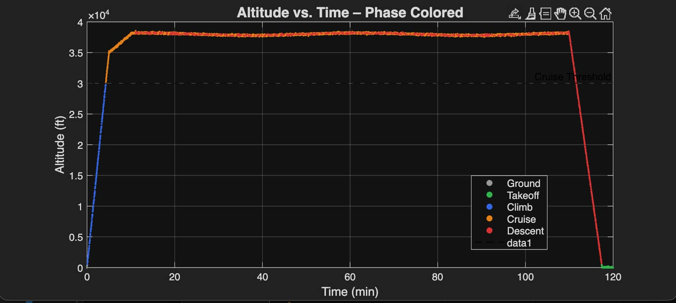
Plot 1: Altitude vs. Time (phase-colored scatter) -- shows climb, cruise plateau, descent

Slide 9
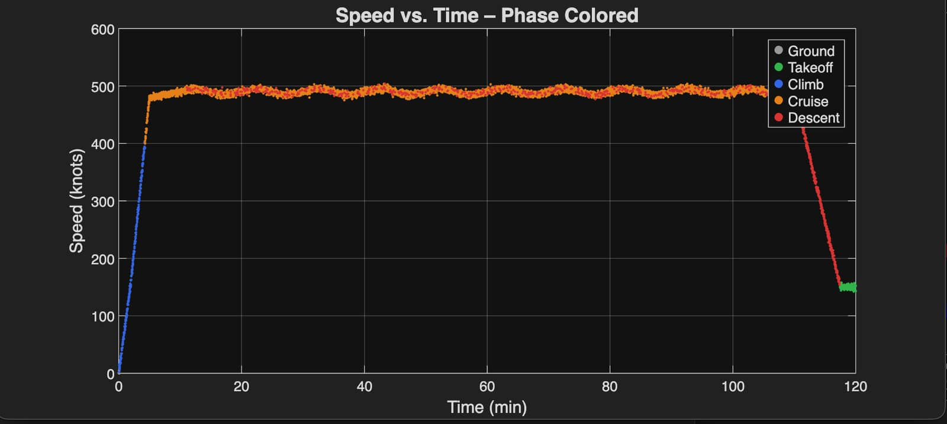
Plot 2: Speed vs. Time (phase-colored scatter) -- acceleration, cruise band ~490 kts, decel

Slide 10
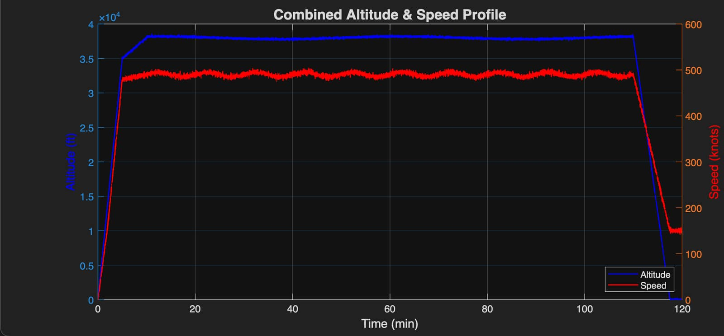
Plot 3: Combined dual-axis -- altitude (blue, left axis) vs. speed (red, right axis)

Slide 11
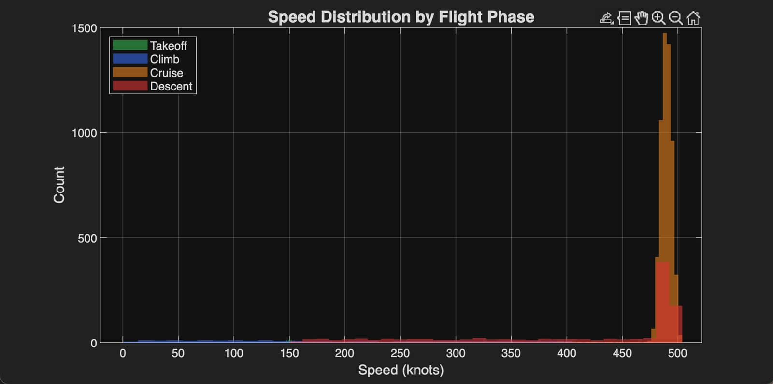
Plot 4: Speed histogram by phase -- cruise distribution is tight; takeoff/descent are spread

Slide 12
Analysis of Results
Speed plot:
Takeoff acceleration from 0 to 160 kts in 2 min, cruise stabilizes near 490 kts
Cruise speed band is narrow (+/- 5 kts), confirming autopilot-like stability
Speed histogram confirms bimodal distribution: low-speed phases vs. high-speed cruise

Slide 13
Analysis of Results
Altitude plot:
Sharp linear climb to ~38,000 ft in first 10 minutes matches real jet climb profile
Cruise plateau shows gentle sinusoidal oscillation from air density variation noise
Descent is smooth and gradual over ~7.5 minutes as expected for commercial approach

Slide 14
Parameter Sensitivity / Exploration
Cruise threshold (ALT_CRUISE):
Raising from 30,000 ft to 35,000 ft reclassifies part of climb as cruise, reducing climb metrics
Climb rate threshold (DALT_CLIMB):
Increasing from 5 to 15 ft/s makes phase detection stricter; short level-offs become descent

Slide 15
Parameter Sensitivity / Exploration
Noise level:
Doubling noise std dev (160 ft instead of 80 ft) causes phase flickering at boundaries
Moving average window (currently 30 s):
Reducing to 5 s allows noise spikes through; increasing to 60 s smooths too aggressively

Slide 16
Model Limitations
Synthetic data does not capture all real-world flight dynamics:
No wind gusts, turbulence, or ATC-mandated altitude holds
Speed and altitude modeled independently; no aerodynamic coupling
Single-segment flight -- no multi-leg routes or holding patterns
Threshold-based phase detection is brittle:
Hard cutoffs can misclassify gradual transitions between phases
More robust approach: Hidden Markov Models or ML-based classifiers
Constant time step (1 s) assumed; real flight recorders may have variable rates

Slide 17
Engineering Relevance
Flight data monitoring (FDM) is mandatory for commercial airlines under FAA/EASA rules
Phase-based analysis feeds into:
Fuel burn optimization (minimize time in climb, maximize cruise efficiency)
Maintenance scheduling (climb and descent cycles drive airframe fatigue)
Safety incident reconstruction (NTSB uses phase-tagged data in investigations)
Aerospace engineers use similar algorithms in Flight Management Systems (FMS)
This project demonstrates core data-driven engineering workflow:
Acquire data => Model => Classify => Compute metrics => Visualize

Slide 18
Team Contributions
Avi Cooperman:
Mathematical model design and phase threshold definition
MATLAB algorithm development and loop logic
Jack O'charek:
Synthetic data generation and noise modeling
Visualization design (all four plots) and metric computation
Joint:
Results analysis, parameter sensitivity exploration, and presentation

Slide 19
Conclusion
We built a MATLAB flight profile analyzer that:
Generates realistic altitude and speed time-series data for a 2-hour flight
Automatically classifies each second into one of five flight phases
Computes max climb rate (~700 ft/min), average cruise speed (~490 kts), descent duration (~7.5 min)
Produces four labeled, phase-colored visualizations
Key takeaways:
Threshold logic is simple yet powerful for structured time-series data

