Slide 1
Compositional Safety and Security Analysis of Architecture Models
Mike Whalen
Program Director University of Minnesota Software Engineering Center
Notes:
1

Slide 2
Acknowledgements
Rockwell Collins (Darren Cofer, Andrew Gacek, Steven Miller, Lucas Wagner)
UPenn: (Insup Lee, Oleg Sokolsky)
UMN (Mats P. E. Heimdahl)
CMU SEI (Peter Feiler)

Slide 3
Main Messages
We need a variety of reasoning approaches and partitioning methods for system-level requirements and analysis
Your How is My What: requirements vs. design is a often matter of perspective
Requirements hierarchies often follow system and software architectures.
Notes:
What is the point of my talk?
- Your how is my what.

Slide 4
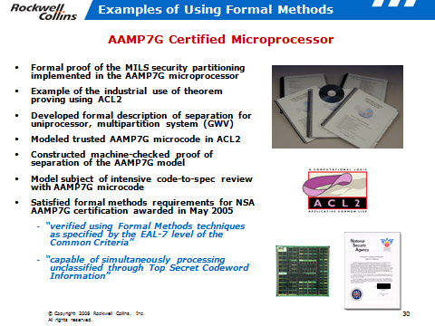
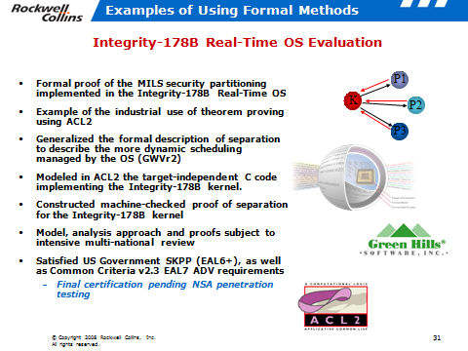
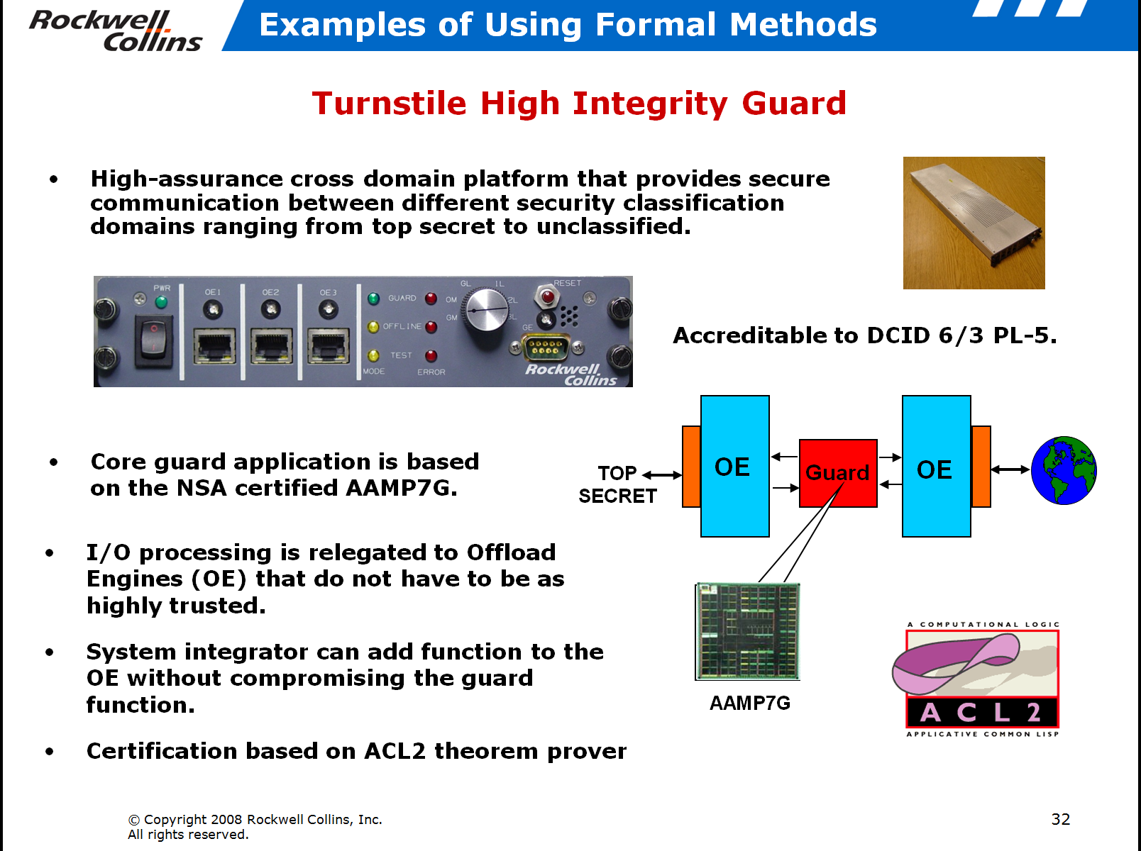

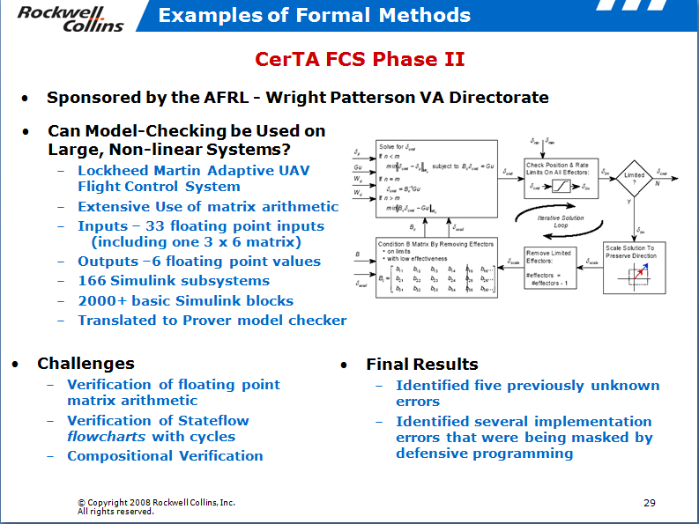
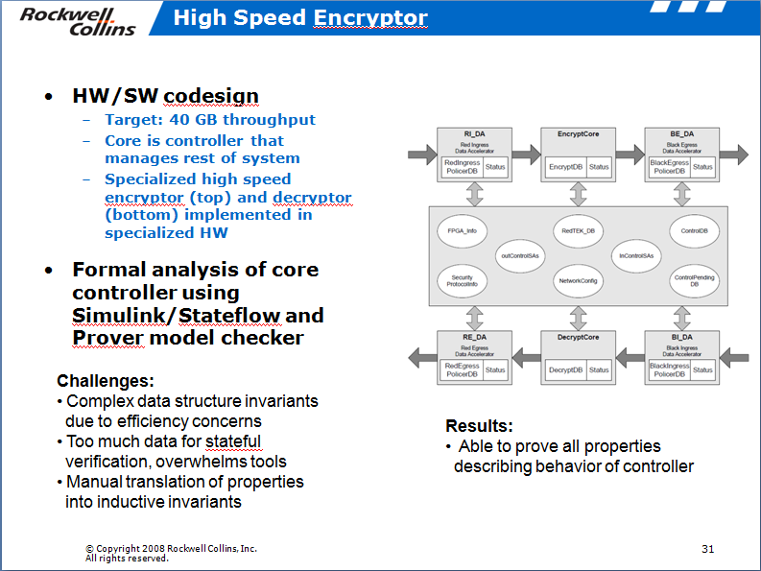
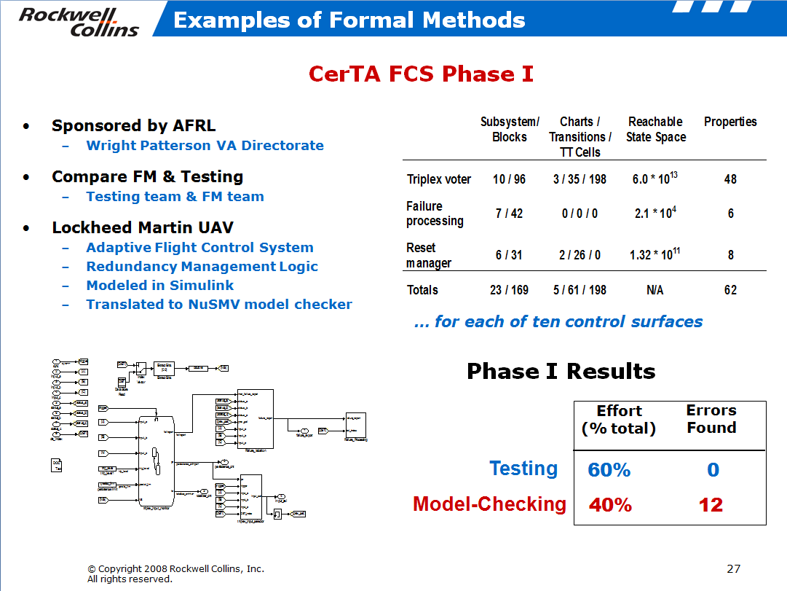
Component Level Formal Analysis Efforts
Notes:
Note: not a one man show! Collins continues to use this technology.

Slide 5



Slide 6
Mismatched Assumptions
System Engineer
Control Engineer
Physical Plant Characteristics
Lag, proximity
Measurement Units
Ariane 4/5
Air Canada
System
Under
Control
Control
System
System User
Data Stream Characteristics
ETE Latency (F16)
State delta (NASA)
Operator Error
Lag, proximity
Application Developer
Compute
Platform
Runtime
Architecture
Application
Software
Hardware Engineer
Embedded SW System Engineer
Concurrency Communication
ITunes crashes on dual-cores
Distribution & Redundancy
Virtualization of HW
(ARPA-Net split)
Slide from: An Overview of AADL v2 by Peter Feiler, 2010

Slide 7
Vision
System design & verification through pattern application and compositional reasoning
LRU
SENSOR 1
VOTE MULTIPLE DATA
COMPUTING RESOURCE A
FAIL-SILENT NODE FROM REPLICAS
SENSOR
COMPUTING RESOURCE
ABSTRACTION
SENSOR 2
COMPUTING RESOURCE B
SENSOR 3
VERIFIED
AVAILABILITY
VERIFIED
INTEGRITY
VERIFICATION
REUSE
ARCHITECTURE
MODEL
COMPOSITIONAL PROOF OF CORRECTNESS
(ASSUME – GUARANTEE)
SAFETY, BEHAVIORAL, PERFORMANCE PROPERTIES
COMPOSITION
© Copyright 2011 Rockwell Collins, Inc.
All rights reserved.

Slide 8
Approach
Complexity-reducing design patterns
Capture best solutions to architectural design problems
Reuse of formally verified solutions
Increase level of design abstraction
2
ARCH PATTERN MODELS
INSTANTIATE ARCH PATTERNS
& CHECK CONSTRAINTS
ANNOTATE
& VERIFY MODELS
PATTERN & COMP SPEC
LIBRARY
SYSTEM MODELING ENVIRONMENT
SYSTEM MODEL
(AADL)
AUTO
GENERATE
SYSTEM IMPLEMENTATION
COMPONENT MODELS
COMPONENT
LIBRARY
COMPOSITIONAL REASONING & ANALYSIS
Design Flow
SPECIFICATION
SYSTEM DEVELOPMENT
FOUNDRY
System architecture modeling
Apply formal specification and analysis tools to system-level design
Separate component specification and implementation
Automated model translation
Compositional verification
Reason about system behavior based on contracts and system design model structure
Compositional approach scales to large software systems
3
1
© Copyright 2011 Rockwell Collins, Inc.
All rights reserved.

Slide 9

Complexity-Reducing Architectural Design Patterns
Design pattern = model transformation
p : M → M (partial function)
Applied to system models
Reuse of verification is key
Not software reuse
Guaranteed behaviors associated with patterns (and components)
Reduce/manage system complexity
Separation of concerns
System logic vs. application logic (e.g., fault tolerance)
Process complexity vs. design complexity
Encapsulate & standardize good solutions
Raise level of abstraction
Codify best practices
© Copyright 2011 Rockwell Collins, Inc.
All rights reserved.

Slide 10
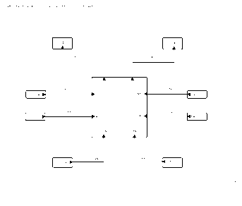
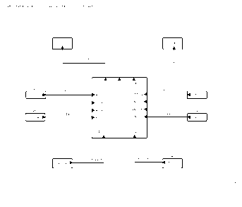
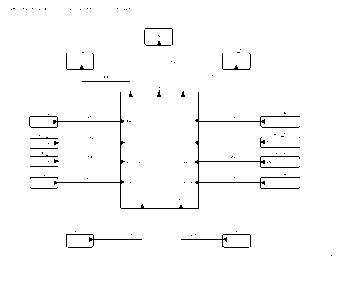
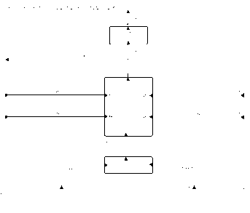
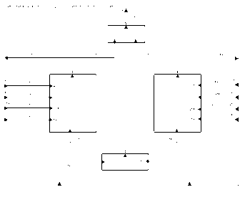
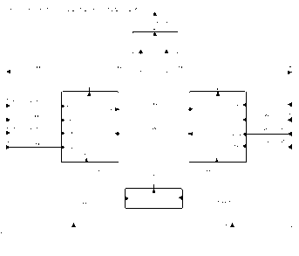
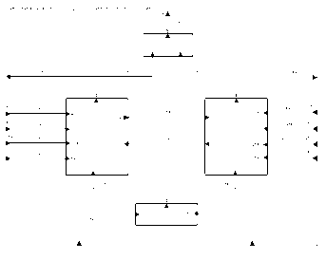
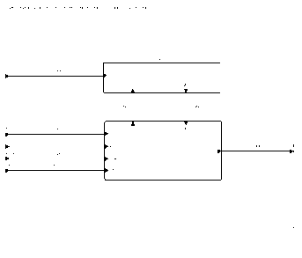
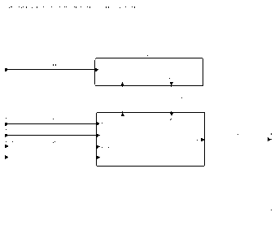
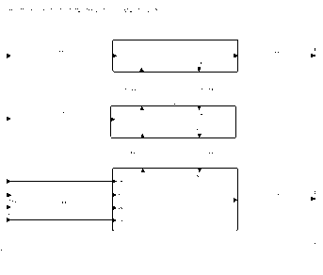
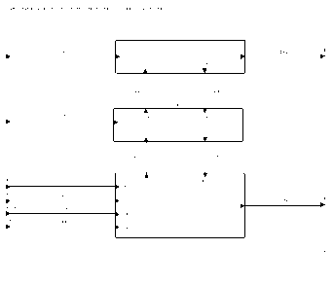
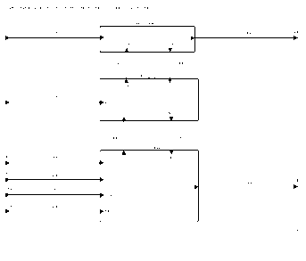
System Design Through Pattern Application
Active Standby Pattern
Initial
System
Replicate
Leader Selection
PALS
Replicate
Final
System
Avionics
System
Flight
Control
System Hierarchy
Flight
Guidance
Pattern Application
© Copyright 2011 Rockwell Collins, Inc.
All rights reserved.

Slide 11
System verification
SPECIFICATION
SYSTEM DEVELOPMENT
FOUNDRY
INSTANTIATE ARCHITECTURAL PATTERNS
ARCH PATTERN MODELS
ANNOTATE
& VERIFY MODELS
PATTERN & COMP SPEC
LIBRARY
SYSTEM MODELING ENVIRONMENT
SYSTEM MODEL
AUTO
GENERATE
SYSTEM IMPLEMENTATION
COMPONENT MODELS
COMPONENT
LIBRARY
COMPOSITIONAL REASONING & ANALYSIS
Reusable Verification:
Proof of component and pattern requirements (guarantees) and specification of context (assumptions)
Instantiation:
Check structural constraints, Embed assumptions & guarantees in system model
Compositional Verification:
System properties are verified by model checking using component & pattern contracts
© Copyright 2011 Rockwell Collins, Inc.
All rights reserved.

Slide 12
Hierarchical reasoning about systems
Avionics system requirement
Relies upon
Accuracy of air data sensors
Control commands from FCS
Mode of FGS
FGS control law behavior
Failover behavior between FGS systems
….
Response of Actuators
Timing/Lag/Latency of Communications
Avionics
System
Under single-fault assumption, GC output transient response is bounded in time and magnitude
ADS_L
ADS_R
FCS
…
FGS_L
FGS_R
Autopilot
…
System Modes
Control Laws
Co-ord

Slide 13
Compositional Reasoning for Active Standby
Want to prove a transient response property
The autopilot will not cause a sharp change in pitch of aircraft.
Even when one FGS fails and the other assumes control
Given assumptions about the environment
The sensed aircraft pitch from the air data system is within some absolute bound and doesn’t change too quickly
The discrepancy in sensed pitch between left and right side sensors is bounded.
and guarantees provided by components
When a FGS is active, it will generate an acceptable pitch rate
As well as facts provided by pattern application
Leader selection: at least one FGS will always be active (modulo one “failover” step)
transient_response_1 : assert true -> abs(CSA.CSA_Pitch_Delta) < CSA_MAX_PITCH_DELTA ;
transient_response_2 : assert true -> abs(CSA.CSA_Pitch_Delta - prev(CSA.CSA_Pitch_Delta, 0.0)) < CSA_MAX_PITCH_DELTA_STEP ;

Slide 14
Hierarchical reasoning between analysis domains.
Flight Control
System
Avionics system requirement
Relies upon
Guarantees provided by patterns and components
Structural properties of model
Resource allocation feasibility
Probabilistic system-level failure characteristics
Under single-fault assumption, GC output transient response is bounded in time and magnitude
Behavior
leader transition
managed on failure
Leader Selection
synchronous
communication
one node
operational
PALS
Replication
GUARANTEES
ASSUMPTIONS
Structure
timing
constraints
not
co-located
Platform
Principled mechanism for “passing the buck”
Resource
Probabilistic
RT sched
& latency
Error
model
© Copyright 2011 Rockwell Collins, Inc.
All rights reserved.

Slide 15
Contracts
Derived from Property Specification Language (PSL) formalism
IEEE standard
In wide use for hardware verification
Assume / Guarantee style specification
Assumptions: “Under these conditions”
Promises (Guarantees): “…the system will do X”
Local definitions can be created to simplify properties
Contract:
fun abs(x: real) : real = if (x > 0) then x else -x ;
const ADS_MAX_PITCH_DELTA: real = 3.0 ;
const FCS_MAX_PITCH_SIDE_DELTA: real = 2.0 ;
const CSA_MAX_PITCH_DELTA: real = 5.0 ;
const CSA_MAX_PITCH_DELTA_STEP: real = 5.0 ;
property AD_L_Pitch_Step_Delta_Valid =
true -> abs(AD_L.pitch.val - prev(AD_L.pitch.val, 0.0)) < ADS_MAX_PITCH_DELTA ;
property AD_R_Pitch_Step_Delta_Valid =
true -> abs(AD_R.pitch.val - prev(AD_R.pitch.val, 0.0)) < ADS_MAX_PITCH_DELTA ;
property Pitch_lr_ok =
abs(AD_L.pitch.val - AD_R.pitch.val) < FCS_MAX_PITCH_SIDE_DELTA ;
property some_fgs_active =
(FD_L.mds.active or FD_R.mds.active) ;
active_assumption: assume some_fgs_active ;
transient_assumption :
assume AD_L_Pitch_Step_Delta_Valid and
AD_R_Pitch_Step_Delta_Valid and Pitch_lr_ok ;
transient_response_1 :
assert true -> abs(CSA.CSA_Pitch_Delta) < CSA_MAX_PITCH_DELTA ;
transient_response_2 :
assert true -> abs(CSA.CSA_Pitch_Delta - prev(CSA.CSA_Pitch_Delta, 0.0)) < CSA_MAX_PITCH_DELTA_STEP ;
© Copyright 2011 Rockwell Collins, Inc.
All rights reserved.

Slide 16
Reasoning about contracts
Notionally: It is always the case that if the component assumption is true, then the component will ensure that the guarantee is true.
G(A ⇒ P);
An assumption violation in the past may prevent component from satisfying current guarantee, so we need to assert that the assumptions are true up to the current step:
G(H(A) ⇒ P) ;

Slide 17
Systems of Contracts
Architectures are hierarchically composed in layers.
Visually: a box and line diagram
Formally you can view a layer as a system S: S = (A, P, C)
C is a finite set of component contracts C: ℙ (A x P)

Slide 18
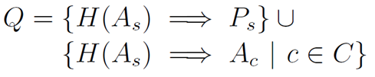
Reasoning about Contracts
Given the set of component contracts: Γ = { G(H(A_{c}) ⇒ P_{c}) | c ∈ C }
Architecture adds a set of obligations that tie the system assumption to the component assumptions
This process can be repeated for any number of abstraction levels

Slide 19
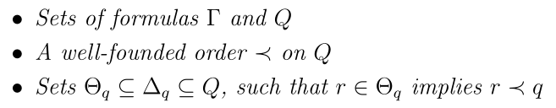
Composition Formulation
Suppose we have
Then if for all q ∈ Q
Γ ⇒ G((Z(H(Θ_{q})) ^ Δ_{q}) ⇒ q)
Then: G(q) for all q ∈ Q
[Adapted from McMillan]

Slide 20
A concrete example
Order of data flow through system components is computed by reasoning engine
{System inputs} → {FGS_L, FGS_R}
{FGS_L, FGS_R} → {AP}
{AP} → {System outputs}
Based on flow, we establish four proof obligations
System assumptions → FGS_L assumptions
System assumptions → FGS_R assumptions
System assumptions + FGS_L guarantees + FGS_R guarantees → AP assumptions
System assumptions + {FGS_L, FGS_R, AP} guarantees → System guarantees
System can also handle circular flows, but user has to choose where to break cycle

Slide 21
Architecture of Generic Infusion Pump
GPCA Pump
Pump Hardware
Pump Controller Software
Flow Rate Detector
Door
Pump Position
Humidity
Temp
Air Pressure
Battery
Power Supply
Air In Line Detector
Pump Motor
Buzzer
GPCA = Generic Patient-Controlled Analgesia
Product Family architecture
Infusion Command

Slide 22
GPCA Pump Example
Property of Interest:
If a “Pump Stop” command is received, then within 1 second, measured flow rate shall be zero.
We will prove this property compositionally based on the architecture of the Pump subsystem.
With
exciting verification
demo!

Slide 23
Proof of GPCA Pump
GPCA Pump
Pump Hardware
Pump Controller Software
Flow Rate Detector
Pump Position
…
Humidity
Temp
…
Battery
Power Supply
…
Pump Motor
Buzzer
Assertion: When a “Pump Stop” infusion command is received, then within 1 second, measured flow rate shall be zero.
Infusion Command

Slide 24
Proof of Reciprocating Pump
GPCA Pump
Reciprocating Pump Hardware
Pump Controller Software
Flow Rate Detector
Door
if pump is in no ambient flow position and pump motor is off, then flow rate will be zero within 200 ms
When pump stop command occurs, pump motor will be switched off when pump motor position reaches no-ambient flow state.
Humidity
Temp
Battery
Power Supply
Assertion: When powered on, pump cycles between ambient and no-ambient flow states every 300 ms.
Pump Motor
Buzzer
Assertion: When a “Pump Stop” infusion command is received, then within 1 second, measured flow rate shall be zero.

Slide 25
Proof of Rotary Pump
GPCA Pump
Rotary Pump Hardware
Pump Controller Software
Flow Rate Detector
Door
if pump is in no ambient flow position and pump motor is off, then flow rate will be zero within 400 ms
When pump stop command occurs, pump motor will be immediately switched off.
Humidity
Temp
Battery
Power Supply
Pump Motor
Buzzer
Assertion: When a “Pump Stop” infusion command is received, then within 1 second, measured flow rate shall be zero.

Slide 26
Architecture and Requirements

Slide 27
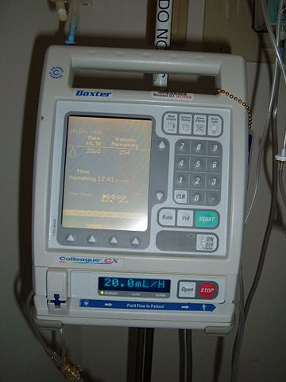
Requirements or Design Information?
The patient shall never be infused with a single air bubble more than 5ml volume.
When a single air bubble more than 5ml volume is detected, the system shall stop infusion within 0.01 seconds.
When a single air bubble more than 5ml volume is detected, the system shall issue an air-embolism command.
When air-embolism command is true, the system shall stop infusion.
When air-embolism command is received, the system shall stop piston movement within 0.1 second.

Slide 28
A: Both
The patient shall never be infused with a single air bubble more than 5ml volume.
When a single air bubble more than 5ml volume is detected, the system shall issue an air-embolism command.
PATIENT THERAPY SYSTEM
INFUSION SYSTEM
DRUG DELIVERY HARDWARE
AIR BUBBLE SENSOR
When air-embolism command is true, the system shall stop infusion.
PUMP SYSTEM
PUMP HARDWARE
PUMP CONTROLLER
When air-embolism command is received, the system shall stop piston movement within 0.1 seconds
When a single air bubble more than 5ml volume is detected, the system shall stop infusion within 0.01 seconds.

Slide 29
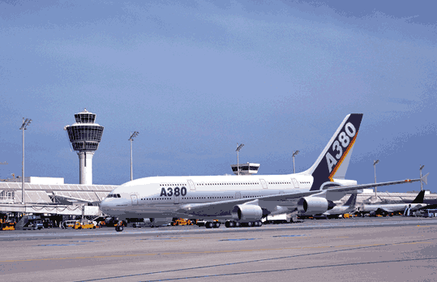

Slide 30
Your How is My What
Systems are hierarchically organized
Requirements vs. architectural design must be a matter of perspective
Need better support for N-level decompositions for requirements and architectural design
Reference model support
How do elements “flow” between world, machine, and specification as we decompose systems?
Certification standard support (DO-178B/C)
Currently: two levels of decomposition: “high” and “low”

Slide 31
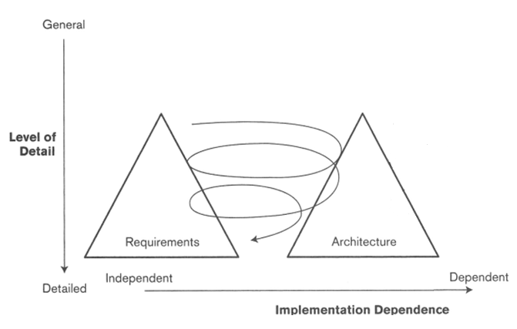
Twin Peaks

Slide 32
Often, Architecture Comes First
Candidate architectures from previous systems
Designer familiarity
Cost amortization
Program families
Certification or criticality requirements
Architectural choices often restrict set of achievable system requirements.

Slide 33
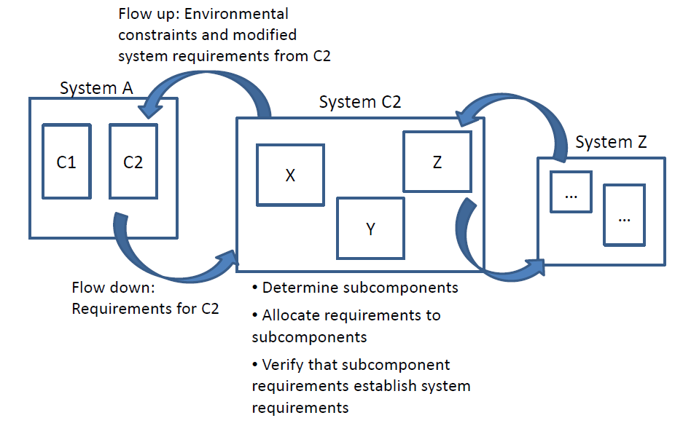
Flow is Bi-directional

Slide 34
Requirements Validation and Verification
Given hierarchical systems, where are the most serious problems with requirements?
At the component level?
At the top-level?
Somewhere in the middle?
A hypothesis:
The most problematic are the layers in the middle
Errors in decomposing system requirements become integration problems.
These are requirements to be both verified and validated.

Slide 35
Structural Properties

Slide 36
Structural Properties
Often, we are interested in properties about a model structure
Given the processor resources, is the system schedulable?
Is my software correctly distributed across different physical resources?
Are my end-to-end timing assumptions met?
Often these involve checking the mapping between the software and the hardware.

Slide 37
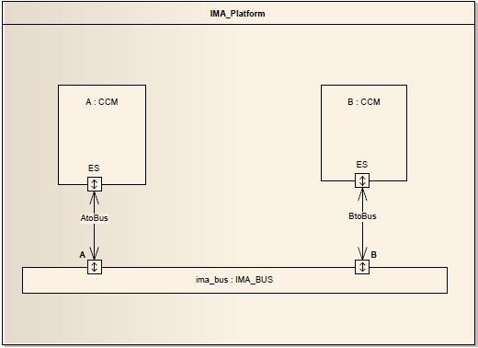
Structural Properties
Software + HW platform
Process, thread, processors, bus
Ex: PALS vertical contract
PALS timing constraints on platform
Check AADL structural properties
Guarantees
Sync logic executes at PALS_Period
Synchronous_Communication
=> “One_Step_Delay”
Assumptions (about platform)
Causality constraint:
Min(Output time) ≥ 2ε – μmin
PALS period constraint:
Max(Output time) ≤ T - μmax - 2ε
Software
Platform

Slide 38
PALS assumptions in AADL
T_{i}
T_{i+1}
( ± ε)
Clock_Jitter
( ± ε)
Period
Deadline
Compute_Execution_Time
Output
message
Output_Time
Latency
Input
message
available
Dispatch_Offset (if imposed)
Dispatch_Jitter (if describing max scheduling delay)
( ±ε)
( ±ε)
Earliest period start on other node
( ±ε)
Period
Thread execution
Deadline
Earliest output message
Thread execution
Min(Output_Time)
Latest output
message
Min(Latency)
Latest period start
Max(Latency)
Latest period start on other node
Max(Output_Time)
Causality Constraint
PALS Period Constraint

Slide 39
Structural property checks
Contract
Platform model satisfies PALS assumptions
Attached at pattern instantiation
Model-independent
Assumptions
Pre/post-conditions
Lute theorems
Based on REAL
Eclipse plug-in
Structural properties in AADL model
PALS_Threads := {s in Thread_Set | Property_Exists(s, "PALS_Properties::PALS_Id")};
PALS_Period(t) := Property(t, "PALS_Properties::PALS_Period");
PALS_Id(t) := Property(t, "PALS_Properties::PALS_Id");
PALS_Group(t) := {s in PALS_Threads | PALS_Id(t) = PALS_Id(s)};
Max_Thread_Jitter(Threads) :=
Max({Property(p, "Clock_Jitter") for p in Processor_Set |
Cardinal({t in Threads | Is_Bound_To(t, p)}) > 0});
Connections_Among(Set) :=
{c in Connection_Set | Member(Owner(Source(c)), Set) and
Member(Owner(Destination(c)), Set)};
theorem PALS_Period_is_Period
foreach s in PALS_Threads do
check Property_Exists(s, "Period") and
PALS_Period(s) = Property(s, "Period");
end;
theorem PALS_Causality
foreach s in PALS_Threads do
PALS_Group := PALS_Group(s);
Clock_Jitter := Max_Thread_Jitter(PALS_Group);
Min_Latency := Min({Lower(Property(c, "Latency")) for
c in Connections_Among(PALS_Group)});
Output_Delay := {Property(t, "Output_Delay") for t in PALS_Group};
check (if 2 * Clock_Jitter > Min_Latency then
Min(Output_Delay) > 2 * Clock_Jitter - Min_Latency
else
true);
end;

Slide 40
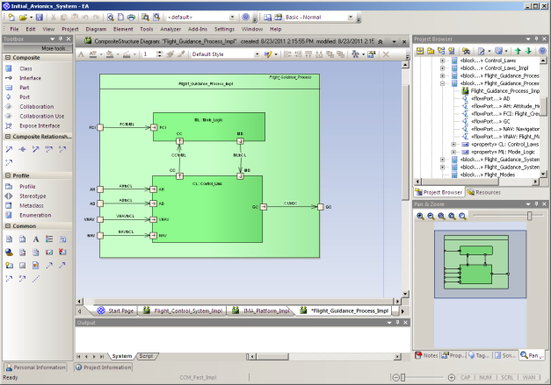
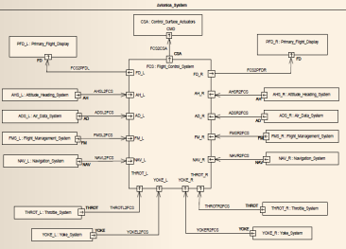
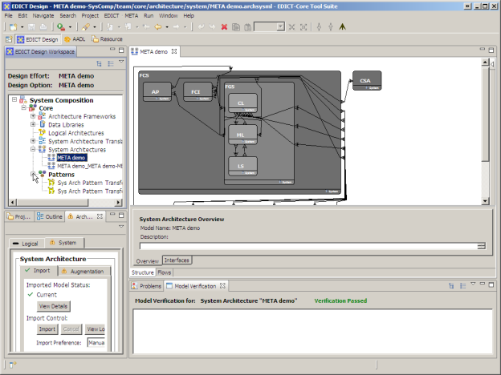
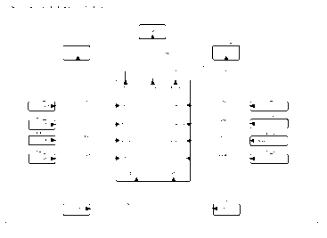
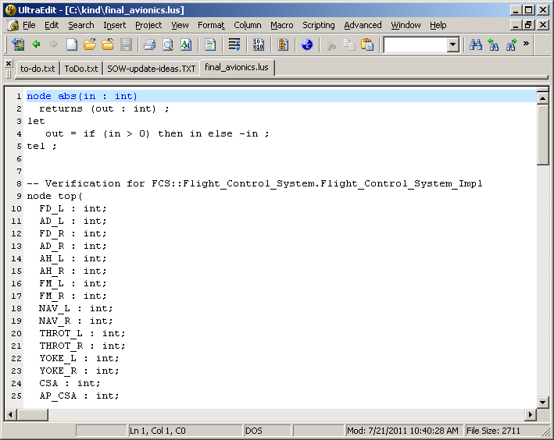
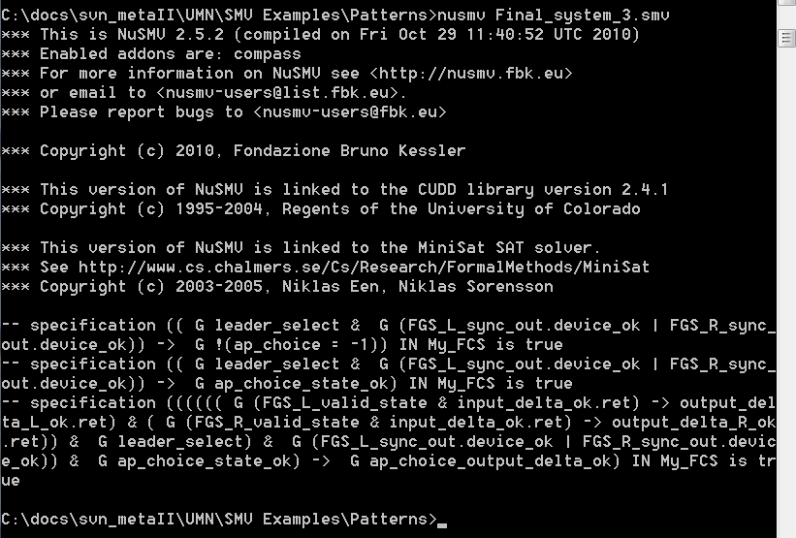
Tool Chain
SysML-AADL translation
Enterprise Architect
OSATE:
AADL modeling
SysML
EDICT:
Architectural
patterns
AADL
Lute:
Structural
verification
Eclipse
AGREE:
Compositional behavior verification
Lustre
KIND

Slide 41

Research Challenges

Slide 42
Structural and Behavioral Properties
Structural (Non-functional) Properties: Analyze conformance, optimization properties for hardware resources and model structure.
Behavioral (functional) Properties: Analyze system behavior. Behavioral properties may use structural properties.
Assertion: My system is schedulable using Rate Monotonic Scheduling.
Assertion: If a “Pump Stop” command is received, then within 1 second the measured flow rate shall be zero.
Theorem RMA
foreach e in Processor_Set do
Proc_Set(e) := { x in Process_Set | Is_Bound_To(x, e) } ;
Threads := { x in Thread_Set | Is_Subcomponent_Of(x, Proc_Set) }
check (sum (get_property_value (Threads “RTOS_properties::Utilization”)) <= (Cardinal (Threads) * (2 ** (1 / Cardinal (Threads))) -1 ) ) ;
End RMA ;
PSL_contract
property no_flow_after_stop : after (not (infusion_control_in.Pump_On)) (exists flow_rate_detector_out.Rate = 0 within STEPS_PER_SECOND *1) ;
assert (no_flow_after_stop) ;
end PSL_contract;
Checkable with Lute
Checkable with AGREE

Slide 43
Are these the “right” logics?
Simpler logics have benefits
Primary benefit: much simpler to analyze
AADL error annex is (mostly) propositional
Makes analysis simpler
Supports useful categorization of errors
Datalog-style logics support “timeless” analysis
The Lute checker is essentially a datalog interpreter
More complicated logics are necessary for certain properties
Richer types (e.g., algebraic types for XML messages)
Quantification

Slide 44
Dealing with Time
Pure synchrony or asynchrony
Uniform discrete time
Choose fixed time quantum between steps
This quantum need not be the same between layers
Adjust process behavior and requirements with clocks.
Non-uniform discrete time
Calendar/Timeout automata advance system to next interesting instant
Dense time
SIMPLEST
MOST ACCURATE

Slide 45
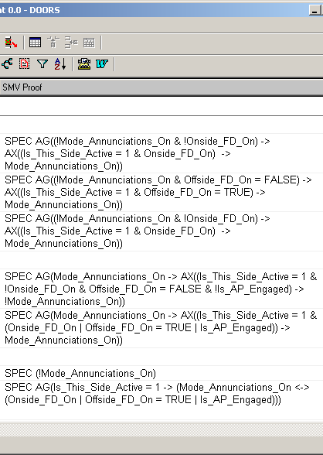
Scaling
What do you do when systems and subcomponents have hundreds of requirements?
FGS mode logic: 280 requirements
DWM: >600 requirements
Need to create automated slicing techniques for predicates rather than code.
Perhaps this will be in the form of counterexample-guided refinement

Slide 46
Assigning blame
Counterexamples are often hard to understand for big models
It is much worse (in my experience) for property- based models
Given a counterexample, can you automatically assign blame to one or more subcomponents?
Given a “blamed” component, can you automatically open the black box to strengthen the component guarantee?
Signal | Step...
 | 0 | 1 | 2 | 3 | 4 | 5
AD_L.pitch.val | -0.91 | -1.83 | -2.74 | -3.65 | -4.35 | -4.39
AD_L.pitch.valid | FALSE | TRUE | FALSE | TRUE | TRUE | FALSE
AD_R.pitch.val | 0.83 | -0.09 | -1.00 | -1.91 | -2.83 | -3.74
AD_R.pitch.valid | TRUE | FALSE | TRUE | FALSE | FALSE | TRUE
AP.CSA.csa_pitch_delta | 0.00 | 0.13 | 0.09 | 0.26 | 0.74 | -4.26
AP.GC_L.cmds.pitch_delta | 0.00 | -4.91 | -4.65 | -4.57 | -4.74 | -4.35
AP.GC_L.mds.active | TRUE | FALSE | FALSE | FALSE | FALSE | TRUE
AP.GC_R.cmds.pitch_delta | 0.00 | 0.83 | -4.43 | -4.48 | 4.91 | 4.83
AP.GC_R.mds.active | TRUE | TRUE | FALSE | FALSE | FALSE | FALSE
Assumptions for AP | TRUE | TRUE | TRUE | TRUE | TRUE | TRUE
Assumptions for FCI | TRUE | TRUE | TRUE | TRUE | TRUE | TRUE
Assumptions for FGS_L | TRUE | TRUE | TRUE | TRUE | TRUE | TRUE
Assumptions for FGS_R | TRUE | TRUE | TRUE | TRUE | TRUE | TRUE
FGS_L.GC.cmds.pitch_delta | -4.91 | -4.65 | -4.57 | -4.74 | -4.35 | 0.09
FGS_L.GC.mds.active | FALSE | FALSE | FALSE | FALSE | TRUE | FALSE
FGS_L.LSO.leader | 2 | 2 | 3 | 2 | 1 | 3
FGS_L.LSO.valid | FALSE | TRUE | FALSE | TRUE | TRUE | FALSE
FGS_R.GC.cmds.pitch_delta | 0.83 | -4.43 | -4.48 | 4.91 | 4.83 | 3.91
FGS_R.GC.mds.active | TRUE | FALSE | FALSE | FALSE | FALSE | FALSE
FGS_R.LSO.leader | 0 | 0 | 1 | 0 | 1 | 1
FGS_R.LSO.valid | TRUE | FALSE | TRUE | FALSE | FALSE | TRUE
leader_pitch_delta | 0.00 | 0.83 | 0.83 | 0.83 | 0.83 | -4.35
System level guarantees | TRUE | TRUE | TRUE | TRUE | TRUE | FALSE
Notes:
Counterexamples can be hard to figure out when you have a functional system. They are much harder to understand (in my experience) when doing these compositional proofs.

Slide 47
“Argument Engineering”
Disparate kinds of evidence throughout the system
Probabilistic
Resource
Structural properties of model
Behavioral properties of model
How do we tie these things together?
Evidence graph, similar to proof graph in PVS
Shows evidential obligations that have not been discharged
SRI is working on this: Evidential Tool Bus (ETB)
This seems to be a reasonable approach for tying tool results together
Declarative (like make or ant), but more powerful (uses Datalog)

Slide 48
Integration with AADL
Type representations
Currently we use “homebrew” property set for typing information
AADL data modeling annex?
Inheritance and Refinement
Extends from same AADL class
Implements from different AADL class
Contracts should preserve behavioral subtyping
Weaken assumptions
Strengthen guarantees
Some subtleties:
For existential properties over traces (CTL), this refinement is generally unsound.
Probably only want to support universal properties (like LTL)
Binding of logical system to physical system
Contracts are built on many assumptions involving physical system involving resources. Currently these are not addressed in the temporal logic, but externally
How do we represent physical failures in logical contracts?

Slide 49
Conclusions
AADL is very nice for designing systems
Good way to describe hardware and software
Lots of built-in analysis capabilities
Allows new system engineering approaches
Iteration between reqs and design
Specification and use of architectural patterns
Looking at behavioral and structural analysis
Still lots of work to do!
..but already can do some interesting analysis with tools
Sits in a nice intersection between requirements engineering and formal methods
Starting to apply this to large UAV models for security properties in the SMACCM project

Slide 50
System Architectural Modeling & Analysis
Software Component Development
System Architecture Development

Slide 51
Thank you!

