Slide 1

Online Construction of Analytical Prediction Models for Physical Environments: Application to Traffic Scene Modeling
Anurag Umbarkar, Shreyas K Rajagopal and Alex Doboli
Department of Electrical and Computer Engineering
State University of New York, Stony Brook, NY 11794
Email: adoboli@ece.sunysb.edu

Slide 2
Presentation Outline
Introduction
Main Challenges
Problem Description
Modeling Methodology
Experimental Results
Conclusions

Slide 3
Introduction
Cyber Physical Systems are distributed systems-of-systems that perform reliable data acquisition in order to build efficient data models.
Modeling natural enviroments vs engineered systems
These models can be used for monitoring, tracking and predicting the dynamics of the physical phenomenon
Data models aid decision-making procedures under resource constraints.
Notes:
Natural environments are arguably more complex and diverse with respect to their composing elements and interactions.
Natural environments are continuously changing without necessarily moving towards an end state or progressing towards a final goal.

Slide 4
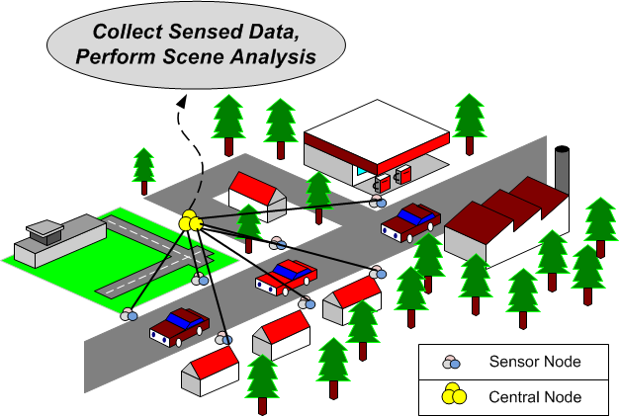
Introduction
Example: Traffic Scene Modeling

Slide 5
Main Challenges
Incomplete sensing
Algorithmic limitations
Human and social dimension
Notes:
The traditional philosophy of embedded system design is to introduce specific sensors to directly sample all the signals important in every situation.
An important caveat is that the system is completely defined, meaning that all its state variables, inputs, and expected responses are well defined for all situations.
The importance of these elements depends to a significant degree on the specific interactions among individuals and groups, and how their behavior adjusts to such interactions.

Slide 6
Problem Description
Finding components of a scene
Understanding the relations between components in a scene
Insight into cause of existing relations
Disambiguation
Predicting the evolution of a scene
Notes:
Scene components are characterized by a set of well defined, repeatable attributes (which creates the invariant identity of a component) and a set of attributes that distinguish the concept from other concepts.
In addition to the correlations that result directly from the nature of the application, other correlations are produced due to specific conditions and properties of the participating elements.
Disambiguation is important as multiple causes can produce similar effects.

Slide 7
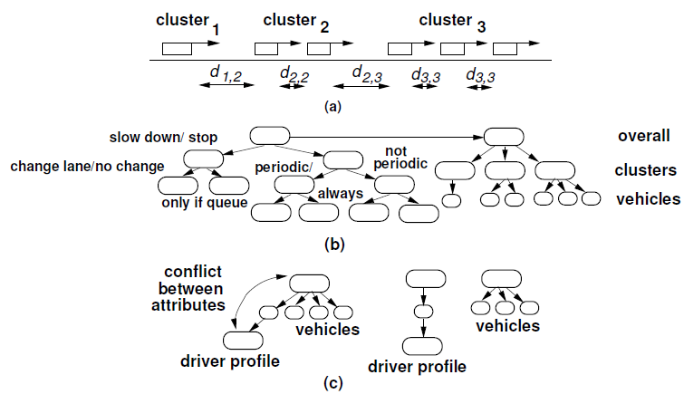
Problem Description
Example: Simple traffic situation

Slide 8
Modeling Methodology
Constructing ontology description for vehicular traffic applications
Constructing traffic scene representation
Predicting traffic dynamics

Slide 9
Ontology Description
Concepts
Attributes
Basic Semantic Elements:
Vehicle attributes
Driver’s driving profile
Cluster of vehicles
Cluster attributes
Cluster-level, social behavior
Cluster dynamics
Road conditions
Weather conditions

Slide 10
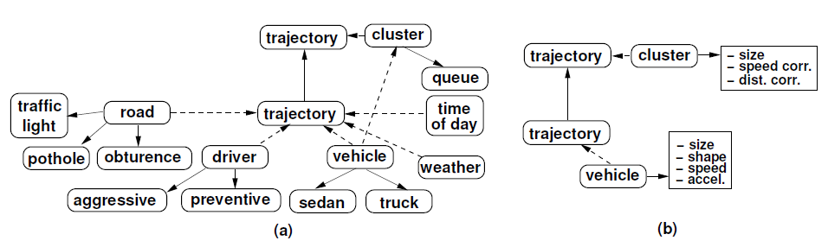
Ontology Description
Example: Simple ontology for traffic applications

Slide 11
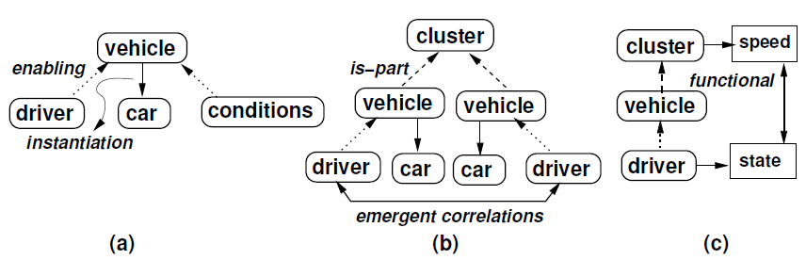
Ontology Description
Relations in ontologies for traffic applications
Enabling relation
Is-part relation

Slide 12
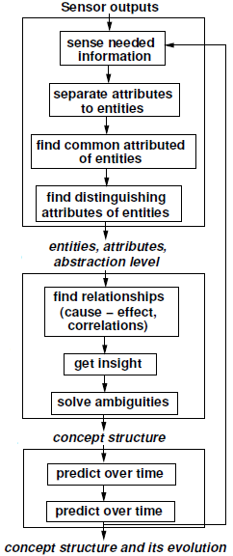
Traffic Scene Representation
Entity Identification
Relationship Understanding
Scene Evolution

Slide 13
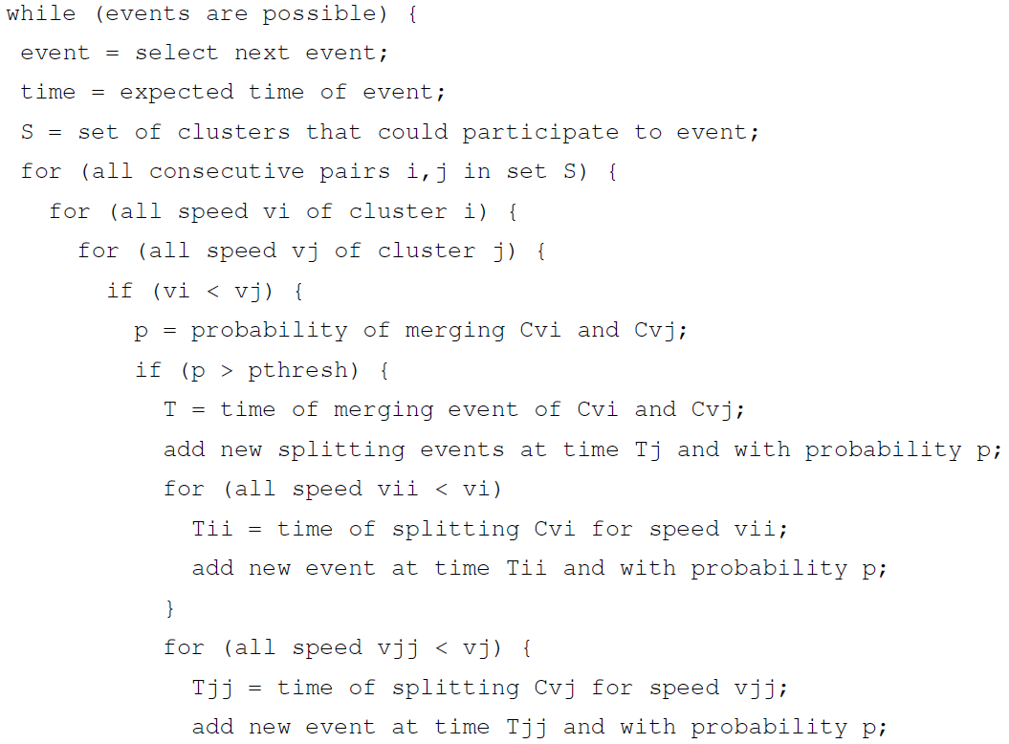
Predicting traffic dynamics

Slide 14
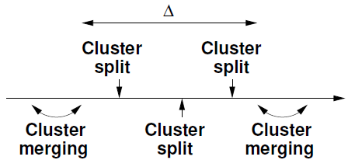



Predicting traffic dynamics
Time of separation
where,
Time of merging

Slide 15
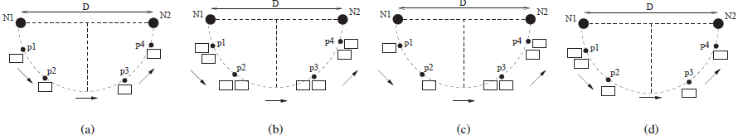
Experimental Results
Experiments with six scenarios:
Single vehicle: Good/Bad driving conditions
Cluster of vehicles: Good/Bad driving conditions
A vehicle joining a cluster
A vehicle splitting from a cluster

Slide 16
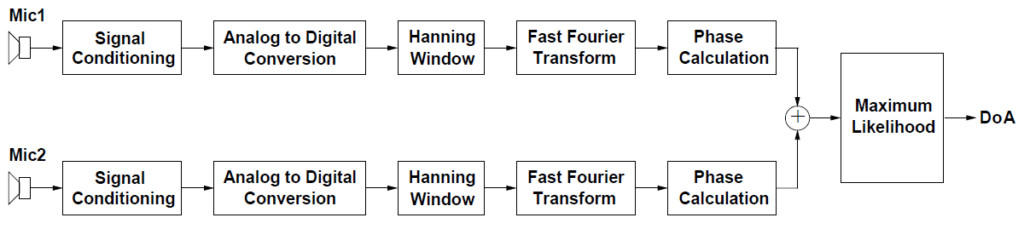
Experimental Results
Extract scene elements:
Sound Sensing and Localization
SVM-based Clustering

Slide 17
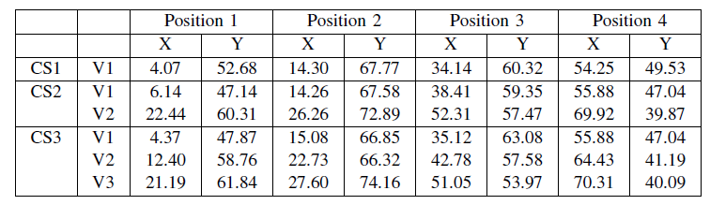
Experimental Results
Spatial Coordinates extracted from DoA estimates
Sources of Error in Experimental setup, sound source
Clustering accuracy: 87.5%
Classification accuracy: 100%

Slide 18
Conclusions
The proposed methodology models the dynamics of traffic scenes, including the participating vehicles, vehicle clusters, attributes and relations of all scene elements, and related events, like cluster merging and splitting.
The main steps of the methodology find the elements of a scene, identify the relations among the elements, and construct analytical prediction models for the traffic scene dynamics.
Compared to other methods, this methodology constructs the models online using data from embedded sensors.

Slide 19
Questions? Comments?

