Slide 1

PVT. LTD.
Presented by
Miss. Shrutika Virape

Slide 2

About Apple Ltd.
Apple Inc. is an American computer and consumer electronics company famous for creating the iPhone, iPad and Macintosh computers. Apple is one of the largest companies globally with a market cap of over 2 trillion dollars.

Slide 3


SPECIALITY
Apple total number of employees in 2023 was 161,000.
Apple phone’s are very expensive and branded
Apple launched their product like iPhone, iPad, Mac, Apple Watch, Vision Pro, and Apple TV;

Slide 4
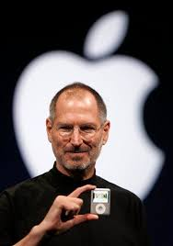
The Man Who Build This Great Company
Steve Jobs

