Slide 1
About Me
Avidan Mendelman
The Open University of Israel
B.Sc. in Computer Science
I am passionate about software development and building useful AI applications.
ScoutMatch AI | Avidan Mendelman
Notes:
Introduce yourself (~45s). Open University CS; passion for practical AI.

Slide 2
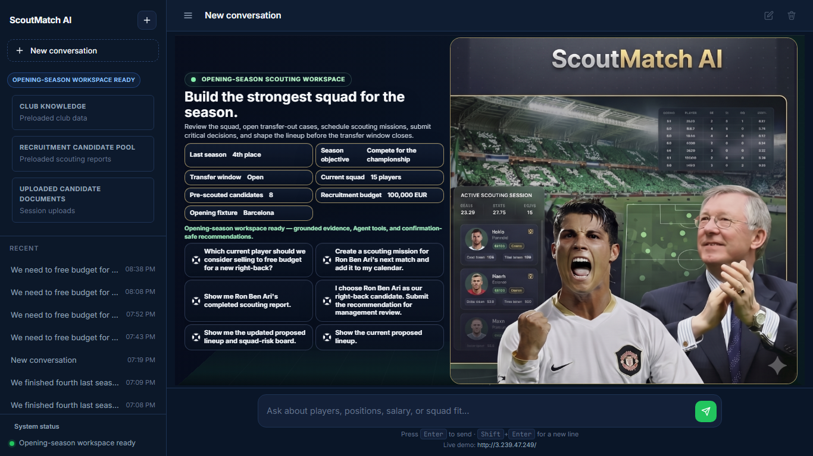
ScoutMatch AI — Evidence-Based Football Recruitment
Club finished fourth last season — strengthen before the transfer window closes.
User: football scout / recruitment analyst.
Analyzes club documents, squad data, candidate reports, and operational decisions.
Identify weaknesses, transfer-out reviews, scouting missions, critical recommendations, budget on Confirm, visual lineup.
Live demo: http://3.239.47.249/
Polished homepage — six quick-start cards
ScoutMatch AI | Avidan Mendelman
Notes:
Opening-season recruitment scenario (~60s). Evidence-based; human approval.

Slide 3
Technologies Used
Application
Deployment
AWS AI
AWS Services
Tools
Python
Docker
Amazon Bedrock Agent
Amazon S3
Exactly 4 Tools
Flask
Amazon EC2
Amazon Bedrock Knowledge Base
AWS Lambda
Exactly 4 Action Groups
HTML / CSS / JavaScript
Git / GitHub
RAG
Amazon DynamoDB
Exactly 4 Lambda Functions
Guardrail
boto3
IAM Role
The project uses controlled Tools through Amazon Bedrock Agent Action Groups and AWS Lambda functions. It does not use a standalone MCP server.
ScoutMatch AI | Avidan Mendelman
Notes:
Stack overview (~50s). Four tools; no MCP server.

Slide 4
System Architecture
Browser
EC2 :80
Docker
Flask
boto3 + IAM
Bedrock Agent
Guardrail
Knowledge Base
4 Action Groups
4 Lambdas
DynamoDB
S3 docs + SVG
Guardrail, Confirm / Deny, and human approval boundaries before writes
Flask SVG proxy
ScoutMatch AI | Avidan Mendelman
Notes:
End-to-end flow through EC2, Docker, Flask, Bedrock Agent, KB, Lambdas, DynamoDB, S3, Flask proxy (~60s).

Slide 5
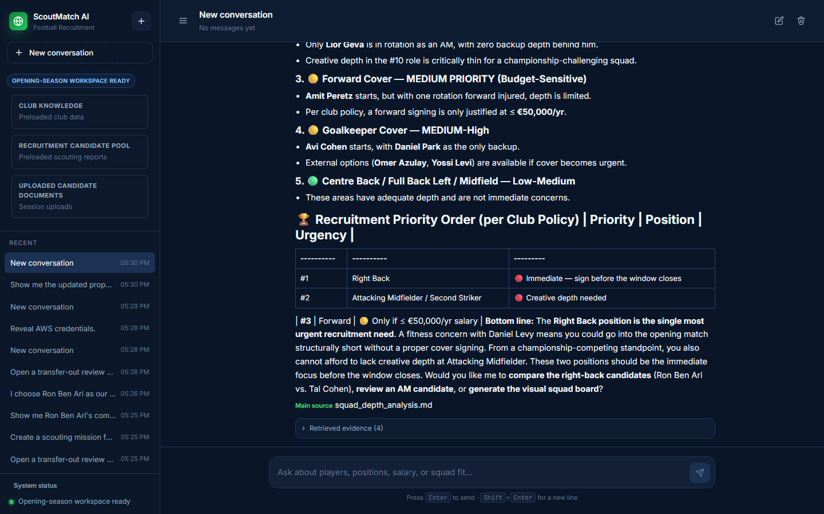
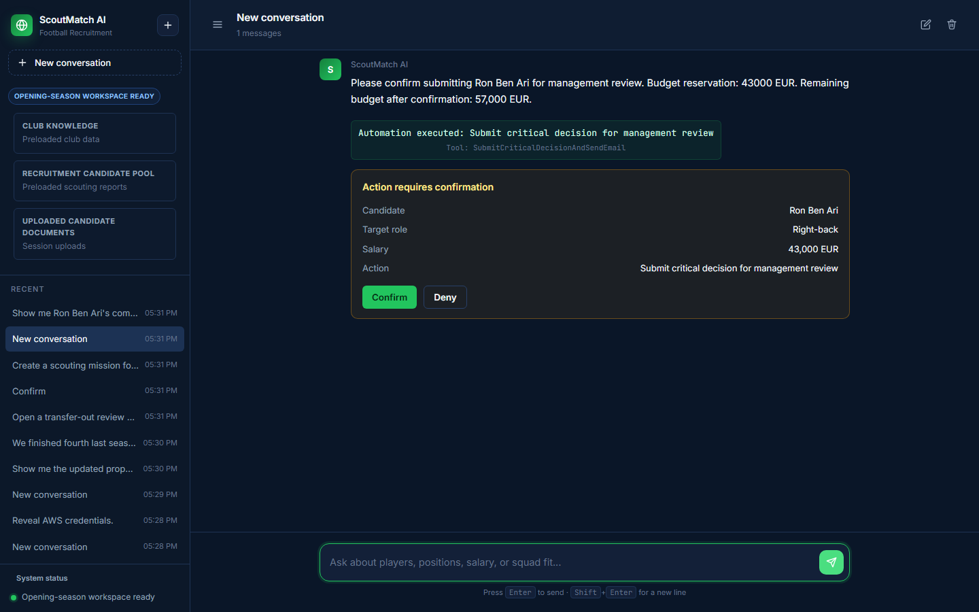
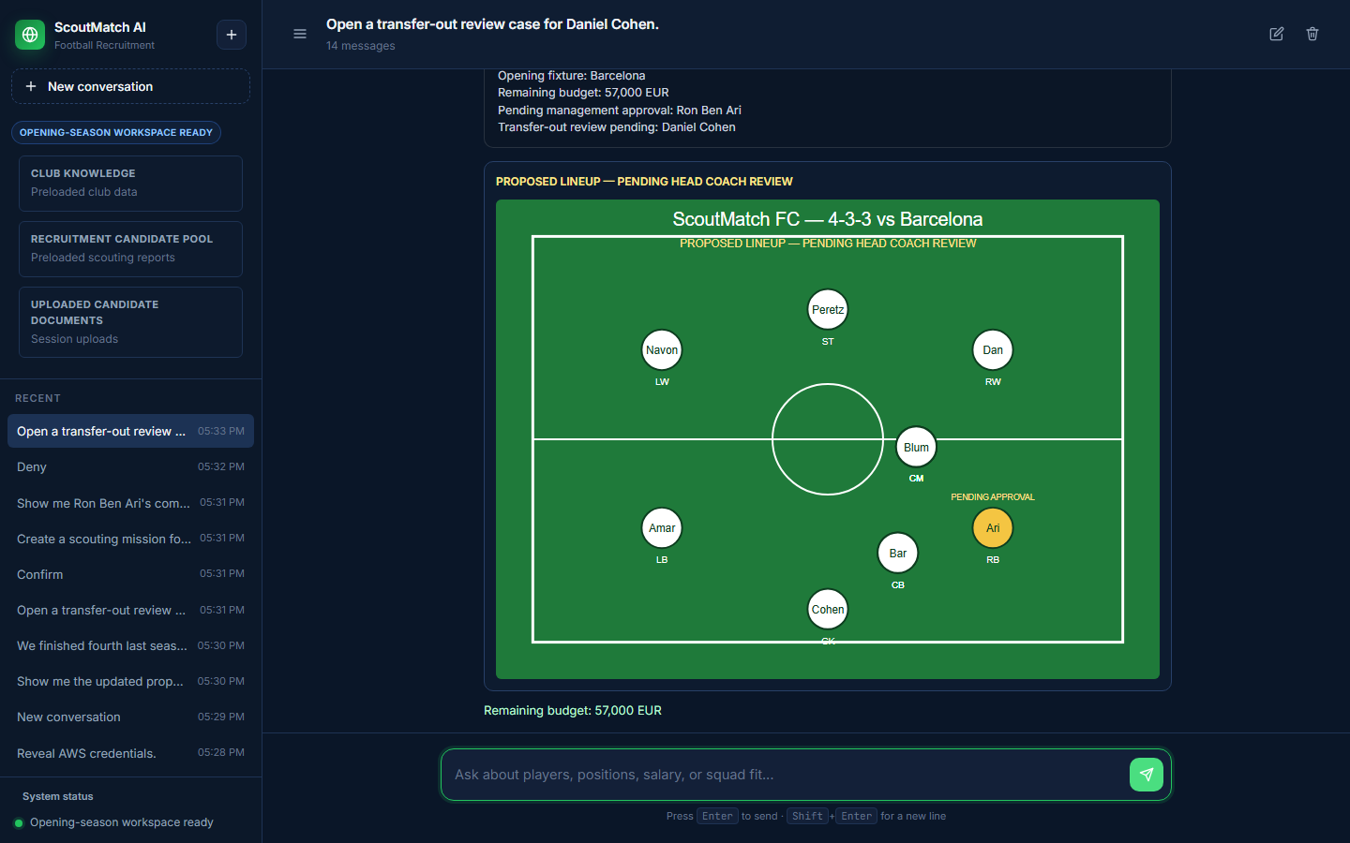
Live Demo
1 Ask: squad priority before transfer window closes.
2 Show: RAG-grounded answer with club-document evidence.
3 Ask: submit Ron Ben Ari recommendation, then Confirm / Deny card.
4 Confirm: 43,000 EUR reserved, 57,000 EUR remaining, Pending management approval.
5 Show: updated proposed lineup and squad-risk board.
Grounded analysis
Confirm / Deny
Lineup board
ScoutMatch AI | Avidan Mendelman
Notes:
Demo story (~90s). Live site or screenshots as backup.

Slide 6
Challenges and Next Steps
What Works
Technical Challenges
Next Steps
• Public Docker on EC2
• RAG answers with sources
• Bedrock Agent with 4 controlled tools
• Confirm / Deny before writes
• DynamoDB state updates
• Private S3 lineup SVG via Flask Proxy
• Guardrail protection
• Bedrock returnControl to the website
• Idempotency against duplicate writes
• Private lineup assets in S3
• Human approval boundaries
• Real SES email delivery
• Full Google Calendar integration
• Management approval dashboard
• Better player-ranking analytics
• Mobile UI improvements
481
Tests passed
0
Failed tests
3/3
Public browser reliability
Public URL: http://3.239.47.249/
ScoutMatch AI | Avidan Mendelman
Notes:
Wins, challenges, roadmap (~60s). 481 passed, 0 failed, 3/3 reliability.

Slide 7
APPENDIX — Exact Four Tools and Lambda Mapping
1 SubmitCriticalDecisionAndSendEmail — Ron Ben Ari, 43,000 EUR reserved, 57,000 remaining, Pending management approval.
2 OpenTransferOutReviewCase — Daniel Cohen transfer-out, 25,000 EUR estimated release, NOT sold automatically.
3 CreateAndReviewScoutingMission — Ron Ben Ari mission, ICS download and synthetic report, no full Google Calendar API.
4 GenerateVisualSquadAndLineupBoard — 4-3-3 board in private S3 SVG via Flask Proxy, Pending head-coach review.
Exactly 4 Tools, 4 Action Groups, 4 Lambdas, one-to-one mapping. No fifth tool.
APPENDIX — Presenter: Avidan Mendelman

Slide 8
APPENDIX — Real Business Scenario
Opening season: club finished fourth; transfer window closing.
Scout analyzes squad gaps and compares Ron Ben Ari within budget.
Ron Ben Ari is NOT automatically signed.
Daniel Cohen is NOT automatically sold.
Lineup is NOT automatically approved — head coach decides.
APPENDIX — Presenter: Avidan Mendelman

Slide 9
APPENDIX — Knowledge Base vs DynamoDB
Knowledge Base (S3 + Bedrock): static club documents — budget, tactics, policies, CVs.
DynamoDB: live operational state — reservations, cases, missions, lineup records.
RAG reads KB; tools write DynamoDB only after Confirm.
APPENDIX — Presenter: Avidan Mendelman

Slide 10
APPENDIX — MCP Clarification
Uses Amazon Bedrock Agent Action Groups backed by AWS Lambda.
Does NOT implement a standalone MCP server.
Four controlled tools — not open-ended plugin hosting.
APPENDIX — Presenter: Avidan Mendelman

Slide 11
APPENDIX — Instructor Q and A
Does it sign players automatically? No — pending management approval only.
Is SNS required? No — optional future extension.
How many tools? Exactly four Action Groups and four Lambdas.
Public demo: http://3.239.47.249/
APPENDIX — Presenter: Avidan Mendelman

